Slide 1
C372 Payment Technologies
Week 01
Lesson 02 Revisiting PetCareApp

Slide 2

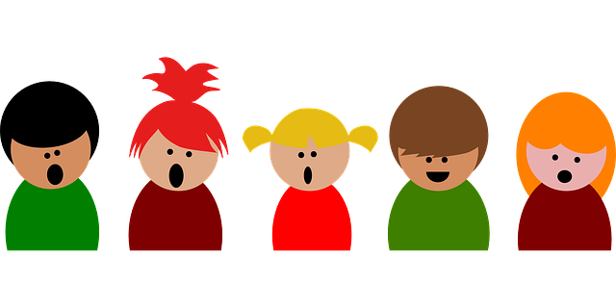

Administrative matters
As you go through the day with your lecturer, there will be activities for you to work on.
Some activities are meant to help you take notes, while others are for you to delve deeper into the topics.
These activities will be mapped in both the slides and worksheet. You should put your answers in the worksheet.
Below are some icons to guide you on what an activity will require you to do.
Answer some questions on your own as you watch a video or listen to your lecturer.
Team discussions
This is a lecturer-led activity. Your lecturer will guide you through an activity step-by-step. Pay close attention!

Slide 3

Lesson Objectives
In this lesson, we will revise
JavaScript conditions, arrays and loops using payment-related examples.
How app.js, MySQL and EJS templates work together in PetCareApp.
How to trace GET and POST requests, from browser actions through route handlers and database operations to the displayed response.
Note:
Record your responses to all activity questions in your worksheet.
Slides with this icon is for your self-reading

Slide 4
Recap

Slide 5
How Digital Payments Move: Three Architectures
Architecture | Example | Simplified movement
Card-based | Visa or Mastercard card | Merchant → card network → issuing bank
Account-to-account(A2A) | PayNow | Payer account → payment infrastructure → recipient account
Wallet-based | GrabPay or stored-value wallet | Wallet balance or linked funding source → merchant
*NFC and QR codes describe how payment information may be presented or exchanged. They do not always identify the underlying payment rail.

Slide 6
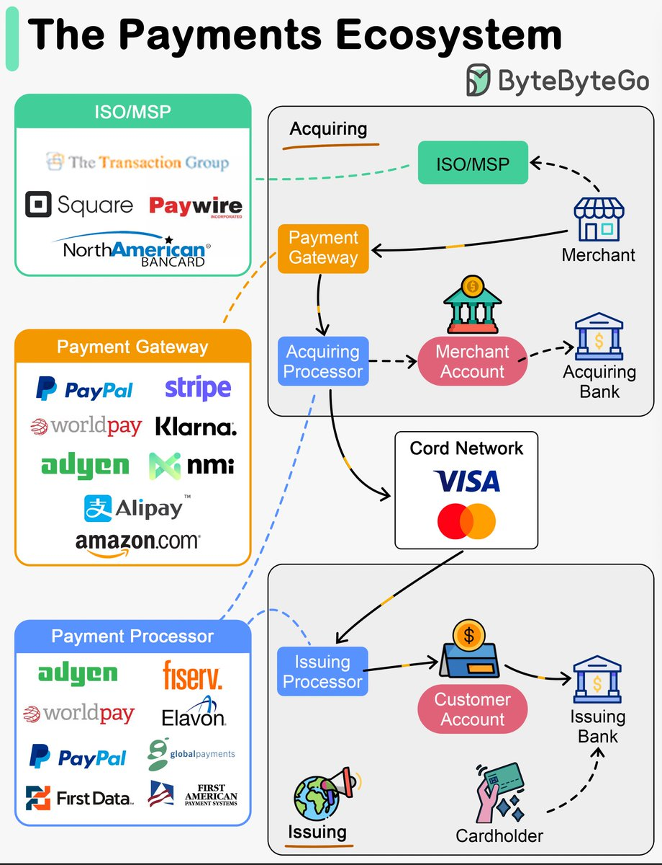
Key players
Six roles commonly found in a card-based transaction.
Customer/Payer: initiates the payment
Merchant/Payee: accepts payment
Gateway/Payment Service Provider: transmits and manages payment requests
Acquirer: supports the merchant’s acceptance of payment
Network: routes card-payment messages
Issuer: approves or declines on behalf of the customer
https://x.com/alexxubyte/status/1755992712229368299

Slide 7
A Payment Does Not Happen All at Once
1. Authorisation
2. Clearing
3. Settlement
Can this transaction proceed?
Transaction details are exchanged.
Funds are transferred later.
Authorisation
The issuer decides whether the transaction may proceed.
Clearing
Transaction information is exchanged between the relevant parties.
Settlement
Funds are transferred between the participating institutions.
When the customer sees “Payment successful,” have the funds necessarily completed final settlement?

Slide 8
Web Application Revision

Slide 9
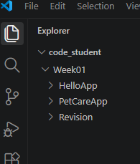
Revision Exercises
In this session, there will be some exercises for you to try out to recap on some JavaScript concepts you have learnt.
Open VSCode in your C372 workspace, you can use the same workspace that was created in lesson 1
In Week01 folder, create a folder named Revision
You will be creating the exercise files in the Revision folder.

Slide 10
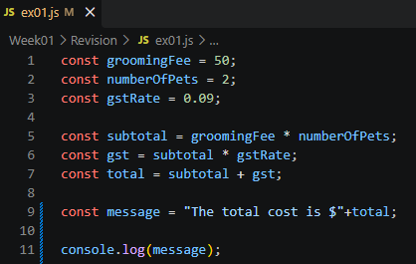
Exercise 1
a) In the Revision folder, create a file named ex01.js. In ex01.js, type the following code below to calculate the pet grooming fee.
Ensure that you are in the right folder in the console(You should be in the Revision folder.)
Run the JS file: node ex01.js
What is the output?

Slide 11
Exercise 1
b) What are the datatypes of the variables?
Variable | Data Type
groomingFee | Number
numberofPets | Number
gstRate | Number
subtotal | Number
gst | Number
message | String

Slide 12
Exercise 1
c) What is the difference between const and let?

Slide 13
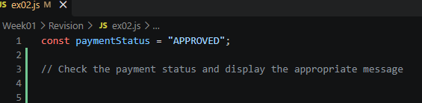
Exercise 2
In the Revision folder, create a file named ex02.js. In ex02.js, implement the logic shown in the table below to process a grooming fee payment status. (Use conditional logic to decide what users see.)
Payment Status | Display in console
APPROVED | Pet-care service confirmed
PENDING | Payment is being processed
DECLINED | Payment unsuccessful

Slide 14
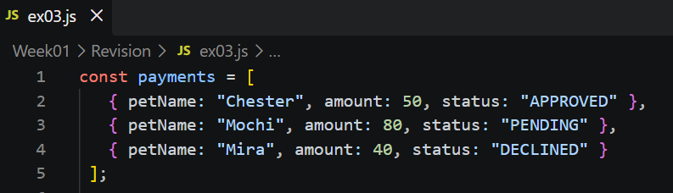
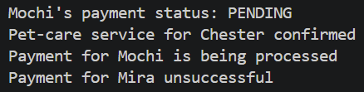
Exercise 3
In the Revision folder, create a file named ex03.js.
Given the payments array as shown:
In ex03.js,
Write the code to display Mochi’s payment status
Use a loop to display the payment details for each pet.
Sample output

Slide 15
PetCareApp Walkthrough

Slide 16

PetCareApp Walkthrough
Use the provided application and existing db.sql.
1
Create database
Run db.sql and confirm users, pets and journal tables.
2
Install
Run npm install if dependencies are not present.
3
Start
Run the application and open it in the browser.
You should have set up PetCareApp in lesson 01. If you have not yet done so, please refer to lesson 01 C372_W01_L01_Installation_Setup.pptx
4
Test
Log in and test pet and journal functions.
5
Inspect
Locate each tested function inside app.js and views/.
Guided practical

Slide 17
PetCareApp Structure
C237 used a simple structure
app.js
views/
public/
Express setup
Route handlers
SQL queries
Request processing
Rendering EJS pages
Login
Admin dashboard
Users
Pets
Journals
EJS partials
Images
CSS stylesheets
Client-side JavaScript
Static assets used by web pages
Browser → app.js → MySQL → EJS response

Slide 18
PetCareApp data
users
pets
journal
Login credentials, name, role and account creation date
Owner, name, species, breed, age and image
Pet activity, notes, entry date and creation date
User
→
Pet
→
Journal entry
Current purpose: manage pet information and record pet-care activities.

Slide 19
PetCareApp Walkthrough
Accounts
Pet profiles
Care journals
Admin tools
Sign up, log in, log out; user and admin roles.
Store name, species, breed, age, and an optional image.
Record dated activities and notes; filter by pet or search text.
Browse users and inspect their pets and journal records.
DATA MODEL
users
1 : many
pets
1 : many
journal
id ? username ? role
owner_id ? details ? image
pet_id ? activity ? date ? notes

Slide 20
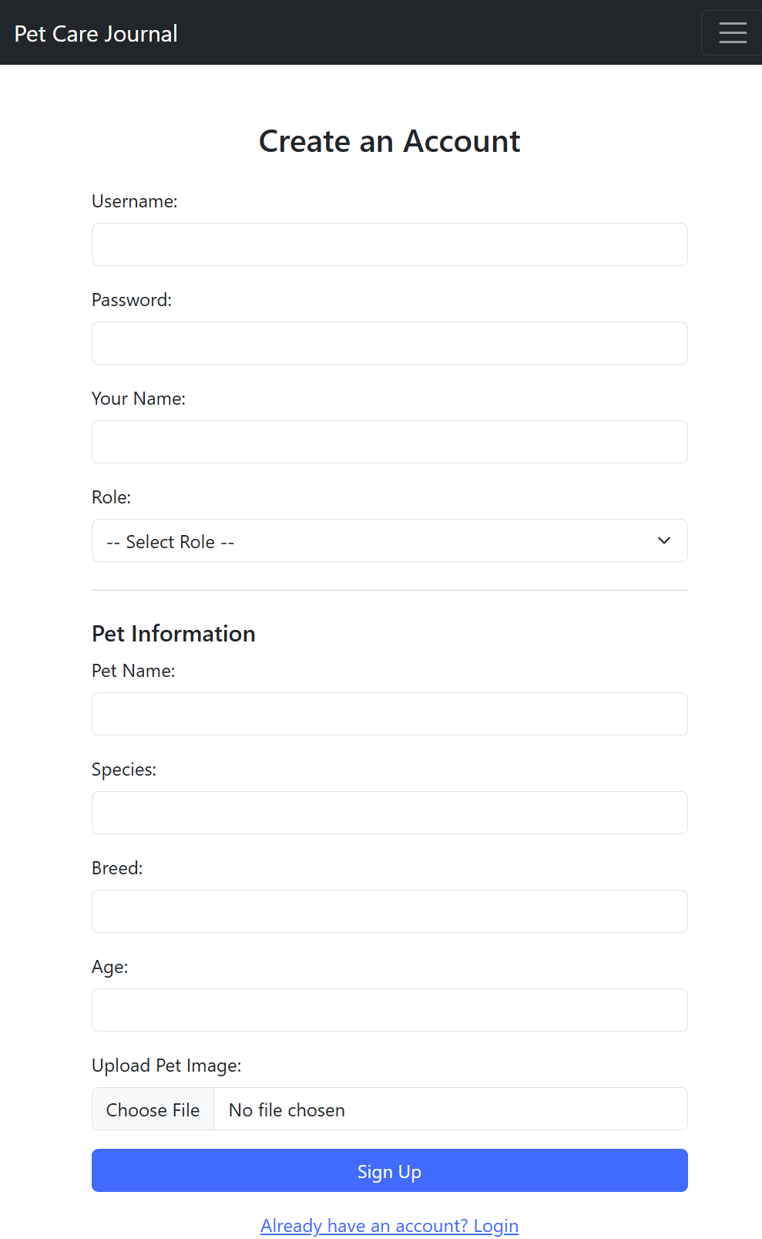
PetCareApp Walkthrough - Signup
Signup collects account details, role, pet attributes, and an optional image upload.
Account fields
Username, password, display name, and role.
FLOW
Form submit
Initial pet
Pet name, species, breed, age, and optional photo.
Insert user
Upload path
Multer saves the image file; the pet row stores its filename.
Insert first pet
Then redirect to login.
SIGNUP FORM

Slide 21
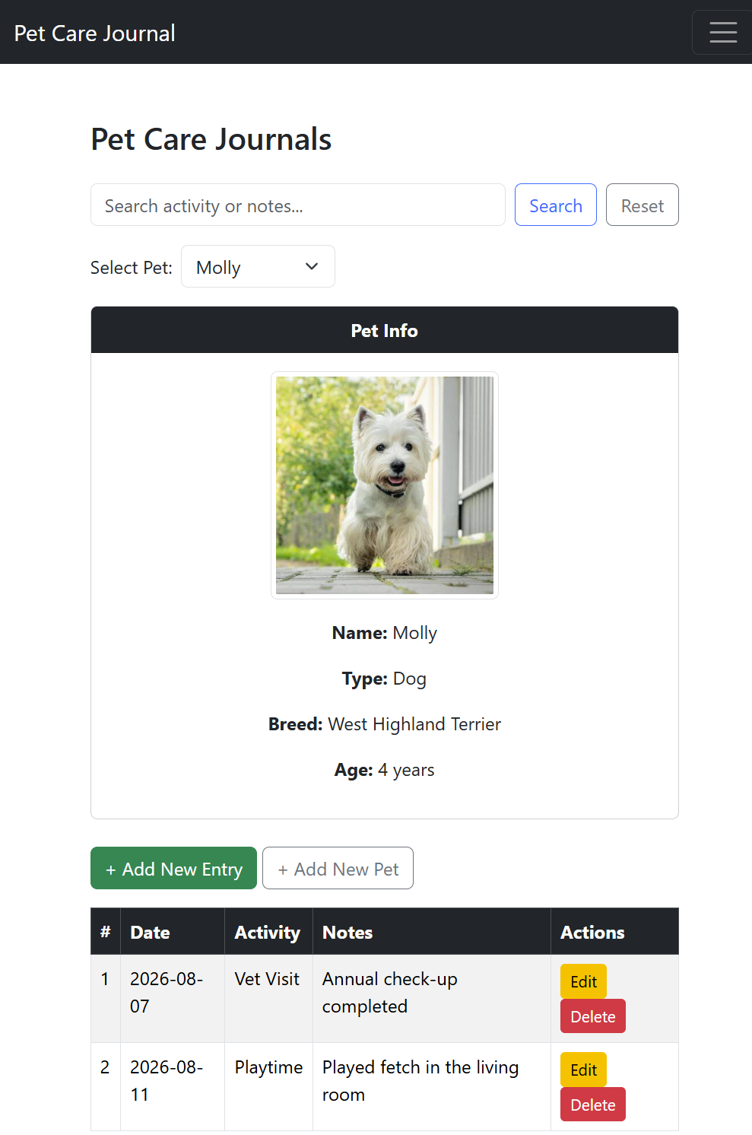
PetCareApp Walkthrough - Pet context and journal entries
Choose a pet to see its profile and matching records; search can narrow by activity or notes.
Pet selector
Switch between pets owned by the signed-in user.
Profile card
Display pet image, species, breed, and age.
Search and filter
Search activity/notes; keep the selected pet filter.
Quick actions
Add an entry or pet; edit/delete listed entries.
JOURNAL LIST

Slide 22
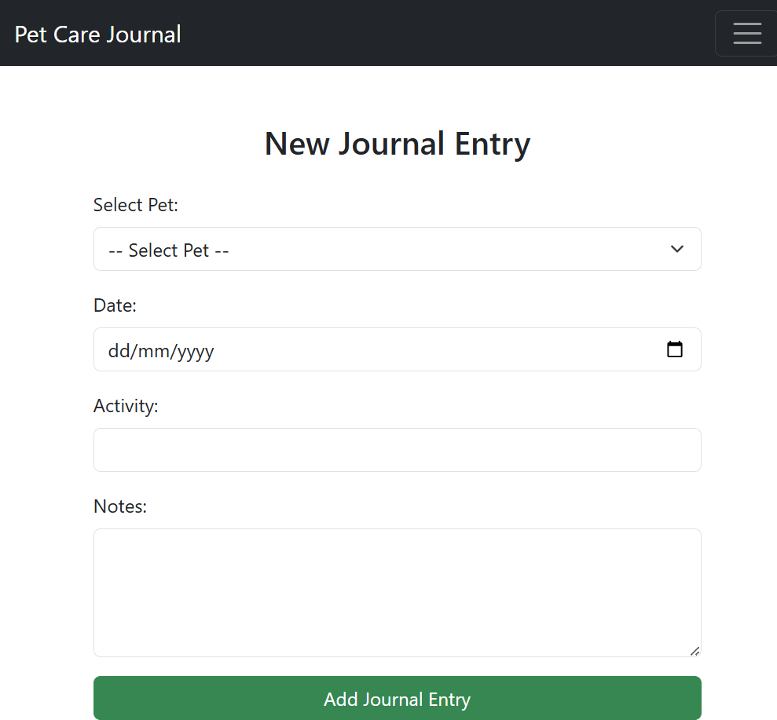
PetCareApp Walkthrough – Journal Entry
Each entry belongs to a pet and records an activity, date, and optional notes.
Create
Read
Choose pet, date, activity, and notes.
Journal page loads pet + entry data from MySQL.
Update
Delete
Edit the date, activity, notes, or pet.
Remove an entry, then return to that pet?s journal.
CRUD = Create ? Read ? Update ? Delete
NEW ENTRY

Slide 23
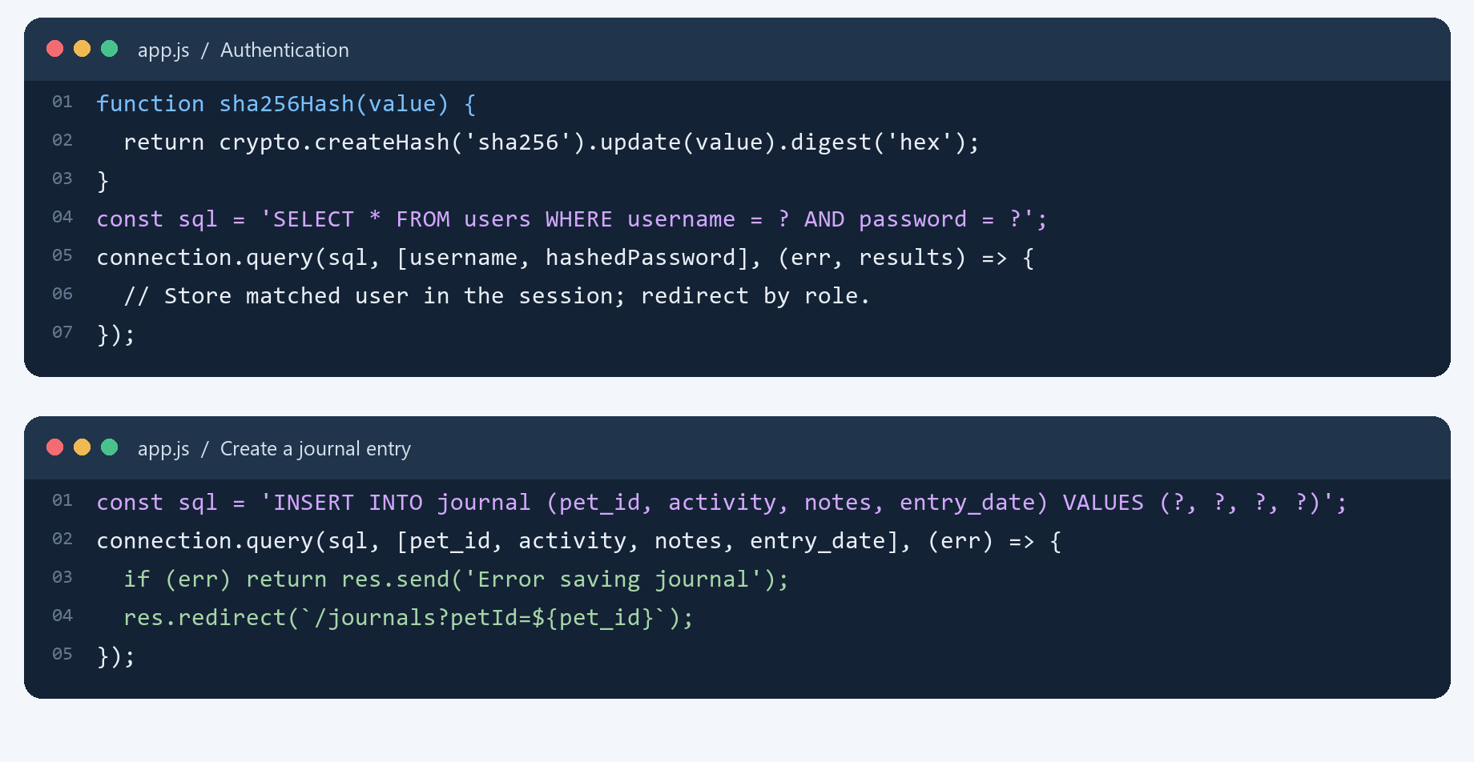
PetCareApp Walkthrough – A form submission becomes a parameterized SQL query
Week01/app.js keeps routing, session handling, database calls, and redirects in one Express entry point.
Prepared values
Question-mark placeholders keep submitted values separate from SQL text.
Callback flow
Handle a database error, then redirect after a successful insert.
Session-aware pages
isLoggedIn checks for a session user before protected routes run.
Production: use bcrypt/Argon2 for passwords.

Slide 24
A single Express app.js renders pages and coordinates persistence
The Week 01 app is intentionally compact: routes call MySQL, then render EJS views.
Browser
Express
MySQL
EJS
Forms + links
Routes + middleware
users / pets / journal
Server-rendered pages
Session + flash
Multer uploads
Admin routes
Session stores login state; flash displays login/signup feedback.
Pet images are saved under public/images; DB keeps the filename.
Role-check dashboard and users; inspect user pets and journals.
Good next steps: move secrets to environment config, strengthen password hashing, add CSRF protection, and use transactions for multi-step signup.

Slide 25

app.js
Sets up an Express server and configures EJS, sessions, flash messages, form handling, static files, and image uploads.
Connects to the MySQL petcare database and hashes passwords with SHA-256.
Handles routes for authentication, admin user management, pet management, and journal actions.
Runs SQL queries to create, retrieve, update, and delete user, pet, and journal data.
Renders EJS pages with relevant database results and session information.
Uses middleware to restrict access to selected routes.
Starts the server on port 3000.
app.js is a single-file Express server for the Pet Care Journal System.
https://tenor.com/view/cat-cat-meme-cat-memes-meme-loading-gif-11112458141014207448

Slide 26

PetCareApp Project Folder Structure
Project folder
Assets such as images, javascript, css should be stored here
Dependencies(external libraries or packages) will be installed here
EJS files that contain HTML and embedded JavaScript in this folder
Entry point for the project to run, also contains business logic*
Files to be ignored when pushing to git
Contains meta data about the project(e.g. project name, description), dependencies required by the project, etc.
Automatically generated when you run npm install for the first time. Locks the version of the packages

Slide 27
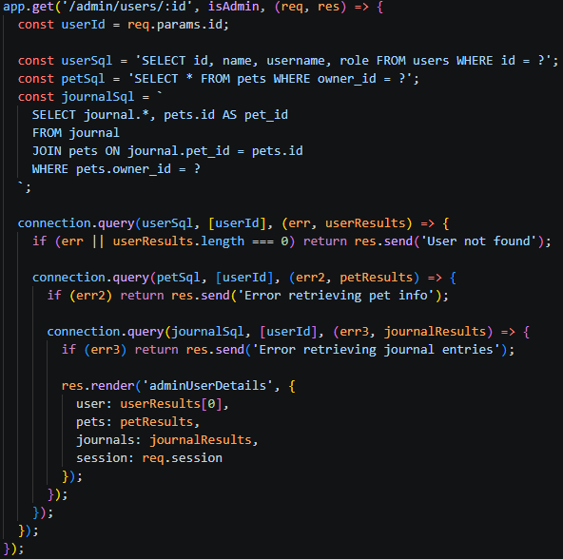
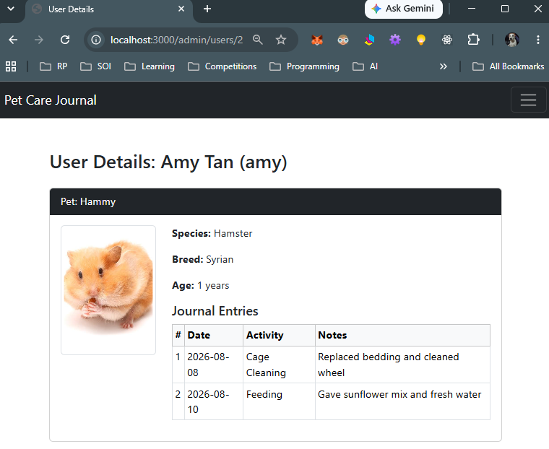
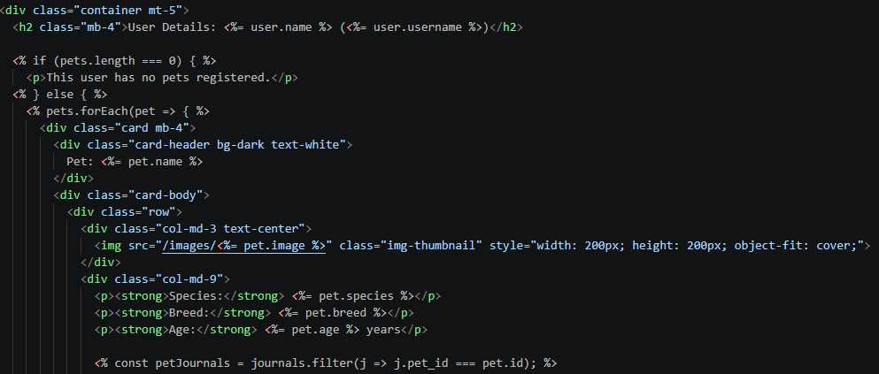
How it works
2. In app.js, Express identifies the route handler that matches the request’s HTTP method and URL path.
1. User clicks on a link or enters url into web browser to make a request
app.js
3. The id is extracted from the URL and the data is retrieved from the database to be processed.
4. The handler passes the retrieved data to adminUserDetails.ejs
adminUserDetails.ejs

Slide 28
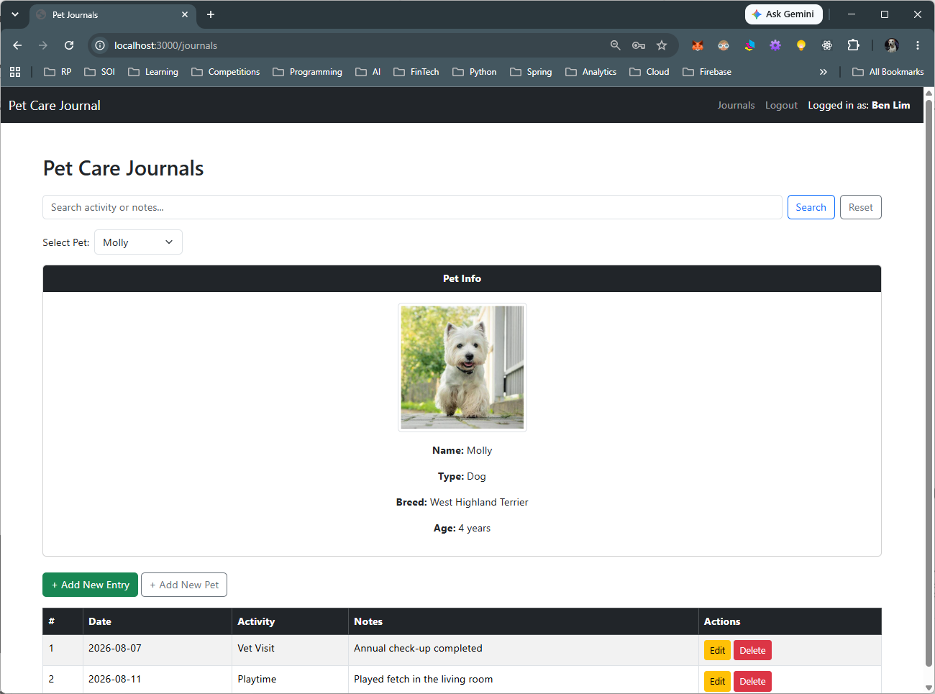
Exercise 4
Given the page shown, trace the request.
Step | Question | Answer
Browser action | Which link did you click? What URL was requested? | Clicked the “View” link on a pet. URL requested: /pets/3
Route handler | What HTTP method and route pattern handle this request? | GET, route pattern /pets/:id
Input | What value does the handler read, and where does it come from—for example, req.params? | The pet id, read from the URL with req.params.id (value “3”)
Database operation | Which SQL query runs? Which table and record does it access? | SELECT * FROM pets WHERE petId = ? with [id]. Table: pets, record: the row where petId is 3
View | Which EJS template is rendered? What data is passed into it? | pet.ejs, with { pet: results[0] } passed in
Output | Where does the template display that data? | Inside pet.ejs, where tags like <%= pet.petName %> print the pet’s details

Slide 29
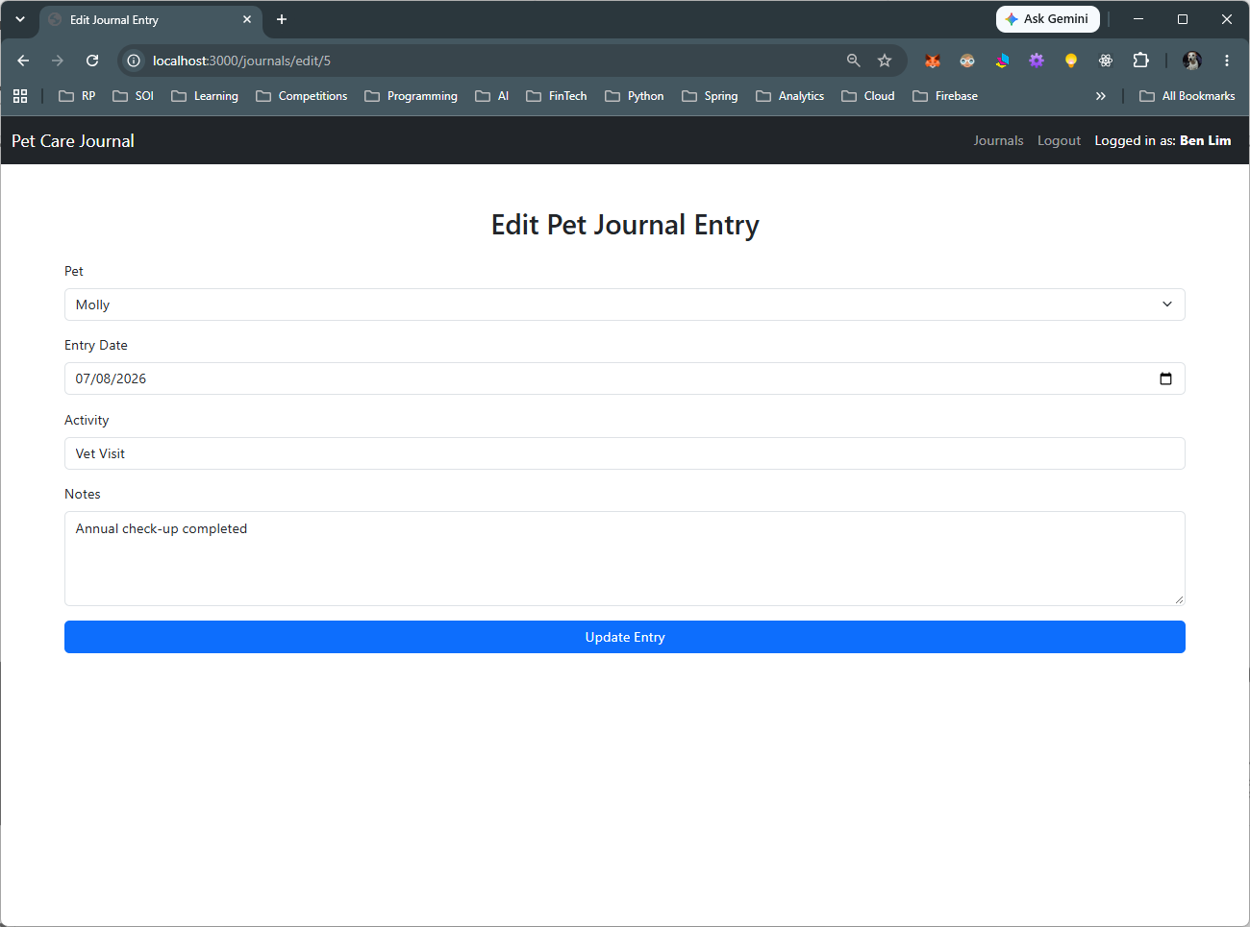
Exercise 5
Step | Question | Answer
Browser action | Which link did you click? What URL was requested? | Clicked the “View” link on a pet. URL: /pets/3
Route handler | What HTTP method and route pattern handle this request? | GET /pets/:id
Input | What value does the handler read, and where does it come from—for example, req.params? | Pet id from the URL, read using req.params.id
Database operation | Which SQL query runs? Which table and record does it access? | SELECT * FROM pets WHERE petId = ? on the pets table, gets the row with that id
View | Which EJS template is rendered? What data is passed into it? | pet.ejs, passed the pet data from the query result
Output | What information appears on the rendered page? | Shown in the page where <%= pet.petName %> and the other fields are printed
Given the page shown, trace the request.
Include details for after Update Entry button is clicked

Slide 30
Where Could Payment Fit?
Pet owner
→
Select pet
→
Choose pet-care service
→
Payment
→
Confirmation
Current data
Possible new data
Possible Payment data
users
pets
journal
services
service bookings
amount
method
status
timestamp
Design question: Which new records are needed before PetCareApp can charge for a service?

Slide 31

Summary
In this lesson, we revised…
JavaScript conditions, arrays and loops using payment-related examples.
How app.js, MySQL and EJS templates work together in PetCareApp.
How to trace GET and POST requests, from browser actions through route handlers and database operations to the displayed response.
We also explored…
Where payment functionality could fit into the pet-care service workflow.
The additional service, booking and payment records needed to support that workflow.

Slide 32
Submissions
Commit your code or any changes you may have made to GitHub (Individual)
Worksheet (Individual)
Upload your deliverables to POLITEMALL even if it is incomplete before the next session.
You can resubmit by 2359 if there are updates.

