Slide 1
C372 Payment Technologies
Week 03
Lesson 05 Spec-driven development with AI

Slide 2



Administrative matters
As you go through the day with your lecturer, there will be activities for you to work on.
Some activities are meant to help you take notes, while others are for you to delve deeper into the topics.
These activities will be mapped in both the slides and worksheet. You should put your answers in the worksheet.
Below are some icons to guide you on what an activity will require you to do.
Answer some questions on your own as you watch a video or listen to your lecturer.
Team discussions
This is a lecturer-led activity. Your lecturer will guide you through an activity step-by-step. Pay close attention!

Slide 3
Recall

Slide 4
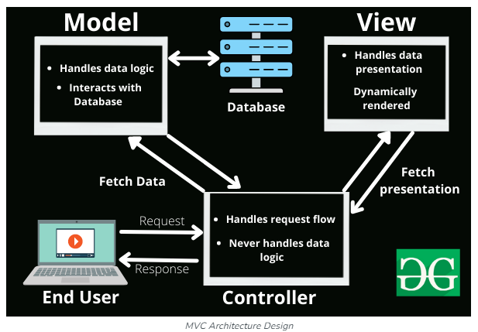
Separation of Concerns with MVC
Model: Handles the data and business logic. It’s responsible for retrieving, storing, and processing data.
View: Manages the presentation layer. It displays data to the user and defines how the UI looks.
Alongside MVC, routes direct incoming requests to the appropriate controller function based on the HTTP method and URL path.
They can also apply middleware, such as login checks, before passing control to the controller.
Controller: Acts as an intermediary between the Model and View. It handles user input, updates the Model, and refreshes the View.
https://www.geeksforgeeks.org/mvc-framework-introduction/
By separating these responsibilities, MVC makes applications easier to maintain, test, and scale. Each component can evolve independently as long as the interfaces between them remain consistent.

Slide 5

Lesson Objectives
By the end of this lesson, you will be able to:
Clarify a payment feature request and write a specification with testable acceptance criteria.
Use the specification to guide AI and critically review its suggestions and generated code.
Implement a payment-preparation endpoint using mock data, routes and a controller.
Open the test URLs in a browser and compare the JSON outputs with the expected results.
Update the specification, code and tests when an agreed requirement changes.
Note:
Record your responses to all activity questions in your worksheet.
Slides with this icon is for your self-reading

Slide 6
This week’s lesson setup
This week, we will use mock data and a mock payment provider.
We will use JSON only, with no EJS and no database backend.
JSON lets you check actual results against expected outputs before investing time in building an EJS view.
This simplified setup lets you focus on the payment process and learn to use AI more effectively.
JSON (JavaScript Object Notation)
Mock payment response (example)
A lightweight text format for exchanging structured data. Objects use key/value pairs.
{
"paymentId": "MOCK-001",
"status": "success"
}

Slide 7
Specifications
Driven
Development
(SDD)

Slide 8
What is spec-driven development?
BEHAVIOUR FIRST; IMPLEMENTATION FOLLOWS
A small, living agreement
It is NOT...
State what the feature must do.
Make the results measurable.
Use it to guide code and tests.
Update it when requirements change.
A long document written after coding.
A vague prompt handed to AI.
Proof that generated code is correct.
AI helps with implementation. You own requirements, decisions and evidence.
5

Slide 9
Exercise 1
In C372 project workspace, create a new folder named Week03.
In the Week03 folder, create a new folder named Lesson05.
From the Resources folder provided today, copy PetCareAppMVC (This is the same app as what you should have created in week 2).
Open routes\petRoutes.js, controllers\petController.js and app.js
Trace the flow of adding a new pet
When copying a project, do not include node_modules as it is a very large folder
REQUEST
ROUTE
MIDDLEWARE
CONTROLLER
MODEL
RESPONSE
POST /pets
>
petRoutes.js
>
Upload + login
>
createPet
>
createPet
>
Redirect

Slide 10
Exercise 2
In your teams, discuss:
What does the statement below mean?
Write at least four clarification questions. Do not code yet.
Include data, success, failure, access and scope questions.
"Allow pet owners to prepare payment details for a pet service."
Clarification Questions | Possible response/assumptions
Which services and prices? | IDs 1/2/3; vaccination 35/ grooming 50/boarding 50
Where does this price come from? | The server’s mock catalogue, not a client-supplied amount
What is returned? | JSON payment-preparation details; currency SGD
What if the service is unknown | 404 with {“error”; “Service not found”}
Does this charge money? | No. preparing details only; no gateway or transactions
Must the owner log in? | Not for this explicitly scoped classroom mock

Slide 11
Scope for this lesson
For ease of testing, we will limit the scope and prepare some mock data
Scope | Mock data/response
Services | Vaccination 35; Pet Grooming 50; Boarding 80
Source of truth | Mock catalogue; the server chooses the price
Response | JSON; currency sgd; status READY_FOR_PAYMENT
Unknown service | HTTP 404; {"error":"Service not found"}
Access | No login for this classroom mock endpoint
Not included | Charging money, gateway, new tables or new pages
Preparing payment details is NOT processing a payment.

Slide 12
Specification vs implementation plan
KEEP THE TWO QUESTIONS SEPARATE
SPECIFICATION: WHAT?
PLAN: HOW / WHERE?
User goal and feature scope.
Request and response contract.
Success and failure rules.
Acceptance criteria.
Files to create or modify.
Imports and exports.
Route-to-controller connection.
Steps to verify the feature.
File names can constrain the plan without replacing the behaviour specification.
12

Slide 13
Exercise 3 - Draft, review, revise, approve
Step
What you do
1. Create
Create the specification file and paste the scaffold.
2. Draft
Use exercise 2 and the scope for this lesson; write simple sentences or bullets.
3. AI review
Ask for gaps and questions, not code or a replacement spec.
4. Revise
Accept, reject or clarify suggestions; edit the draft.
5. Approve
Partner checks the criteria before you move to Activity 4.
Your first draft need not be perfect. Do not hand the decisions over to AI.
14

Slide 14
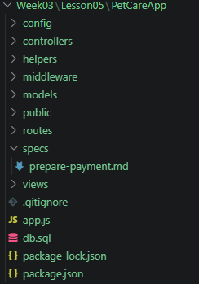
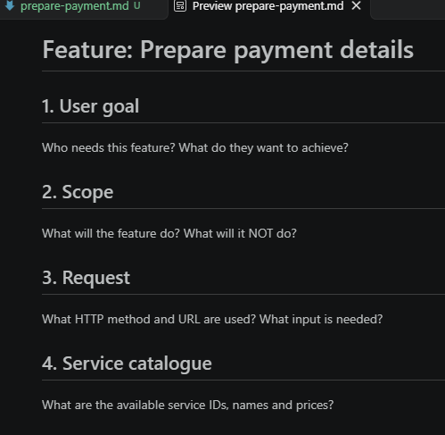
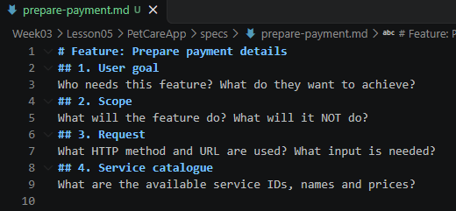
Exercise 3 - Create your specification
In Week03 > Lesson05 > PetCareApp folder, right-click the PetCareApp and select New folder…
Name the new folder specs
Right-click on the folder specs and select New File.
Name the new file prepare-payment.md.
Preview .md file
An .md file (Markdown file) is a plain-text document that uses simple, readable symbols to format text
Step 1 | Create the specification file and paste the scaffold.

Slide 15
Exercise 3 – Prepare the Scaffold
In prepare-payment.md, paste the scaffold shown below
Replace the questions with answers in your own words, based on the scope for this lesson.
Draft your answers first, ask AI to review, revise, then approve before coding.
# Feature: Prepare payment details
## 1. User goal
Who needs this feature? What do they want to achieve?
## 2. Scope
What will the feature do? What will it NOT do?
## 3. Request
What HTTP method and URL are used? What input is needed?
## 4. Service catalogue
What are the available service IDs, names and prices?
Use Ctrl-Shift-V if you are unable to paste the text in prepare-payment.md
Step 1 | Create the specification file and paste the scaffold.

Slide 16
Exercise 3 – Scaffold continue
In prepare-payment.md, paste the next section of scaffold shown below.
In this section, we include the responses and checks here to make the behaviour testable.
Replace the questions with answers in your own words, based on the scope for this lesson.
Draft your answers first, ask AI to review, revise, then approve before coding.
## 5. Successful response
What HTTP status, JSON fields, values and types are required?
## 6. Unsuccessful response
What happens when the requested service does not exist?
## 7. Acceptance criteria
- AC1:
- AC2:
- AC3:
- AC4:
- AC5:
## 8. Open questions
What has not yet been agreed? Do not silently invent an answer.
Use Ctrl-Shift-V if you are unable to paste the text in prepare-payment.md
Write checks for service IDs 1, 2, 3 and 999, plus the successful response.
Step 1 | Create the specification file and paste the scaffold.

Slide 17
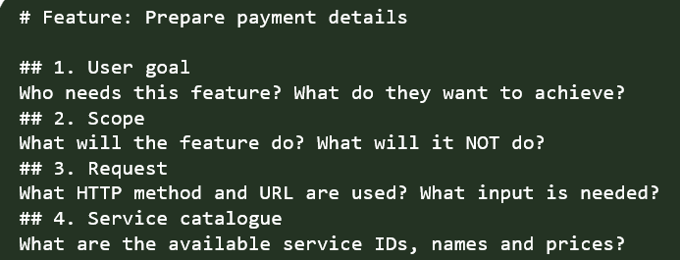
Exercise 3 – User goal and scope
"Allow pet owners to prepare payment details for a pet service."
Scope | Mock data/response
Services | Vaccination 35; Pet Grooming 50; Boarding 80
Source of truth | Mock catalogue; the server chooses the price
Response | JSON; currency sgd; status READY_FOR_PAYMENT
Unknown service | HTTP 404; {"error":"Service not found"}
Access | No login for this classroom mock endpoint
Not included | Charging money, gateway, new tables or new pages
Step 2 | Use exercise 2 and the scope for this lesson; write simple sentences or bullets.

Slide 18
Exercise 3 - Specify the request and service catalogue
Goal: review the selected service and amount before payment.
GET /payments/prepare/:serviceId
ID (number) | Service name (string) | Price (number)
1 | Vaccination | 35
2 | Pet Grooming | 50
3 | Boarding | 80
Use the catalogue price. Do not accept a client-supplied payment amount.
Step 2 | Use the scope for this lesson; write simple sentences or bulletpoints.
18

Slide 19
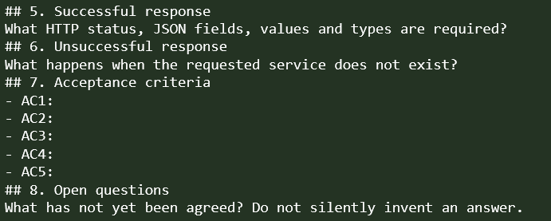
Exercise 3 - Specify the successful response
{
"serviceId": 1,
"serviceName": "Vaccination",
"amount": 35,
"currency": "sgd",
"status": "READY_FOR_PAYMENT"
}
Exactly five fields
serviceId, amount: numbers
Other fields: strings
Currency and status: exact values
35 is a JSON number. "35.00" is a string.
They are not the same contract.
An API contract is an agreed communication format: what you send and what you should receive.
Step 2 | Use the scope for this lesson; write simple sentences or bulletpoints.
19

Slide 20
Exercise 3 - Specify failure and acceptance criteria
ID | When requested | Then expect
AC1 | Service ID 1 | 200; Vaccination; amount 35
AC2 | Service ID 2 | 200; Pet Grooming; amount 50
AC3 | Service ID 3 | 200; Boarding; amount 80
AC4 | Service ID 999 | 404; {"error":"Service not found"}
AC5 | Any successful response | Exactly 5 fields; correct types and fixed values
Include scope exclusions: no charging, gateway, new tables or EJS pages.
Step 2 | Use the scope for this lesson; write simple sentences or bulletpoints.
20

Slide 21
Exercise 3 - AI prompt | Review my draft, do not code
Get AI to review your draft
Read my draft in specs\prepare-payment.md.
We are learning to write specifications.
Do not rewrite the file or generate application code yet.
Check for ambiguity, missing success/failure rules,
unclear JSON fields or types, contradictions and untestable criteria.
For each issue: quote my draft, explain the gap,
and suggest clearer wording or ask a clarification question.
Do not invent services, prices, access rules, input-validation rules
or payment-processing requirements.
List unresolved decisions as questions.
Use Ctrl-Shift-V if you are unable to paste the instruction as text in the AI Chat
Step 3 | AI Review. Save your draft first. AI feedback is advice, not an approved requirement.
Step 4 | Read the updated revised specification.
21

Slide 22
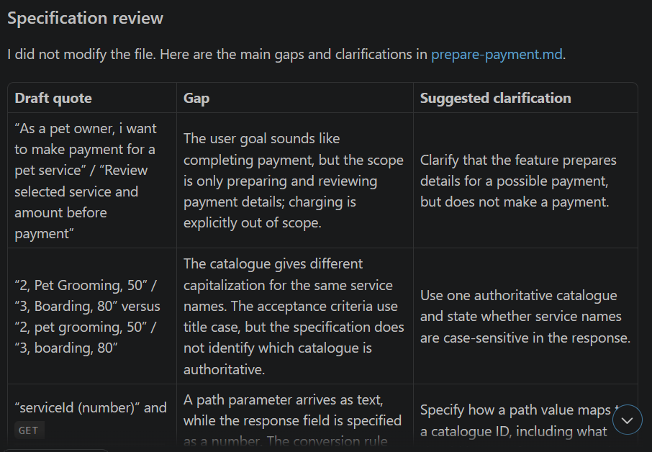
Exercise 3 - Evaluate AI feedback before revising
Example of some suggestions AI might give you
Sample output
AI suggestion
Decision
Why?
Specify whether amount is a number or string.
ACCEPT
It clarifies the agreed numeric type.
Add a real payment gateway.
REJECT
Real payment processing is outside scope.
Return 400 for malformed IDs.
CLARIFY
A new validation rule needs agreement first.
Edit the draft yourself, or ask AI to apply only your approved changes.
Keep unresolved questions visible; do not turn assumptions into requirements.
Keep the agreed scope. Do not accept a suggestion just because AI sounds confident.
Step 3 | AI Review. Ask for gaps and questions, not code or a replacement spec.
22

Slide 23
Exercise 3 - AI prompt | Apply approved spec revisions
OPTIONAL EDITING ASSISTANCE
Revise specs\prepare-payment.md using only these approved changes:
[list the changes you have accepted]
Keep the agreed behaviour and scope unchanged.
Do not add new features or resolve open questions silently.
Leave unresolved questions visible.
Do not generate application code.
Show the revised text or diff so I can review it.
Step 4 | Read the revised specification. You remain responsible for the final wording.
23

Slide 24
Exercise 3 - Review the spec before asking AI to code
Checklist before you approve the specs
01
Can you predict the response without reading implementation code?
02
Check names, types, prices, status codes and out-of-scope items.
03
Resolve missing decisions. Then approve your specification.
Paste the specifications in prepare-payment.md in your worksheet.
Step 5 | Approve the revised spec, then move to Exercise 4. No coding yet.
24

Slide 25
Exercise 4 Ask AI for a plan
Use the prompt below to ask AI for a plan
Read specs\prepare-payment.md and inspect this Express app.
Do not modify files yet.
Plan these changes using existing CommonJS patterns:
Create data\mockServices.js
Create controllers\paymentController.js
Create routes\paymentRoutes.js
Modify app.js to register the router
Explain responsibilities, imports/exports and verification steps.
No packages, database changes, EJS pages or service layer.
Flag unresolved questions. Wait for approval.
Review the plan before allowing implementation.
20

Slide 26
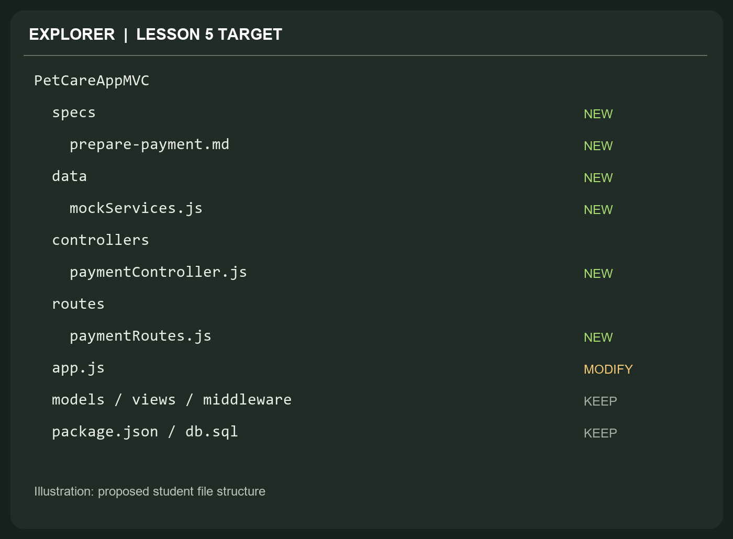
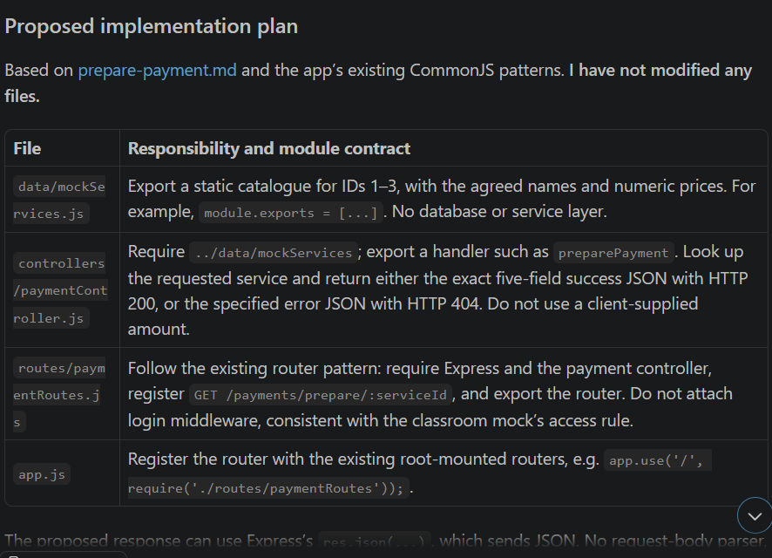
Exercise 4 Check: The file-level plan
Sample output
Approve only if the plan:
Preserves existing routes.
Uses the catalogue price.
Keeps response logic in the controller.
Adds no real payment integration.
Three new JS files + one app registration. The specification stays alongside the code.
Reject a plan that adds a gateway, accepts the client's price or rewrites unrelated code.
21

Slide 27
Exercise 4 Check: After Plan Approval
The files below should be created after the plan is approved. Check that the responsibilities are correct.
File
Responsibility / connection
data\mockServices.js
Export the catalogue array using module.exports.
controllers\paymentController.js
Import catalogue; export preparePayment; handle 200 / 404.
routes\paymentRoutes.js
Import controller; map GET + :serviceId; export router.
app.js
Register the router; preserve existing middleware and routes.
Verification
Check AC1-AC5 and one existing Week 2 flow.
Paste the code for the files above in your worksheet.
23

Slide 28




Exercise 4 Check: Implementation matches requirements
Remember to commit and push your code to your C372 weekly lesson repository with suitable comments

Slide 29
Exercise 5 Predict the result
Scenario | Http status codes | Why?
A. Router not registered. The file exists, but app.js never loads it. | 404 Not Found | Express has no route for the URL, so it returns its default “Cannot GET” 404.
B. Route uses :id. Controller reads serviceId. :id vs serviceId | 404 Not Found | Parameter mismatch
C. Price of service is $35, but client sends a modified price /1?amount=1 | 200; | The server ignores the query string and returns the price from its own catalogue ($35.00). The client can never set the price.
Execute checks to confirm your own implementation.

Slide 30
Testing

Slide 31
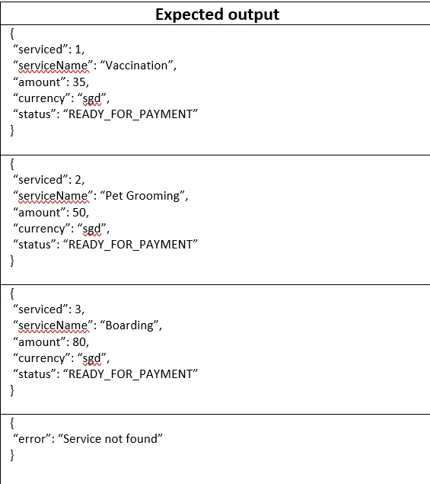

Exercise 6 Run simple acceptance checks
In Week03\Lesson05\PetCareAppMVC root, run:
  npm install
  node app.js
Test the following URLs in your browser and record the expected output:
URL | Expected output
http://localhost:3000/payments/prepare/1
http://localhost:3000/payments/prepare/2
http://localhost:3000/payments/prepare/3
http://localhost:3000/payments/prepare/999

Slide 32
Reminders

Slide 33
AI Journal
Document your AI-assisted work in your AI interaction journal as you go, not just after completing the task.
  Record your prompts: Capture what you asked AI, including the context or requirements you provided.
  Keep relevant AI responses: Include excerpts or screenshots of suggestions, explanations or generated code - not only your final solution.
  Show your verification: Explain how you checked the AI’s output against your specification and tests. Record expected and actual results, including failed checks.
  Explain your decisions: State which suggestions you accepted, rejected or modified, and why.
  Document corrections: Show errors or gaps you identified, what you changed and how you confirmed the correction worked.
  Commit to GitHub regularly: Commit after meaningful steps. Use clear commit messages describing what changed and why, rather than “update” or “done”.
Your journal should demonstrate your understanding and judgement - not simply reproduce an AI conversation.

Slide 34
GitHub Repositories
You will need to create 3 GitHub repositories:
  Weekly Lessons(public)
  CAs(1 and 2)(private)
  FA(private)
Add your lecturer’s GitHub ID to your repositories
Please update your links here: C372 Student Weekly lessons, CA and FA Individual GitHub Repository – Fill out form
If you have already added a link earlier for weekly lessons, you may still update the repository links in the updated form.

Slide 35
Schedule
Note: Kahoot quiz date added, FA milestones shifted
Updated: 25 October 2026
Week | Lesson |  |  |  | Remarks
 | No. | Mode | No. | Mode
1 | 1 | F2F | 2 | F2F | Learning Memo 1 Release
2 | 3 | F2F | 4 | F2F | FA* Release
3 | 5 | F2F | 6 | F2F
4 | 7 | AEL | 8 | F2F | CA1 Kahoot Quiz in Lesson 08
5 | 9 | AEL | 10 | AEL | Singapore Fintech Fest Week CA1 SA3 Submission Week
6 | 11 | F2F | 12 | F2F | FA Milestone 1 Submission
7 | 13 | F2F | 14 | F2F
8 | 15 | F2F | 16 | F2F | OH2027 (7 – 9 Jan) Learning Memo 2 Release FA Milestone 2 Submission
9 | 17 | F2F | 18 | F2F | CA2 SA3 Submission Week
10 | 19 | F2F | 20 | F2F | CA2 Kahoot Quiz in Lesson 19
11 | 21 | F2F | 22 | F2F | FA Final SA3 Submission Week
12 | 23 | F2F | 24 | F2F | FA Presentation Week
13 | 25 | AEL | 26 | AEL

Slide 36
Summary
In this lesson, you have:
Clarified a vague feature request and agreed its scope before coding.
Written a specification with request and response rules, JSON data types and testable acceptance criteria.
Reviewed AI feedback and implementation plans, accepting only changes that match the agreed requirements.
Built a mock payment-preparation endpoint using routes, a controller and server-side catalogue prices, without charging money.
Checked successful and unknown-service responses against expected HTTP status codes and JSON outputs.
Learned to update the specification first when requirements change, then align the code and tests.

Slide 37
Submissions
Worksheet (Individual)
Upload your deliverables to POLITEMALL even if it is incomplete before the next session.
You can resubmit by 2359 if there are updates.

