Slide 1
C372 Payment Technologies
Week 02
Lesson 03 Separation of Concerns and MVC

Slide 2



Administrative matters
As you go through the day with your lecturer, there will be activities for you to work on.
Some activities are meant to help you take notes, while others are for you to delve deeper into the topics.
These activities will be mapped in both the slides and worksheet. You should put your answers in the worksheet.
Below are some icons to guide you on what an activity will require you to do.
Answer some questions on your own as you watch a video or listen to your lecturer.
Team discussions
This is a lecturer-led activity. Your lecturer will guide you through an activity step-by-step. Pay close attention!

Slide 3

Lesson Objectives
By the end of this lesson, you will be able to:
Explain Separation of Concerns and the roles of Model, View, Controller and routes.
Trace a request through an Express MVC application, from browser to database and view.
Write context-rich Copilot prompts and check its explanations against the existing code.
Evaluate an AI-generated refactoring plan against the specification before approving edits.
Refactor PetCareApp into MVC and verify that its behaviour stays unchanged.
Note:
Record your responses to all activity questions in your worksheet.
Slides with this icon is for your self-reading

Slide 4
Recall

Slide 5
A single Express app.js renders pages and coordinates persistence
The Week 01 app is intentionally compact: routes call MySQL, then render EJS views.
Browser
Express
MySQL
EJS
Forms + links
Routes + middleware
users / pets / journal
Server-rendered pages
Session + flash
Multer uploads
Admin routes
Session stores login state; flash displays login/signup feedback.
Pet images are saved under public/images; DB keeps the filename.
Role-check dashboard and users; inspect user pets and journals.
Good next steps: move secrets to environment config, strengthen password hashing, add CSRF protection, and use transactions for multi-step signup.

Slide 6

app.js
Sets up an Express server and configures EJS, sessions, flash messages, form handling, static files, and image uploads.
Connects to the MySQL petcare database and hashes passwords with SHA-256.
Handles routes for authentication, admin user management, pet management, and journal actions.
Runs SQL queries to create, retrieve, update, and delete user, pet, and journal data.
Renders EJS pages with relevant database results and session information.
Uses middleware to restrict access to selected routes.
Starts the server on port 3000.
app.js is a single-file Express server for the Pet Care Journal System.
https://tenor.com/view/cat-cat-meme-cat-memes-meme-loading-gif-11112458141014207448

Slide 7

PetCareApp Project Folder Structure
Project folder
Assets such as images, javascript, css should be stored here
Dependencies(external libraries or packages) will be installed here
EJS files that contain HTML and embedded JavaScript in this folder
Entry point for the project to run, also contains business logic*
Files to be ignored when pushing to git
Contains meta data about the project(e.g. project name, description), dependencies required by the project, etc.
Automatically generated when you run npm install for the first time. Locks the version of the packages

Slide 8
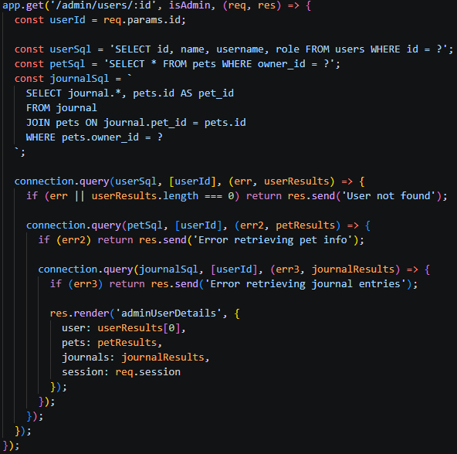
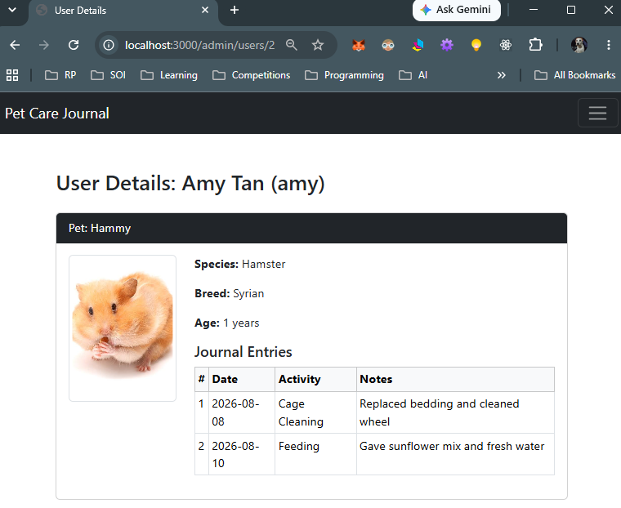
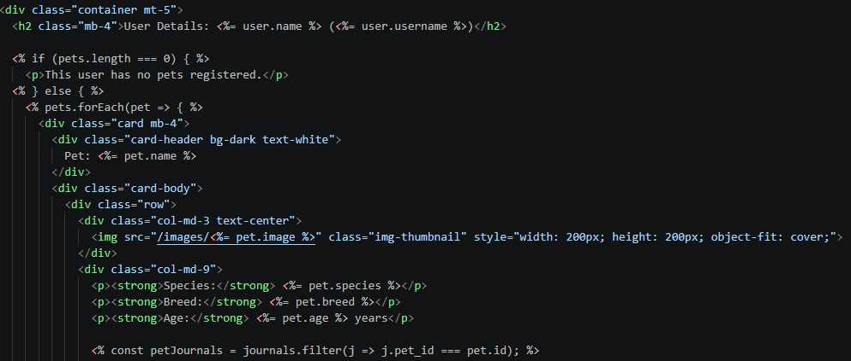
How it works
2. In app.js, Express identifies the route handler that matches the request’s HTTP method and URL path.
1. User clicks on a link or enters url into web browser to make a request
app.js
3. The id is extracted from the URL and the data is retrieved from the database to be processed.
4. The handler passes the retrieved data to adminUserDetails.ejs
adminUserDetails.ejs

Slide 9
Where Could Payment Fit?
Pet owner
→
Select pet
→
Choose pet-care service
→
Payment
→
Confirmation
Current data
Possible new data
Possible Payment data
users
pets
journal
services
service bookings
amount
method
status
timestamp
Design question: Which new records are needed before PetCareApp can charge for a service?

Slide 10
Separation of Concerns

Slide 11
app.js
Currently in PetCareApp,
  EJS files are already separated in the views folder
  app.js contains the database credentials, handles input, data, business logic
As the project grows larger, it can become difficult to manage.
Including credentials directly in app.js introduces potential security vulnerabilities.

Slide 12
Separation of Concerns
Separation of Concerns (SoC) is a fundamental software design principle that promotes organizing a program into distinct sections, where each section addresses a separate concern or responsibility.
A concern in software development can be any distinct functionality or feature, such as business logic, user interface, database interaction, or security.
The primary goal of SoC is to isolate responsibilities within different modules, layers, or classes of an application. This improves maintainability, readability, scalability, and testability.

Slide 13
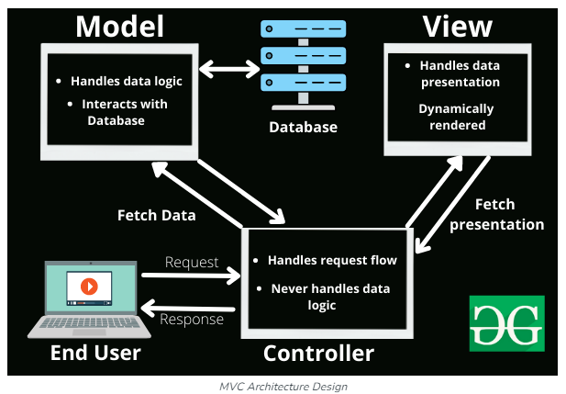
Model-View-Controller(MVC)
In C237, we used the template engine Embedded JavaScript(EJS) to help us process and display the views. The EJS files were placed in a folder named views
Model and controller, there was no explicit structuring of this, as all the logic was in app.js.
While the code will still work, as the project grows larger, it can become difficult to manage.
In this module, we will look at how to organize code for better maintainability and scalability.
https://www.geeksforgeeks.org/mvc-framework-introduction/

Slide 14
Separation of Concerns with MVC
Model: Handles the data and business logic. It’s responsible for retrieving, storing, and processing data.
View: Manages the presentation layer. It displays data to the user and defines how the UI looks.
Alongside MVC, routes direct incoming requests to the appropriate controller function based on the HTTP method and URL path.
They can also apply middleware, such as login checks, before passing control to the controller.
Controller: Acts as an intermediary between the Model and View. It handles user input, updates the Model, and refreshes the View.
https://www.geeksforgeeks.org/mvc-framework-introduction/
By separating these responsibilities, MVC makes applications easier to maintain, test, and scale. Each component can evolve independently as long as the interfaces between them remain consistent.

Slide 15
Exercise 1
In your teams, discuss what different responsibilities does app.js in PetCareApp handle? Give one example of each.

Slide 16
MVC is Separation of Concerns in action
MODEL
CONTROLLER
VIEW
Retrieves and stores data.
Examples:
• pets
• journals
• services
• bookings
• payments
Handles the request and coordinates the workflow.
Examples:
• validate pet ownership
• decide next action
• choose view
Displays data and captures user input.
Examples:
• list of pets
• service selection
• checkout page
• payment result
Routes direct requests to the relevant controller.

Slide 17
MVC responsibilities: What belongs where?
Considerations before accepting any refactor
1
ROUTE
2
CONTROLLER
Maps method + path, applies middleware, delegates.
Reads req, decides the flow, calls models, sends res.
3
MODEL
4
VIEW
Contains SQL and returns data through callbacks.
Uses the data object passed to res.render(...).
Red flag: moving the same mixed code into controllers/ is not a proper MVC refactor.

Slide 18
Exercise 2
In your teams, discuss how you would reorganise the Add a New Pet feature using MVC. Identify the responsibilities of the Model, View and Controller, and explain how routes connect requests to the controller. Keep the feature’s existing behaviour unchanged.
Component | Guiding question | Team’s response
Model | What database operations should this component handle?
View | What should the form display and allow the user to enter?
Controller | How should this component process the submitted data and decide what response to send?
Routes | Which requests should connect to which controller functions? What middleware is needed?

Slide 19
AI Assisted Coding
Responsible AI Use

Slide 20

What is AI-assisted coding?
AI-assisted coding is using AI tools to help you understand, write and modify code, as well as develop tests to check that it works as intended.
As a student: Use AI to support your learning by exploring solutions and clarifying unfamiliar concepts. Make sure you understand the code you submit and can explain how it works.
As a future developer: Use AI to support implementation while you make decisions about requirements, software design and quality.
Image generated with Google, Gemini, 2026

Slide 21

What is AI-assisted coding?
Programming fundamentals still matter: Apply your knowledge to judge whether a suggestion solves the right problem.
You remain responsible: AI-generated code can contain mistakes. Review and test it before accepting it.
Key message: AI can support your work, but YOUR understanding and judgement remain essential.
Image generated with Google, Gemini, 2026

Slide 22
AI-assisted coding – YOUR Role
Give clear instructions. State the feature, relevant files and expected behaviour. For this task, preserve the existing workflow.
Ask for a plan first. Have AI explain the current code and propose how to separate Model, View, Controller and routes.
Review before accepting. Check that each responsibility belongs in the correct layer. Ask AI to explain unfamiliar code.
Work in small steps. Keep a backup or Git checkpoint, then review and test each change before continuing.
Take responsibility for the result. Verify successful actions and error cases. Be ready to explain how your code works.
Image generated with Google, Gemini, 2026

Slide 23
AI-assisted coding – YOUR Role
General steps when you are using AI to assist in your coding:
Study the specification and record the application’s current behaviour.
Make a backup or Git checkpoint.
Submit the specification to Copilot (Or whichever GenAI tool you are using) and request a plan only.
Review the proposed plan against the specification and existing code.
Request corrections or approve the plan when satisfied.
Test that your application works as expected.
Image generated with Google, Gemini, 2026

Slide 24
Exercise 3
*A refactor reorganises code while preserving the intended user workflow.
Open PetCareApp MVC Refactoring* Specification.docx. In your teams, study the document and complete the table below. Do not ask AI to edit the project yet.
Be ready to explain one proposed code move and one behaviour that must remain unchanged.
Focus | Questions to discuss | Team’s Response
Purpose | What is the specification asking you to change? Explain “structural refactor” in your own words.
What must stay unchanged | Identify four behaviours that must be preserved. Why is preserving them important?
Responsibilities | Choose the Add a New Pet feature. Where should its routes, request handling, SQL and form belong after refactoring?
Constraints | Identify two changes that are explicitly prohibited. Why might an apparently helpful “improvement” be outside the scope of this task?
Evidence of success | Propose three checks you would perform to confirm that the refactored application still works as before.
Questions or concerns | Identify any requirement you do not understand or need to check against the existing code.

Slide 25
Supervised Refactoring
VS Code with GitHub Copilot

Slide 26
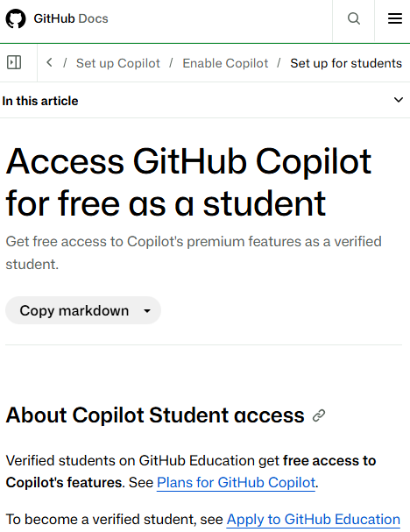
GitHub Copilot
As a student, you can access GitHub Copilot for free.
Apply here: https://docs.github.com/en/education/about-github-education/github-education-for-students/apply-to-github-education-as-a-student
Follow the instructions from GitHub.
If you have already created a GitHub Student Developer Pack - GitHub Education you should have access to GitHub Copilot.
Click on your profile icon at the top right, select “Copilot settings” to view your copilot access

Slide 27
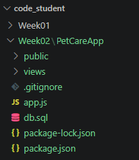
Exercise 4
In your C372 VS Code workspace, create a new folder named Week02.
In the Resources folder provided to you, you should find a folder named PetCareApp
Right click on PetCareApp folder and copy this folder. (Ctrl-C)
Go to Week02 folder in VS Code and paste PetCareApp into Week02 folder. (Ctrl-V)
Check that PetCareApp is within Week02 folder. It should look similar to the screenshot here.
Note: This is the same PetCareApp as from Week 1. You may also copy from Week01 folder but do not copy the node_modules as there are many files and it will take quite long to copy all the files over.

Slide 28
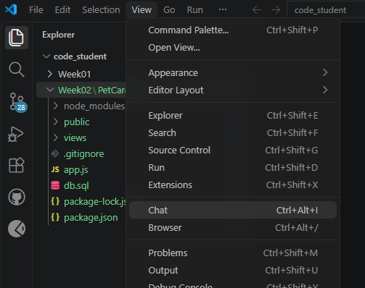
Copilot in VS Code
We will be using Copilot in VS Code to assist us in creating the model and controller.
You will need to be logged in to GitHub in VSCode
In VS Code, go to View > Chat, the Chat box should open, usually on the right panel.

Slide 29
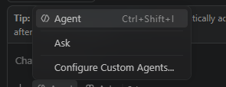
Copilot in VS Code - Modes
Option | What it does
Agent | Works on coding tasks by inspecting the project, editing files and using tools such as terminal commands or tests, subject to permissions. You should review its changes.
Ask | Answers questions and explains code without directly changing project files. It can suggest code for you to review and apply yourself.
Configure Custom Agents | Creates or manages specialised agents with reusable instructions and selected tools. This is a configuration option, not another chat mode.

Slide 30

Providing context to AI
What is context?
  The information AI uses to understand your task, such as project files, requirements, existing code and error messages.
Why does it matter?
  Relevant context helps AI suggest changes that fit your application rather than give a generic solution.

Slide 31

Providing context to AI
Give both the task and the background
  Explain what you want to achieve, which code is involved and what must remain unchanged.
Include relevant files
  Add the project folder or specific files so Copilot can examine the code related to your request.
Check its understanding
  Ask Copilot to explain the current implementation before proposing changes. Providing context does not guarantee a correct answer.

Slide 32
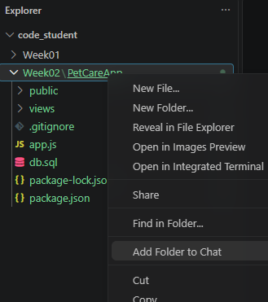
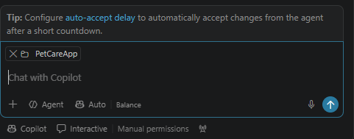
Exercise 5
To enhance the quality of results, it's important to provide relevant context. For this exercise, that means including details from the PetCareApp project.
  Right-click on the folder PetCareApp within Week02 folder
  Select Add Folder to Chat
Once added, you should see the PetCareApp project added as shown here.

Slide 33
Exercise 6
Write a prompt asking Copilot to analyse the PetCareApp project and explain how the Add a New Pet feature works. Use the Ask mode.
What to record | Response
Original prompt
Context provided
Key findings from Copilot
Two claims we checked, with code references
What was missing, unclear or incorrect?
Revised prompt and what improved

Slide 34
Exercise 7
Push your code to Github (Make it a habit to do so regularly at appropriate times.)
Right-click PetCareApp from Week02 folder, Select “Add Folder to Chat”
Copy the specifications from PetCareApp MVC Refactoring Specification.docx and paste it into GitHub Copilot.
Change to Agent mode in the chat
Submit the prompt
Observe the output. It should show you:
  An inventory of the existing routes and behaviour
  Proposed MVC folder structure and file mapping
  A staged migration plan
Do not approve any edits yet.
Although it is in Agent mode, it still stops before editing the files to check for you approval. Why?

Slide 35
Exercise 8
Review Copilot’s proposed plan against the specification and existing code.
Do not approve any edits yet.
Complete the checks below and record evidence for your decision.
Check | What to verify | Evidence
Route accuracy | Choose one route. Do its HTTP method, URL and middleware match the existing code?
MVC responsibilities | For Add a New Pet, does the plan correctly separate routes, request handling, SQL and the form?
Scope | Does the plan preserve existing behaviour and avoid adding features or unrelated improvements? Identify any omissions or concerns.
Migration steps | Does the plan break the refactor into manageable stages with checks before proceeding?
Readiness | Have you recorded the current behaviour and created a backup or Git checkpoint?

Slide 36
Exercise 9
Depending on your earlier response in the previous exercise, make your decision:
Approve: The plan matches the specification and your checks support proceeding.
Request corrections: You found a specific error, omission or out-of-scope change.
Ask for clarification: Part of the plan is unclear or lacks enough detail to verify.

Slide 37
Exercise 10
After resolving concerns, approve the first stage. Review the changed files and test that stage before allowing Copilot to continue.
MVC refactor verification checklist
Check | What to verify | Done
Responsibilities are separated | Routes map requests, controllers handle requests and responses, models contain SQL, and views contain EJS presentation code. | □
Routes remain consistent | HTTP methods, URLs and middleware order match the original application. | □
Existing features still work | Test login/logout, pet selection, search, journal add/edit/delete, and adding a pet with a photo. | □
Access controls still work | Regular users cannot access admin pages. The admin walkthrough succeeds. | □
The refactor stays within scope | No unintended changes to the database schema, redirects, uploads or existing behaviour. | □
Right-click on PetCareApp in Week02 folder, select Open in Integrated Terminal
Run the command: npm install
Run the command: node app.js
Use the MVC refactor verification checklist to check that all features work as expected.
If there are errors, or unexpected behaviour, copy the error or describe the issue to copilot.

Slide 38
CA1
Code Check-in and AI Journal
Refer to Section D in your worksheet

Slide 39
Summary
In this lesson, you have:
Explained Separation of Concerns and the roles of Model, View, Controller and routes.
Traced how requests and data move through an MVC application.
Used clear Copilot prompts and checked its explanations against the code.
Reviewed the refactoring plan against the specification before approving edits.
Reorganised PetCareApp into an MVC structure with clearly separated responsibilities.
Tested the refactored application to verify that its existing behaviour stayed unchanged.
Before (Week 01)
app.js: routes + request handling + SQL
After (Week 02)
routes / controllers / models / views / middleware / config

Slide 40
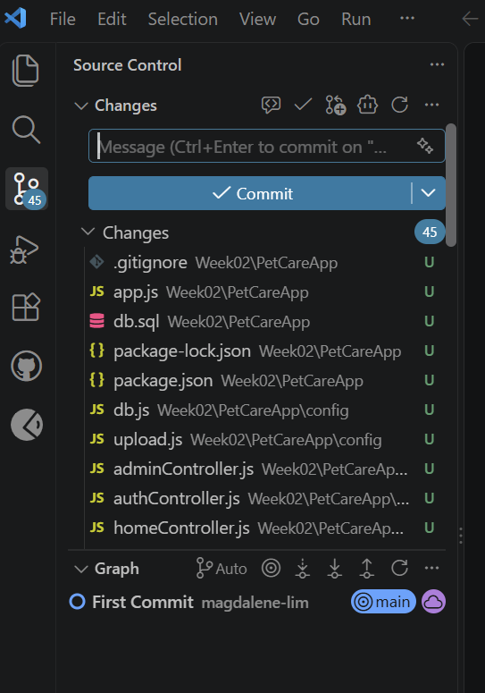

Reminders
Check in your code using VS Code
  1. Before editing, open Source Control and select More Actions (...) > Pull.
  Already edited files? Commit your changes before pulling.
  2. Make your changes, save all files and test the application.
  3. Review changes in Source Control. Click + beside each file to stage it.
  4. Enter a clear message on the changes, then click Commit.
  5. Pull again before pushing. Resolve any conflicts and retest.
  6. Select More Actions (...) > Push. Confirm the latest commit on GitHub.
  Keep node_modules out of your commit with .gitignore.
Start work on your AI journal.

Slide 41
Submissions
Worksheet (Individual)
Upload your deliverables to POLITEMALL even if it is incomplete before the next session.
You can resubmit by 2359 if there are updates.

