Slide 1

Procedure for Baseline Assessment
Linux Servers
Baseline Assessment
Using Tenable Security Center

Slide 2
PREREQUISITES
Server Credentials
Create an admin/root user on each server to be assessed. Assign a complex password (more than
12 characters with mix of capital & small letters, special characters, numbers, etc.) for this user.
Service Property
Before running a scan on any server, ensure “Remote Registry” Service is set to Manual.
Admin Share
Admin$ share should be enabled on the servers that are to be scanned.

Slide 3
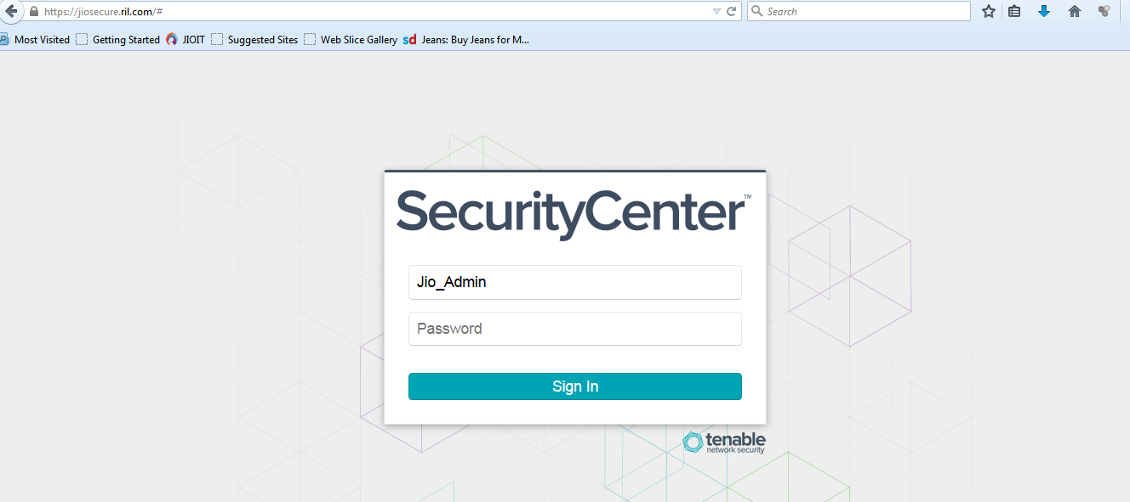
SECURITY CENTER : LOGIN
URL : https://jiosecure.ril.com
Enter the provided Security Manager credentials

Slide 4
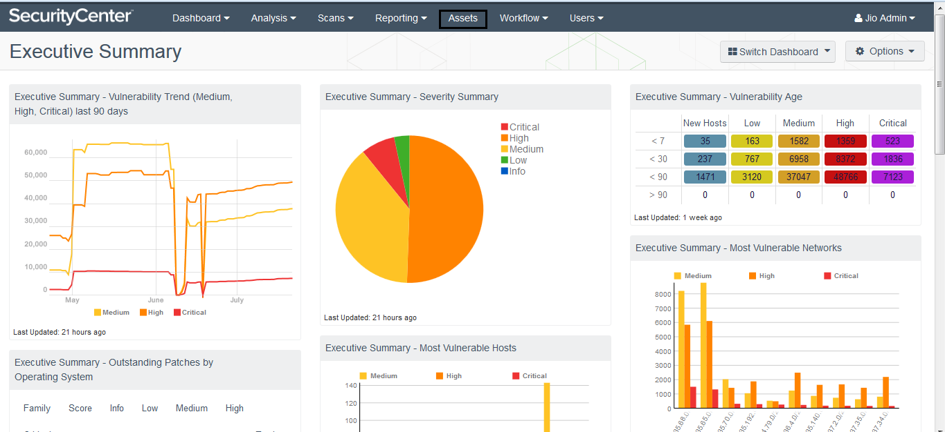
Asset Creation: Click On Asset Tab in Console

Slide 5
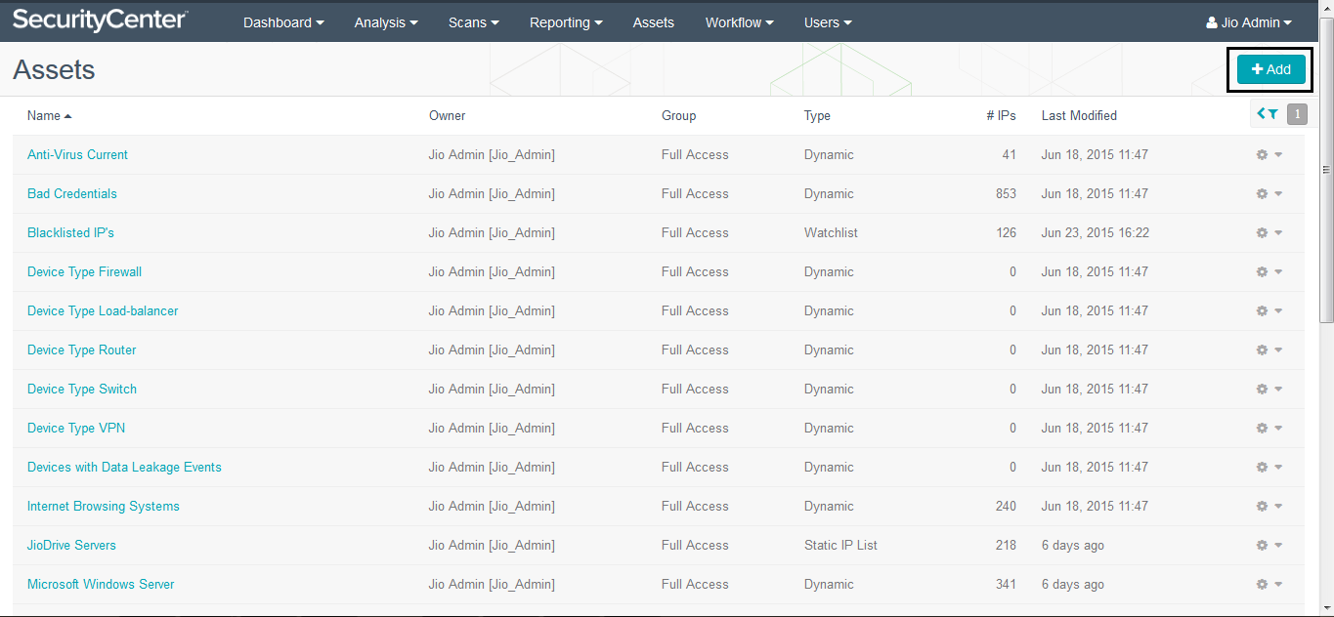
Click on Add button

Slide 6
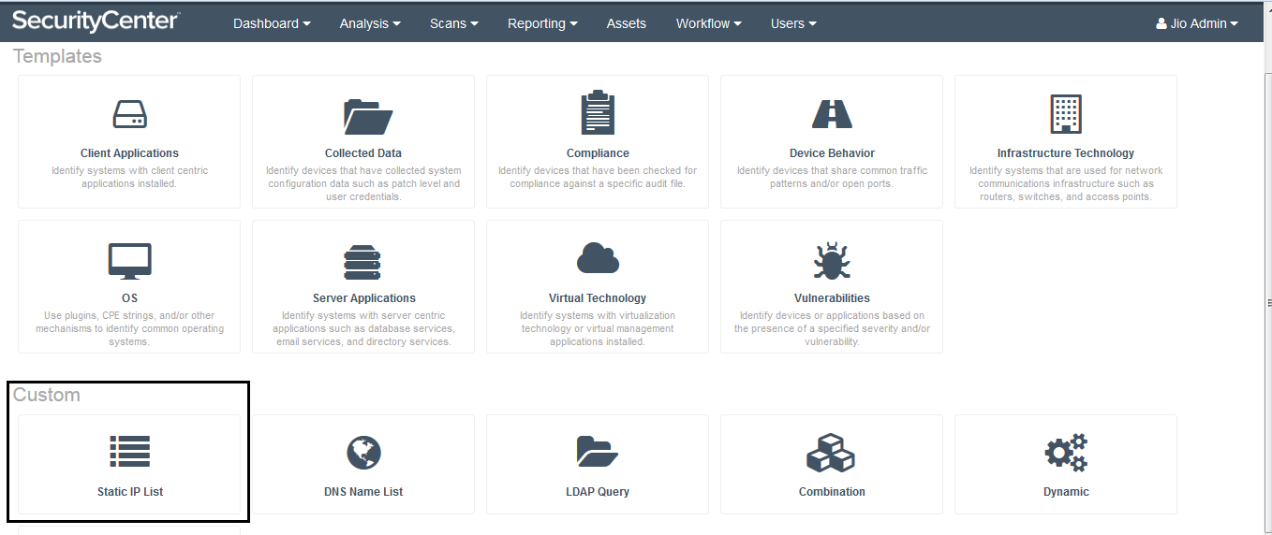
Click on Static IP List

Slide 7
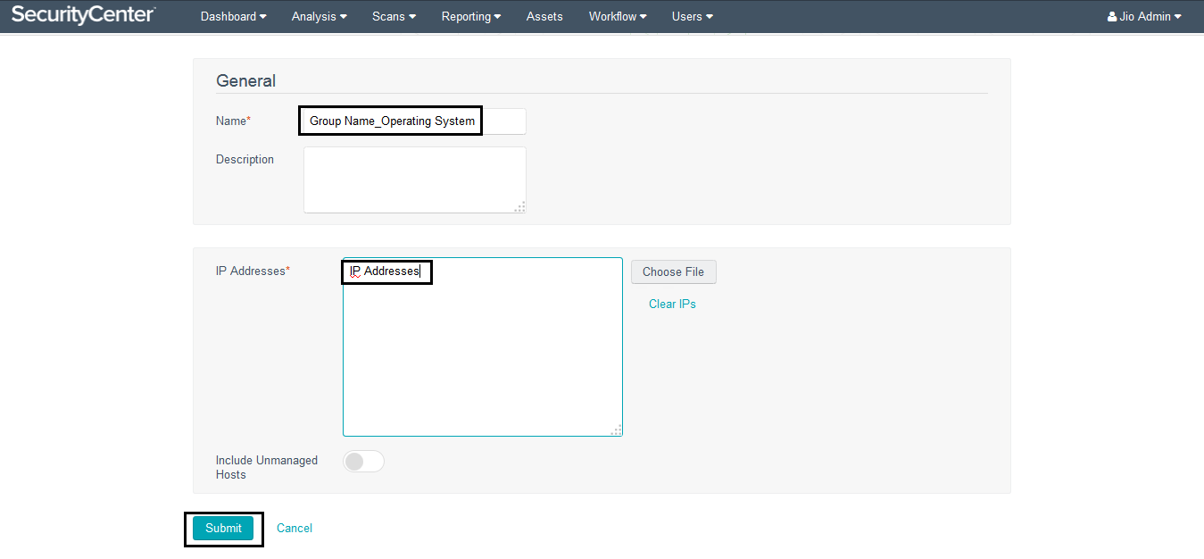
Provide Name for Asset List & Write down IP Addresses

Slide 8
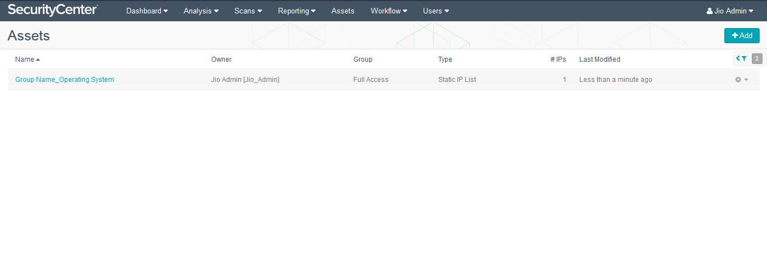
Asset is Created

Slide 9
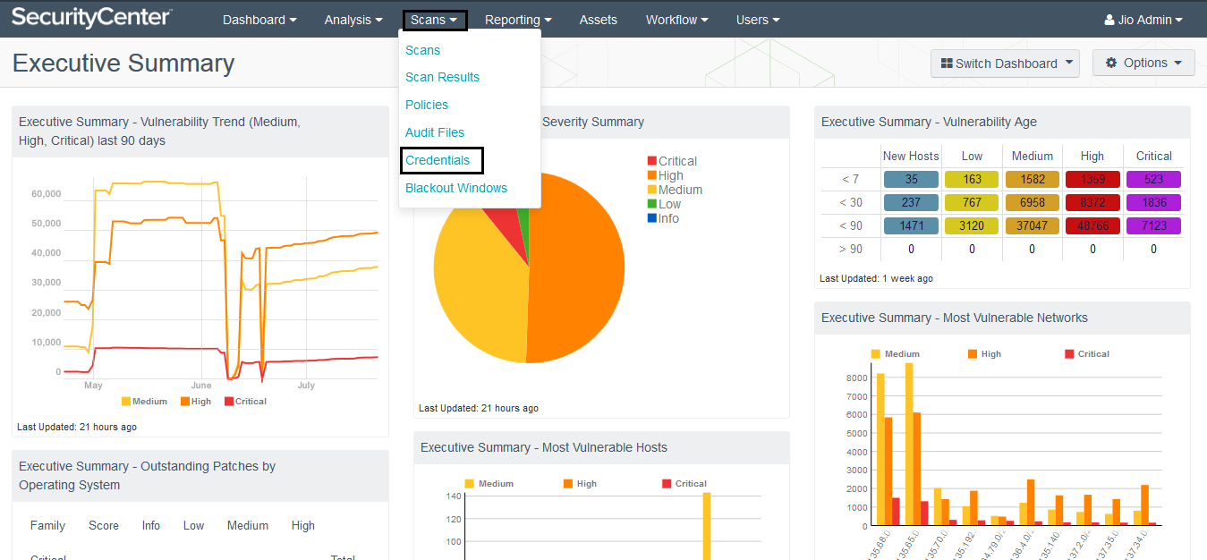
Click on Scans Tab on Console & Select Credential to Create New Credential

Slide 10
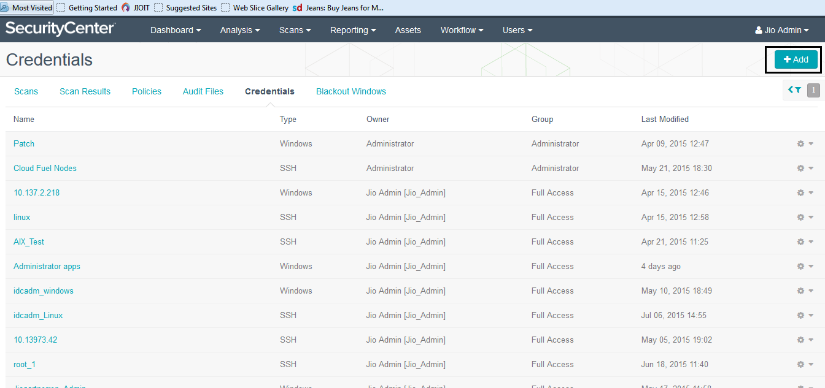
Click on Add on the Credentials Page

Slide 11
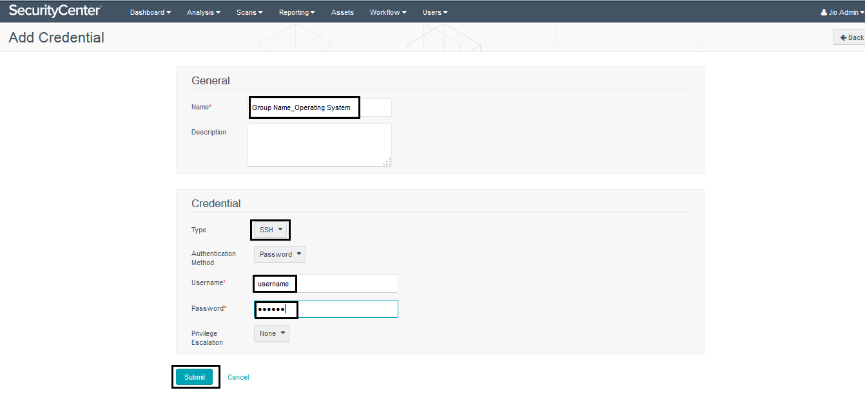
Provide the details in the highlighted fields and Click on Submit to save the credentials

Slide 12
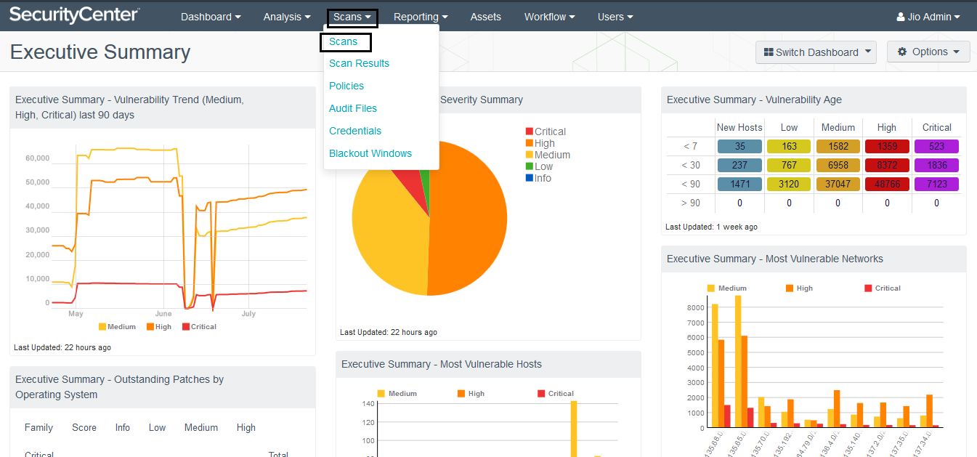
Click Scans Tab on Console to create New scan Template

Slide 13
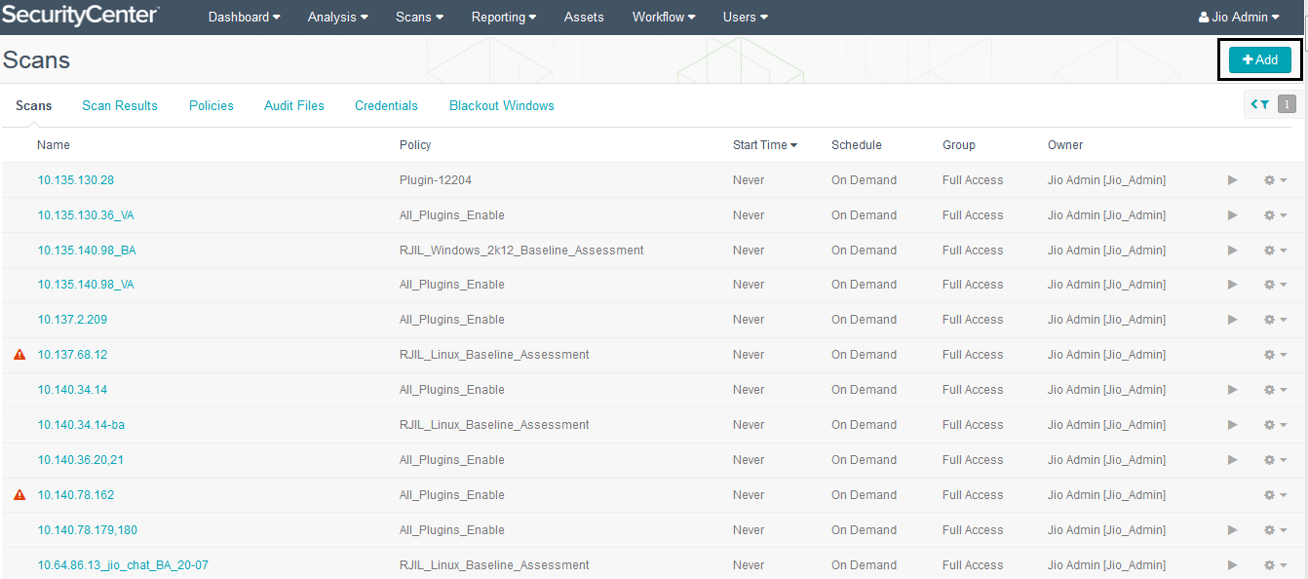
Click on Add button to create New Scan template

Slide 14
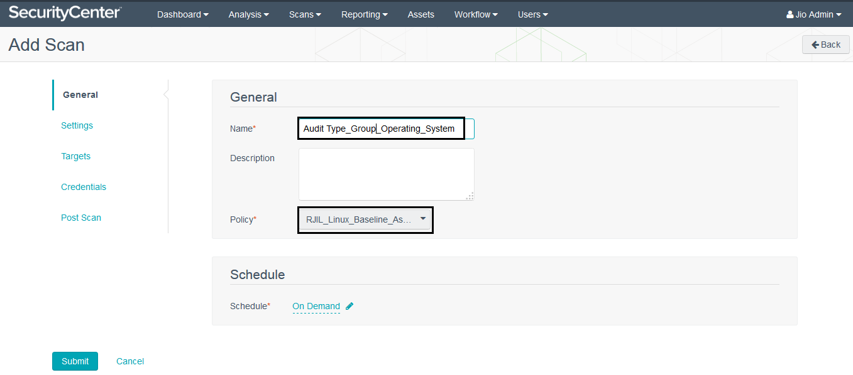
Provide the details of Template Name & select Scan policy

Slide 15
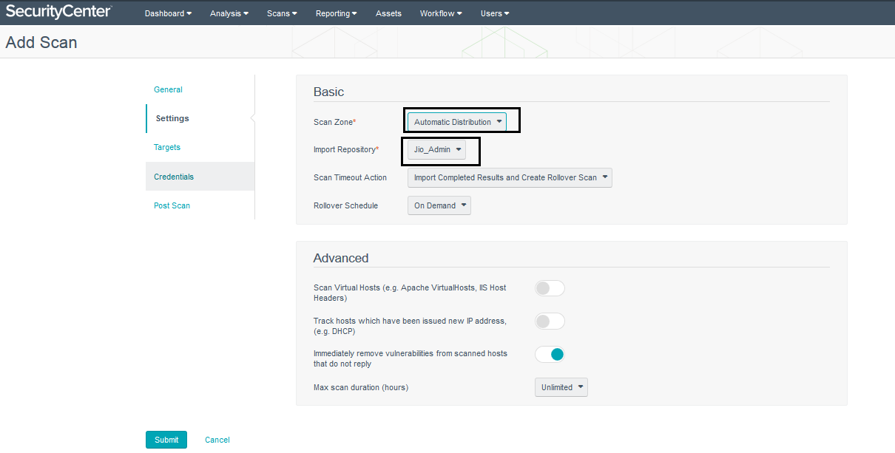
Provide the details of Scan zone & Import Repository

Slide 16
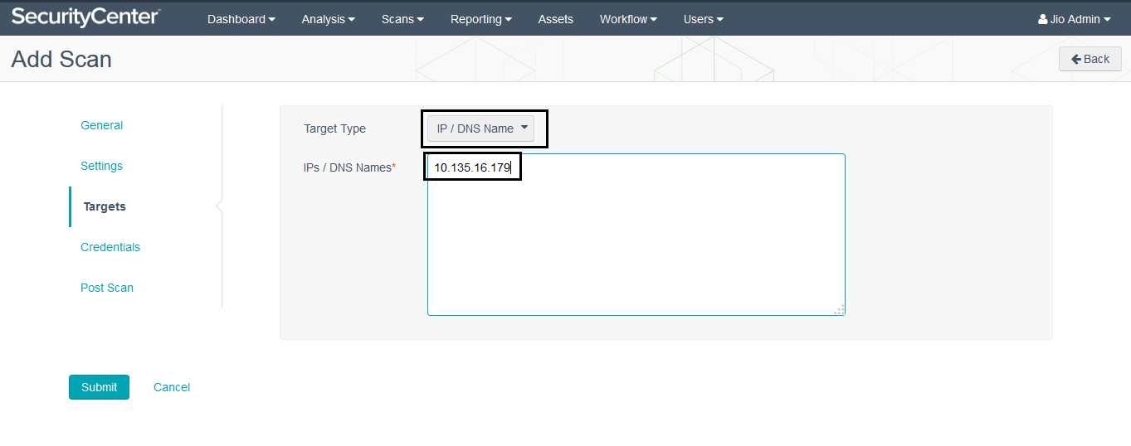
Provide the details of Target IP Addresses Select Target Type as IP/DNS Name

Slide 17
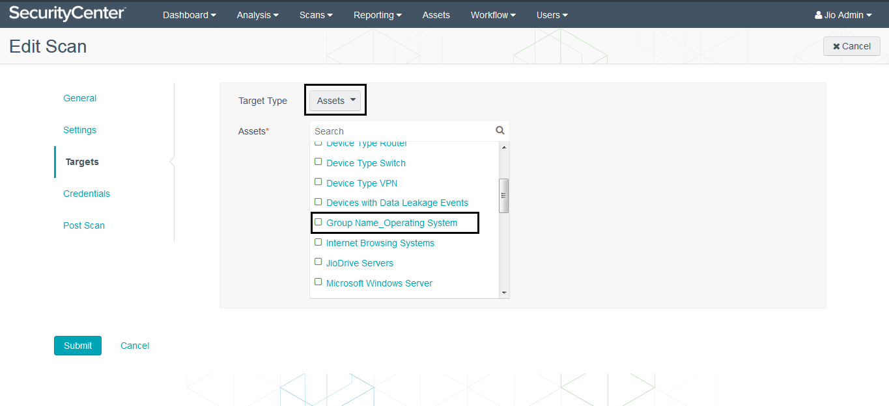
Provide the details of Target IP Addresses: Select target Type as Assets & then select Assets Name

Slide 18
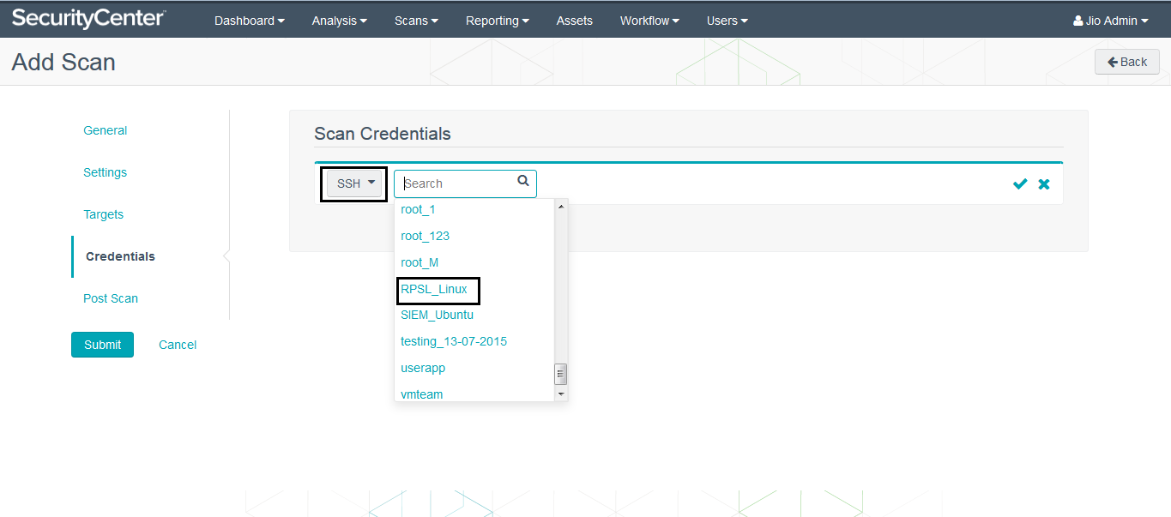
Select Desired Credentials & then Click Submit Button to launch scan

Slide 19
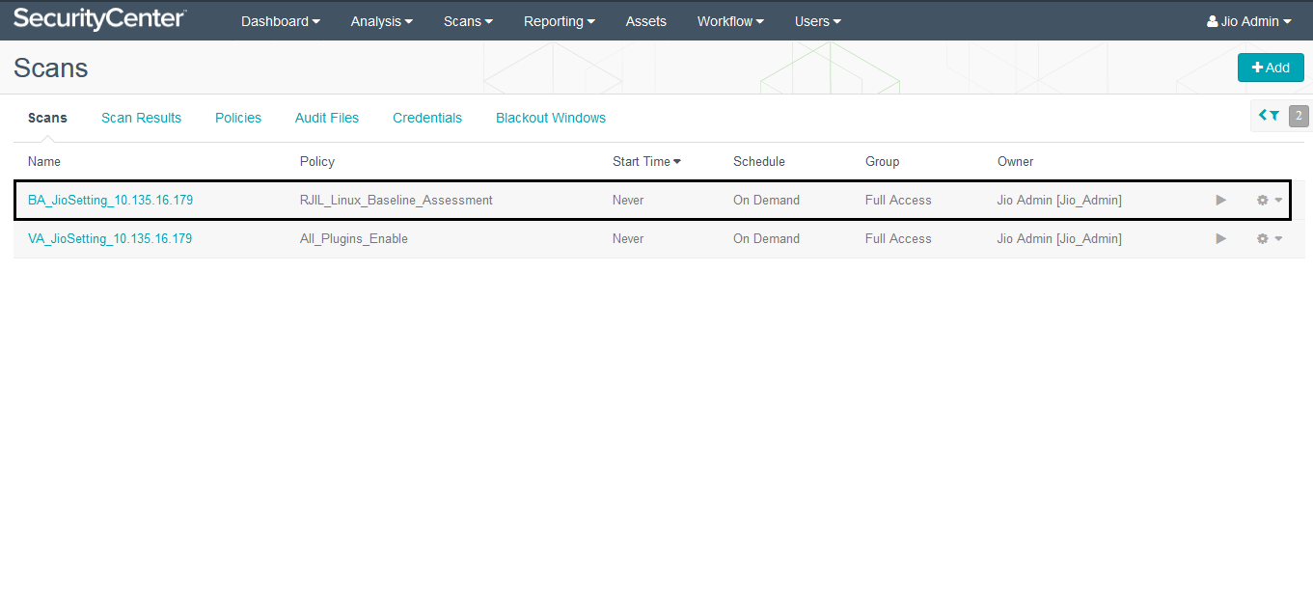
Click on Play Button to Launch Scan

Slide 20
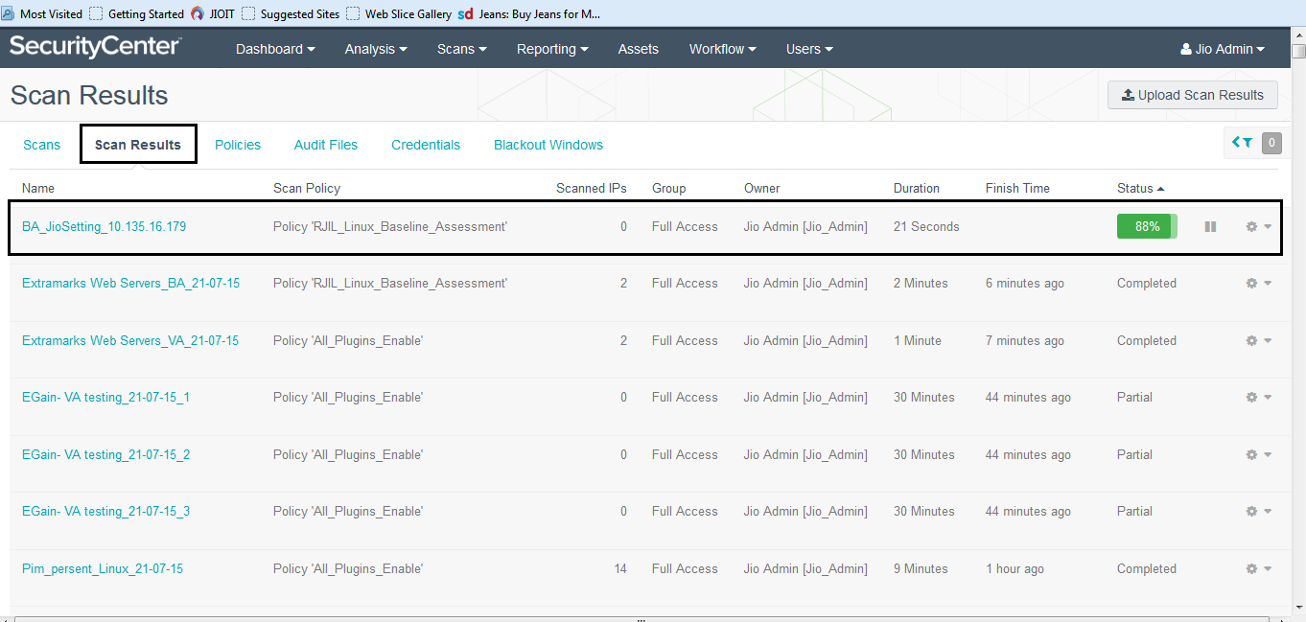
Click on Scan Result to see Scan Status

Slide 21
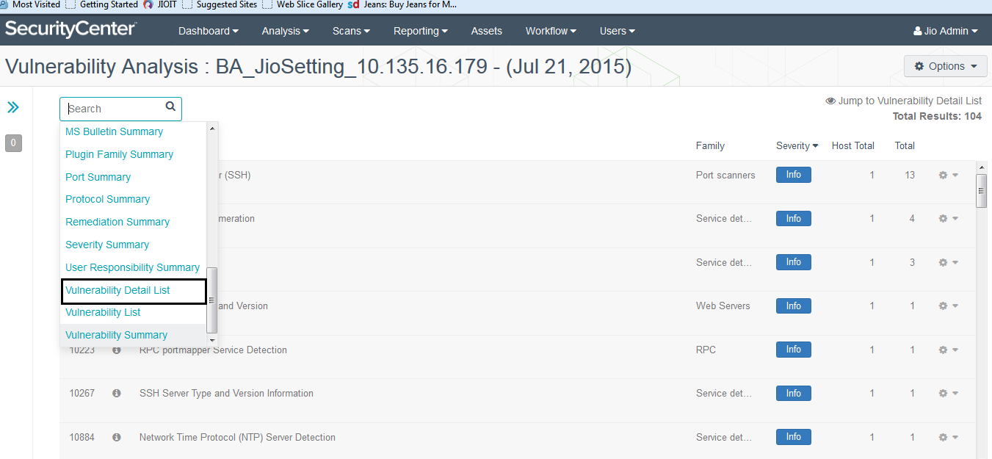
Click on Vulnerability Detail List to see detailed Result of Scan

Slide 22
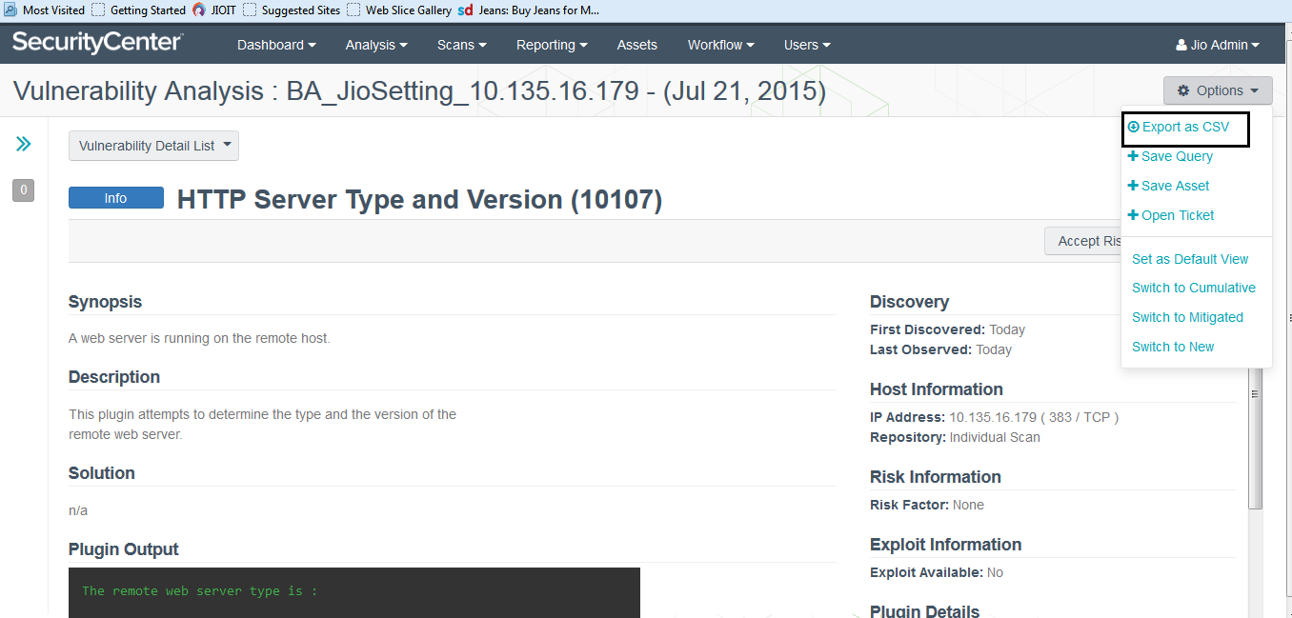
Click on Option Tab to Export Result

