Slide 1

0
0.15
0.3
0.4
0.5
0.6
Depth [mm]
0.7
0.9
1.15
1.4
1.6
1.8

Slide 2
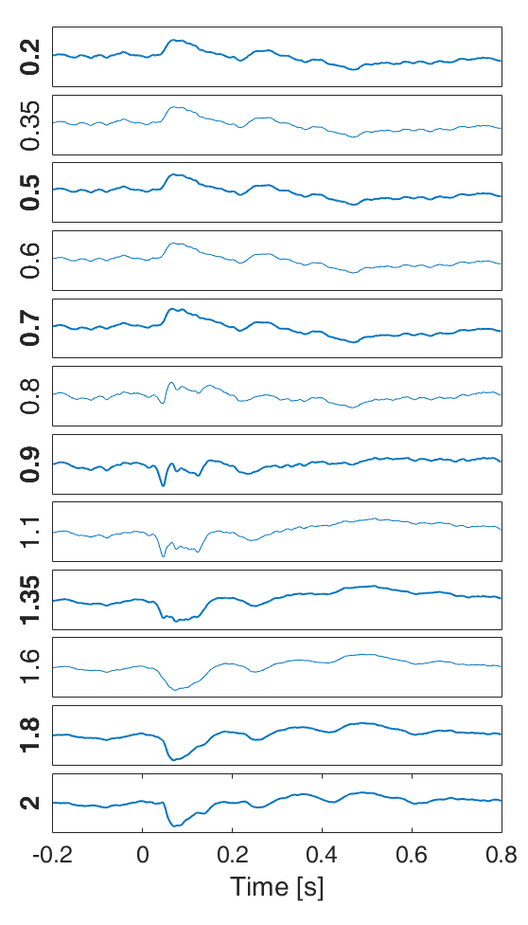
0
0.15
0.3
0.4
Depth [mm]
0.5
1.8 1.6 1.4 1.15 0.9 0.7 0.6 0.5 0.4 0.3 0.15 0
0.6
0.7
0.9
1.15
1.4
1.6
1.8

Slide 3
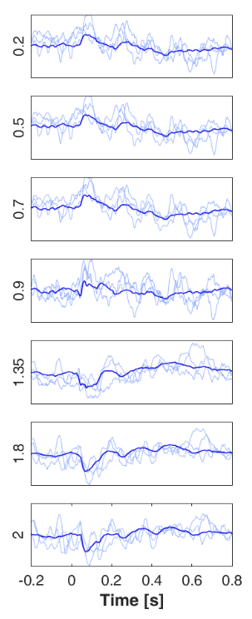
Depth [mm]
1.8 1.6 1.15 0.7 0.5 0.3 0

Slide 4
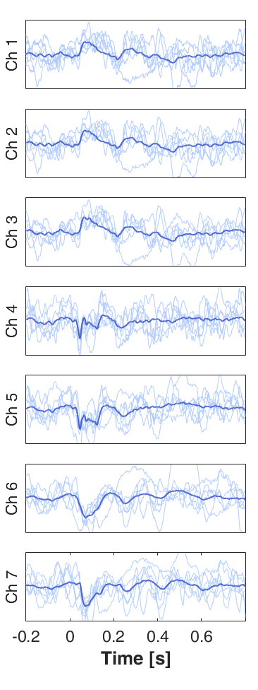
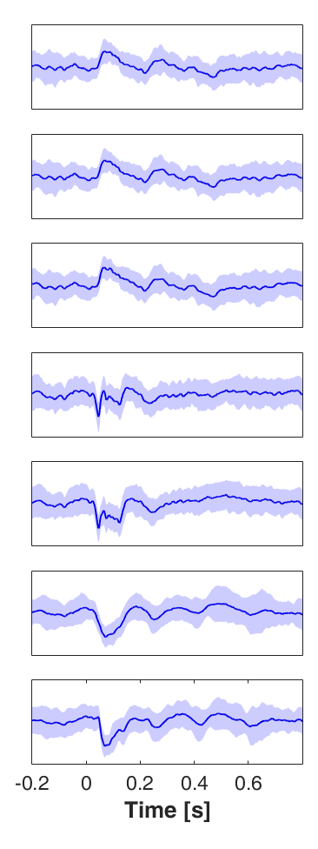

Slide 5
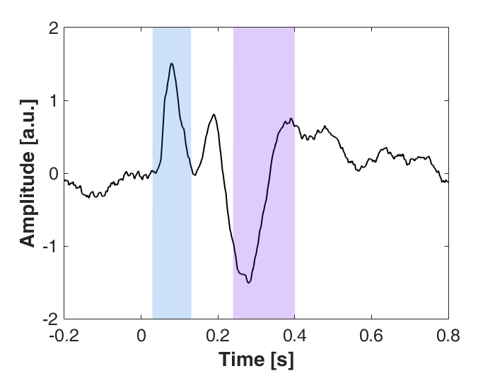
amplitude of 1st peak
amplitude of 2nd peak

Slide 6
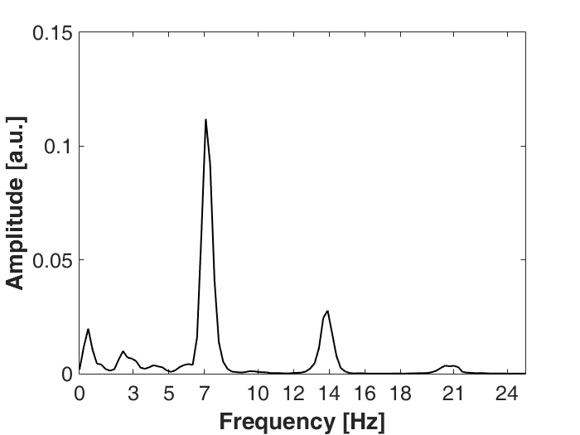
amplitude of peak in
fundamental frequency
amplitude of peak
in second harmonic

Slide 7
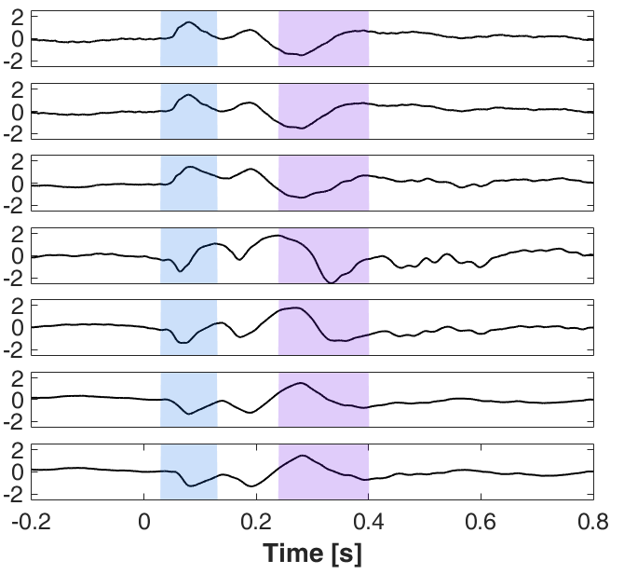

Slide 8

sink
50
source
-50
0

