Slide 1

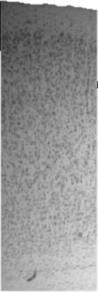
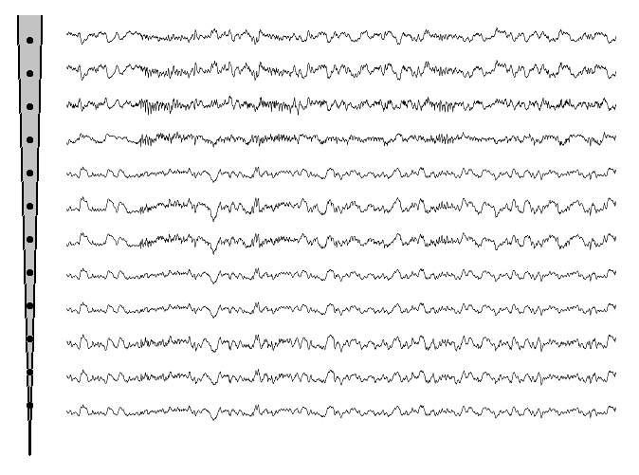
Primary Visual Cortex (V1)
surface
Local Field Potential
I
supragranular
II
III
granular
IV
V
infragranular
VI
white matter

Slide 2
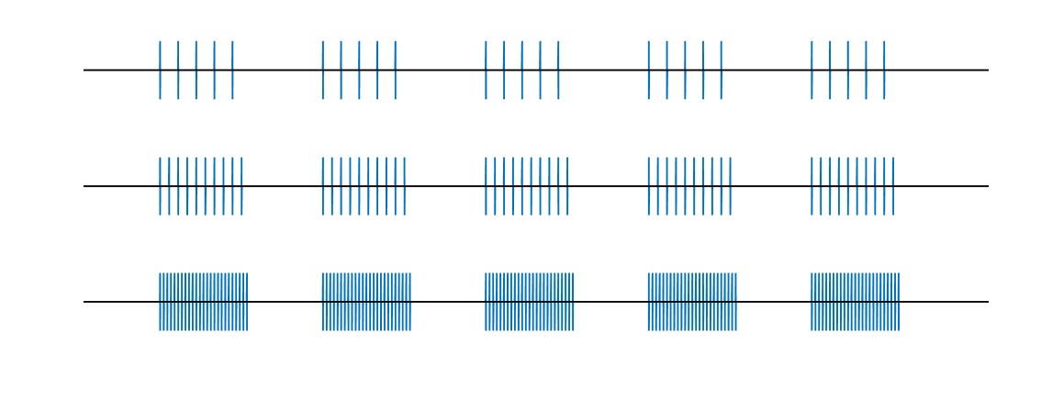
Number of repetitions depends on frequency
Different frequencies
5 s
2-3 s
40 repetitions of chunks
…
…
…
5 s
2-3 s

Slide 3
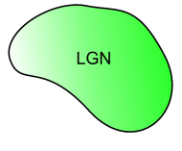
I

