Slide 1

Government Engineering College , Raipur C.G.
Department of Computer Science and Engineering
Presentation of Machine Learning Based Fraud Detection for Credit Card
Session :2022-23
Submitted by:
Harsh Kumar Kandra(301602219019)
Yash Bakshi(301602219059)
Lalini Sahu(301602220303)
Guided by:
Mrs. Hazra Anjum Khan Mam
(Asst. Professor)

Slide 2
Objective
Our goal machine learning based fraud detection for Credit Card is to detect fraudulent transactions while trying to minimize the false fraud classifications using various Machine learning algorithms, as well as to analyze the behavior of each algorithm in order to solve our problem.

Slide 3
Abstract
It is vital that credit card companies are able to identify fraudulent credit card transactions so that customers are not charged for items that they did not purchase. Such problems can be tackled with Machine Learning. This project intends to illustrate the modelling of a data set using machine learning with Credit Card Fraud Detection.
The Credit Card Fraud Detection Problem includes modelling past credit card transactions with the data of fraud ones. Our objective here is to detect of the fraudulent transactions while minimizing the incorrect fraud classifications. Credit Card Fraud Detection is a typical sample of classification. In this process, we have focused on analyzing and pre-processing data sets as well as the deployment of multiple anomaly detection algorithms such as Logistic regression, Random Forest, KNN, SVM algorithm on the PCA transformed Credit Card Transaction data.

Slide 4
Literature Survey
Fraud act as the unlawful or criminal deception intended to result in financial or personal benefit. It is a deliberate act that is against the law, rule or policy with an aim to attain unauthorized financial benefit.
Numerous literatures pertaining to anomaly or fraud detection in this domain have been published already and are available for public usage. A comprehensive survey conducted by Clifton Phua and his associates have revealed that techniques employed in this domain include data mining applications, automated fraud detection, adversarial detection. In another paper, Suman, Research Scholar, GJUS&T at Hisar HCE presented techniques like Supervised and Unsupervised Learning for credit card fraud detection. Even though these methods and algorithms fetched an unexpected success in some areas, they failed to provide a permanent and consistent solution to fraud detection.

Slide 5
Credit Card Fraud Detection System-A Survey:
Credit card frauds are increasing day by day regardless of the various techniques developed for its detection. Fraudsters are so expert that they generate new ways for committing fraudulent transactions each day which demands constant innovation for its detection techniques.
Most of the techniques based on Artificial Intelligence, Fuzzy logic, neural network, logistic regression, Naïve Bayesian, Machine learning, Sequence Alignment, decision tree, Bayesian network, meta learning, Genetic Programming etc., these are evolved in detecting various credit card fraudulent transactions. This paper presents a survey of various techniques used in credit card fraud detection mechanisms. (Author-Dinesh L. Talekar, K. P. Adhiya)

Slide 6
A Comparative Analysis of Various Credit Card Fraud Detection Techniques:
In this paper the concept of frauds related to credit cards and their various types is introduced. They have explained various techniques available for a fraud detection system such as Support Vector Machine (SVM), Bayesian Network, K- Nearest Neighbor (KNN), Hidden Markov Model, Fuzzy Logic Based System and Decision Trees. An extensive review is done on the existing and proposed models for credit card fraud detection and has done a comparative study on these techniques on the basis of quantitative measurements such as accuracy, detection rate and false alarm rate.(Author-Yashvi Jain, Namrata Tiwari, Shripriya Dubey,Sarika Jain)

Slide 7
Data Set
The dataset contains transactions made by credit cards in September 2013 by European cardholders. This dataset presents transactions that occurred in two days, where we have 492 frauds out of 284,807 transactions. The dataset is highly unbalanced, the positive class (frauds) account for 0.172% of all the transactions.
It contains only numerical input variables which are the result of a PCA transformation. Unfortunately, due to confidentiality issues, we cannot have the original features and more background information about the data. Features V1, V2, … V28 are the principal components obtained with PCA, the only features which have not been transformed with PCA are 'Time' and 'Amount’.
Time: contains the seconds elapsed between each transaction and the first transaction in the dataset. Amount: contains the amount of transactions.

Slide 8
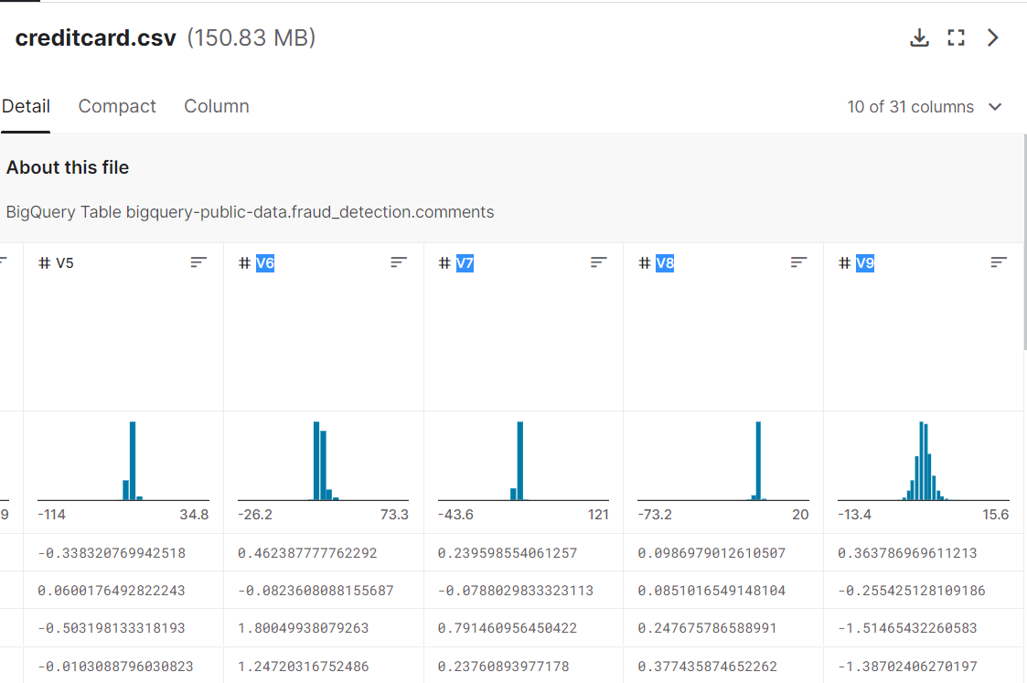

Slide 9
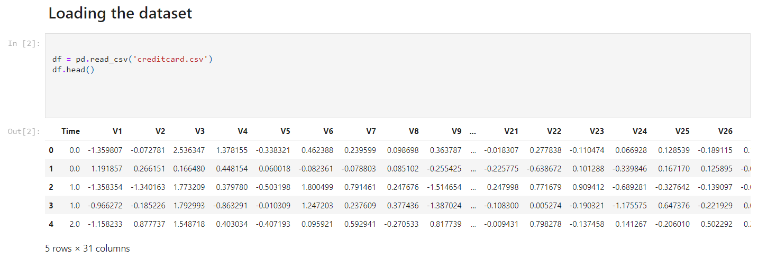
Data Set

Slide 10
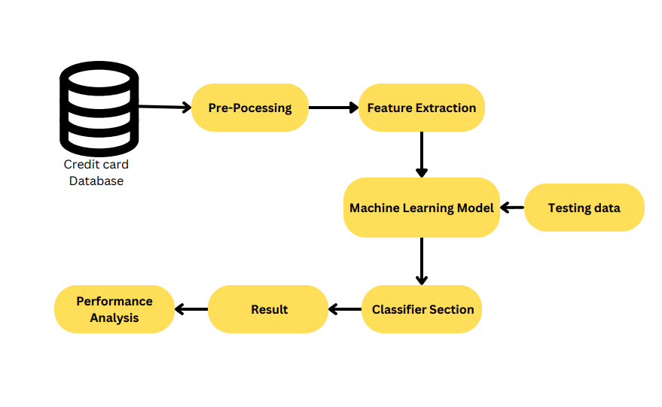
Flowchart

Slide 11
Packages
Different packages are being used for data exploration, pre processing and for implementing Machine learning algorithm are:
• NumPy: For simple arrays.
• pandas - used to perform data manipulation and analysis.
• SciKit: Learn- for pre-processing.
• Matplotlib and Seaborn: For plotting and representing confusion matrix colour format.

Slide 12
Data Pre-processing
Pre-processing refers to the modifications we do to our data before feeding it to the algorithm. Data preprocessing is a technique used to turn raw data into a clean data collection. In other words, anytime data is received from various sources, it is collected in raw format, which makes analysis inefficient and inaccurate.
1. Data Cleaning
Handling Missing Values: There are various ways of handling missing values, namely:
Ignoring the tuple- Simply discard the tuples with that missing information. This is feasible for large data sets, where ignoring a small proportion of tuples wouldn’t significantly affect the further analysis.
Manually filling in missing values can be an extremely tiresome process but might be necessary, especially when the dataset is small.
Assigning a constant to all missing values
Imputation- Done by replacing the mean of all samples, the mean of samples with similar classification or resultant values, or any other logical manner.

Slide 13
2. Integration of Data
The practice of merging data from numerous sources into a single dataset is known as data integration. This entails schema integration, which entails integrating information from many sources and resolving data value conflicts caused by discrepancies in units of measurement, representation, and so on.
3. Data Reduction
Dimensionality Reduction:
Principal component analysis - Principal component analysis or PCA works by searching for a set of orthogonal vectors, which is smaller than the original attribute vectors, that can best represent the data, thus resulting in dimensionality reduction. PCA compounds the original attributes into an
an alternative, smaller set.
4. Feature scaling or normalization.
Often, multiple variables change over different scales, or one will change linearly while another will change exponentially. For example, amount might be measured in thousands of dollars, while class is represented in a single digit. Scaling helps to transform the data in a way that makes it easier for algorithms to tease apart a meaningful relationship between variables.

Slide 14
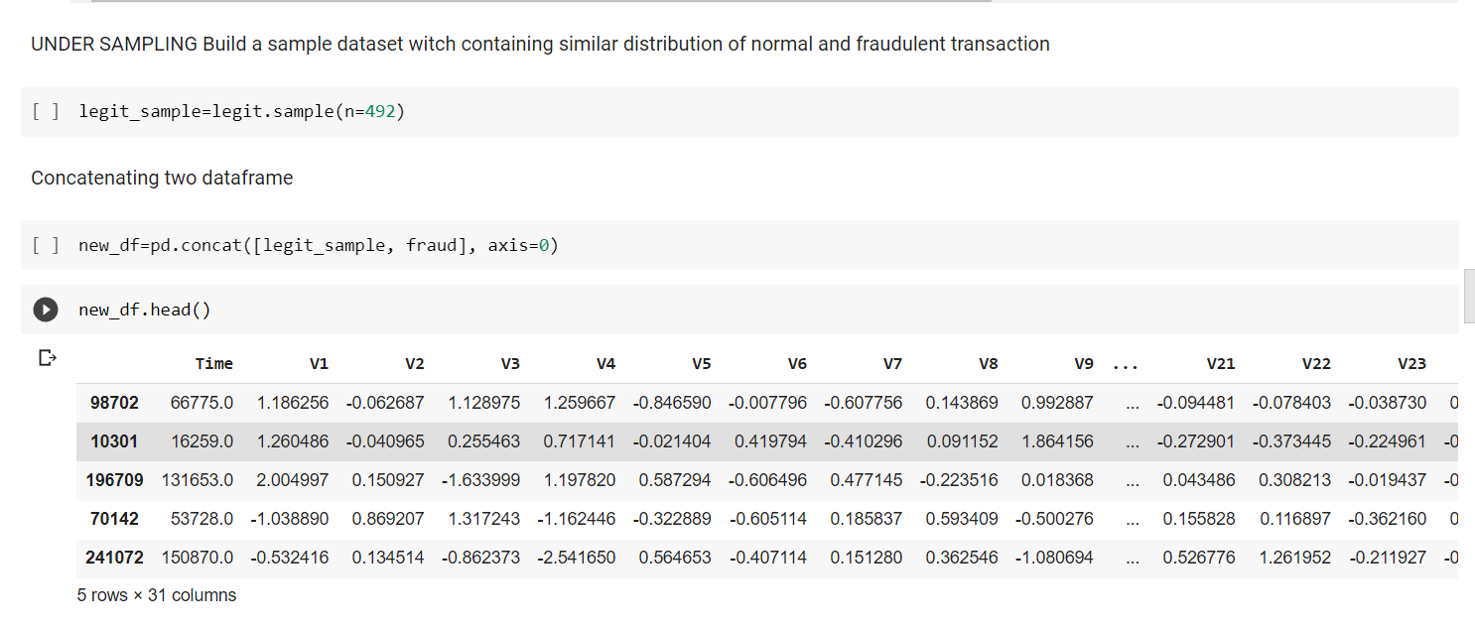
Sampling the data
Under Sampling
Under sampling is a technique to balance uneven datasets by keeping all of the data in the minority class and decreasing the size of the majority class. It is one of several techniques data scientists can use to extract more accurate information from originally imbalanced datasets.

Slide 15
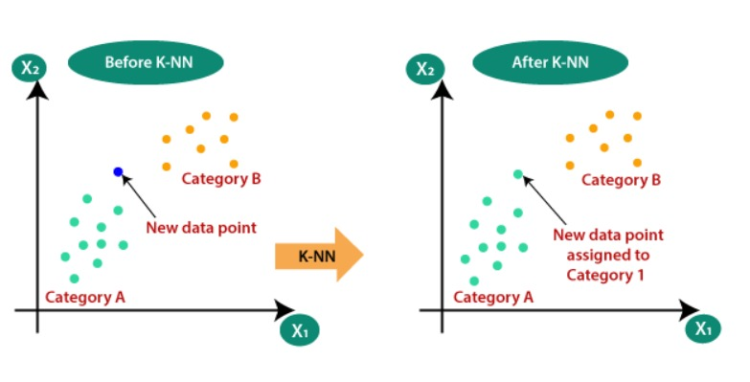
KNN(K-Nearest Neighbor)
KNN is a simple, supervised machine learning (ML) algorithm that can be used for classification or regression tasks - and is also frequently used in missing value imputation. It is based on the idea that the observations closest to a given data point are the most "similar" observations in a data set, and we can therefore classify unforeseen points based on the values of the closest existing points. By choosing K, the user can select the number of nearby observations to use in the algorithm.

Slide 16
ALGORITHM
Step-1: Select the number K of the neighbors
Step-2: Calculate the Euclidean distance of K number of neighbors
Step-3: Take the K nearest neighbors as per the calculated Euclidean distance.
Step-4: Among these k neighbors, count the number of the data points in each category.
Step-5: Assign the new data points to that category for which the number of the neighbor is maximum.
Step-6: Our model is ready.

Slide 17
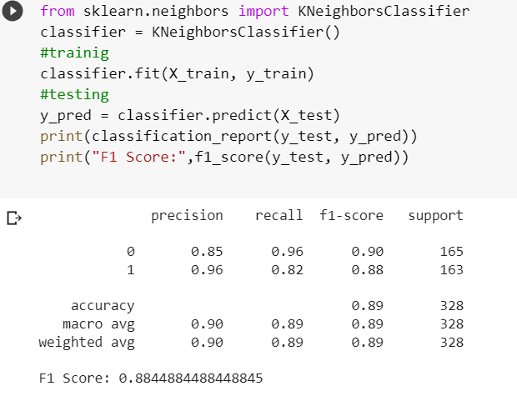

Slide 18

SVM(Support vector machine)
Support Vector Machine or SVM is one of the most popular Supervised Learning algorithms, which is used for Classification as well as Regression problems. However, primarily, it is used for Classification problems in Machine Learning.
The goal of the SVM algorithm is to create the best line or decision boundary that can segregate n-dimensional space into classes so that we can easily put the new data point in the correct category in the future. This best decision boundary is called a hyperplane.

Slide 19
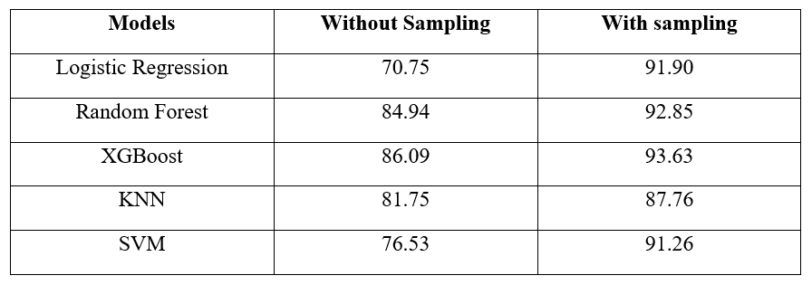
RESULT SUMMARY
Summary of machine learning models result:
According to the summary of the results accuracy increases with sampling.

Slide 20
Future Scope
Our work can be extended to use of Deep Learning techniques in order to build more complex models and to increase efficiency and accuracy of such models. Deep learning has shown to be quite good at spotting and stopping credit card fraud. Deep learning models can analyze massive amounts of transactional data and accurately spot fraudulent tendencies by utilizing the power of neural networks and sophisticated data processing methods.

Slide 21
References
Machine Learning Group - ULB: Credit Card Fraud Detection, Kaggle Datasets
Bertrand Lebichot, Yann-Aël Le Borgne, Liyun He, Oblé, Bontempi. Deep-Learning Domain Adaptation Techniques for Credit Cards Fraud Detection, INNSBDDL 2019: Recent Advances in Big Data and Deep Learning, pp 78-88, 2019
Fabrizio Carcillo, Olivier Caelen, Frederic Combining Unsupervised and Supervised Learning in Credit Card Fraud Detection, Information Sciences, 2019
“Survey Paper on Credit Card Fraud Detection by Suman” , Research Scholar, GJUS&T Hisar HCE, Sonepat published by International Journal of Advanced Research in Computer Engineering & Technology (IJARCET) Volume 3 Issue 3, March 2014
“Credit Card Fraud Detection: A Realistic Modeling and a Novel Learning Strategy” published by IEEE TRANSACTIONS ON NEURAL NETWORKS AND LEARNING SYSTEMS, VOL. 29, NO. 8, AUGUST 2018

