Slide 1

E-commerce Cohort
Retention Analysis
Portfolio presentation | Product analytics case study
EXECUTIVE SUMMARY
CONTEXT Product team suspects that many newly observed users may not be returning consistently
Dataset | RetailRocket public dataset with 2.7M+ user-level events
Key finding | Largest retention decline occurs between D1 and D7, and remains broadly consistent across mature cohorts
Action | Use early browsing breadth as an engagement signal to encourage early exploration and re-engage low-breadth users
BUSINESS QUESTION
How can we validate newly observed user retention and improve retention outcomes?
1/6

Slide 2




How retention was measured
Cohort anchor First observed event date
Retention metric Exact-day any-event return
first_seen
view
addtocart
transaction
Checkpoints D1, D7, D14, and D30
measured using full 24-hour
day buckets
Segmentation First-3-day browsing breadth
1 item / 2 or 3 items / ≥ 4 items
Note: first_seen is a proxy for signup, and retention is measured only for users with enough observation time.
2/6

Slide 3
The largest retention drop happens between D1 and D7
Overall exact-day any-event retention by checkpoint
Checkpoint | Mature users | Retained users | Exact-day retention rate | Drop from previous checkpoint
D1 | 1,366,774 | 21,813 | 1.596% | -
D7 | 1,328,821 | 6,756 | 0.508% | -1.088 pp
D14 | 1,262,817 | 3,730 | 0.295% | -0.213 pp
D30 | 1,115,048 | 1,651 | 0.148% | -0.147 pp
* pp = percentage points
* Mature users means users whose first-seen date is early enough that the dataset has enough observation time to measure that checkpoint.
Exact-day retention generally declines from D1 to D30, especially drops sharply after Day 1 and before Day 7.
This suggests an early lifecycle window to investigate.
Next: Is the D1–D7 drop mainly driven by a few unusual cohorts?
?
3/6

Slide 4
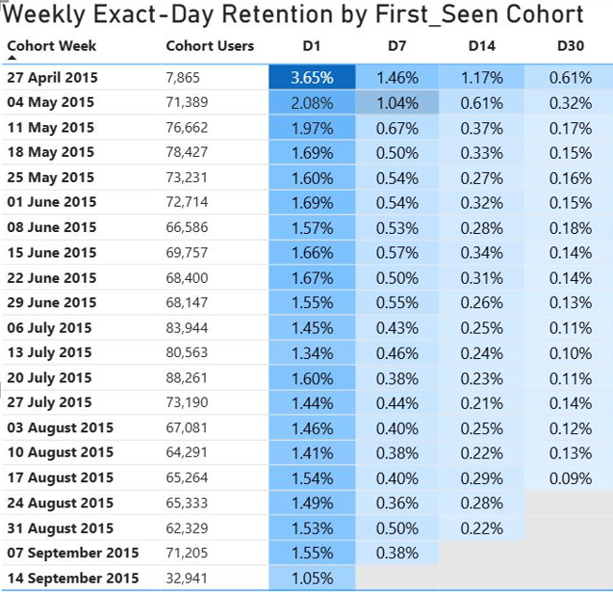
The D1–D7 drop is broadly consistent across cohorts
Weekly exact-day retention by first-seen cohort
Most mature weekly cohorts follow a similar pattern: D1 is highest, followed by lower D7, D14, and D30 retention. This makes the early drop-off pattern found in the overall table more reliable.
Also strengthens the case that the D1–D7 window is worth investigating for early retention actions
Note: first and last cohort weeks are boundary cohorts and excluded from interpretation.
Next: Can early user behavior help distinguish users with stronger vs weaker retention?
?
4/6

Slide 5
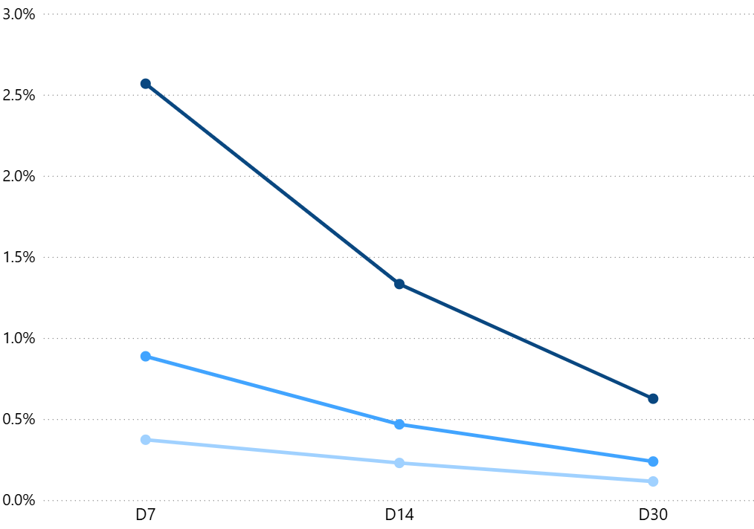
Broader early browsing is associated with
stronger retention at D7, D14, and D30
Segments are based on the number of distinct items that users interacted with during the first 3 days:
1 item, 2 or 3 items, and equal or more than 4 items.

Exact-day retention by early browsing breadth
Retention is consistently ordered by early browsing breadth: users who interacted with ≥ 4 items have the highest retention at every checkpoint, followed by 2 or 3 items, while 1 item users have the lowest.
This makes early browsing breadth a useful signal for identifying users who may need engagement support.
≥4 items
2 or 3 items
1 item
Note: D1 is excluded because it falls partly within the first 3 days used to define the segments.
5/6

Slide 6




Recommended action path
1
2
3
4
First 3 days
After first 3 days
Day 7
Day 14 & Day 30
Increase early
item exploration
Re-engage low-breadth users
Measure early success
Check durability
Test stronger discovery surfaces to move users beyond one item
Target users who explored only 1 item with reminders or related-item recommendations.
Compare D7 return against a control group
Track whether improvement lasts
Recommendations are hypotheses to test through experiments or causal analysis, not proven causal effects.
6/6

