Slide 1


Slide 2
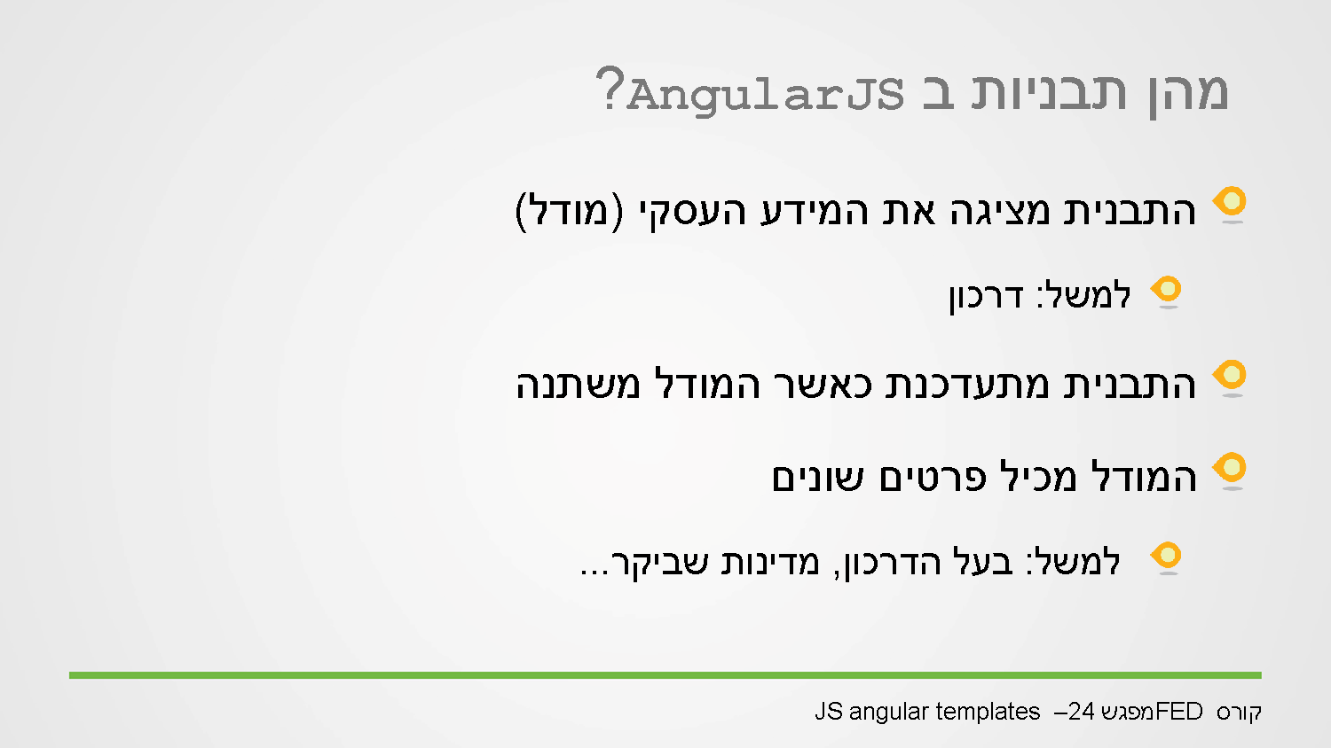
Notes:
Templates - generate the html in runtime, in the client side.
In my model I have an array of objects representing passports, I would like that every change in the passport list the pattern will change.

Slide 3
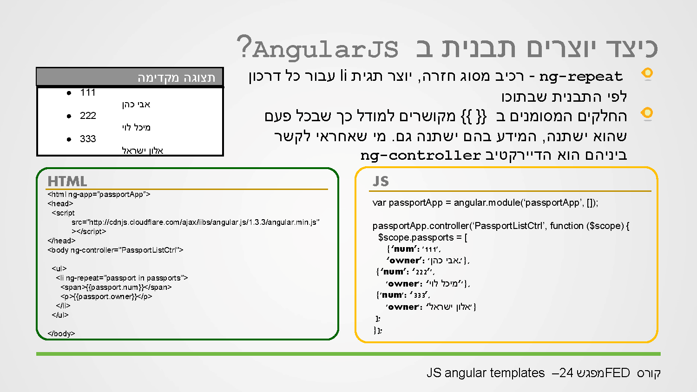
Notes:
Ng-repeat – directive related to html template.
One of the most important directive is ng-repeat, we put it on html element, in the value I pass an array (that exists on the scope) when angular run it replicates the element as the number of objects in the array.
In the example the array is $scope.passports.
<element ng-repeat=‘item in array’ >(the array must be on the $scope)
</element>

Slide 4
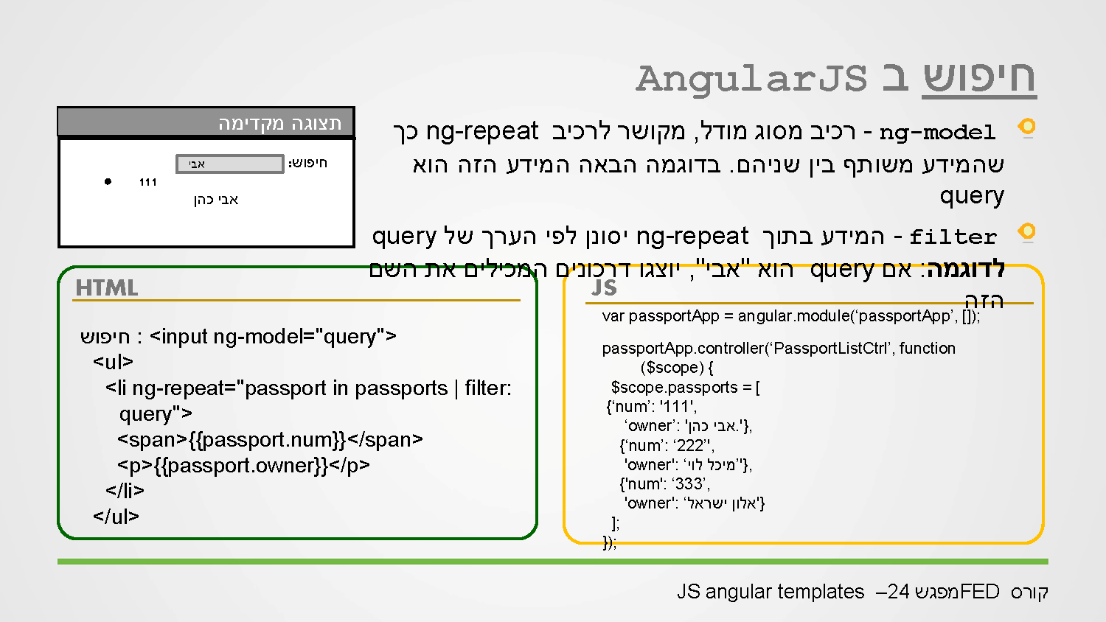
Notes:
Search – better described as filtering,
<input type=“text” ng-model=“searchText”>
<element ng-repeat=“item in array | filter: searchText”>
The filter is done on all properties of the object’s in the array.
In order to filter on specific property, in the ng-model we have to write “searchText.Property”.
Declaring a variable in the ng-model added it to the $scope so it can be used in the controller.

Slide 5
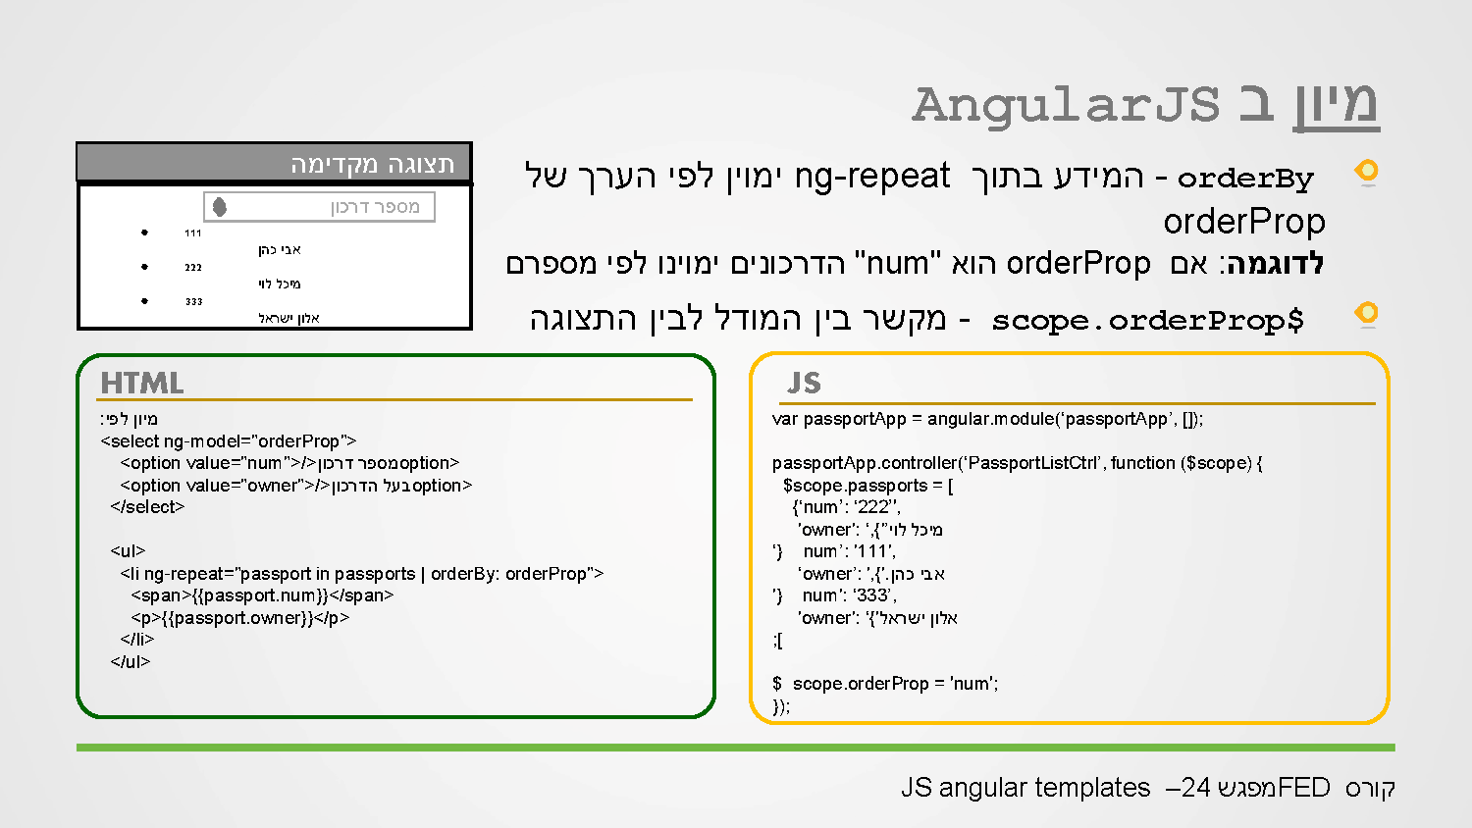
Notes:
orderBy : expression : true/asc false/desc

Slide 6
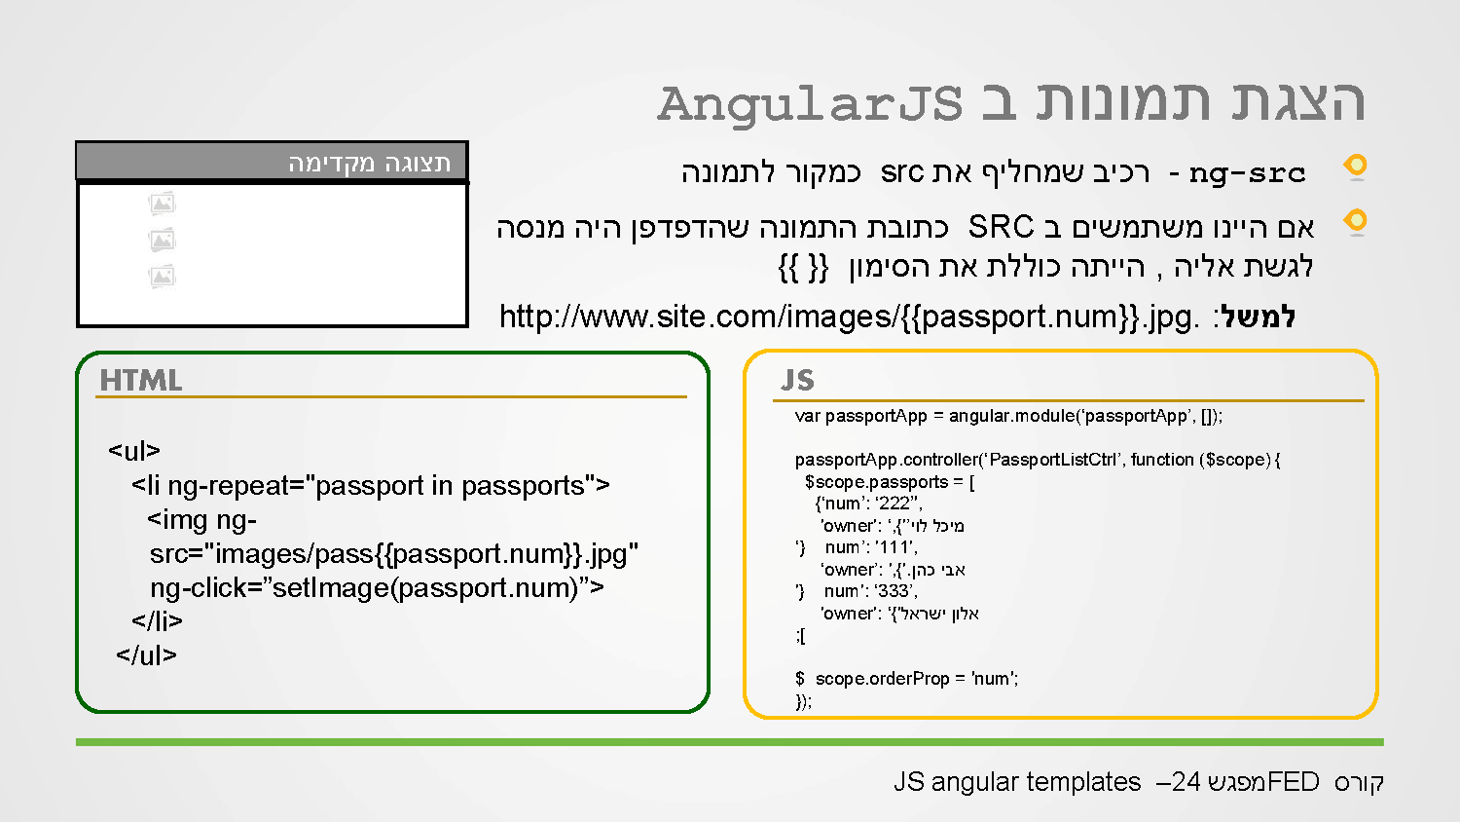

Slide 7
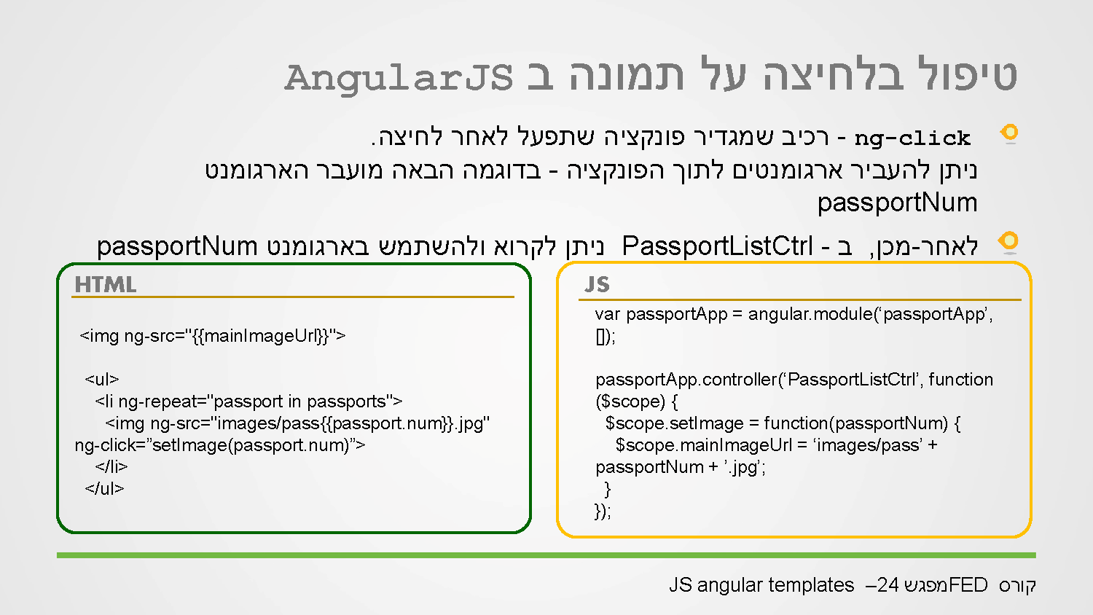

Slide 8
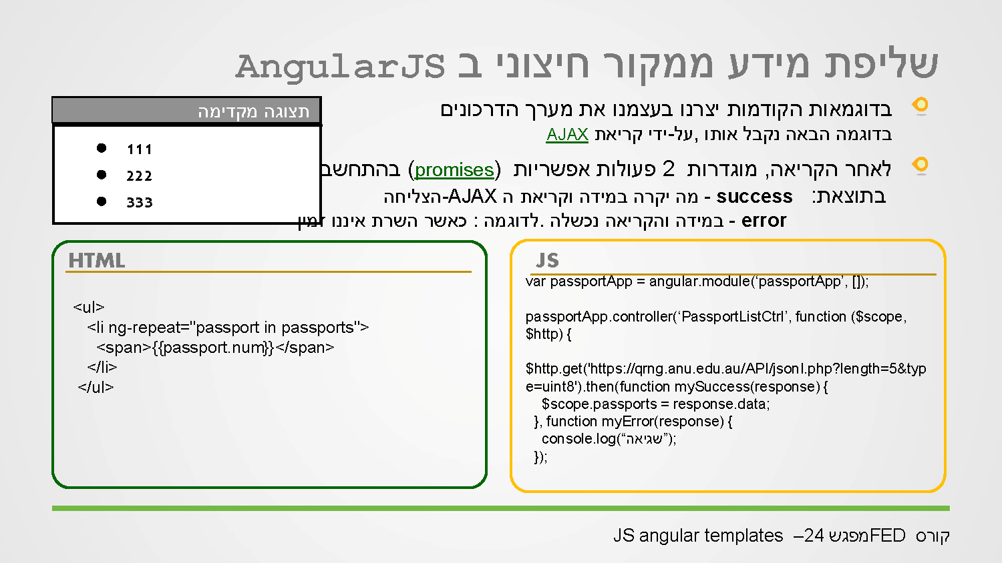

Slide 9
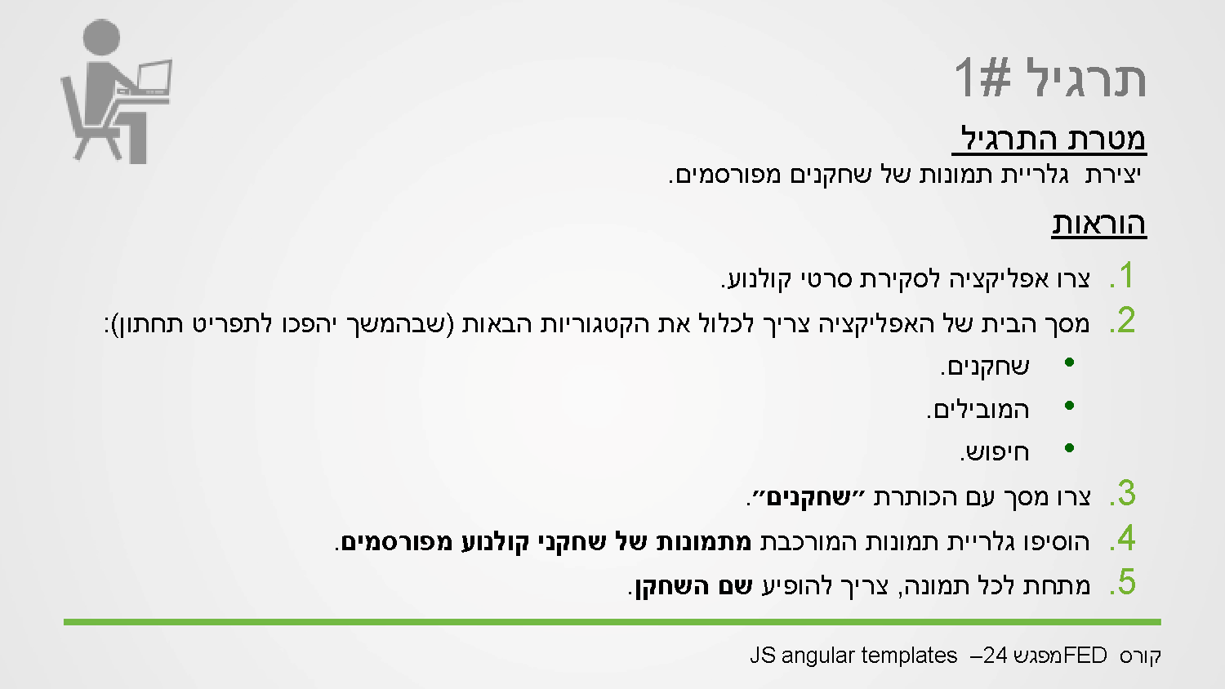

Slide 10
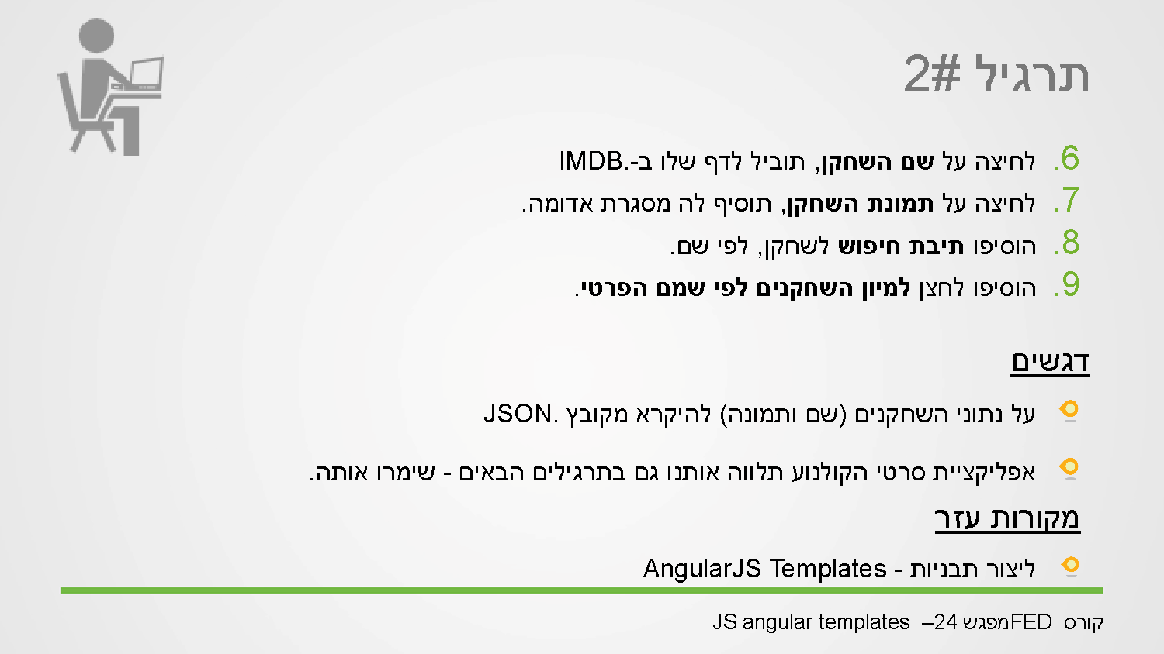

Slide 11
