Slide 1


Slide 2
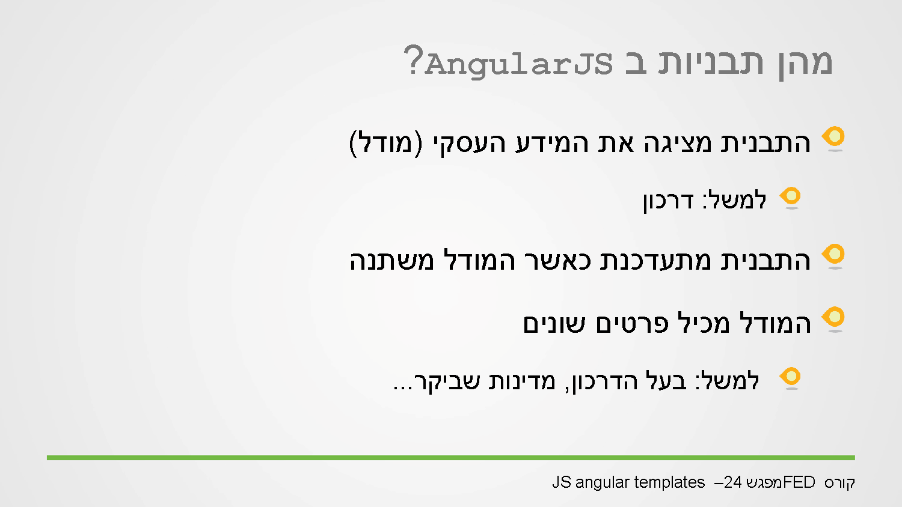
Notes:
Templates - generate the html in runtime, in the client side.
In my model I have an array of objects representing passports, I would like that every change in the passport list the pattern will change.

Slide 3
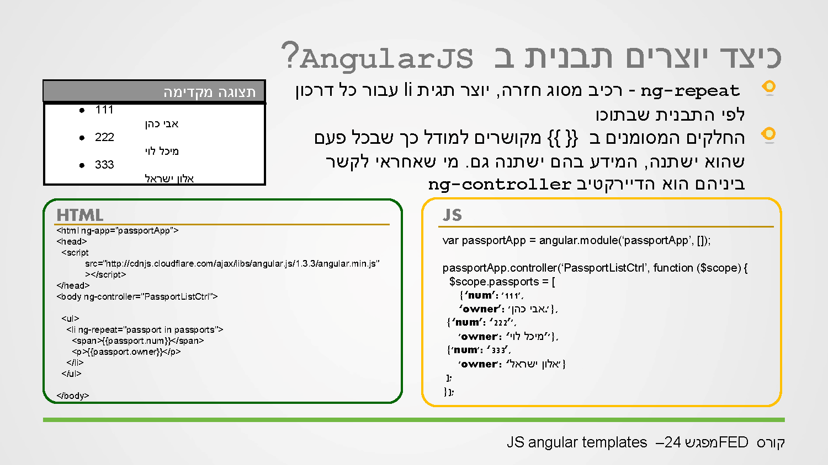
Notes:
Ng-repeat – directive related to html template.
One of the most important directive is ng-repeat, we put it on html element, in the value I pass an array (that exists on the scope) when angular run it replicates the element as the number of objects in the array.
In the example the array is $scope.passports.
<element ng-repeat=‘item in array’ >(the array must be on the $scope)
</element>

Slide 4
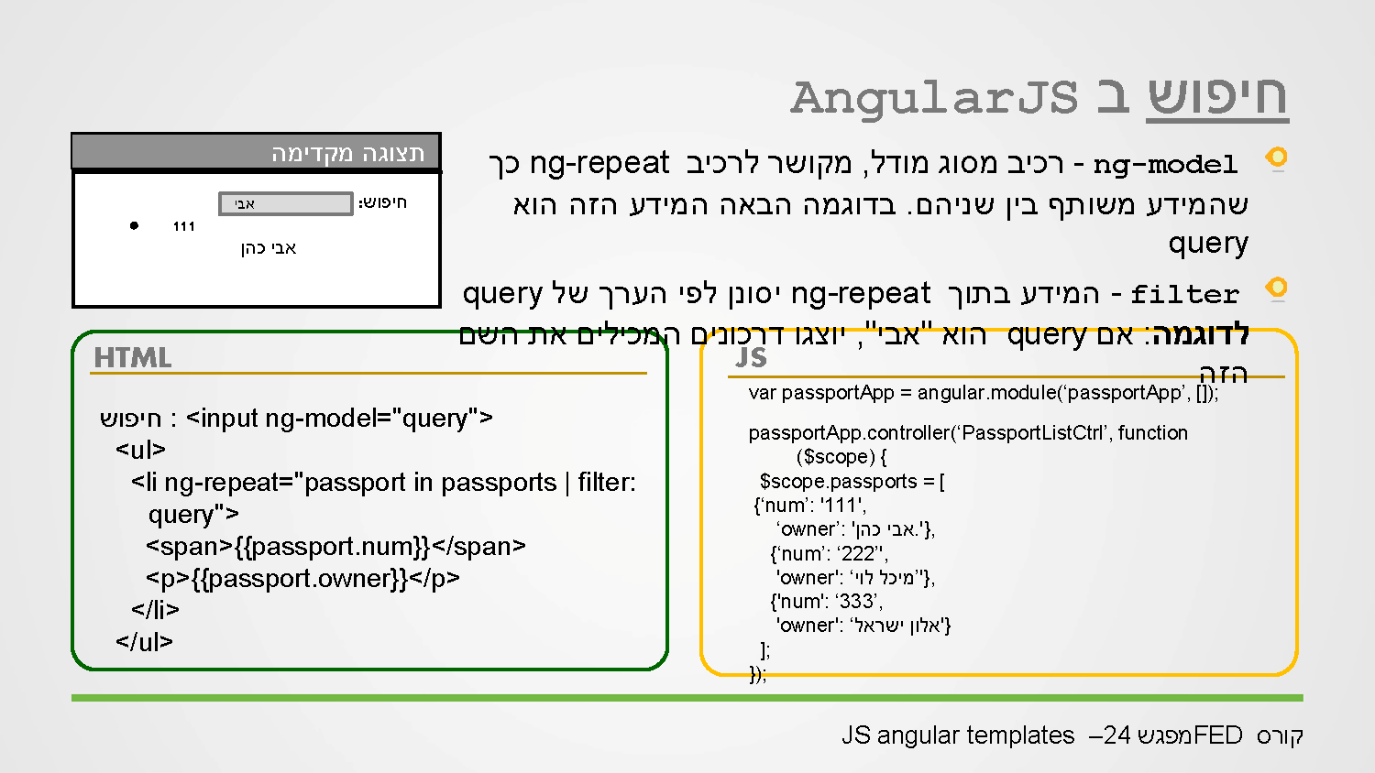
Notes:
Search – better described as filtering,
<input type=“text” ng-model=“searchText”>
<element ng-repeat=“item in array | filter: searchText”>
The filter is done on all properties of the object’s in the array.
In order to filter on specific property, in the ng-model we have to write “searchText.Property”.
Declaring a variable in the ng-model added it to the $scope so it can be used in the controller.

Slide 5
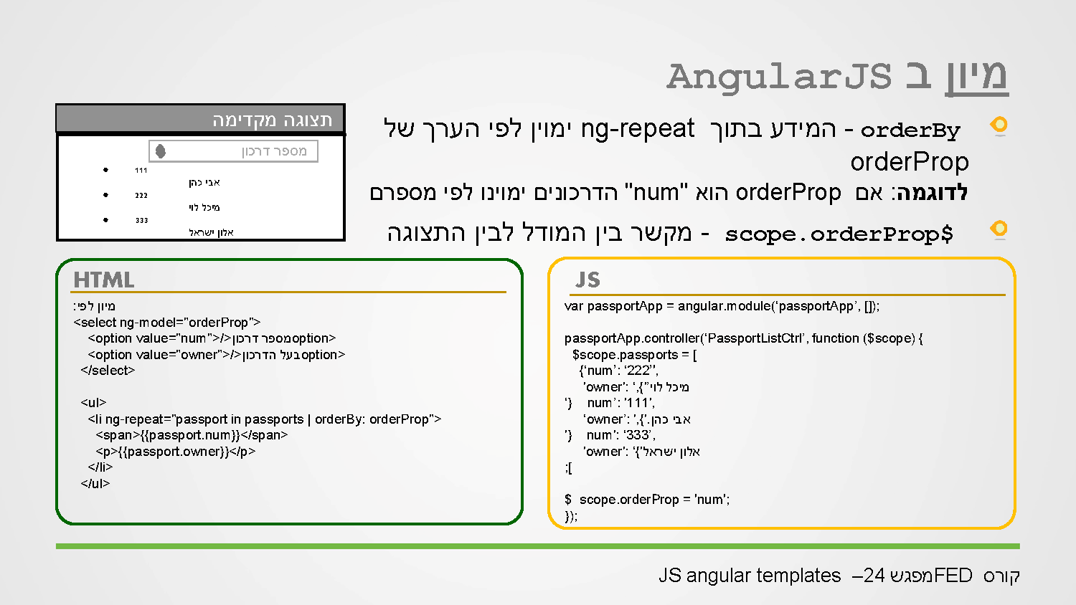
Notes:
orderBy : expression : true/asc false/desc

Slide 6
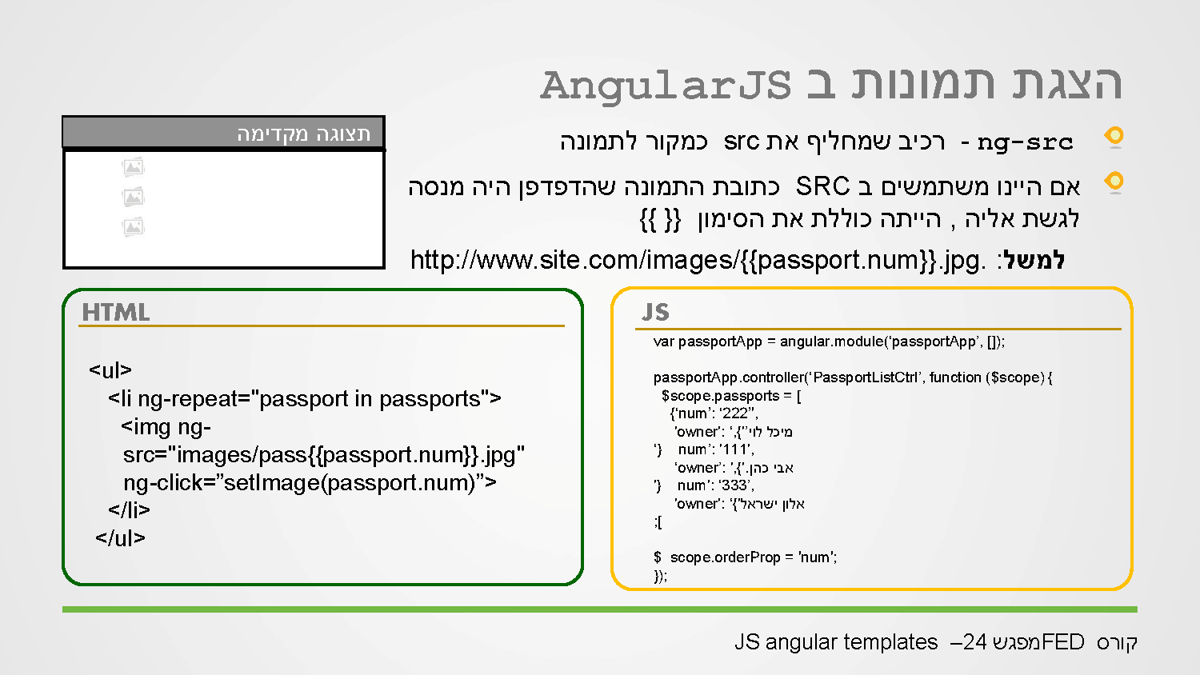
Notes:
Ng-show/ng-hide = expression when expression has a Boolean result , can put true/false/condition for ng-show will display element if exp is true for ng-hide will hide if the exp is true.
A better use instead of ng-repeat is ng-options only on select element ( https://www.w3schools.com/angular/ng_ng-options.asp ) gives more options than ng-repeat. For ex:
If we have the following:
[{
id:333,
name: “brad pit”,
img:”…”,
birthday: “…”,
…
},{…},…]
Ng-repeat:
<select ng-model=“selectedActor”>
<options ng-repeat=“actor in actors” value=“{{actor.id}}” >{{actor.name}}</options>
</select>
Ng-options:
Using ng-options in the selected actor we will get the actual object and not only the actor.id

Slide 7
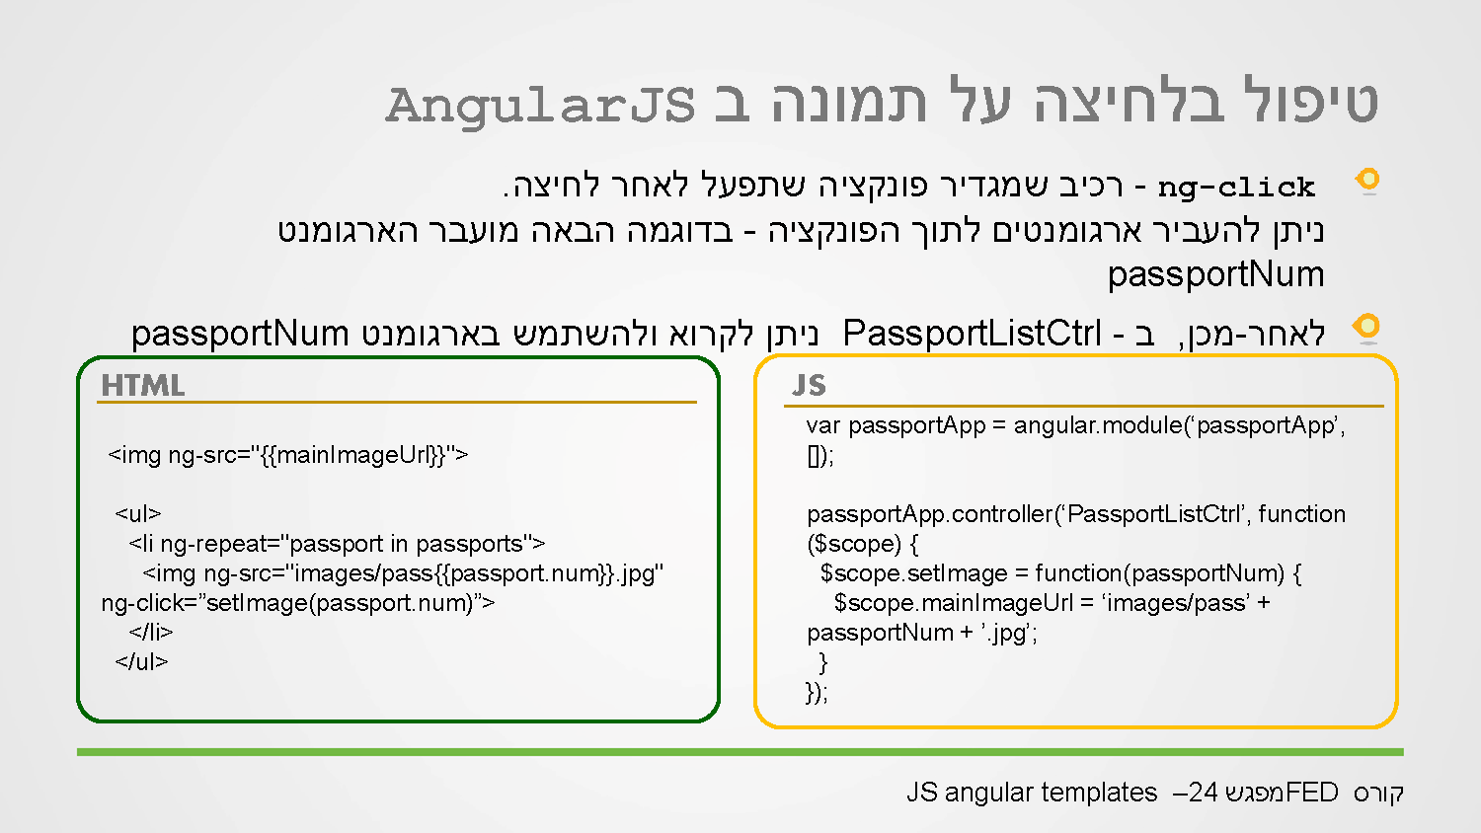
Notes:
Ng-class
Changes the way we handle element class, it can get a String, Array, Object
String – works like a regular class (setting the class of an element)
Array – array of classes to set to an element ng-class=“[‘…..’,’…..’,…]
Object – {
className: bool,
className: bool,
…
}

Slide 8
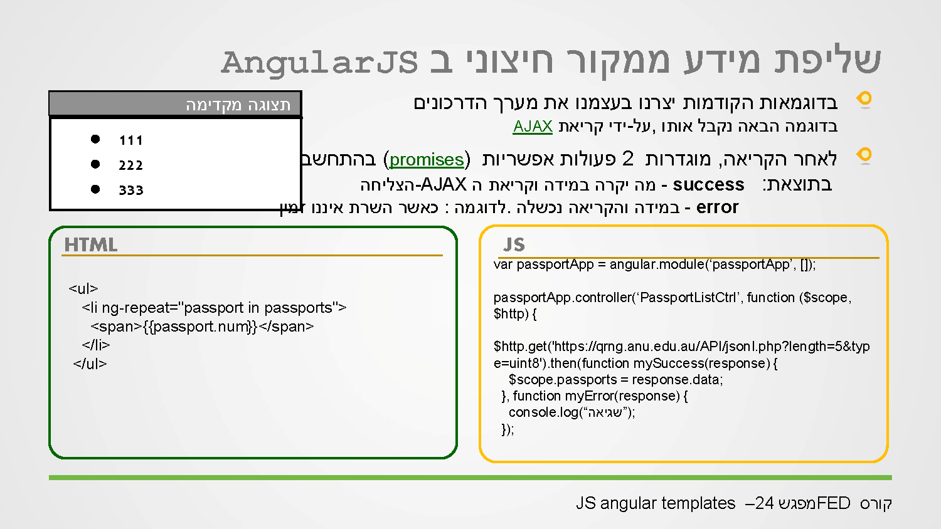
Notes:
Promise – a javascript object for making async actions.
In httpp calls we want to make an async call and call a function when the call is returned.
Angular http works with Promise, the return value of calling a promise object is a promise object with the property .then(…) which is called when the async funcitons returns. The .then function lokks like this X.then(success function,error function); -> X.then(function(…){…},function(….){…});
Angular has a service called $http type of Promise with function get(url) :
$http.get(‘http://…..’).then(function(response){…},function(…){…});
The response object parameter for the success function has the properties code for the http code and data for the content of the html.
Reponse.code , response.data
!!! To use the $http we have to pass it in the controller declaration.
The difference between a javascript object and a json object is that in json we have to add single or double quots to the object keys (properties)

Slide 9


Slide 10
Connecting to External API

Slide 11
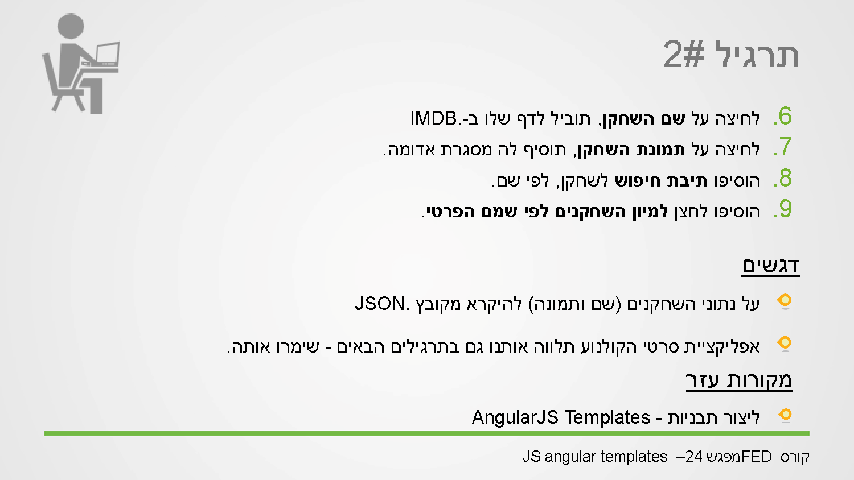

Slide 12
