Slide 1


Slide 2
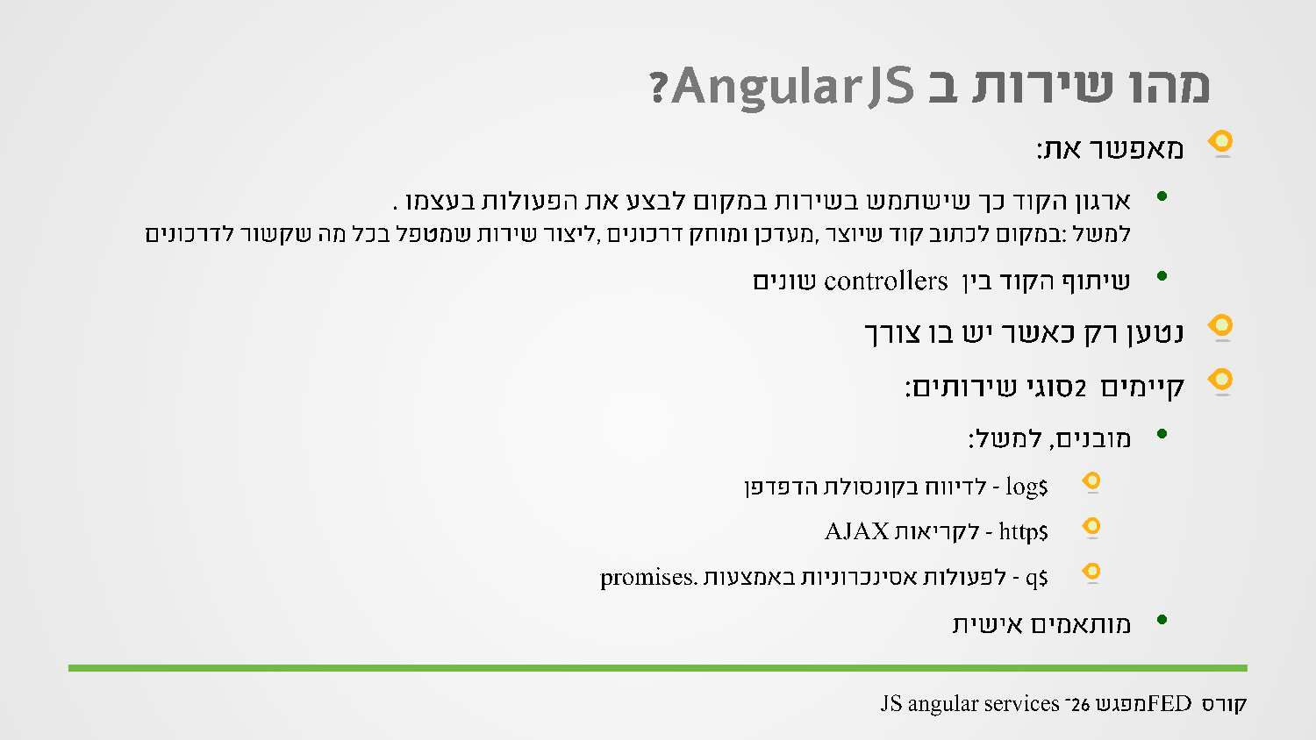
Notes:
An example of a service is conversion between measurements.
The services are created one, and can be sent to several controllers, there already made services that start with $ so it is not recommended to start service with $.
$scope is a service that makes the data binding with our controller.
$http is a service for performing async operations.
To use a service in the controller it must be passed in the function parameters of app.controller(…);
$location gives me access to the url (used in routes).
$timeout timer function that runs a callback after x millisecs. Ex : surfing to a web site that after a few seconds I am prompt to signup.
$interval calls callback every interval millisec.
$log like console.log give logging options to the browser for lo, info warning,error,debug
$q helps to make Promise objects (async operations)
var async = $q.defer(){
……..
async.resolve(); //for the first success callback in “then”
async.reject(); // for the second error callback in “then”
}
Return async.promise;

Slide 3
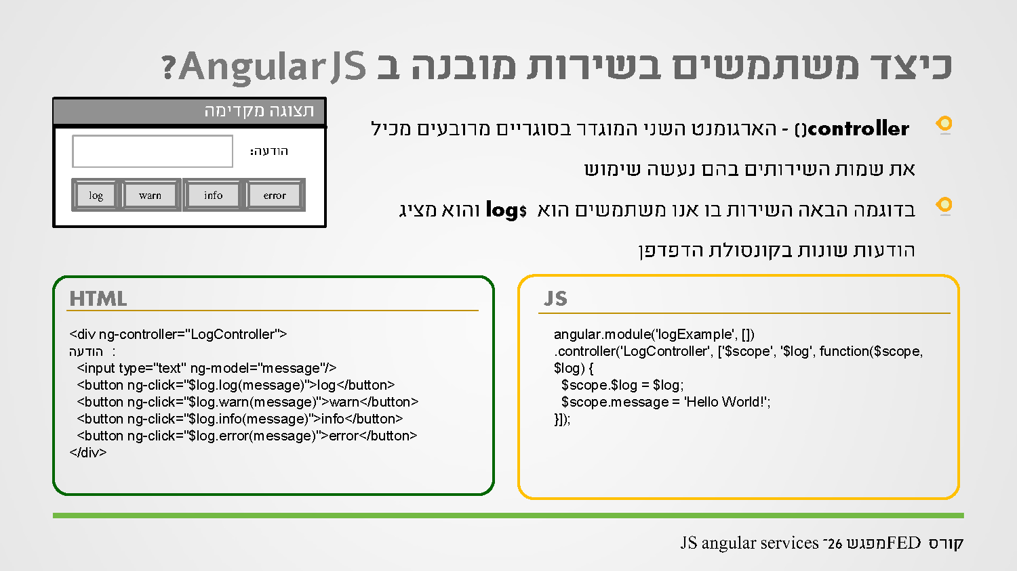

Slide 4
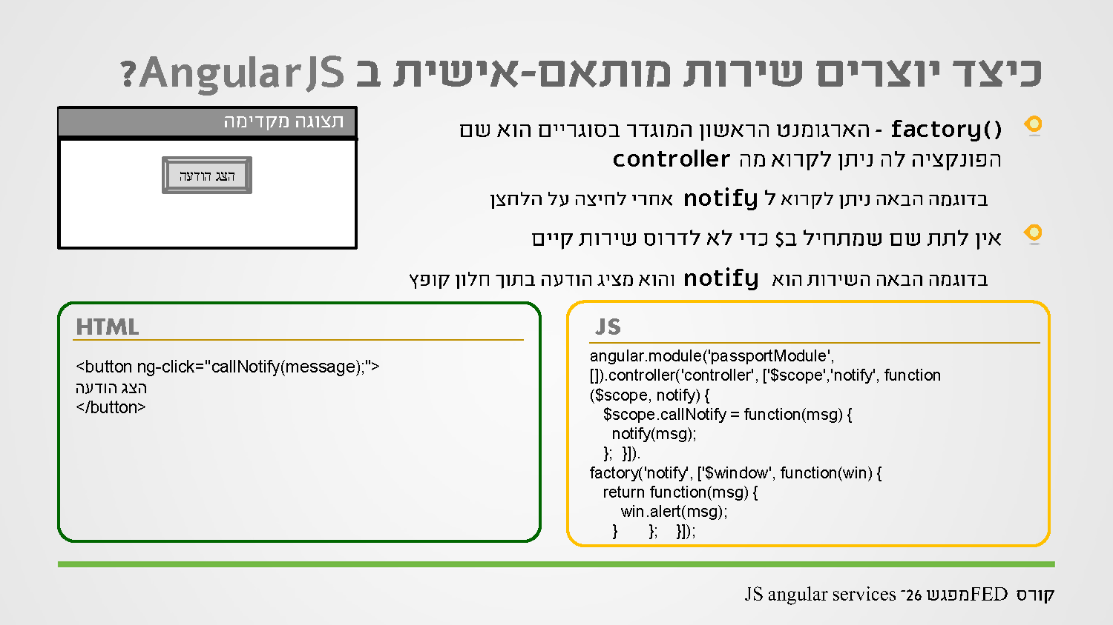
Notes:
There are 3 ways to create a service factory service and provider. (app.factory ,app.service ,app.provider).
App.factory(“<name>”,function($log,$http…..){
function one(){};
function tow(){};
function three(){};
return {
f1 : one,
f2 : two
};
};
We can call to <name>.f1() that will call one function inside the service. <name>.three() cannot be called outside the service.
The use for service is to take the data model out of the controller and put it in the service

Slide 5


Slide 6
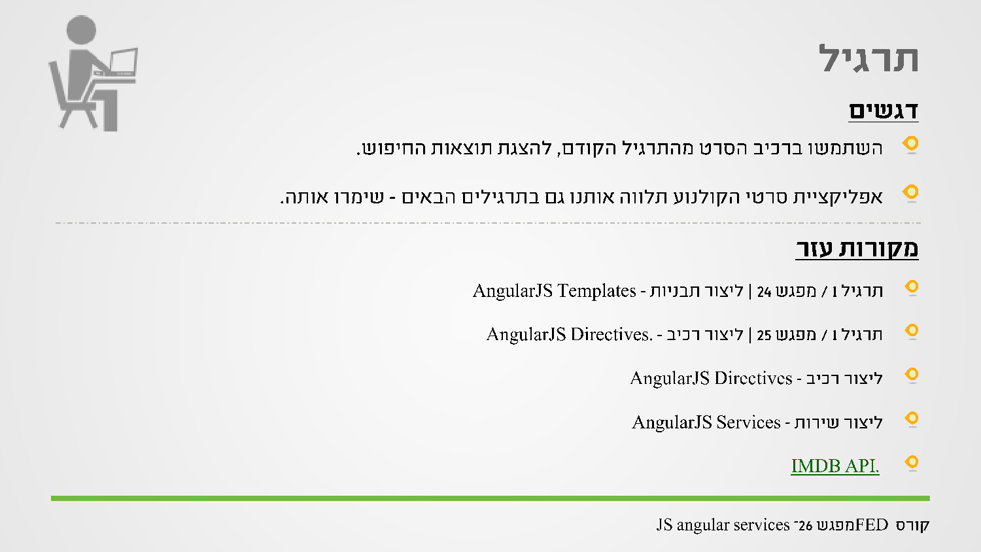

Slide 7
