Slide 1
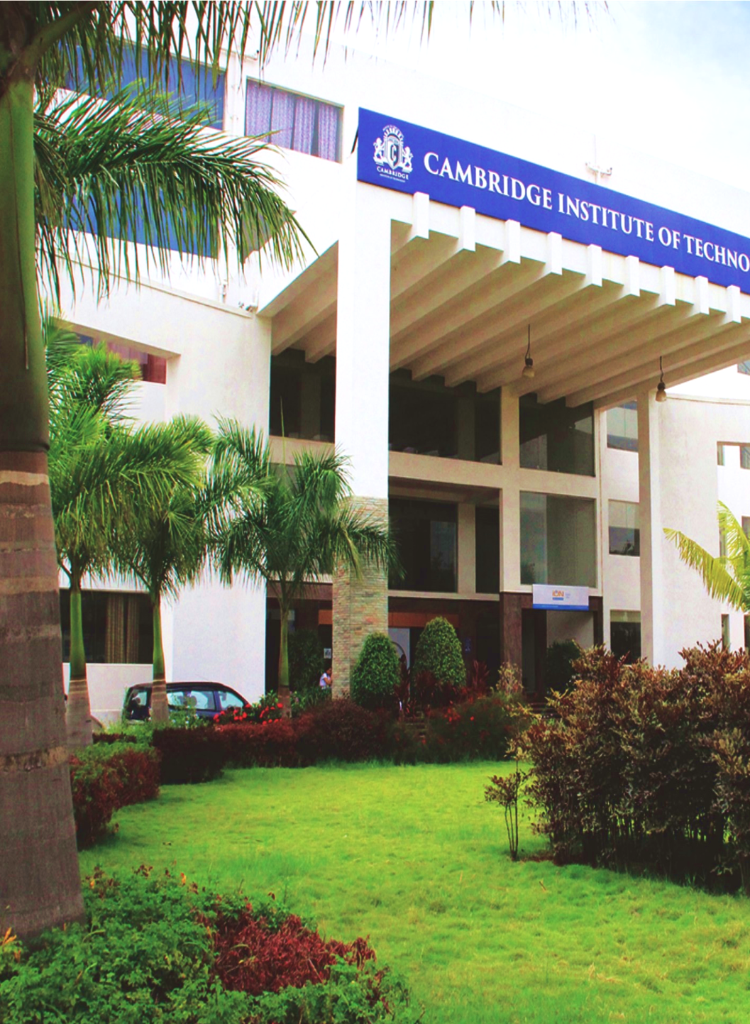

Department of Master of Computer Applications
Project Work
25MCA604
Project Title: Application based Business Decision Intelligence and also integrated with predictive Analytical system
SDG: SDG 9 – Industry, Innovation and Infrastructure
Name of the Student: V.Tharun kumar
USN: 1CD25MC077
www.cambridge.edu.in

Slide 2

Problem Statement
Modern businesses generate large volumes of data across sales, inventory, finance and customer channels, but most of it is used only to report what has already happened.
Decisions on stock, pricing, staffing and budgets are still driven by intuition and static reports, so shifts in demand are rarely anticipated in advance.
Risks such as sudden demand drops, revenue leakage, billing fraud and stock-outs are usually identified only after the loss has already occurred.
Conventional BI dashboards are descriptive – they show what happened, but not what will happen next or what action should be taken.
Small and medium enterprises cannot afford dedicated data science teams to build and maintain such predictive models.
Need: An AI-based system that analyses business data to predict sales and demand, detect risks and anomalies, and provide intelligent recommendations for better business decision-making and resource optimization.
Department of Master of Computer Applications
www.cambridge.edu.in

Slide 3
Motivation
Forecasting errors hit profitability directly – excess stock locks up working capital, while stock-outs cause lost sales and customer churn.
Most small and mid-sized firms still plan using spreadsheets and personal experience; hiring analytics specialists is expensive, so advanced forecasting stays out of reach.
Fraudulent transactions, duplicate billing and unusual cost spikes go unnoticed when thousands of records are verified manually.
Managers need more than numbers – they need clear guidance on what to stock, when to reorder and where to reallocate budget.
Mature open-source ML libraries and affordable cloud computing now make such a system practical even for small organisations.
Accurate forecasting reduces waste and optimizes resources, supporting SDG 9 (Industry, Innovation and Infrastructure) and SDG 12 (Responsible Consumption and Production).
Department of Master of Computer Applications
www.cambridge.edu.in

Slide 4
Existing System
Current Practice
Spreadsheet-based forecasting using simple averages, growth percentages and manual judgement.
Traditional BI dashboards (Excel, Power BI, Tableau) that summarise historical performance.
ERP and inventory modules with static reorder levels and fixed threshold-based alerts.
Standalone statistical models (ARIMA, regression) built by analysts outside the daily business workflow.
Limitations
Descriptive and reactive – explains what happened, not what will happen or what to do about it.
Ignores seasonality, festivals, promotions and other external factors that drive real demand.
No automated anomaly or risk detection; problems surface only after financial loss.
Data stays siloed across billing, inventory and accounting systems, so there is no single unified view.
Requires technical expertise and heavy manual effort, and does not scale as data volume grows.
Department of Master of Computer Applications
www.cambridge.edu.in

Slide 5
Proposed System
An integrated, web-based Decision Intelligence platform built around five modules:
Data Integration Layer – imports sales, inventory, finance and CRM data from CSV, Excel or databases, then cleans it, handles missing values and engineers features such as lags, rolling averages, seasonality and holiday flags.
Predictive Analytics Engine – time-series and machine learning models (ARIMA/SARIMA, Prophet, XGBoost, LSTM) forecast sales and demand by product, category and region, with the best-performing model selected automatically.
Risk and Anomaly Detection – Isolation Forest and autoencoder based detection flags unusual transactions, cost spikes, margin erosion and abnormal demand variation in near real time.
Recommendation Engine – converts forecasts and risk signals into concrete actions: reorder quantity, safety stock levels, pricing and discount suggestions, and budget reallocation.
Insight Dashboard – KPI monitoring, drill-down charts, alerts, what-if simulation and plain-language explanations backed by feature-importance scores.
Department of Master of Computer Applications
www.cambridge.edu.in

Slide 6
Objectives
To design a unified data ingestion and preprocessing pipeline that consolidates sales, inventory, finance and customer data from multiple sources into a single analysis-ready dataset.
To develop machine learning and time-series models that forecast future sales and product demand at product, category and regional level.
To implement an anomaly detection module that identifies operational and financial risks such as fraudulent transactions, cost spikes and abnormal demand variation.
To build a recommendation engine that translates forecasts and risk signals into concrete decisions on inventory, pricing and resource allocation.
Department of Master of Computer Applications
www.cambridge.edu.in

Slide 7
Objectives (contd)
To incorporate explainable AI techniques so that every prediction and recommendation can be justified to business users.
To design an interactive dashboard providing KPI monitoring, drill-down analysis, automated alerts and what-if simulation for decision support.
To evaluate model performance using standard metrics – MAE, RMSE and MAPE for forecasting, and precision, recall and F1-score for anomaly detection.
To ensure the system is modular, scalable and secure, with role-based access control and support for periodic model retraining.
Department of Master of Computer Applications
www.cambridge.edu.in

Slide 8
System Architecture
DATA SOURCES
Sales & Billing | Inventory | Finance / ERP | CRM | CSV, Excel & SQL files | External factors (festivals, promotions, weather)
DATA INGESTION & PREPROCESSING LAYER
Data cleaning | Missing-value handling | Outlier treatment | Feature engineering: lag variables, rolling means, seasonality & holiday flags
AI / MACHINE LEARNING ENGINE
Forecasting Module
ARIMA / SARIMA, Prophet,
XGBoost, LSTM
Risk & Anomaly Detection
Isolation Forest, Autoencoder,
Z-score thresholds
Recommendation Engine
Rule-based logic +
optimization on predictions
INSIGHT & EXPLAINABILITY LAYER
KPI computation | SHAP / LIME feature importance | Automated alert generation | Plain-language insight summaries
DECISION DASHBOARD (Web Application)
Forecast charts | Drill-down analysis | Risk alerts | What-if simulation | Exportable reports for management
Department of Master of Computer Applications
www.cambridge.edu.in

Slide 9
Tools and Technologies
Programming
Python 3.11,
Jupyter Notebook, VS Code
Data Processing
Pandas, NumPy,
SQLAlchemy
Machine Learning
Scikit-learn, XGBoost,
Statsmodels, Prophet
Deep Learning
TensorFlow / Keras
(LSTM networks)
Explainable AI
SHAP, LIME,
feature-importance plots
Backend & API
Flask / FastAPI,
REST services
Frontend & Charts
React.js, Plotly,
Chart.js
Database & DevOps
MySQL, MongoDB,
Docker, Git / GitHub
Methodology
Iterative Agile development following the CRISP-DM lifecycle – business understanding, data understanding, data preparation, modelling, evaluation and deployment.
Department of Master of Computer Applications
www.cambridge.edu.in

Slide 10
Expected Outcomes
A working web-based decision intelligence platform that unifies business data and produces predictions on demand.
Sales and demand forecasts at product, category and regional level, targeting a forecast error (MAPE) within 10–15% on the test data.
Automated risk and anomaly alerts that cut detection time from days to near real time.
Actionable recommendations for reordering, pricing and budget allocation that help reduce both stock-outs and excess inventory.
Transparent, explainable outputs that build user trust and support internal audit requirements.
Reduced dependence on specialised analytics expertise, with measurably faster decision cycles for management.
Department of Master of Computer Applications
www.cambridge.edu.in

Slide 11
Implementation Summary
913,000
500
4
10
118
real daily sales rows, 2013–2017
store–item series forecast
forecasting models benchmarked
screens built from the design
automated tests passing
What was built
Data pipeline
Forecasting
Risk & anomalies
Recommendations
What-if simulator
Explainability
Reports (PDF/Excel)
Login & roles
Honest scope: only the sales are real data (Kaggle). Prices, costs, inventory, logistics costs and all anomaly labels are synthetic, so results show how well the method works, not how a real retailer would perform.
Department of Master of Computer Applications
www.cambridge.edu.in
Notes:
All figures come from docs/results/EVALUATION.md and the project README. Only the daily sales are real; everything else in the retail scenario is synthetic.

Slide 12
Forecasting: Model Comparison
MAPE % on the 90-day holdout (lower is better)
13.0%
MAPE on all 500 series (target 10–15%)
3.6%
MAPE on daily chain totals
47%
lower error than the best naive baseline (24.5%)
Prophet and SARIMA fit one model per series, so all models are compared on a 20-series sample. XGBoost and LSTM also ran on all 500 series (13.0% and 13.2%).
Department of Master of Computer Applications
www.cambridge.edu.in
Notes:
20-series benchmark sample (2 items per store), last 90 days held out, recursive multi-step forecast. XGBoost on all 500 series: MAPE 13.03%, WAPE 11.37%, chain-total MAPE 3.55%, R2 0.92. Best naive baseline on all series: 24.54%.

Slide 13
Forecast Accuracy on Holdout
Chain-wide units per week: actual vs predicted
Error by forecast horizon
Horizon | WAPE | Bias
Days 1–30 | 10.8% | −1.8%
Days 31–60 | 10.8% | −3.9%
Days 61–90 | 13.0% | −5.0%
Forecasts run slightly low and drift lower with the horizon.
Error is similar across the 10 stores (WAPE 10.4–13.2%) and 5 categories (10.7–12.1%).
WAPE = sum of absolute errors ÷ sum of actual units. Bias = predicted ÷ actual − 1.
Department of Master of Computer Applications
www.cambridge.edu.in
Notes:
Weekly chain-wide totals of the 90-day holdout (2017-10-03 to 2017-12-31), XGBoost recursive forecast from the training cut-off. WAPE/bias by horizon from docs/results/tables/error_by_horizon.csv.

Slide 14
Explainable Forecasts (SHAP)
What drives the forecast (share of mean |SHAP| %)
By driver group
Recent run-rate
55%
Weekly pattern
32%
Seasonality & events
11%
Store / product baseline
2%
Each forecast also gets a plain-language summary, a step-by-step contribution bridge and drift / fairness checks (PSI ≤ 0.12, store error parity 91%).
Price and promotion are not model inputs, so no price-elasticity curve is shown; the model relies on recent sales, weekday and season.
Department of Master of Computer Applications
www.cambridge.edu.in
Notes:
Exact TreeSHAP via XGBoost pred_contribs: base value plus feature contributions equals the forecast (balance verified to 1e-6 in tests). Global shares are mean |SHAP| over a sample of store-days.

Slide 15
Anomaly Detection Results
Precision, recall and F1 by detector
0.68
ensemble F1 (precision 0.67, recall 0.70)
79%
of injected events caught at least once
14 s
full scan of 913,000 rows → 737 alerts
Voting beats every single detector. Labels are synthetic and real data contains unlabelled oddities, so precision is understated; this is not a fraud-detection accuracy claim.
Department of Master of Computer Applications
www.cambridge.edu.in
Notes:
Row-level metrics against injected anomalies (944 billed rows: 200 duplicate billing, 150 margin erosion, 594 demand-drop days; 40 logistics spikes). The detectors never see labels. Ensemble = at least two of three detectors agree.

Slide 16
Recommendations & What-If
49 recommended actions
Example action
Transfer 659 units of Consumer Tech Item 36 from Bengaluru Jayanagar to Hubballi Hub
Donor holds 75 days of cover; surplus 3,715 units; confidence 93%
Calculation trail on every action, editable before approval
Monte Carlo what-if re-simulates 30 days of demand and stock for all 500 series in about 0.6 s
Example: an 8% price cut plus 12% voucher on electronics lifts units ≈49% but lowers profit — margins are thin
Caveat: price and budget effects rest on assumptions; quality has no real-outcome validation yet
Department of Master of Computer Applications
www.cambridge.edu.in
Notes:
49 actions generated from the 90-day forecast and the synthetic current stock position. The simulator uses stated assumptions (category price elasticities, write-off rates, marketing share).

Slide 17
Testing & Deployment
Measured performance (913,000 rows, 500 series)
79 + 39
91%
Operation | Time
Clean data + engineer features | 2.5 s
90-day forecast, all 500 series | 0.2–0.4 s
Typical page request (API) | 15–60 ms
What-if simulation (250 runs) | 0.6 s
Anomaly scan of full history | 14 s
Train + benchmark 4 models | 127 s
backend + frontend tests
backend line coverage
23/23
3 roles
end-to-end checks in Docker
JWT login + audit trail
One command to run: docker compose up --build
Admin, Manager and Analyst permissions enforced by the API; every action is written to a hash-chained audit log.
Docker tested on Docker Desktop for Windows; MySQL was not tested (SQLite is the default database).
Department of Master of Computer Applications
www.cambridge.edu.in
Notes:
Timings measured on the development machine (CPU only). Smoke test: scripts/smoke_test.py, 23 checks through the nginx container on port 8080. Coverage from docs/results/EVALUATION.md.

Slide 18
Objectives vs Outcomes
Objective | Outcome | Status
Unified ingestion & preprocessing | CSV / Excel / Parquet pipeline, quality score 100/100 | Met (files only)
Forecast at product, category, region | 4 models; MAPE 13.0% vs 10–15% target | Met
Anomaly detection | Ensemble F1 0.68 on injected anomalies | Met
Recommendation engine | 49 actions with calculation trail | Built, not validated
Explainable AI | Exact TreeSHAP; LIME not built | Met (SHAP)
Interactive dashboard & what-if | 10 screens, simulator, PDF/Excel reports | Met
Evaluation with MAE/RMSE/MAPE, P/R/F1 | Reproducible tables and figures | Met
Modular, secure, periodic retraining | Roles + audit done; retraining is manual | Partly met
Department of Master of Computer Applications
www.cambridge.edu.in
Notes:
Full traceability with deviations and assumptions: docs/report/OBJECTIVES_TRACEABILITY.md.

Slide 19
Conclusion & Future Work
Conclusion
Limitations
Future work
Integrating forecasting, risk detection, recommendations and explanations in one tool works as a prototype.
Forecast error 13.0% MAPE, 47% better than naive; the anomaly ensemble beats every single detector.
Only sales are real; other data are synthetic.
Batch scans, not real-time; no scheduler or database / ERP connectors.
Recommendation quality and usability not yet validated with users.
Pilot with a real retailer's data.
Scheduled retraining and report delivery.
Reduce forecast bias; make risk alerts feed recommendations.
Run the user study (SUS).
Department of Master of Computer Applications
www.cambridge.edu.in
Notes:
Conclusion drawn from the measured results; limitations are stated in docs/report/CHAPTER_5_Conclusion_and_Recommendations.md.

Slide 20

Department of Master of Computer Applications
www.cambridge.edu.in

