Slide 1


Data-Driven Storytelling Presentation:
Chase Business Performance Analysis

Slide 2
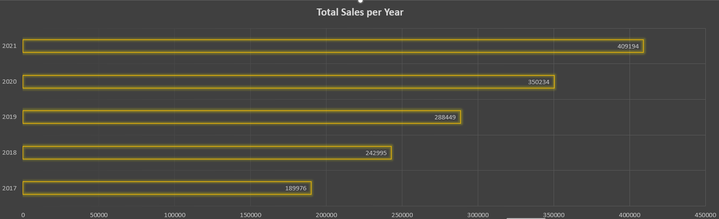
There has been yearly steady increase in our overall sales

Slide 3
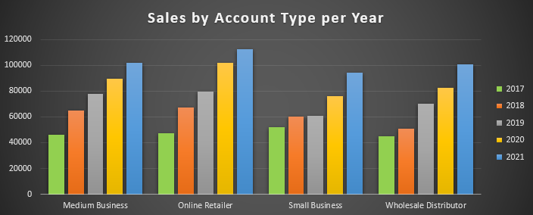
Graph depicts our different Account Type
Small Business in the year 2018 is almost stagnant.
Rest all the Accounts have performed with steady increase each passing year.

Slide 4
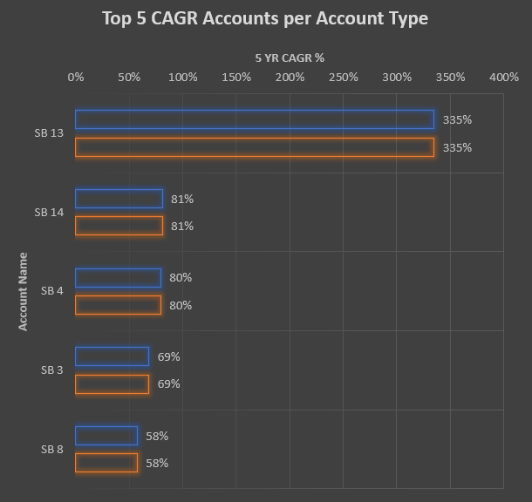

Slide 5
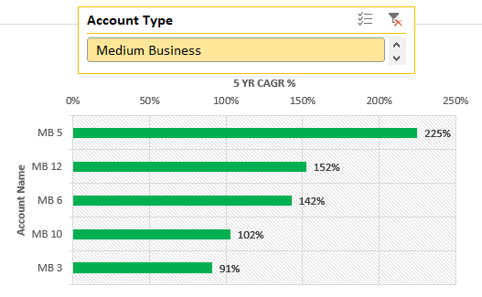
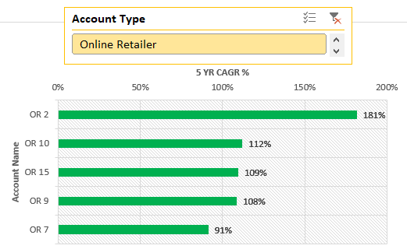
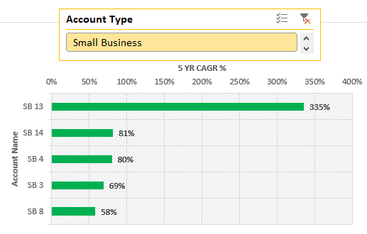
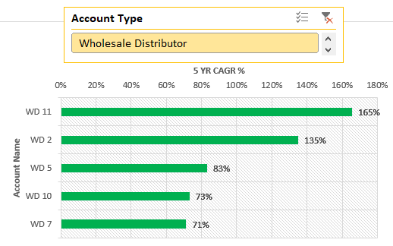
Top 5 CAGR for each Account Type

Slide 6
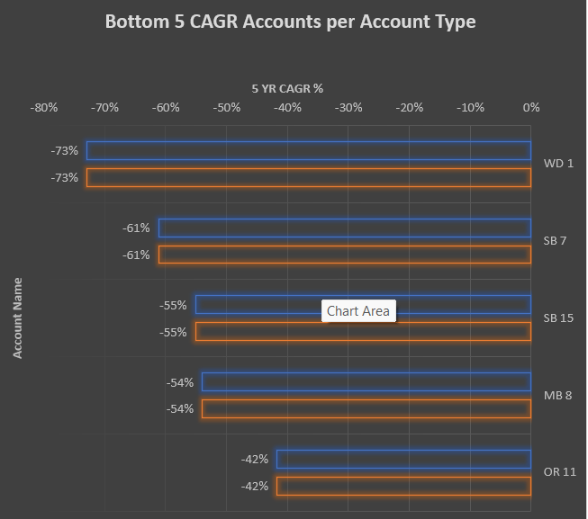

Slide 7
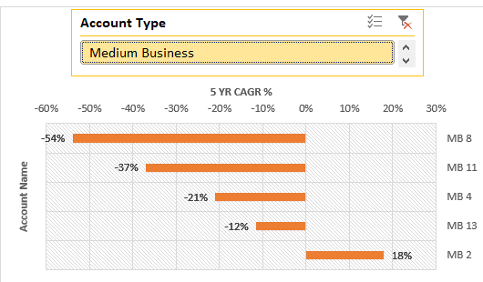
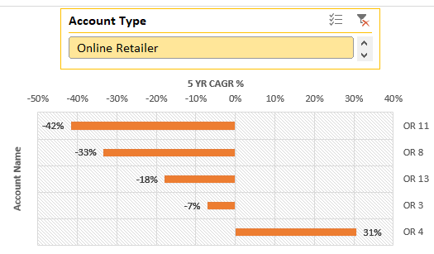
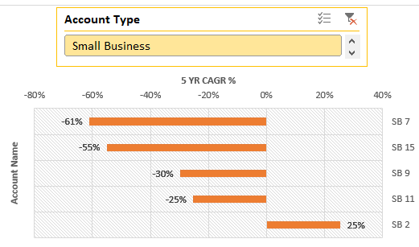
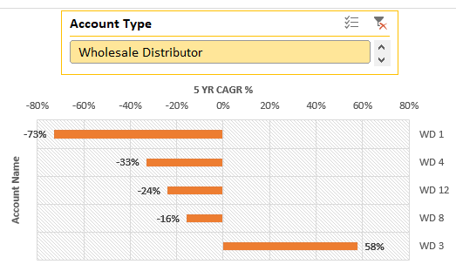
Bottom 5 CAGR for each Account Type

Slide 8
Summary
Our business has been progressively increasing over the years
SB13, the highest 5yr CAGR holder has more than 250% compared to 2nd highest in the Small Business category. This will increase the bargaining power of the Account holder.
80% of the Top 10 CAGR accounts has social media presence.
The other 20 % are Wholesale Distributors who have nil social media presence.
Only 20 % of the Top 10 CAGR accounts have Posters.
From the analysis we can confirm that Social media presence does have a good impact on the business and things like posters are getting outdated.
Leveraging the power of technology wherever possible improves our business.

Slide 9
Thank You

