Slide 1
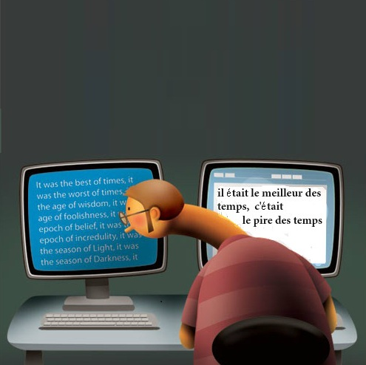
Multilingual Plagiarism Detection
Lalit Agarwal
Menna Mostafa

Slide 2
1
Problem Definition
According to Wikipedia, Plagiarism is:
Inserting a text—copied word-for-word, or closely paraphrased with very few changes—from a source that is not acknowledged anywhere in the article.
Summarizing a source in your own words, without citing the source in any way. [1]
Problem Definition - Challenges - Approach - Implementation - Results - Future Work

Slide 3
2
Problem Definition
In monolingual documents, plagiarism can be detected by means of document similarity, synonyms, …
What about Multilingual Plagiarism?
The look of Yosemite, from the toolbars to window construction, has been adjusted. Windows and the dock are now translucent.
Yosemite的外观，从工具栏到窗口设计，都进行了调整。窗口和停靠栏都是半透明的。
Problem Definition - Challenges - Approach - Implementation - Results - Future Work

Slide 4
3
Challenges
Machine translation (MT)?
There is more than one way to translate a word.
Different languages have different syntax.
Current MT tools are inefficient. [2]
The look of Yosemite, from the toolbars to window construction, has been adjusted. Windows and the dock are now translucent.
优山美地的外观，从工具栏窗口建设，进行了调整。 Windows和码头现在是半透明的。
Yosemite's appearance, from the toolbar window construction, have been adjusted. Windows and Marina is now translucent.
Problem Definition - Challenges - Approach - Implementation - Results - Future Work

Slide 5


4
4
Approach
Collection based Algorithms
Training with thousands of parallel or comparable documents about different topics.
Source docs
in L1
Suspect
doc in L2
concatenated
testing
training
Algorithm
similarity
Threshold Tuning
L1
L2
Problem Definition - Challenges - Approach - Implementation - Results - Future Work

Slide 6
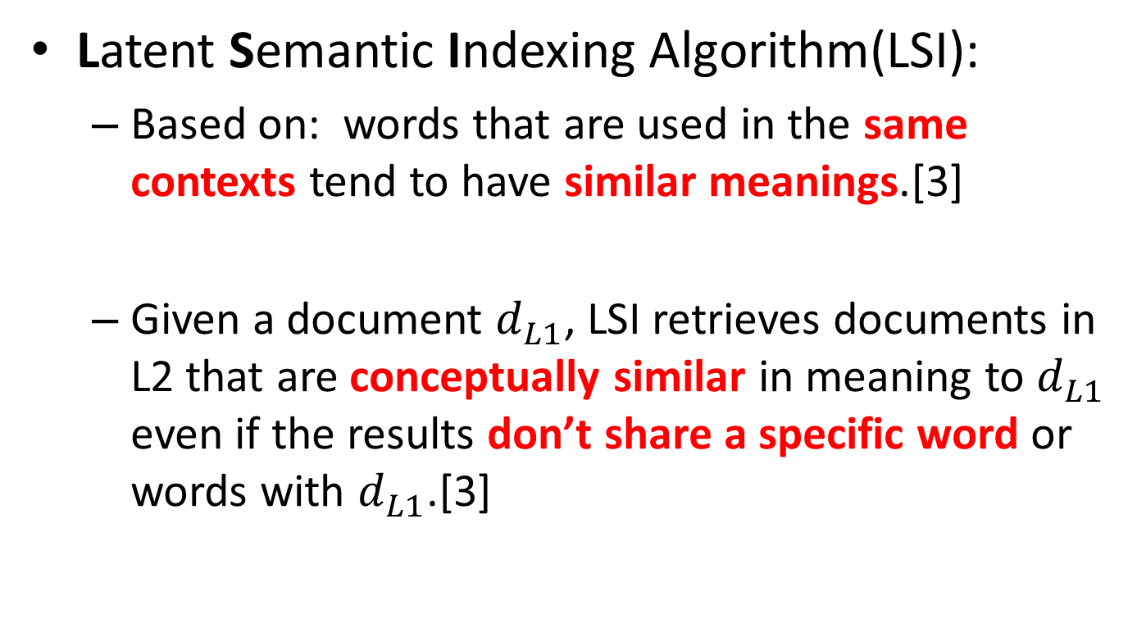
5
5
Approach
Latent Semantic Indexing Algorithm(LSI):
Based on: words that are used in the same contexts tend to have similar meanings.[3]
Given a document $d_{L1}^{}$, LSI retrieves documents in L2 that are conceptually similar in meaning to $d_{L1}^{}$ even if the results don’t share a specific word or words with $d_{L1}^{}$.[3]
Problem Definition - Challenges - Approach - Implementation - Results - Future Work

Slide 7
6
5
6
Approach
The disadvantages of using collection based approach are:
Collection (training) data coverage.
Computationally and memory intensive.
We will attempt to overcome some of these disadvantages by looping humans in.
Problem Definition - Challenges - Approach - Implementation - Results - Future Work

Slide 8
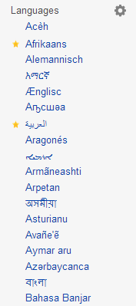
7
6
5
7
Implementation
Language Pair:
English <-> Chinese
Training Datasets:
United Nations manually translated sessions [Parallel]. (politics, economic, human rights topics)
Wikipedia dataset using multilingual links and Wikipedia official dumps [Comparable]. (politics, science, sports, biographies, art, ...)
Mix of both
Problem Definition - Challenges - Approach - Implementation - Results - Future Work

Slide 9
8
7
6
5
8
Implementation
LSI implementation:
Used gensim (Python library) implementation of LSI.
Test Documents:
28 English-Chinese pairs collected manually from various sources such are:
Wikipedia Chinese featured documents.[4]
Edinburg University plagiarism dataset (translated by MT tools and verified by Jerry!).[5]
Xinhuanet bilingual zone. [6]
Yeeyan manually translated articles.[7]
Problem Definition - Challenges - Approach - Implementation - Results - Future Work

Slide 10
9
8
7
6
5
9
Implementation
Documents Preprocessing:
English documents:
Lower case
Clear non-alpha characters
Remove stop words.[8]
Stemming.[9]
Chinese documents:
Cut words (segmentation).[10]
Remove stop words.[8]
Removed documents shorter than 30 words.
Removed words that appeared in less than 5 documents.
Removed words that appeared in more than half the documents.
Afterwards, retained only the top 150,000 words from both languages.
Problem Definition - Challenges - Approach - Implementation - Results - Future Work

Slide 11
10
9
8
7
6
5
10
Implementation
LSI infers some latent topics.
Example:
Topic 1: -0.184*"委员会" + -0.170*"会议" + 0.162*"安全" + 0.148*"council" + 0.139*"我们" + 0.136*"secur" + -0.135*"committe" + -0.124*"a" + -0.123*"大会" + 0.115*"理事会"
committee
conference
security
general assembly
council
Problem Definition - Challenges - Approach - Implementation - Results - Future Work

Slide 12
12
11
10
9
8
7
6
5
11
Implementation
Topics in the parallel test dataset:
Politics
The 1996 United States campaign finance controversy was an alleged effort by the People's Republic of China to influence domestic American politics …..
Economics
Bank of China (Hong Kong) Limited is the second-largest commercial banking group ….
Technology
Many people blame Microsoft’s predicament on Steve Ballmer, the big, bald, manic, fist-pumping sales …..
Sports
Top seed Novak Djokovic is one match win away from becoming year-end world No. 1
Problem Definition - Challenges - Approach - Implementation - Results - Future Work

Slide 13
13
12
11
10
9
8
7
6
5
12
Results
Tested the system using the manually collected dataset:
28 Chinese documents versus a collection of around 10000 English documents (including corresponding pairs of the 28 docs).
Some documents were not retrieved at all.
Top seed Novak Djokovic is one match win away from becoming year-end world No. 1…..
UN Secretary-General Ban Ki-moon said Friday that there is hope that the ebola outbreak could be contained by mid-2015
Dataset Size Wikipedia (in k),UN (in k) | Top1 | Top2 | Top3 | Top4 | Top5 | Total in Top 5 | Total not in Top5
25,5 | 12 | 6 | 4 | 2 | 1 | 25 | 3
30,5 | 15 | 7 | 1 | 2 | 0 | 25 | 3
35,5 | 14 | 6 | 3 | 1 | 0 | 24 | 4
Problem Definition - Challenges - Approach - Implementation - Results - Future Work

Slide 14
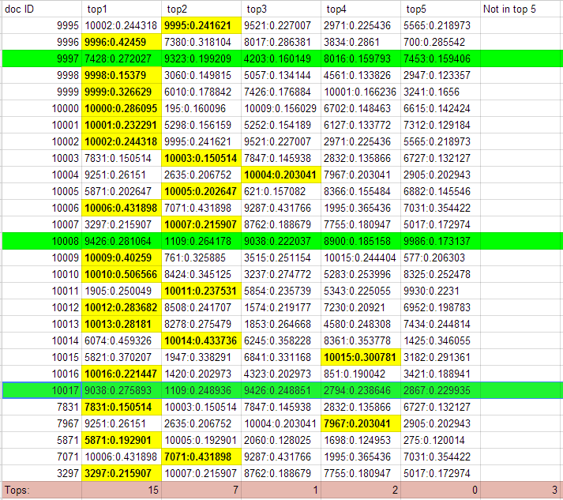
Not recognized
Problem Definition - Challenges - Approach - Implementation - Results - Future Work

Slide 15
14
13
12
11
10
9
8
7
6
5
13
Results
Some topics were not included (or not well covered)in the training documents, and in result they are unrecognized by the algorithm.
Therefore, we ran two experiments with humans:
Evaluate how users perceived plagiarism by displaying 4 articles, 2 plagiarized and 2 similar, and asking users for their opinions.
Evaluate the algorithm similarity index and missing topics. (no one offered to help ☹)
Problem Definition - Challenges - Approach - Implementation - Results - Future Work

Slide 16
14
13
12
11
10
9
8
7
6
5
15
Results
Feedback received from users on Exp1 :
Reduce documents length.
Split documents to sentences.
Results were somewhat inconsistent.
Each user took around 2-3 mins per document pair.
Users | Document:1 ISIS Same Author | Document:2 Ebola Same Author | Document:3 Online Privacy Diff Authors | Document:4 IPhone Security Diff Authors | Document:5 Exactly Translated Document
User1 | Partially Plagiarized | Plagiarized | Partially Plagiarized | Not Plagiarized | Plagiarized
User2 | Partially Plagiarized | Plagiarized | Not Plagiarized | Not Plagiarized | Not Plagiarized
User3 | Partially Plagiarized | Plagiarized | Partially Plagiarized | Not Plagiarized | Partially Plagiarized
User4 | Plagiarized | Plagiarized | Not Plagiarized | Partially Plagiarized | Not Plagiarized
Problem Definition - Challenges - Approach - Implementation - Results - Future Work

Slide 17
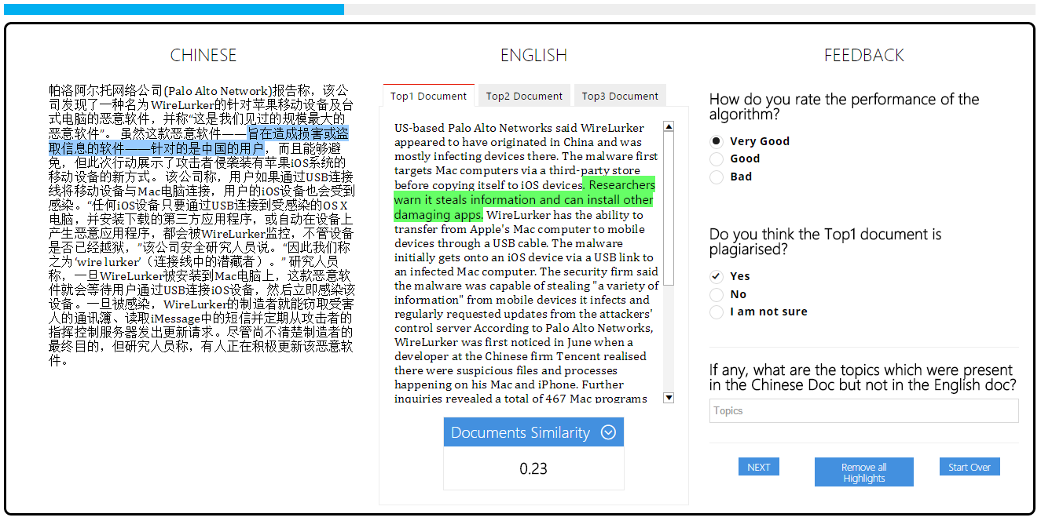
15
14
13
12
11
10
9
8
7
6
5
14
Results (UI from Exp2)
Problem Definition - Challenges - Approach - Implementation - Results - Future Work

Slide 18
16
14
13
12
11
10
9
8
7
6
5
16
Future Work
Use the collected data from users to:
Tune the threshold for deciding if a document pair is plagiarized or not.
Add missing topics to the training data.
Sample documents from Wikipedia that gives good and equal coverage over the general topics.
Problem Definition - Challenges - Approach - Implementation - Results - Future Work

Slide 19
16
14
13
12
11
10
9
8
7
6
5
17
References
[1] http://en.wikipedia.org/wiki/Wikipedia:Plagiarism
[2] https://www.plagiarismtoday.com/2011/02/24/the-problem-with-detecting-translated-plagiarism/
[3] http://en.wikipedia.org/wiki/Latent_semantic_indexing
[4]http://en.wikipedia.org/wiki/Wikipedia:WikiProject_China/Featured_and_good_content
[5]http://www.inf.ed.ac.uk/teaching/courses/tts/assessed/assessment3.html
[6] http://www.xinhuanet.com/english/bilingual/news.htm
[7] http://www.yeeyan.org/
[8] https://code.google.com/p/stop-words/
[9] http://www.nltk.org/_modules/nltk/stem/porter.html
[10] http://code.google.com/p/smallseg/

Slide 20
Question 1

Slide 21
Question 2

Slide 22
Thank You!

