Slide 1

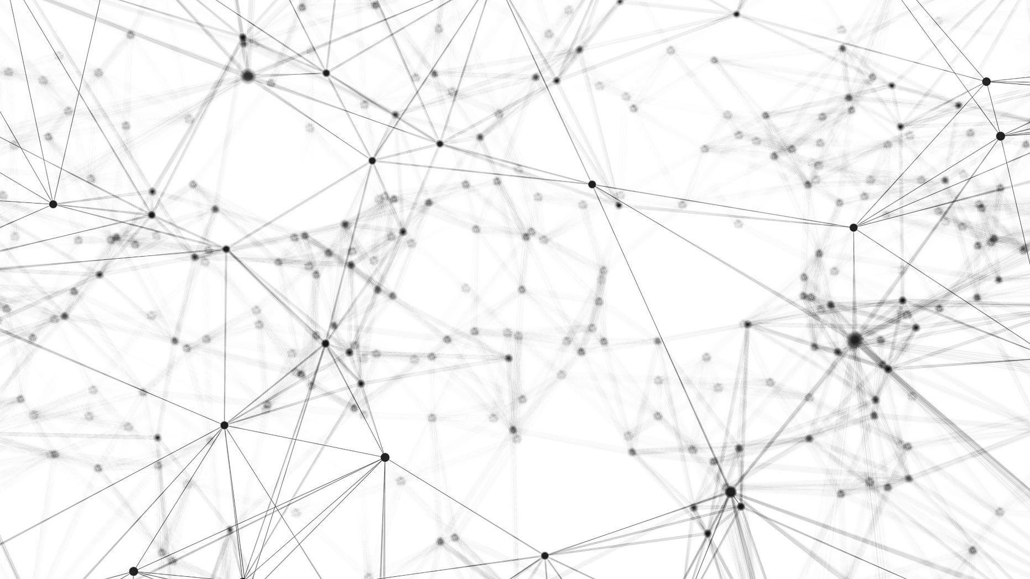
Transformer: A machine learning model of human attention.
Lalitanjali Bondili, Vanessa Moody
Dec 16, 2020

Slide 2
Content
01
02
03
04
05
Motivation
Dataset
Chatbot
Transformer from Scratch
Transfer Learning with GPT2
Summarize
Extractive : SpaCY
Abstractive : GPT2
Data exploration
LDA
Cosine Similarity
Visualizations
Notes:
The encoder converts the original input sequence into its latent representation in the form of hidden state vectors. The decoder tries to predict the output sequence using this latent representation.

Slide 3
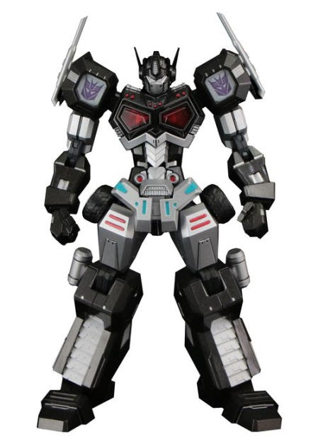


Motivation
Transformers are state of the art models capable of generating human quality responses and potentially passing the turing test
They handle tasks such as question answering, sentiment analysis, neural translation, text summarization
Ambition was to build a chatbot that should not be distinguishable from a real human.
Notes:
The encoder converts the original input sequence into its latent representation in the form of hidden state vectors. The decoder tries to predict the output sequence using this latent representation.

Slide 4




Dataset
Used the Cornell Movie Dialog Corpus: Over 221k conversational exchanges
Scraped data from the following subreddits: Gathered over 195k exchanges
AskScience
Science
WorldNews
News
Notes:
The encoder converts the original input sequence into its latent representation in the form of hidden state vectors. The decoder tries to predict the output sequence using this latent representation.

Slide 5
Chatbots

Slide 6


Multi Head Attention Transformer Chatbot
1
The transformer model was first proposed in the “Attention is all you need” paper in 2017.
Transformer consists of encoder and decoder.
Instead of recurrent or convolution layers, Transformer uses multi-head attention layers.
Notes:
Talking points:
Transformer model was first proposed in 2017 and it was a groundbreaking concept
Instead of recurrent layers, we used multi-head layers
Unlike RNNS and LSTMS, it is able to pass a whole sentence instead of just word by word into the model

Slide 7
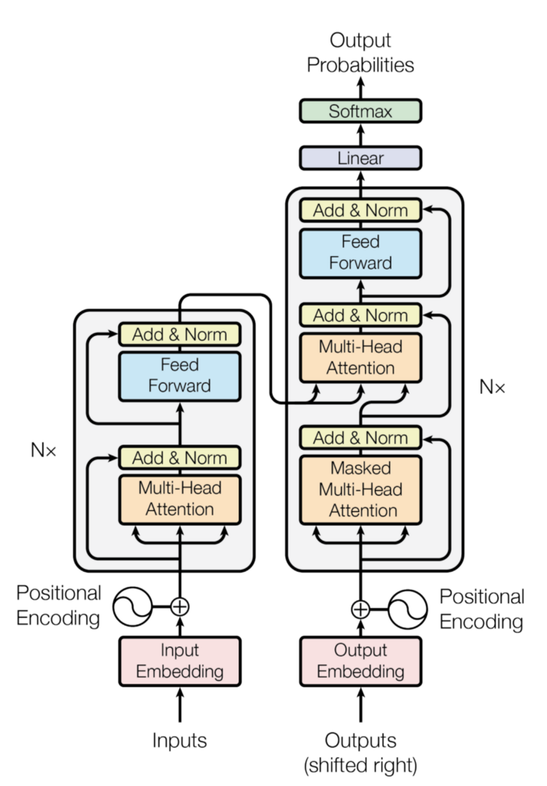
Multi Head Attention Transformer Architecture
Uses the encoder to get a better understanding of the context and the complete sentence
Attention: Aims to encode a word based on all other words in the sequence.
Embeddings for words the appear in the sentence after the word being predicted are masked by multiplying with 0
Positional encodings: Information about the relative or absolute position of the tokens in the sequence
Input Embeddings: The input seq is the one-hot encoding of each word
Previous predictions
Encoder
Decoder
Notes:
Talking points:
Lets look into the architecture of the transformer with multi head attention model. Here, we are trying the predict the next word in a sentence.
This is an encoder-decoder structure
One hot encodings of words are input
Positional encodings are added to these. These represent information about the position of a word in a sequence
Next is the attention, the signature part of the model. I will go deeper into this module in the next slide.
The encoder block is followed by the decoder block.
We input the previous predictions and their positional encodings into the model
Next is a masked attention. If we are predicting the third word in a sentence, this is will only let the decoder see the first and second word so that it does not have information about the upcoming words in the sentence.
Then we have the input from the encoder which helps the decoder get a better understanding of the context
Followed by some dense layers and finally softmax to which outputs word probabilities.
The encoder converts the original input sequence into its latent representation in the form of hidden state vectors. The decoder tries to predict the output sequence using this latent representation.
The decoder block works similarly. We pass in the target sequence of words encoded in an embedding along with the positional encodings.
The decoder's self-attention block generates the attention vectors for the target sequence to find out how much each word in the target sequence is related to other words in the sequence. This first attention block of the decoder is called the masked attention block, this because we apply a masking layer to this block. This ensures that while generating the attention vectors for the target sequence, we can use all the words from the input sequence, but only the previous word of the target sequence.

Slide 8
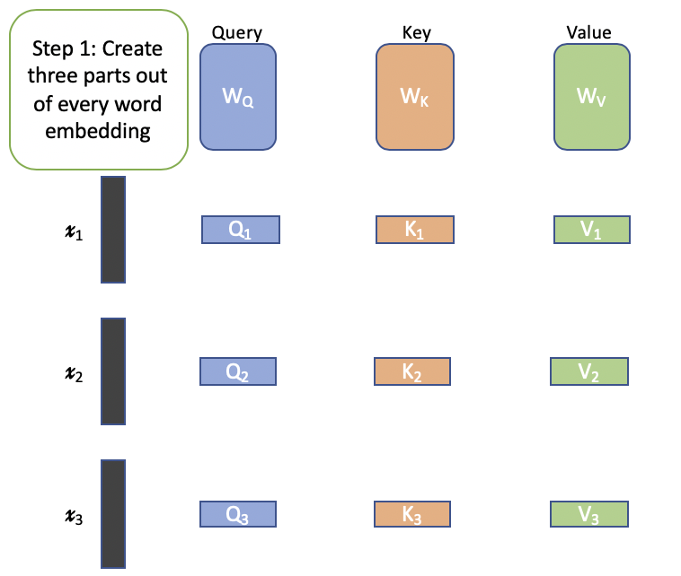
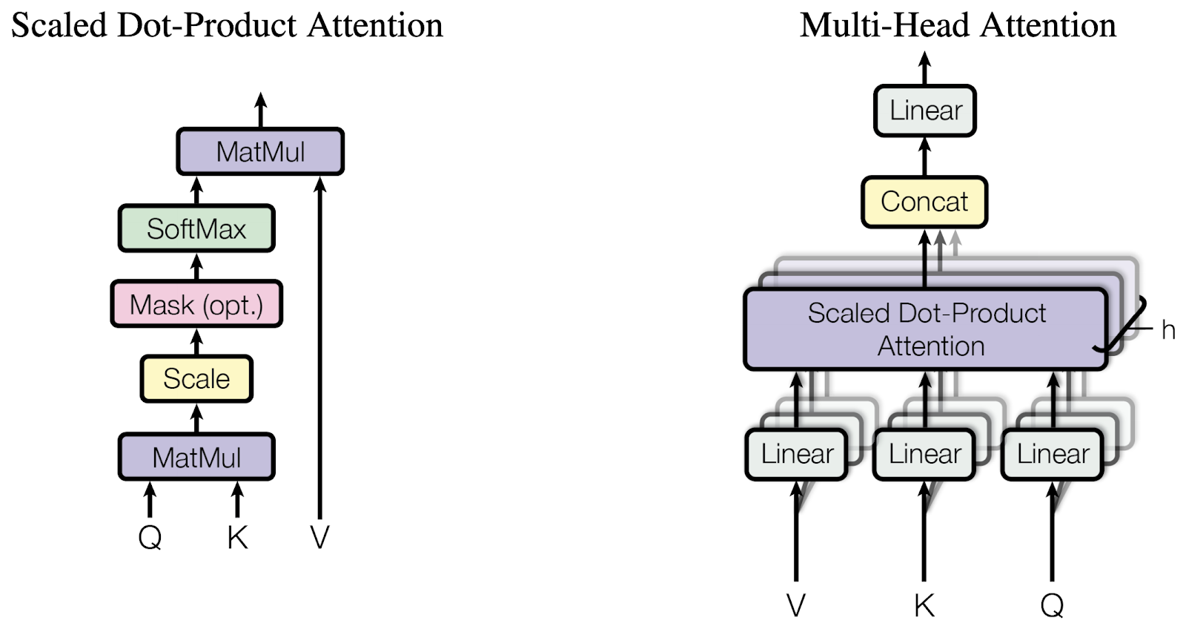
Scaled Dot Product Attention
Step 2:
Apply scaled dot product attention
Step 3:
Apply multi head attention
Query: x2 is being measured(queried) against x1
Key: Score representing how much x2 values x1
Value: new value of x1 with respect to x2. Low value means the words are not related.
Scaling: ensures stable gradients
Softmax: ensure that the score is bounded and relative difference between the scores is maintained
Multi-head: Multiple such sets of query, key and value are learned using the same original words(x1, x2, etc).
Notes:
Talking points:
The attention module splits each word embedding into 3 matrices: query , key and value.
Query and Key are used to describe the influence one word has on the other. Value is the final quantified output.
Scaling and softmax are used in the function to ensure stable gradients during training
Finally, this each word is split into query, key and value multiple times and thus this architecture is called multi head attention
In each head, the matrices are initialized differently and finally their values are concatenated with each other.
Say x1 wants to know its value with respect to x2. So it’ll ‘query’ x2. x2 will provide the answer in the form of its own ‘key’, which can then be used to get a score representing how much it values x1 by taking a dot product with the query. Since both have the same size, this will be a single number. This step will be performed with every word.
dot product gives the similarity between two vectors. In summary, two vectors are closely related if the dot product is 1 (or -1 in case of negative correlation) and have no correlation if the dot product is 0.
The intuitive reason for this design is that each of the heads looks at the original embedding in a different context as each of the Q, K, V matrices are initialized randomly at the beginning and then modified based on the loss backpropagated during training. So the final embedding is learnt taking into consideration various contexts at the same time.
This is a regular feed-forward network that is applied to every attention vector

Slide 9
Chatbot using GPT2 and transfer learning
2
Developed by OpenAI, GPT-2 is a pre-trained language model which we can use for various NLP tasks, such as: Text generation. Language translation. Building question-answering systems
Leveraged the gpt2_simple github library, which amalgamates other githubs including the original OpenAI GPT2 release to provide an easy to use GPT2 wrapper
Notes:
The encoder converts the original input sequence into its latent representation in the form of hidden state vectors. The decoder tries to predict the output sequence using this latent representation.

Slide 10
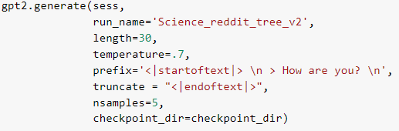
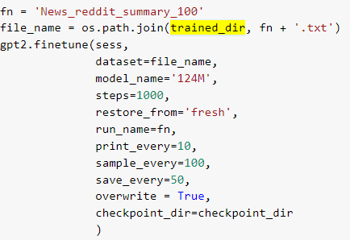
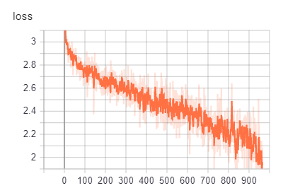
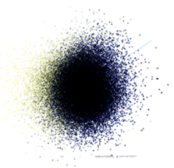
Methods Used
Format
<|startoftext|>
speaker 1
> speaker 2
speaker 3
> speaker 4
<|endoftext|>
Format
<|startoftext|>
speaker 1
>
Logging
Notes:
The encoder converts the original input sequence into its latent representation in the form of hidden state vectors. The decoder tries to predict the output sequence using this latent representation.

Slide 11
Characteristics and the Output
 | Multi-head attention | Finetuned GPT2
How are you doing? | I’m doing pretty good. how are you ? | A doctor. I’m still in shock.
How do we know stars are made of gas? | i think it is a huge metal container will be very rare . | There are lots of theories for this. https://en.m.wikipedia.org/wiki/Astronomy#/wiki/
Are stars made of gas? | yes . and i have seen the movie with the movie with the movie open . | Yes, they are made of hydrogen.
Can I eat plastic | sure , but i m not hungry cookies and i will eat the cake | Plastic is toxic. Plastic is a known carcinogen.
Advantages
Incorporates the “understanding” of other relevant words and their positions
Contextually and grammatically correct sentences
Disadvantages
For best results, needs to be trained on a mega large set of data using multiple high-powered GPUs
Non-coherent or repetitive output with low training
Notes:
The encoder converts the original input sequence into its latent representation in the form of hidden state vectors. The decoder tries to predict the output sequence using this latent representation.

Slide 12
Comments Summarization

Slide 13
Summarization
Extractive
Abstractive
Extracts and concatenates important sentences in the reddit comments.
calculates the importance of each sentence based frequency of important keywords and their weights.
Generates a summary by paraphrasing
<|startoftext|> reddit thread
<|sep|> thread title
<|endoftext|>
Sample Output
Which output is real?
How does the Sun's gravity affect the comet Halley’s?
How far from the sun does an comet orbit?
How do comet showers behave? Is there a limit to how long they last on average?
-bottom line is the reason we don’t trust people and the reason things are getting shut down, is because enough people aren’t even trying to do the right thing that it’s raising the risk for everyone by an unacceptable level.
-people can also wear a mask while shopping for groceries, and the fact that people are moving around makes spread less likely.
Notes:
The encoder converts the original input sequence into its latent representation in the form of hidden state vectors. The decoder tries to predict the output sequence using this latent representation.

Slide 14
Data Exploration

Slide 15
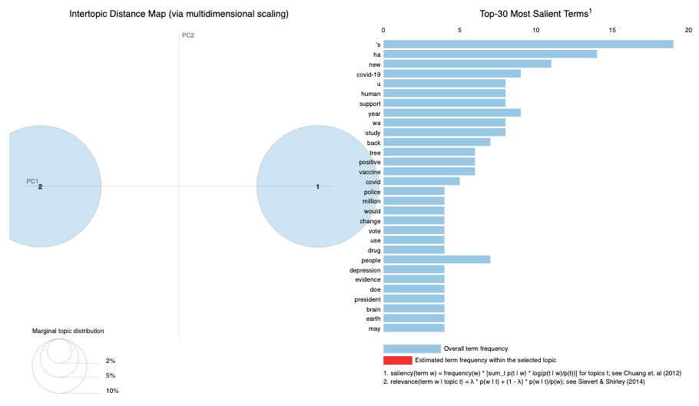
Latent Dirichlet Allocation(LDA)
Used to build topics where specific groups of words can be used to represent the topic of a document/corpus.
We generated topics for all comments within a post
Notes:
The encoder converts the original input sequence into its latent representation in the form of hidden state vectors. The decoder tries to predict the output sequence using this latent representation.

Slide 16
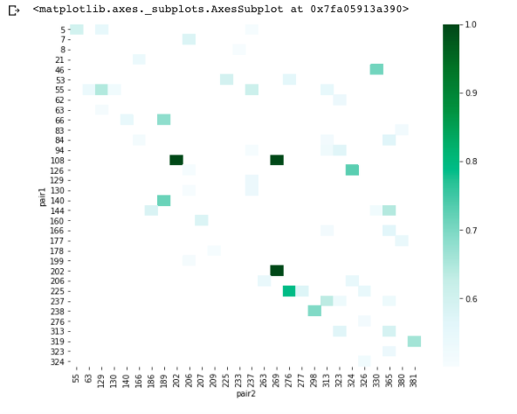
Cosine Similarity
Finds the similarity between 2 documents.
We used this method to find the similarity between 2 posts from reddit.
Notes:
The encoder converts the original input sequence into its latent representation in the form of hidden state vectors. The decoder tries to predict the output sequence using this latent representation.

