Slide 1
POD-Based Modeling for
E-Machine EMag Force Prediction
A data-driven approach using Proper Orthogonal Decomposition (POD)

Slide 2
Agenda
- What is POD?
- Where is POD used?
- Our problem: predicting EMag forces
- How we apply POD to this dataset
- Model inputs and outputs
- Validation: does POD find the real physics?
- Results
- Summary and next steps
POD Model for EMag Force Prediction
1

Slide 3
What is POD?
- Proper Orthogonal Decomposition (POD) = the SVD applied to a dataset of "snapshots"
- Same mathematics as PCA - widely used under the name POD in fluid dynamics and structural dynamics
- Breaks complex, high-dimensional data into a small number of "modes", ranked by how much of the data's variance each one explains
- Each mode is a fixed spatial pattern paired with a coefficient that says how strongly that pattern is present in each snapshot
  - Data ≈ Σ (mode strength) × (spatial pattern) × (how strongly it's present)
- No physics assumptions required - the patterns are found directly from the data
POD Model for EMag Force Prediction
2

Slide 4
Where is POD used?
- Fluid dynamics - reduced-order models of complex flow fields (the classic use of the name "POD")
- Structural dynamics - extracting dominant vibration mode shapes
- Image compression / face recognition - "eigenfaces" is the same idea applied to images
- Building fast surrogate models - replacing an expensive simulation with a cheap one that reproduces its dominant behavior
- General principle: any dataset with a dominant, low-dimensional structure hiding inside high-dimensional data can be compressed this way with very little loss
POD Model for EMag Force Prediction
3

Slide 5
Our problem: predicting EMag forces
- Need: the radial (Fr) and tangential (Ft) electromagnetic force on each of the 48 stator teeth
- At any operating point - any torque, any rotor (electrical) angle
- These forces are what drive the NVH (noise, vibration, harshness) analysis
- Today: every new operating point needs a full FEA simulation - slow
- Goal: a fast, accurate surrogate model that reproduces FEA-quality forces instantly
POD Model for EMag Force Prediction
4

Slide 6
Why POD fits this problem
- The 96 numbers per snapshot (48 Fr + 48 Ft) are not an arbitrary pattern
- Earlier analysis of the raw FEA data found it is dominated by a handful of repeating spatial wave shapes around the 48 teeth
- POD is the natural, assumption-free tool to discover and exploit exactly this kind of hidden low-dimensional structure directly from data
- Used here as an independent, data-driven check on a separate hand-built physics model - if POD finds the same structure with no hints given, that's strong confirmation the structure is real
POD Model for EMag Force Prediction
5

Slide 7
How we apply POD - Step 1: Spatial modes
- Stack every training snapshot (one torque + angle combination) as one row of a big table: rows = snapshots, columns = the 48 teeth
- Take the SVD of that table, separately for Fr and for Ft
- The result is a small set of "spatial modes" - fixed shapes across the 48 teeth, ranked by how much of the data's variance each one explains
- Keep only as many modes as needed to explain 99.99% of the variance
  - Result on our data: just 6 modes (out of a possible 48) explain essentially 100% of the signal, for each of Fr and Ft
POD Model for EMag Force Prediction
6

Slide 8
How we apply POD - Step 2: Angle behavior
- Project every snapshot onto the spatial modes to get one coefficient per mode per snapshot
- At a fixed torque, track how each mode's coefficient changes as the rotor angle sweeps - this is the "temporal" side of POD (here, electrical angle plays the role of time)
- The natural oscillation speed of each mode is not assumed - it is discovered directly from the data for that mode
- A smooth wave is fit to each mode's coefficient vs angle, including a secondary wobble rhythm found empirically in the data
POD Model for EMag Force Prediction
7

Slide 9
How we apply POD - Step 3: Torque behavior & prediction
- Repeat the angle fit at every torque level present in the training data
- Fit a smooth curve through the resulting numbers across torque, for each mode
- To predict a new (torque, angle): read the curves for that torque, reconstruct each mode's coefficient at that angle, and recombine with the spatial shapes
- The result is the full 96-number force prediction - no simulation, closed-form, near-instant
POD Model for EMag Force Prediction
8

Slide 10
Model inputs and outputs
INPUT
Torque (Nm)
Electrical angle (deg)
(RPM - fixed in
current dataset)
OUTPUT
Fr - radial force
(48 values, one per tooth)
Ft - tangential force
(48 values, one per tooth)
96 numbers total
POD model
- 2 numbers in, 96 numbers out - a direct, closed-form replacement for an FEA run at that operating point
- Prediction cost: a handful of spline lookups and one inverse transform - effectively instant
- Internally, the model only ever stores: 6 spatial mode shapes per channel + a set of smooth curves across torque per mode - a tiny model compared to a neural network
POD Model for EMag Force Prediction
9

Slide 11
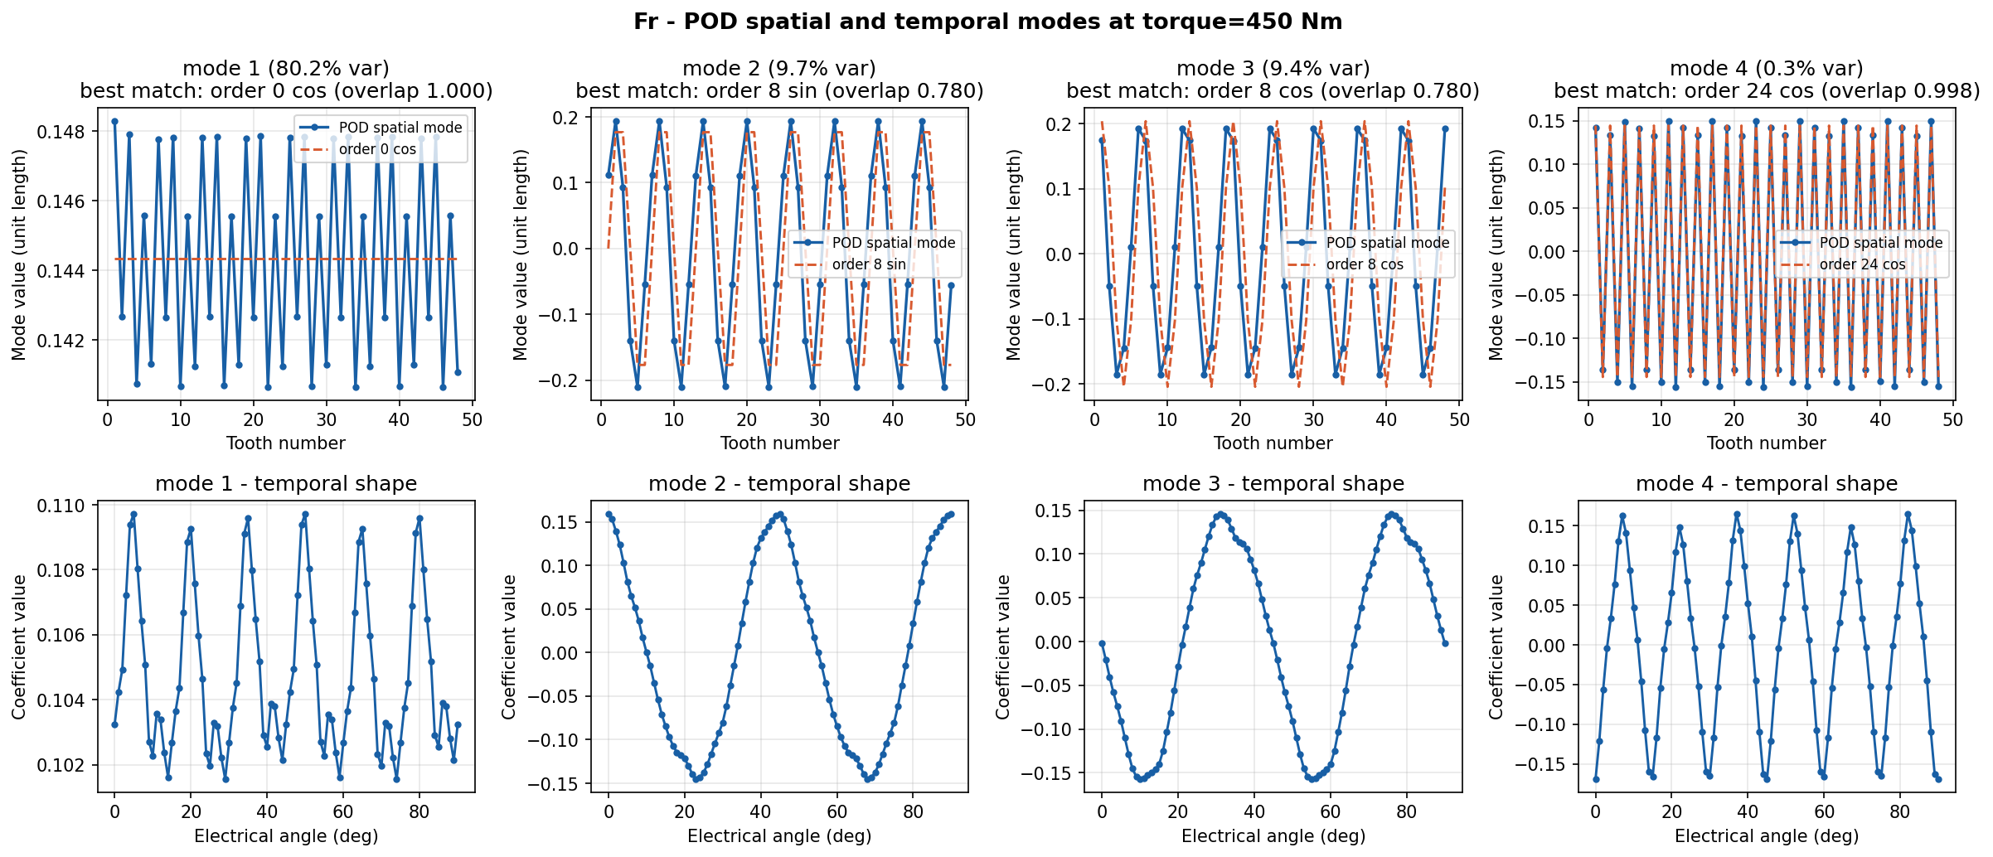
Validation: POD rediscovers known physics
With zero physics input, POD's own spatial modes (blue) line up almost exactly with the expected harmonic waves (orange dashed) at orders 0, 8, 8, 24 - the same orders found by independently hand-analyzing the FEA data.
POD Model for EMag Force Prediction
10

Slide 12
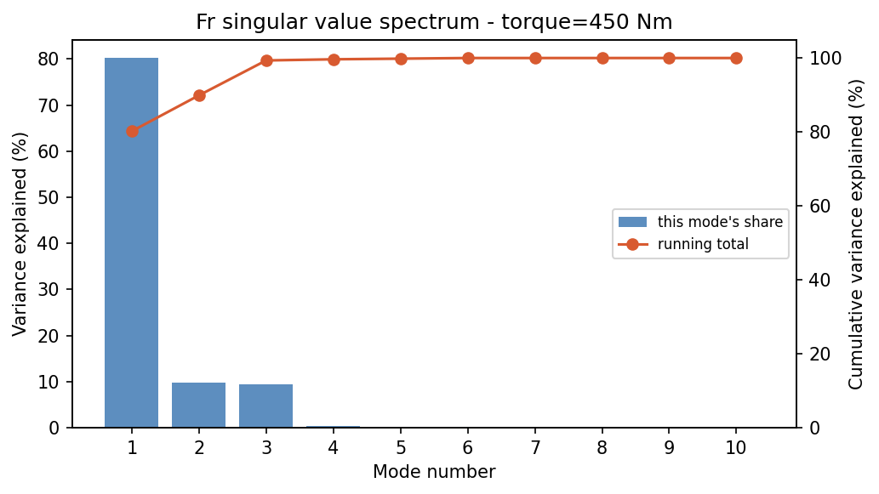
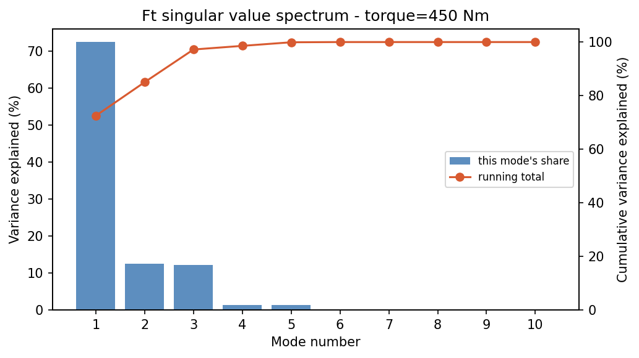
How much each mode matters: the energy spectrum
Fr (radial force)
Ft (tangential force)
Mode 1 alone explains 72-80% of the variance; by mode 4 the running total is essentially 100%. Modes past that point are noise-level - confirming 6 modes per channel is enough, not an arbitrary cutoff.
POD Model for EMag Force Prediction
11

Slide 13
Validation - what this confirms
- A plain SVD needs only 4-6 modes to explain ~100% of the variance in the force data
- The dominant spatial modes match plain cos/sin waves at orders 0, 8, 16, and 24 - exactly the orders used in the separate, hand-built harmonic model
- Orders 8 and 16 each show up as two modes with nearly equal strength - the expected signature of a spatial pattern that rotates with the rotor, rather than one that stays still
- The model's own frequency-discovery step (given no hints) came back with exactly [0, 8, 8, 16, 16, 24] for both Fr and Ft
- A small wobble effect (24 cycles per electrical turn) found independently while refining the hand-built model shows up here too - a third, independent confirmation it's a real effect in the machine
POD Model for EMag Force Prediction
12

Slide 14
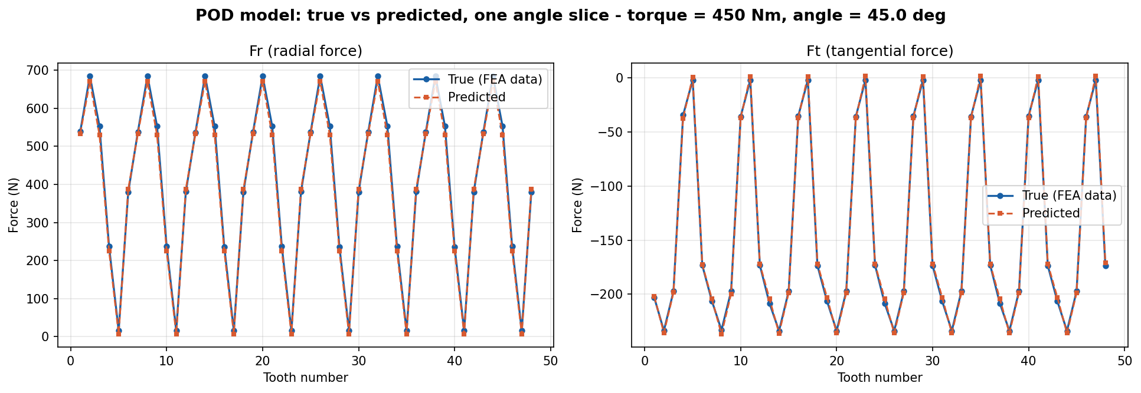
Predicted vs FEA data - a torque the model never saw
Torque = 450 Nm held out entirely during fitting. Predicted (orange) vs true FEA data (blue) overlap almost exactly across all 48 teeth, for both Fr and Ft.
POD Model for EMag Force Prediction
13

Slide 15
Results
Predicting a torque the model never saw during training (the meaningful generalization test)
Model | Mean R² (new-torque test)
Harmonic model (hand-built physics) | 0.9822
POD model (data-driven) | 0.9822
Interpolation baseline (no physics) | 0.9252
Interpolating within a torque already seen during training (the easier test)
Model | Overall R² | Fr R² | Ft R²
Harmonic model | 0.9999 | 0.9999 | 0.9997
POD model | 0.9836 | 0.9559 | 0.9816
Interpolation baseline | 0.8781 | 0.6788 | 0.8466
POD Model for EMag Force Prediction
14

Slide 16
Summary
- POD is a general, data-driven way to find hidden low-dimensional structure in complex data and build fast surrogate models
- Applied to our EMag force data: found just 6 dominant modes per force channel, matching known machine physics exactly
- Accuracy on new, unseen torque levels: R² = 0.9822 - matching the hand-built physics model almost to the decimal
- Fast: closed-form prediction, no training data needed at inference time, no simulation required
- Value: independent, assumption-free confirmation that the hand-built harmonic model's physics assumptions are correct
POD Model for EMag Force Prediction
15

Slide 17
Limitations and next steps
- Limitations (shared with the hand-built model)
  - Electrical angle only covers 0-90 degrees in the current dataset, not the full 360
  - Only one RPM in the dataset - speed-dependence is untested
  - POD's own weak spot: its basis is learned from training data, so basis quality depends on how completely that data covers the angle sweep
  - Lowest-torque region (±75 Nm) is the least accurate for both physics-grade models - a real property of the machine, not a model flaw
- Next steps
  - Extend FEA data to a full 360 degree electrical cycle to verify angle extrapolation
  - Add further RPM sweeps - test whether the same dominant orders still hold at other speeds
  - Use POD as the automatic structure-discovery step for any future machine geometry, before hand-building a physics model
POD Model for EMag Force Prediction
16

