Slide 1
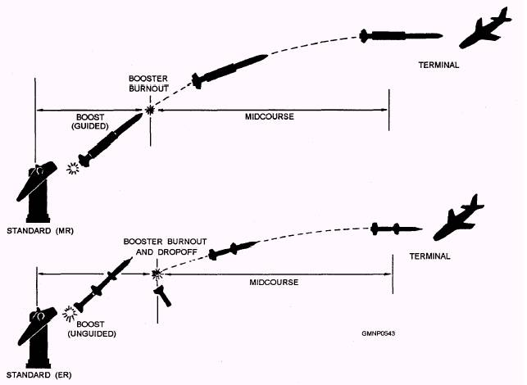

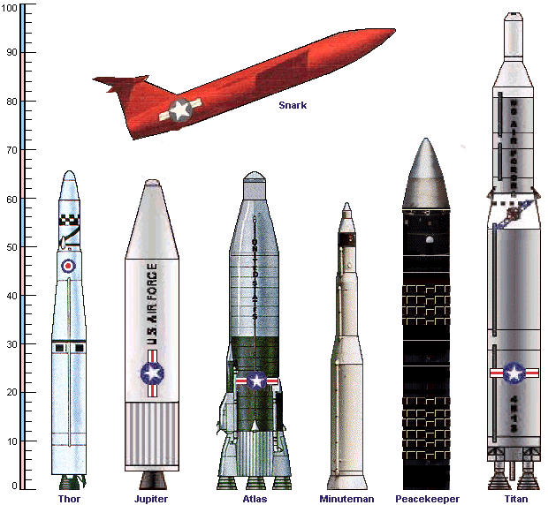

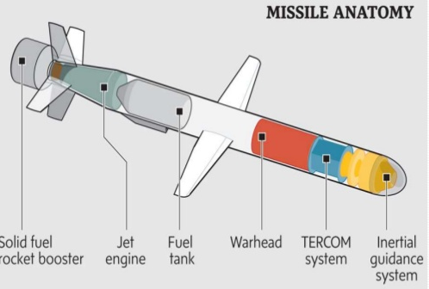
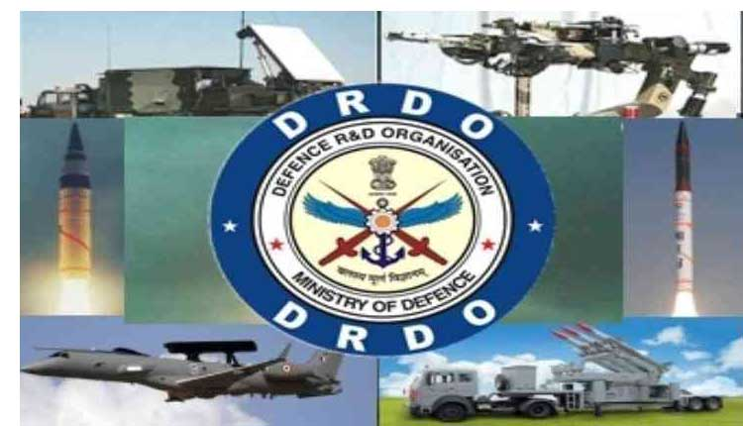
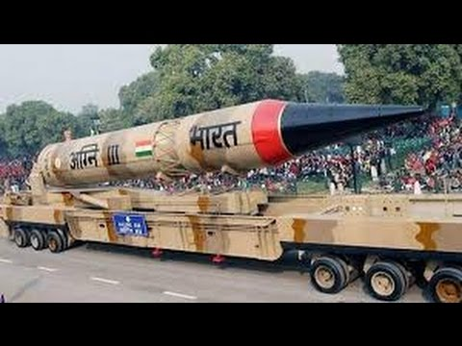

Team members:
Gauri Sharma (9917102084)
Lalit Bhagat (9917103024)
Shivam Aggarwal (9917103169)
Kushagra Jain (9917103033)
Ayush Bansal (9917103145)
Shubham Dubey (9917103147)

Slide 2
Problem Statement:
The position of an object in the air can be indicated by latitude, longitude and altitude for a given time. A trajectory is a stream of such quadruples (time, latitude, longitude and altitude). Given a large set of such trajectories, without any other information, problem is to cluster them into meaningful objects such as Helicopter, Fighter/civilian Aircraft, UAV, Cruise Missile, dropped bomb, etc. An optimal scalable solution is desired using open source tools. Design a system to estimate location of flying object based on its trajectory, provide guidance to missile to shoot them depending on their location when missile will meet the object on its trajectory.
Source: https://www.sih.gov.in/sih2020PS/QWxs/U29mdHdhcmU=/QWxs/QWxs
PS number: CK108
By: Dte of IT & Cyber Security, DRDO

Slide 3
Motivation
Throughout the nuclear era, the conventional wisdom has been that one state’s nuclear acquisition has driven its adversaries to follow suit. The world is always on the verge of facing nuclear war, in order to ensure safety of its citizens ,countries have developed different technologies and systems to counter such situations .
This project would serve well to the department of defence for them to predict what air object is entering the airspace of the country and intercept it, if its not authorised to gain access .

Slide 4
Work Flow
Dataset
Data pre-processing
Clustering algorithm
Trajectory prediction
Missile Guidance system
Testing
Solution Implementation

Slide 5
Dataset
The dataset should contain trajectories namely 5 parameters i.e. longitude, latitude, altitude, speed and time for different air objects like planes, drones, missiles , dropped bombs/objects etc. This would develop the basic understanding of the algorithm about different possible trajectories.
Due to unavailability of official records , we have scraped the trajectories from air traffic websites. The air traffic control monitors aircrafts their trajectories and provides advisory services.
The Dataset can also be generated mathematically using different trajectory functions ,equations and using simulation.

Slide 6
Data Pre-processing
Once we get hold of the dataset(training) it would further undergo some cleaning with each parameter pre-processed separately and then would be normalised. This can be done using min-max or standard scaling.
Line by line : Data can be normalised per trajectory using only first few data points of the trajectory the entire row can be normalised. This process will be repeated for each row. This method will reveal the highs and lows of each row differently.
The column method/ (or doing it once) : few columns say x are selected and fit the scaling algorithm on the basis of this combined data. Then the whole dataset could simply fit/ transformed this would generalise the dataset.
Normalization is necessary before folding the data as training set to LSTM network. Min-Max normalization is a linear strategy, the features of data are scaled between 0 and 1.

Slide 7
Clustering
Clustering based on velocities and altitude, because all the air objects can be differentiated with ease using these parameters. Clustering algorithm used will be DBSCAN. It identifies the dense region by grouping together data points that are closed to each other based on distance measurement
Advancement in machine learning combined with military grade cameras with resolution of 47 megapixels(eg imperx Military and Defence camera lines includes remarkable features and with the use of look up tables, programmable knee corrections or image enhancement, the user can see what was originally not visible has made Image detection accurate and easy, classification of image can be done using any algorithm.

Slide 8
Trajectory Predictions
A trajectory can be looked as a multivariate Time Series data.
A neural network specialized for time series data like LSTM can be used. Applying sliding windows in LSTM maintains the continuity and avoids compromising the dynamic dependencies of adjacent states in the long-term sequences, which helps to improve accuracy of trajectory prediction.
A statistical model like exponential smoothing
A hybrid model can also be used.
We can compare their metrics either by plotting graphs each (latitude Vs time, longitude Vs time, Altitude Vs time and Velocity Vs time (if needed)) or we can use a metric(RMSE OR MAE) for the same.

Slide 9
Missile Guidance System
After successfully predicting trajectory points. Now we can solve the equations using maths and provide appropriate guidance to the missile.
A guidance system comprises of an electronic and a mechanical unit, the purpose of electronic unit is to anticipate the location of target, compare it line of sight (LOS) and then send the necessary command to the mechanical unit. Electronic unit keeps the missile stable during flight.

Slide 10
Testing
For testing purpose we will make use of freely available open source flight simulators such as FlightGear. It creates the most realistic flight simulator possible that is free to use, modify and distribute.
FlightGear is used all over the world by desktop flight simulator enthusiasts, for research in universities and for interactive exhibits in museums.
It features more than 400 aircrafts, a worldwide scenery database, a multi-player environment, detailed sky modelling, a flexible and open aircraft modelling system, varied networking options, multiple display support, a powerful scripting language and an open architecture.

Slide 11
Thank you

