Slide 1

EMPOWER HER

Slide 2
INTRODUCTION
No RTE, beti bacho, beti pado schemes, kasthura Gandhi worked
Rather than bury in debt, can get their college paid
65% of adolescent girls drop out
Women want to pursue education even after marriage (fellowships)
Scholarships and fellowships for Women
Many remain oblivious to various opportunities
Missing awareness
To overcome tedious task of searching for scholarships
Financial Aid

Slide 3
Some of the Scholarships
Post-Graduate Indira Gandhi Scholarship for Single Girl Child :36,200 per anum
AICTE PG (GATE/GPAT) Scholarship Qualifying mark and studying in AICTE recognized institution
Post Matric Scholarship
L'Oreal India For Young Women in Science Scholarship Min 85% marks inr 2.5 lakhs
Merit cum means scholarship scheme
Post Graduate Merit Scholarship for University Rank Holders :3100 per month for 2 years
Rajarshi Chhatrapati Shahu Maharaj Shikshan Shulk Shishyavrutti Yojna(50% tuition fee for PG’s)
Tata Education Trust Scholarship Scheme
Postdoctoral Fellowship for Women

Slide 4
PROBLEM DEFINITION
Who: teir-2 and teir-3 are the target audience ,weak economic status, academic profiles
What: Personalized scholarship platform for education opportunities and financial help options.
Why: Showing the scholarship opportunities according to their preferences
When: Available 24*7
Where: Access it from anywhere provided with internet connection.

Slide 5
EXISTING SYSTEM and PROPOSED SYSTEM
Existing System
Not personalized
There is no platform containing all the applicable scholarships for women particularly
No quick updates
Proposed System
Personalized
Platform where all the girls and women will get to explore scholarships from government and private organizations.
Additional features

Slide 6
FEATURES
User Friendly
Tour
Language
Personalization
Future Scope(Organization Registration)
Letting Suggestions IN
Notifications

Slide 7
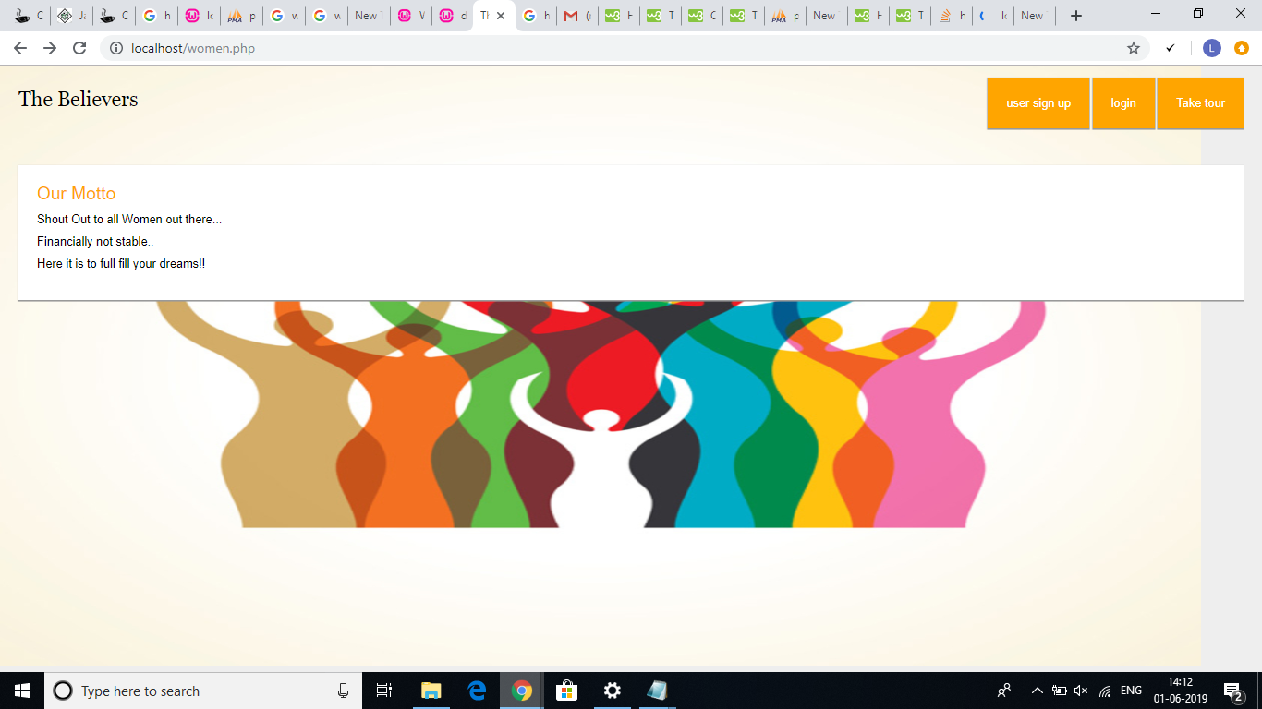

Slide 8
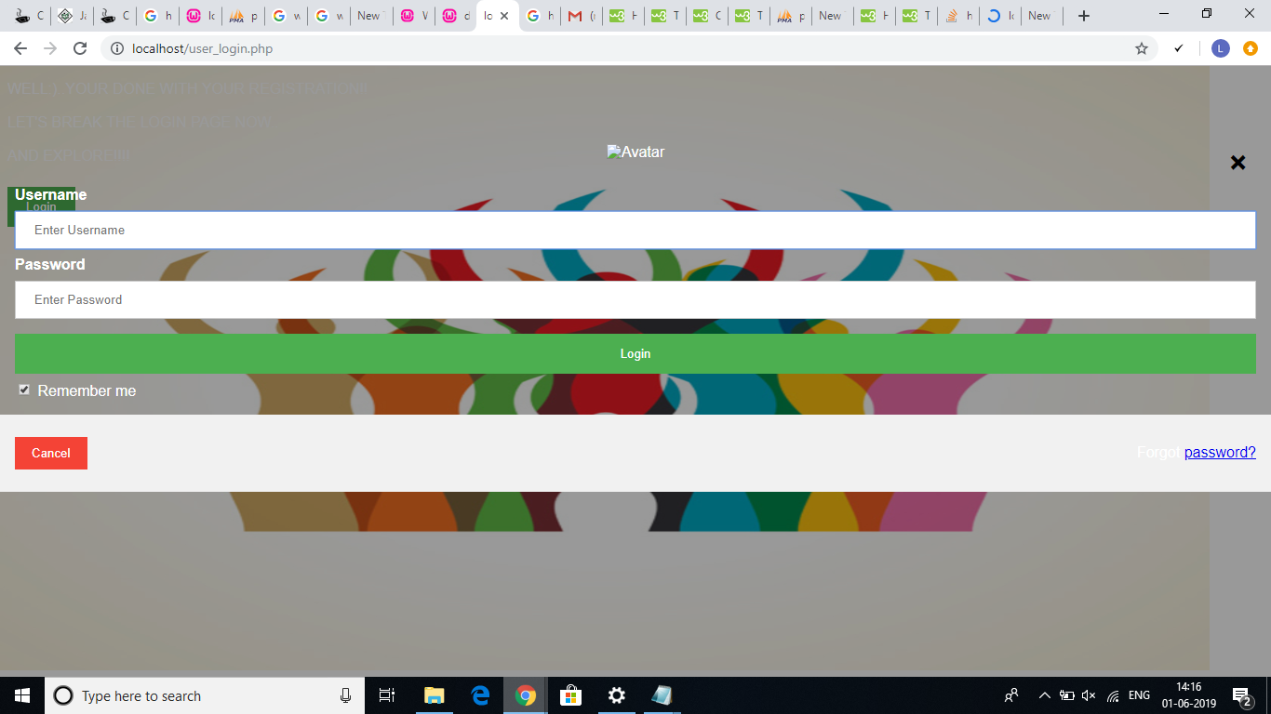

Slide 9
THANK YOU

