Slide 1


TELANGANA GROWTH ANALYSIS
Lalitha Sagi

Slide 2
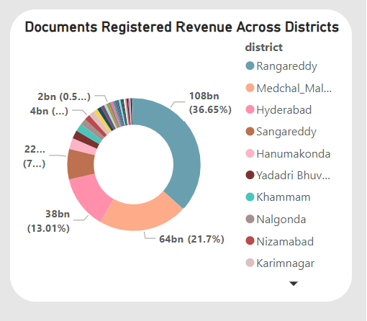
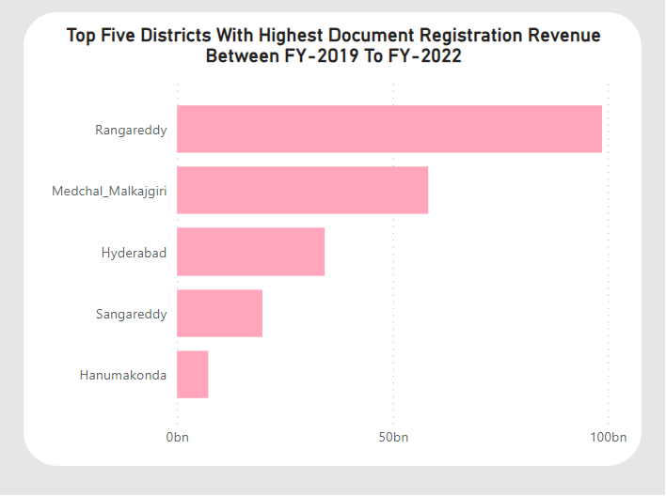
Stamp Registration
Revenue generated from document registration across districts in Telangana?
Top 5 districts that showed the highest document registration revenue growth between FY 2019 and 2022.

Slide 3
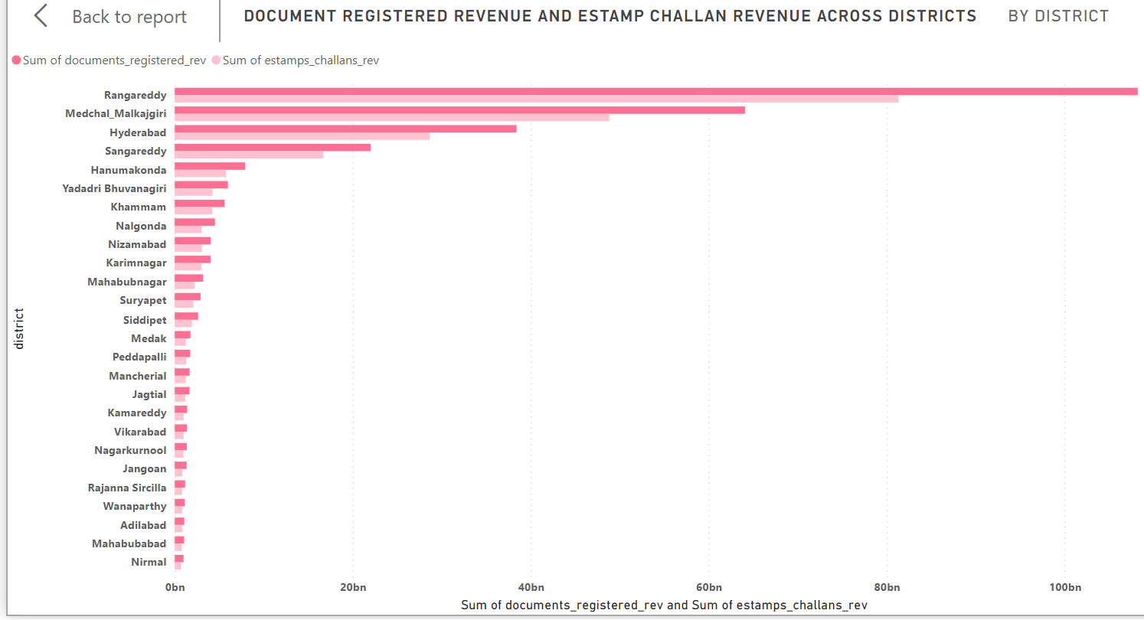
Stamp Registration
Comparison of Revenue generated from document registration to the revenue generated from e-stamp challans across districts

Slide 4
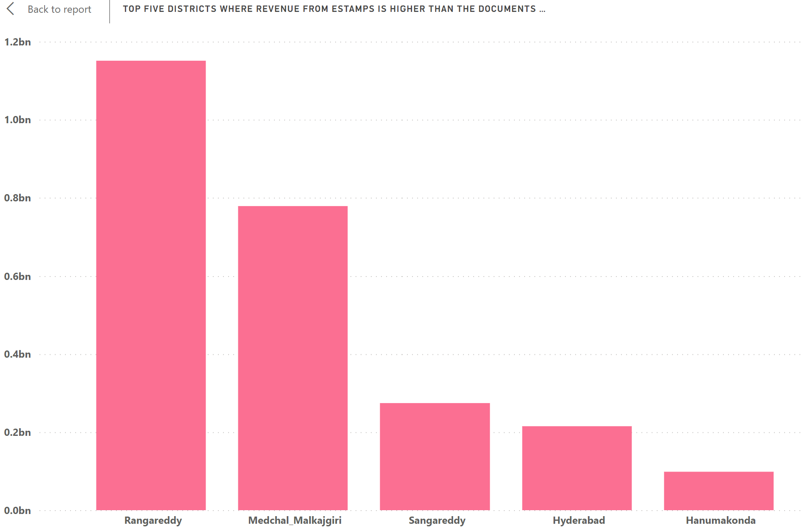
Stamp Registration
Top 5 districts where e-stamps revenue contributes significantly more to the revenue than the documents in FY 2022?

Slide 5
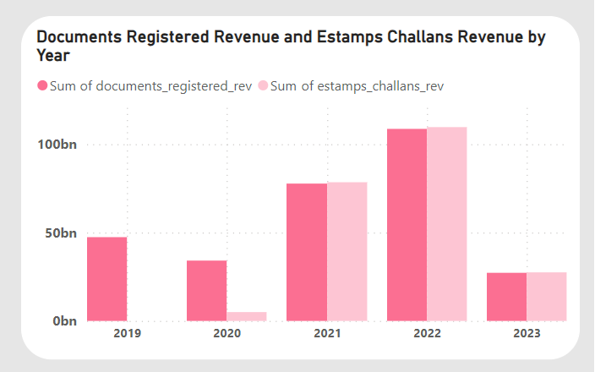
STAMP REGISTRATION
Alteration of document registration count pattern since the implementation of e-Stamp challan?
People started preferring digital services and processes post COVID-19
Suggestions To The Government:
Digitalizing and automating document registrations
Ensuring accountability and promoting transparency in the entire process

Slide 6
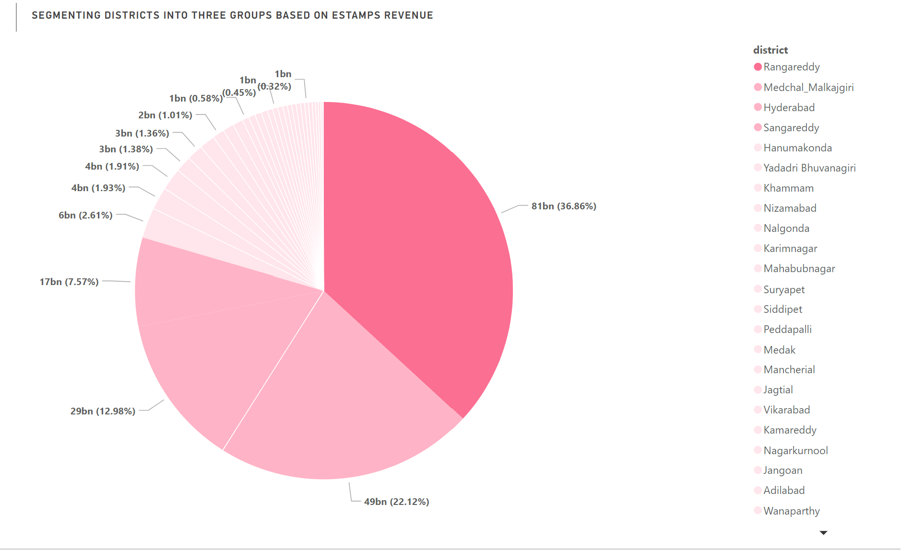
STAMP REGISTRATION
Categorize districts into three segments based on their stamp registration revenue generation during the fiscal year 2021 to 2022.
Segment 1:
(Rangareddy)
Stamp Revenue>35% of total stamp revenue during FY 2021 to FY 2022
Segment 2
(Medchal_Malkajgiri,Hyderabad,Sangareddy):
Stamp Revenue>Between 7% to 35% of total stamp revenue during FY 2021 to FY 2022
Segment 3:
(Other Districts)
Stamp Revenue>Below 7% of total stamp revenue during FY 2021 to FY 2022

Slide 7
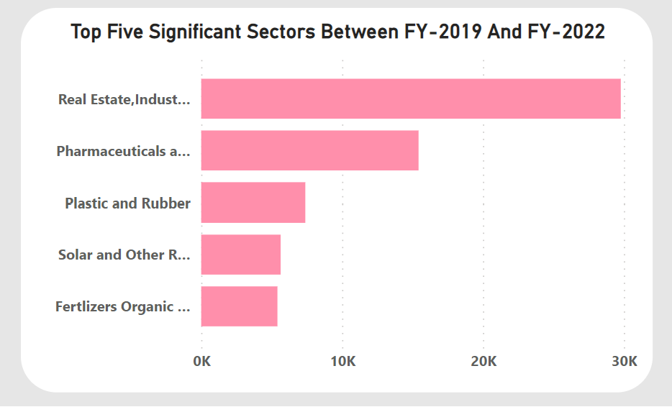
Ts-Ipass
The top 5 sectors that have witnessed the most significant investments in FY 2022.

Slide 8
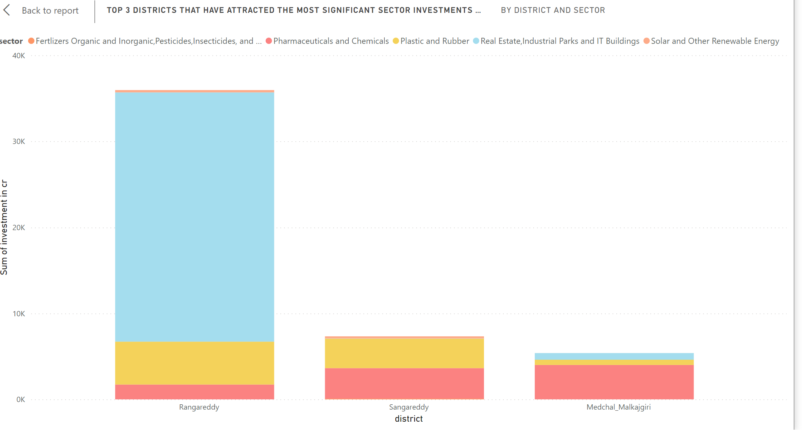
Ts-Ipass
Top 3 districts that have attracted the most significant sector investments during FY 2019 to 2022
Why?
Rising demands for infrastructure in Rangareddy.
Need of medicines during COVID-19

Slide 9
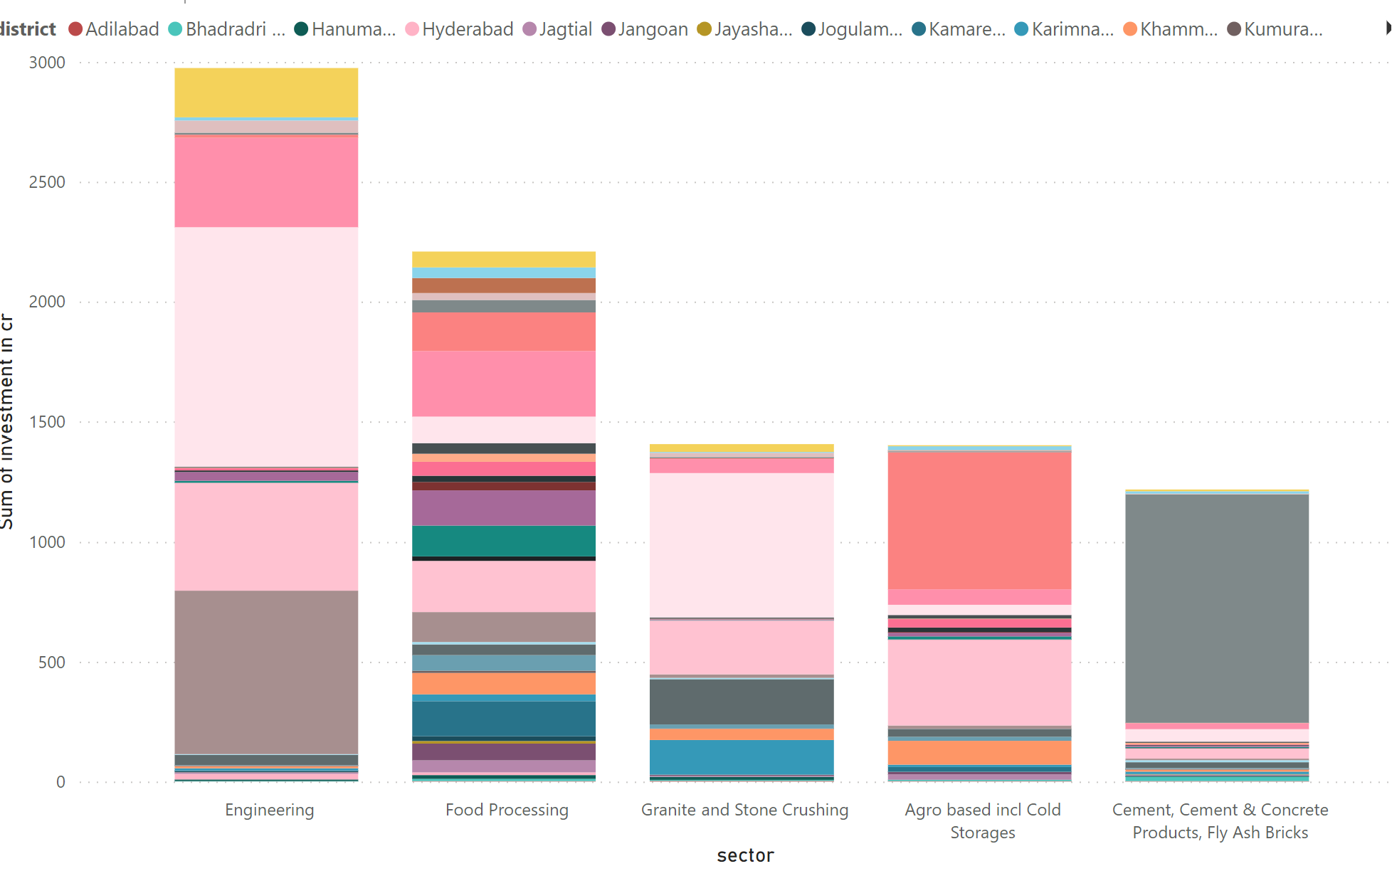
Ts-Ipass
Sectors that have shown substantial investment in multiple districts between FY 2021 and 2022

Slide 10
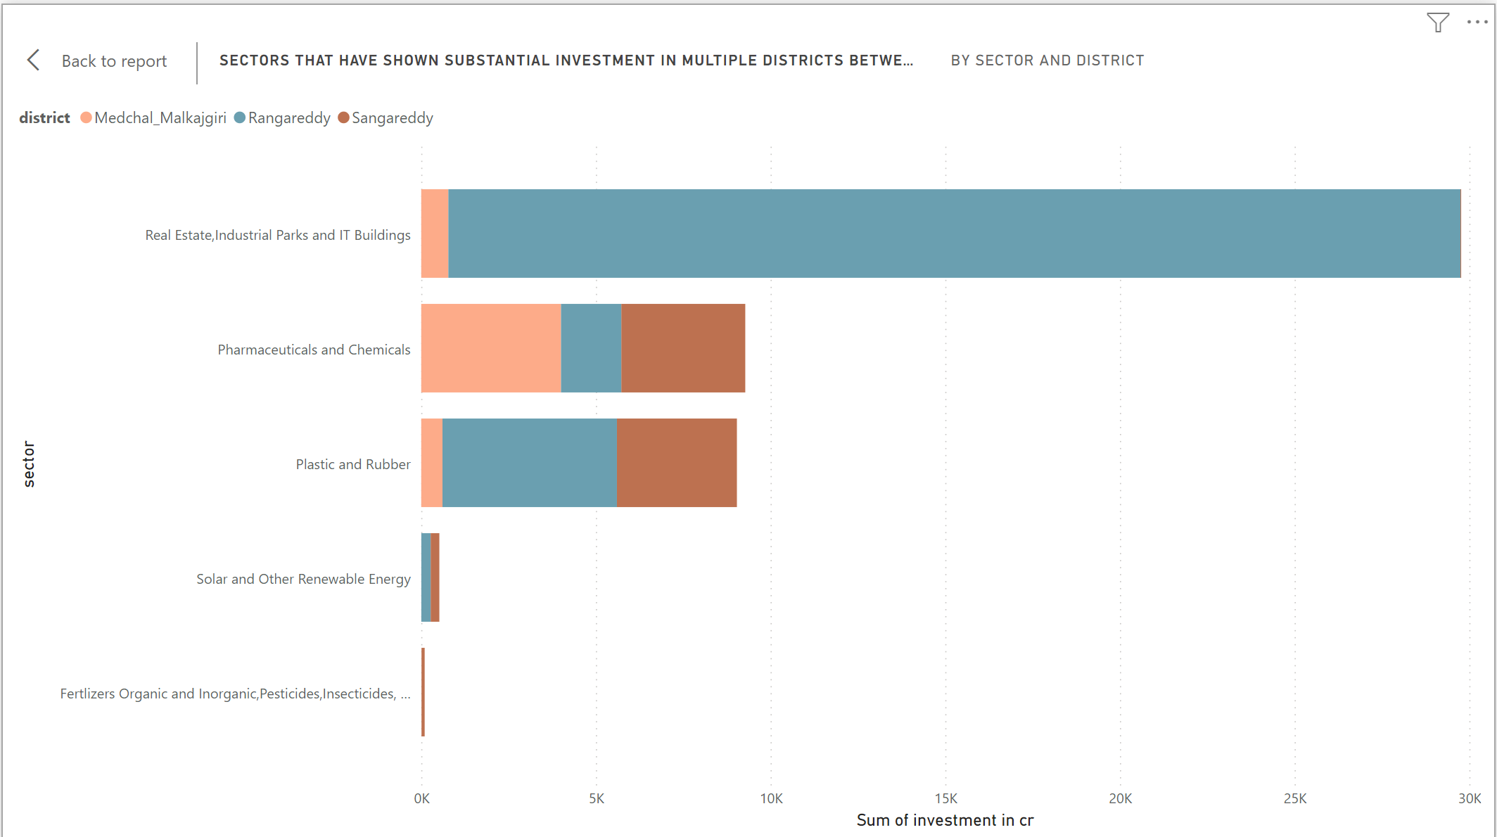
Ts-Ipass
Sectors that have shown substantial investment in multiple districts between FY 2021 and 2022

Slide 11
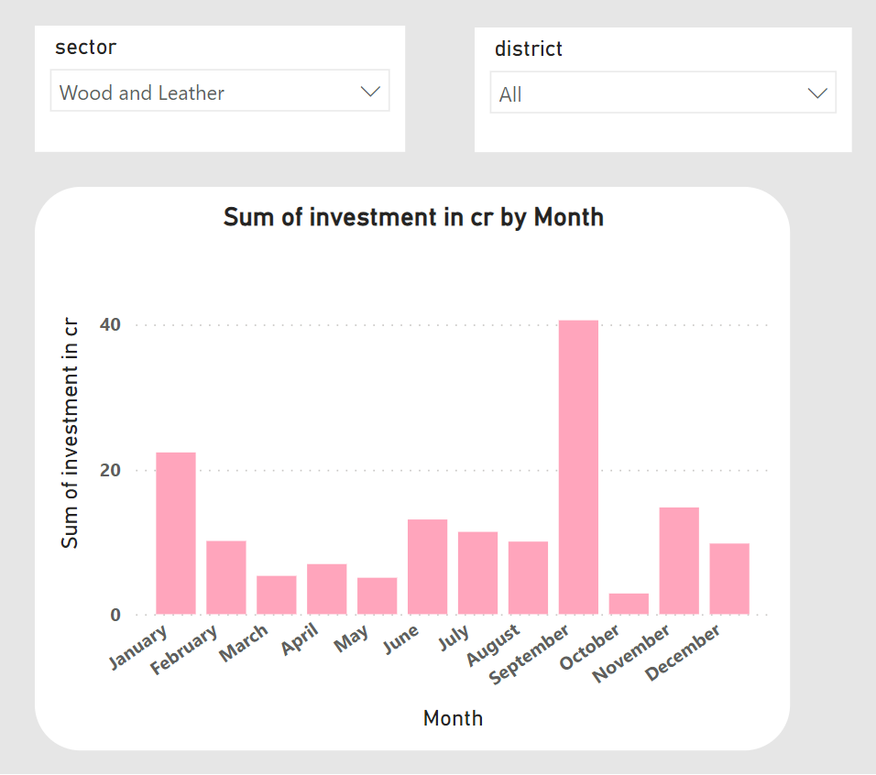
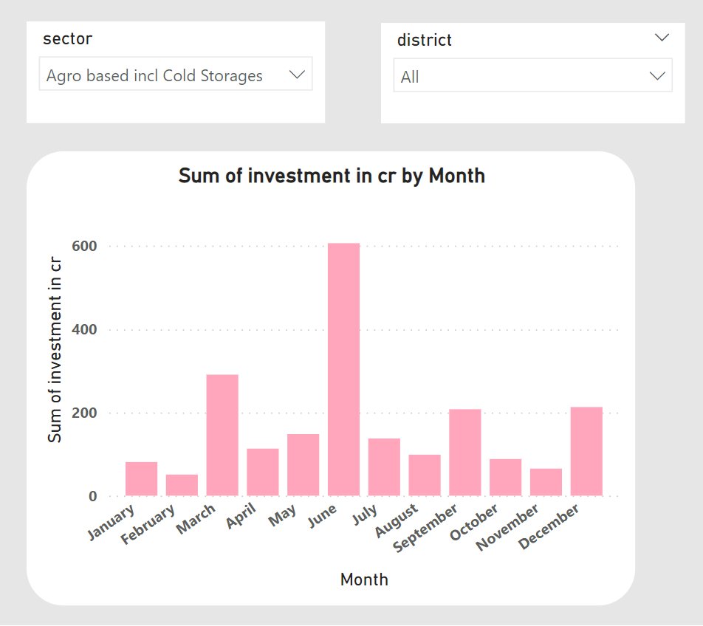
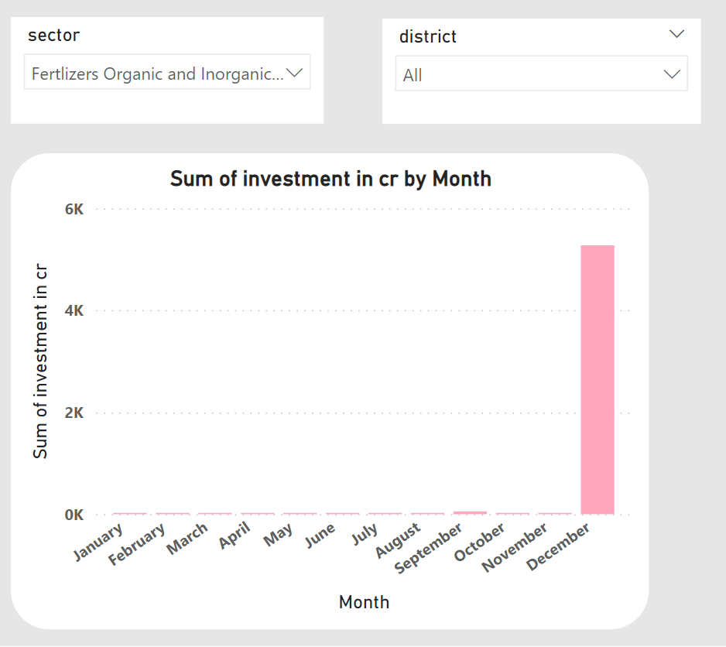
TS-IPASS
Seasonal patterns or cyclicality in the investment trends for sectors
Wood and Leather – Invested during the winter season
Agro based incl Cold Storages – Invested during summer season to provide cold storage to Crops , Vegetables.
Fertilizers – Heavily invested during December as it is a crucial month in India for Rabi crop season.

Slide 12
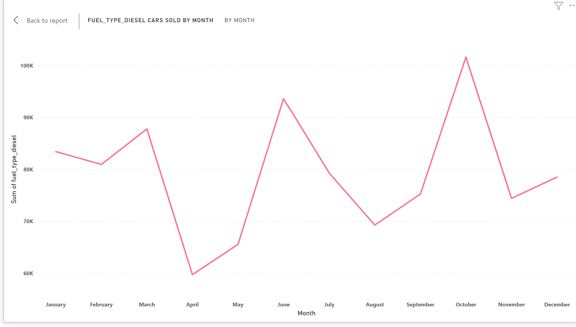
Transportation
Correlation between vehicle sales and specific months or seasons
Fiscal Year-End Discounts: In India, the fiscal year ends in March. Many car manufacturers and dealerships offer significant discounts and promotions on various car models .
Monsoon Season and Agriculture: June marks the beginning of the monsoon season in India. Diesel cars are better suited to driving in wet and slippery conditions than petrol cars. They also have better traction on rough roads. They are often preferred in rural areas due to their fuel efficiency and ability to handle rough terrain, making them suitable for agricultural purposes.
Festive Season in October: October is a festive month in India, with festivals such as Diwali and Navratri celebrated across the country. During festive seasons, people tend to make significant purchases, including cars, as it is considered auspicious to do so.

Slide 13
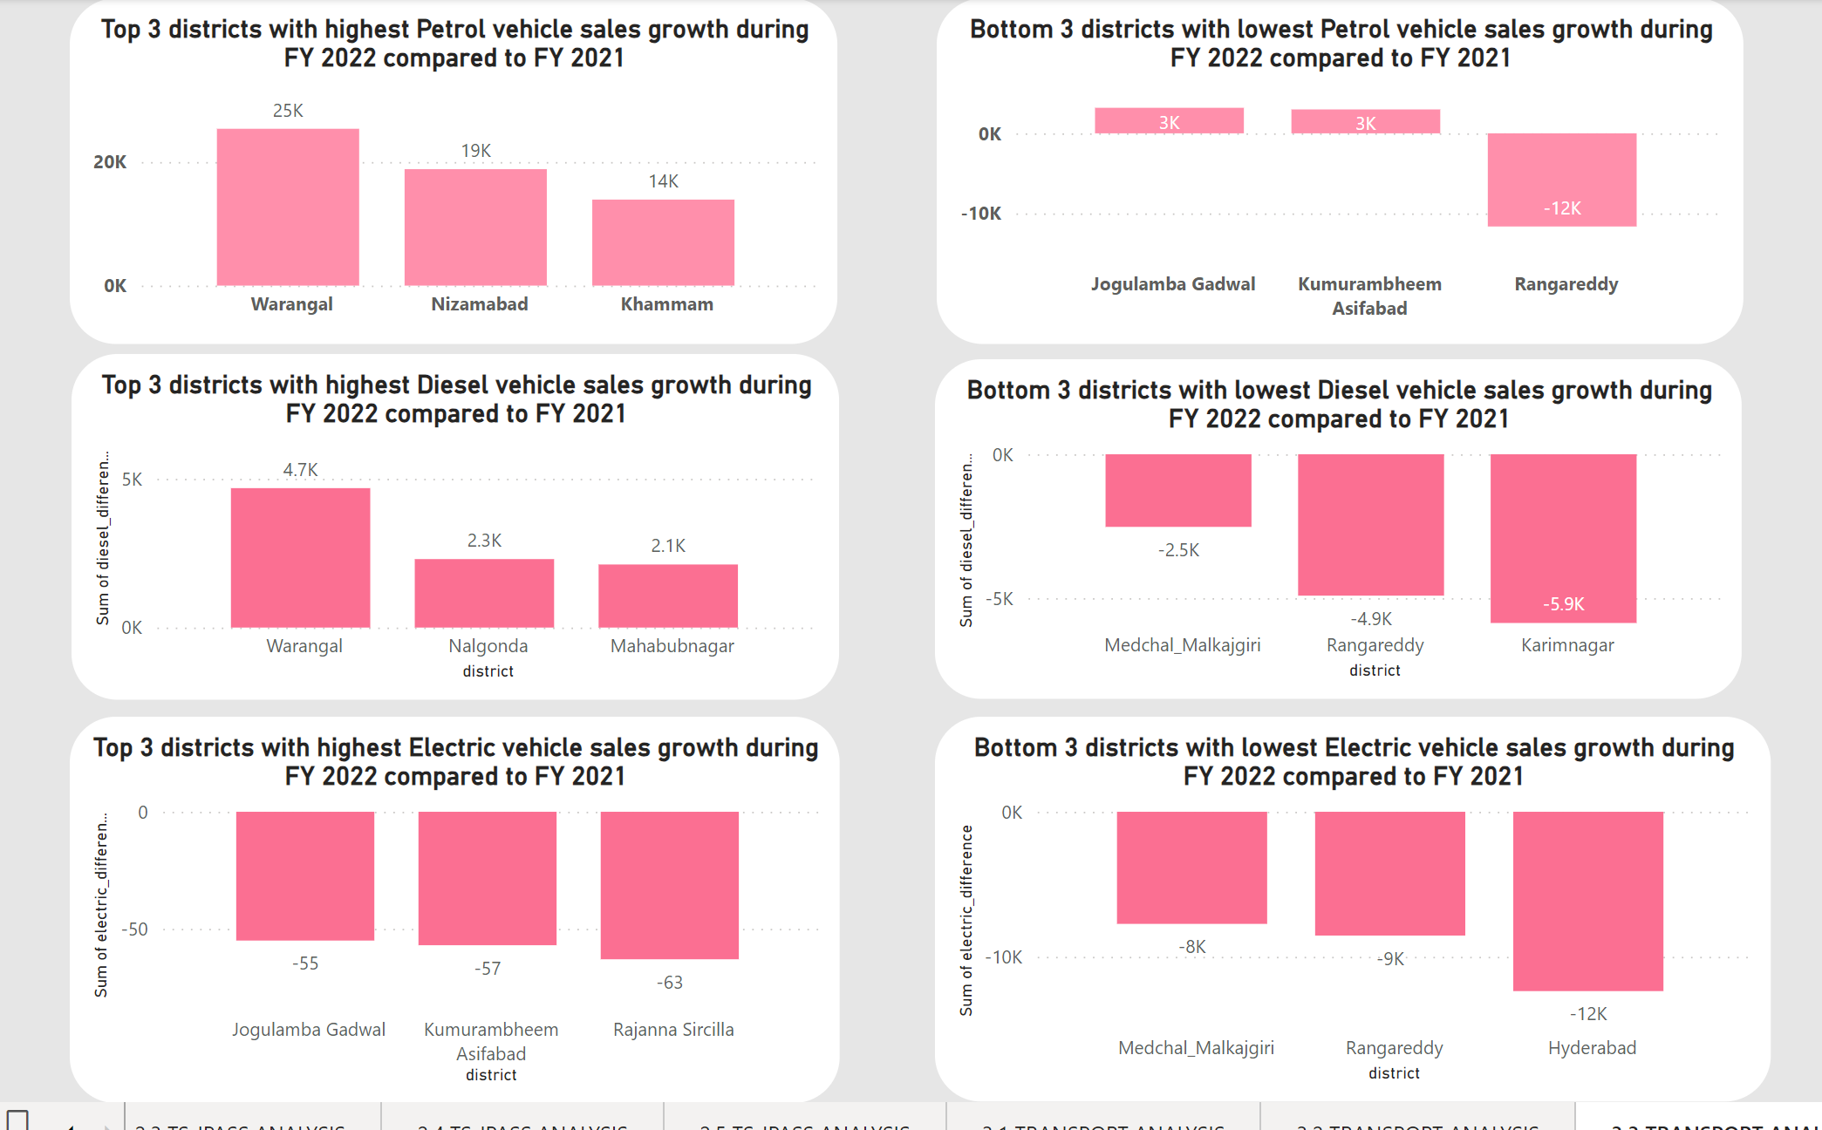
Transportation
Top 3 and bottom 3 districts that have shown the highest and lowest vehicle sales growth during FY 2022 compared to FY 2021?

Slide 14
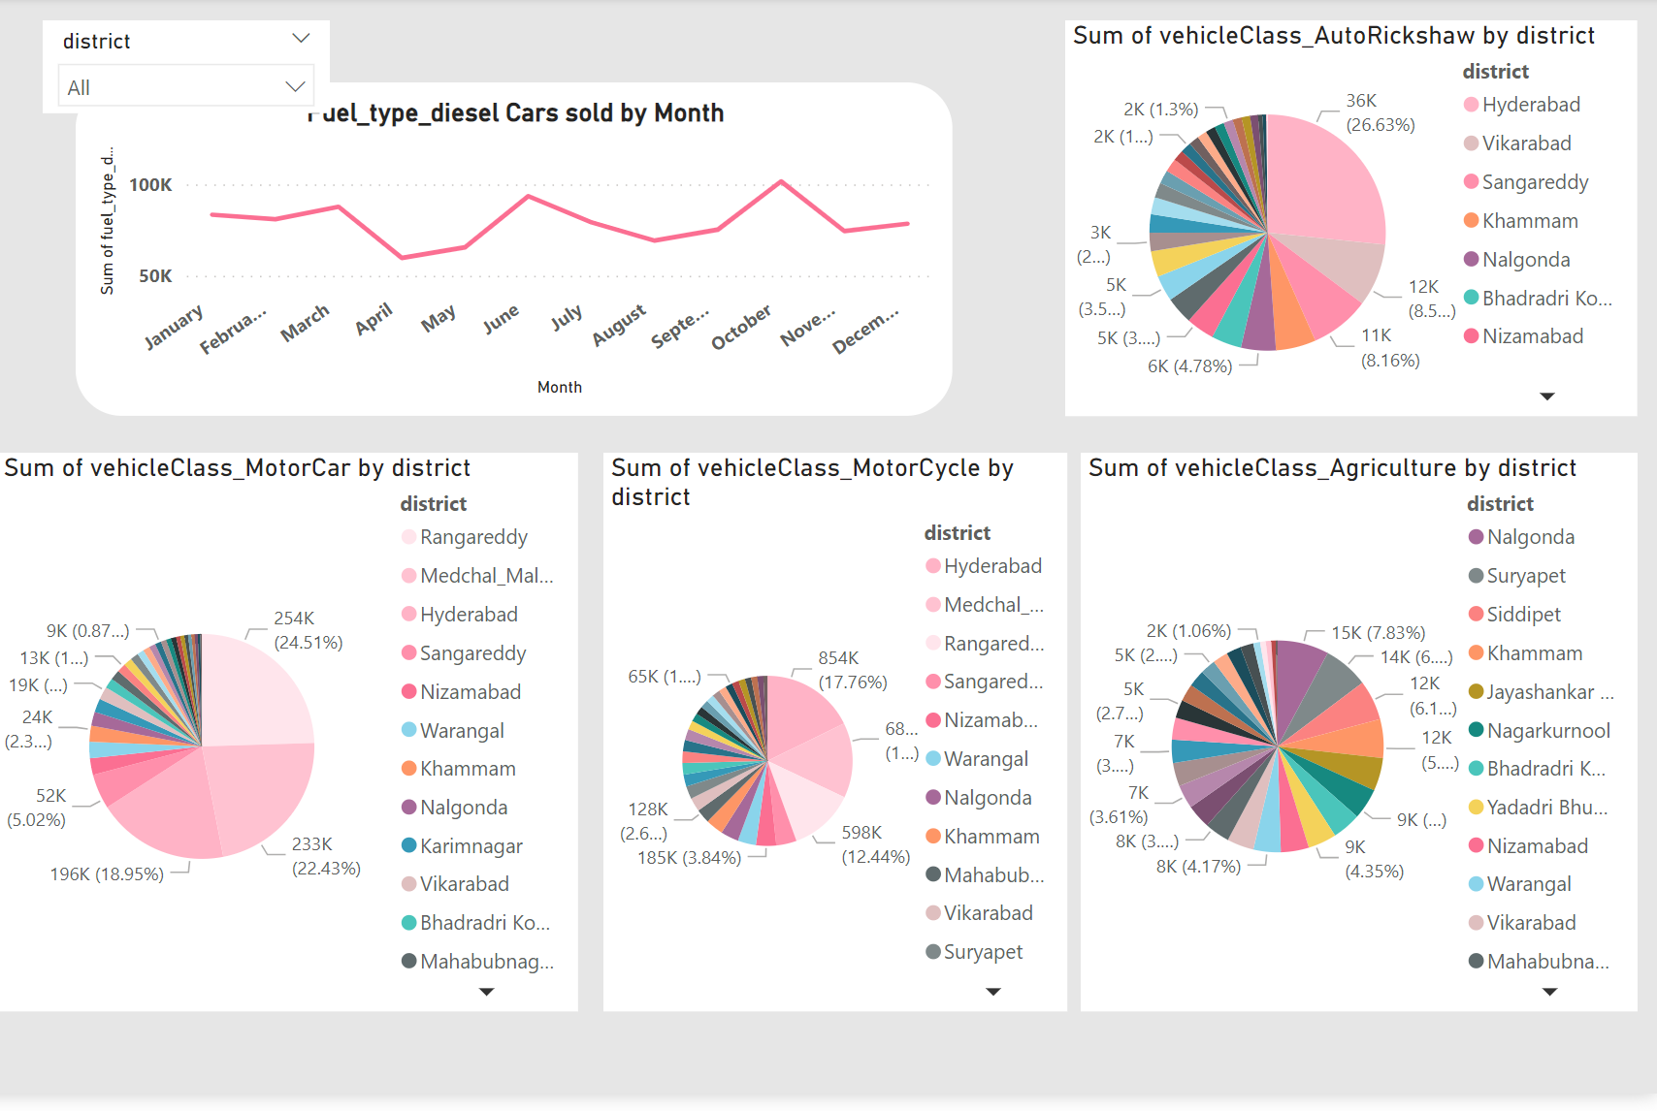
Transportation
Distribution of different types of Vehicles Across Different Districts
Hyderabad district’s first preference is Autorickshaw, and the second preference is Motorcycle.
Rangareddy and Medchal_Malkajgiri districts prefers Motorcars
Nalgonda district prefers Agriculture class vehicles

Slide 15
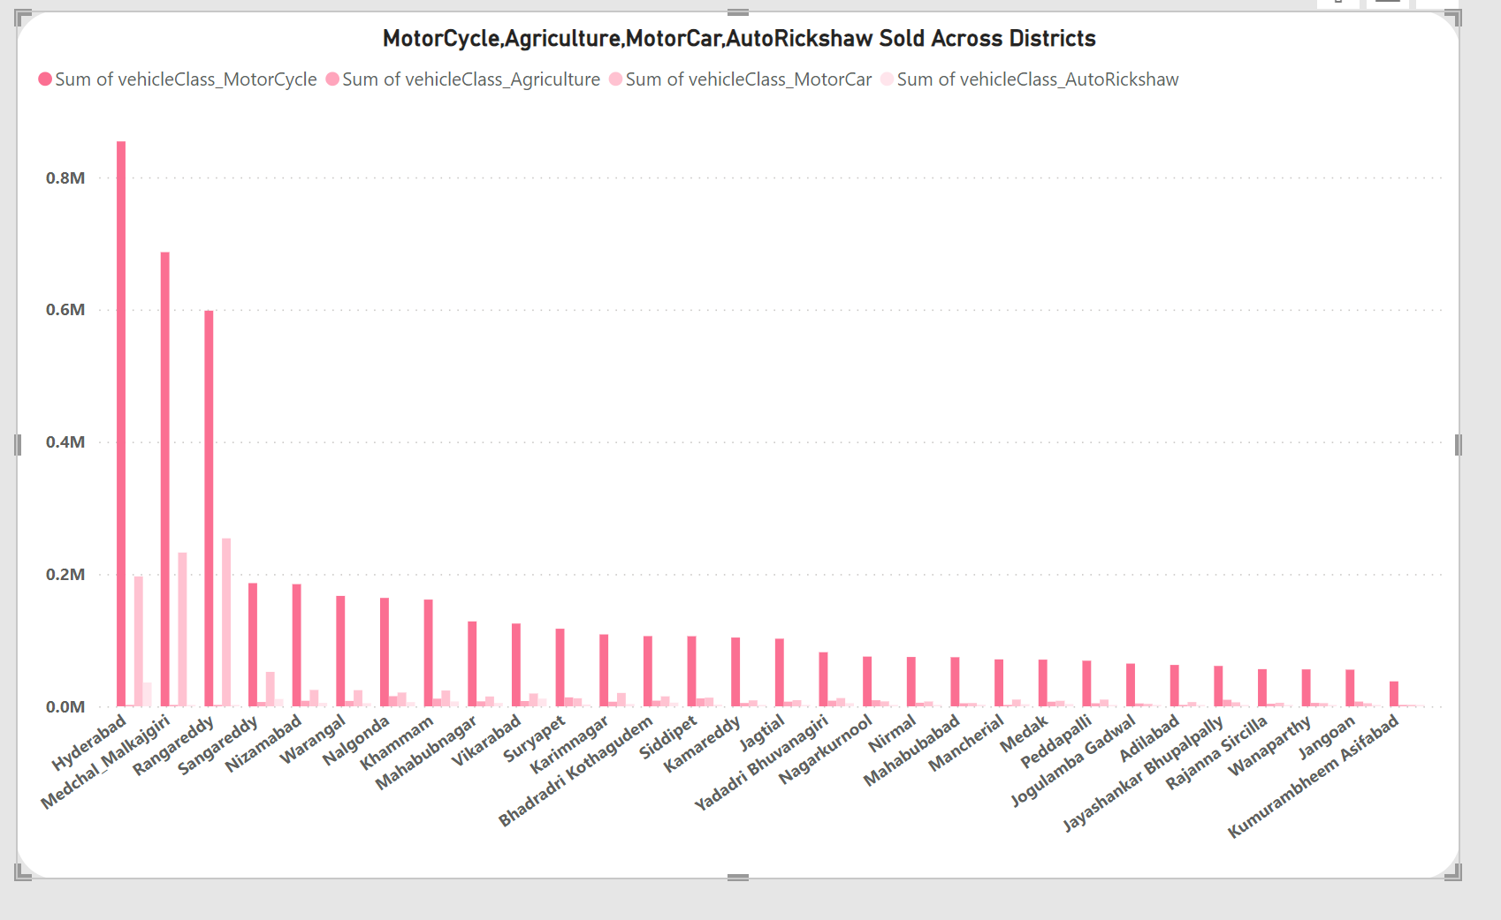
Transportation

Slide 16
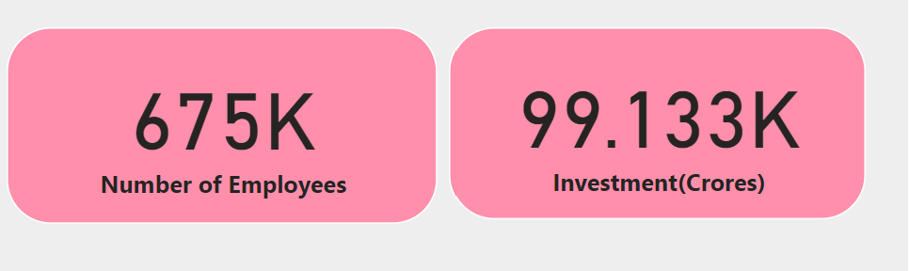
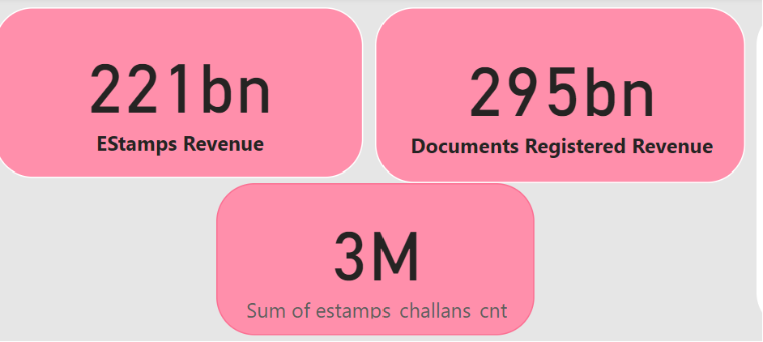
ACHIEVEMENTS
These quantifiable achievements indicate the government's commitment to economic development and job creation through significant investments in sectors. It's essential to further analyze the impact of these investments on the economy, including sectoral growth, GDP contribution, and the quality of jobs created, to comprehensively assess the success of these initiatives.
The introduction of electronic stamps has been invaluable in streamlining administrative processes. It has reduced paperwork and costs, improved document security, and enabled remote stamping, enhancing accessibility. Furthermore, efficient record-keeping and reporting have simplified compliance and auditing, making it an essential tool for modern governments and organizations.

Slide 17
INSIGHTS
INSIGHT 1:
Rangareddy district stands out as a high revenue generator, contributing significantly more than other districts. The government should consider studying the factors contributing to its high stamp revenue and assess whether similar strategies can be applied in other districts.
Medchal_Malkajgiri, Hyderabad, and Sangareddy, have a moderate contribution to the total stamp revenue. While they do not generate revenue as high as Rangareddy, they still play a significant role. The government should consider strategies to optimize revenue collection in these districts further, potentially exploring methods that have been successful in Rangareddy.

Slide 18
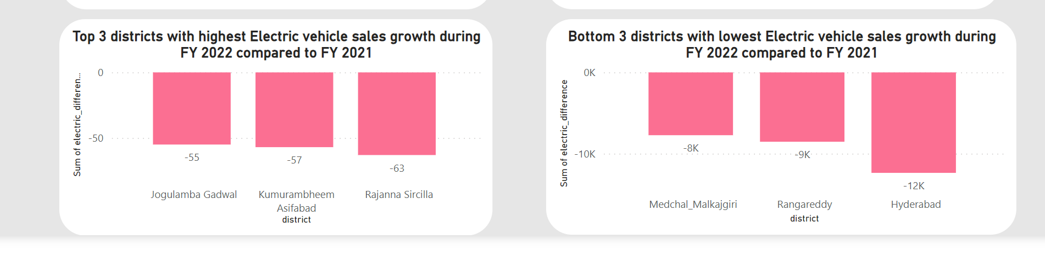
INSIGHTS
INSIGHT 2:
In FY 2022, all districts experienced a decline in electric vehicle sales when compared to FY 2021. There was no district that recorded a growth or increase in EV sales; instead, a decrease was observed across all the districts.
The government can conduct a thorough analysis to identify the reasons behind the decline in electric vehicle sales in these districts. Potential barriers such as lack of charging infrastructure, affordability issues, or consumer awareness may need to be addressed.
Consider offering incentives, subsidies, or tax breaks to encourage the adoption of electric vehicles. These incentives can make electric vehicles more attractive to consumers and help boost sales.

