Slide 1
Diwali sales analysis
The data analysis of Diwali sales data.

Slide 2
Introduction
Diwali, also known as the Festival of Lights, is one of the most celebrated festivals in India, marked by vibrant festivities, religious rituals, and a widespread tradition of gifting.
This analysis delves into the sales dynamics during the Diwali season, aiming to uncover key trends, patterns, and consumer preferences. By examining sales data from various sectors, such as Footwear, Furniture, Home Décor and more, this report seeks to provide valuable insights into the factors influencing purchasing decisions, the effectiveness of marketing strategies, and the overall economic impact of Diwali sales.

Slide 3


Data Acquisition and Cleaning
Data Sources
Data Preprocessing
Explore diverse data sources from various web sources. Data contains 11251 Rows and 15 columns.
Clean and preprocess data to remove outliers, handle missing values, remove unnecessary columns and ensure data consistency.

Slide 4
Exploratory Data Analysis
For the Diwali sales data, EDA involves thoroughly examining the data to identify key trends, anomalies, and relationships that can inform business strategies and marketing efforts during the festive season.
For EDA we used various Python libraries such as Pandas for data preprocessing, NumPy
for numerical calculations to calculate mean, median, mode, standard deviation, and range
for continuous variables like sales amount, and number of units sold.
Matplotlib and Seaborn libraries for visual representation of Data.

Slide 5
statistics
 | Age | Orders | Amount
Count | 11239 | 11239 | 11239
mean | 35.410357 | 2.489634 | 9453.610553
std | 12.753866 | 1.114967 | 5222.355168
min | 12.000000 | 1.000000 | 188.000000
25% | 27.000000 | 2.000000 | 5443.000000
50% | 33.000000 | 2.000000 | 8109.000000
75% | 43.000000 | 3.000000 | 12675.000000
max | 92.000000 | 4.000000 | 23952.000000

Slide 6
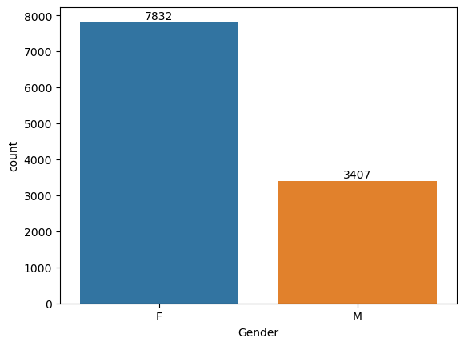
observations
Gender Analysis:
Females purchased more than Males.
No.of Female =7832
No.of Male = 3407
Amount:
Female = 74335853
Male = 31913276

Slide 7
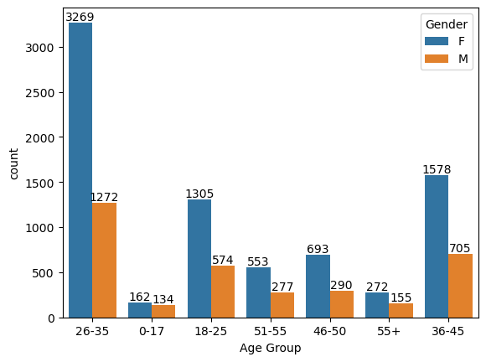
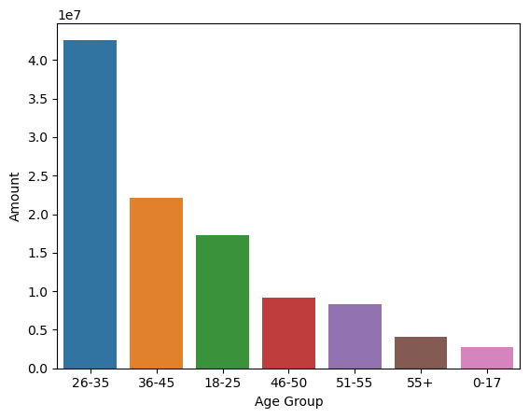
Age Group:
People belonging to the 26-35 age group have given more purchase count.
Amount:
People belonging to 26-35 have highest purchasing amount.

Slide 8
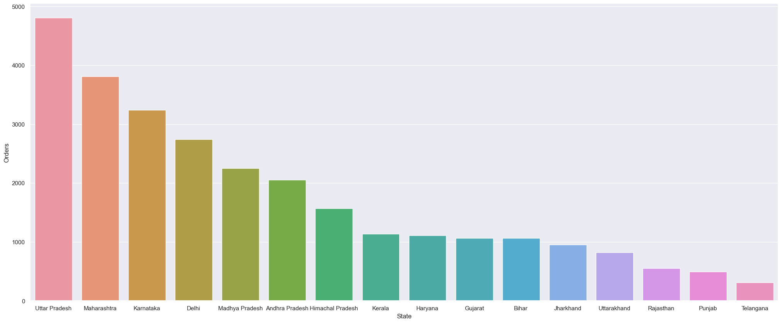
These are the top 10 States who has given more orders for the festival.
Highest=Uttar Pradesh.

Slide 9
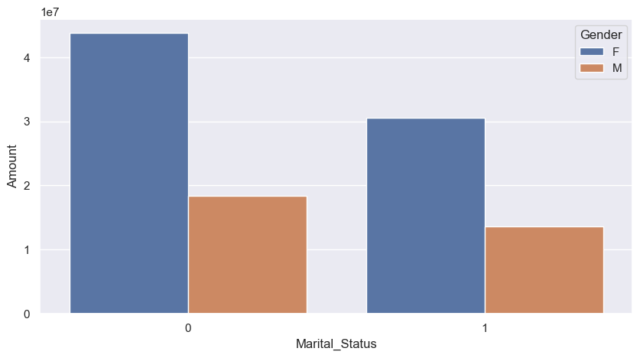
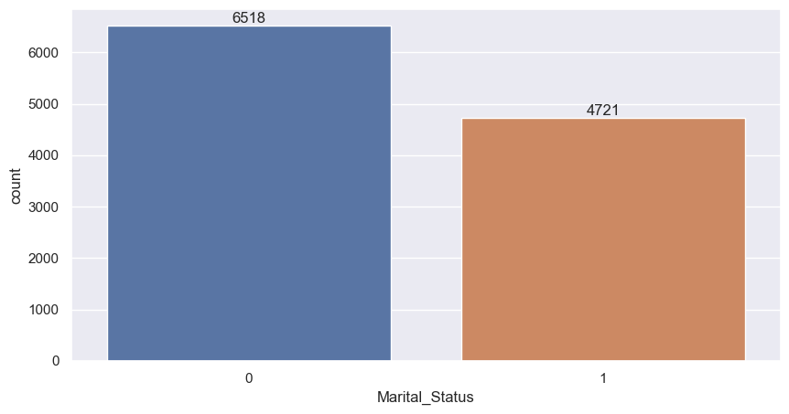
0-Married
1-UnMarried

Slide 10
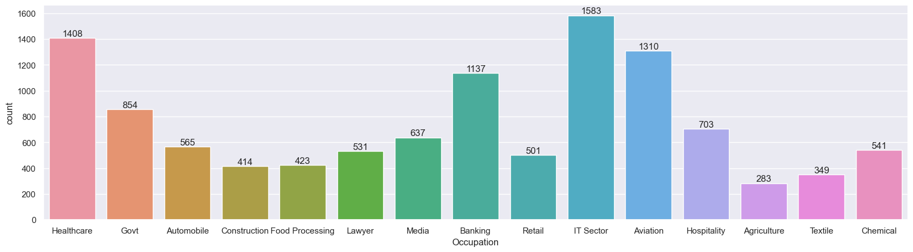
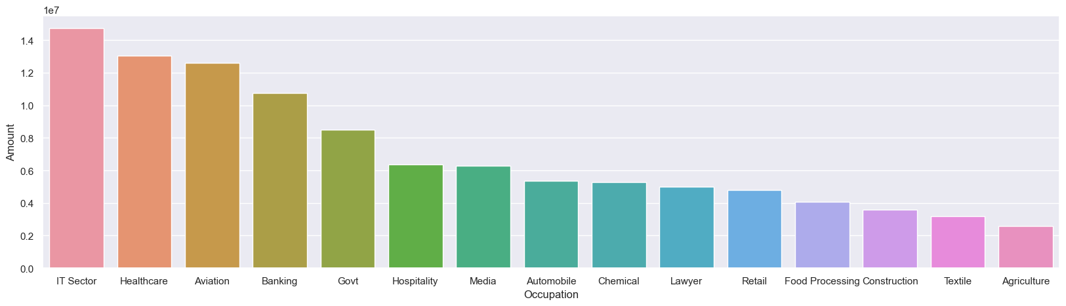
Occupation

Slide 11
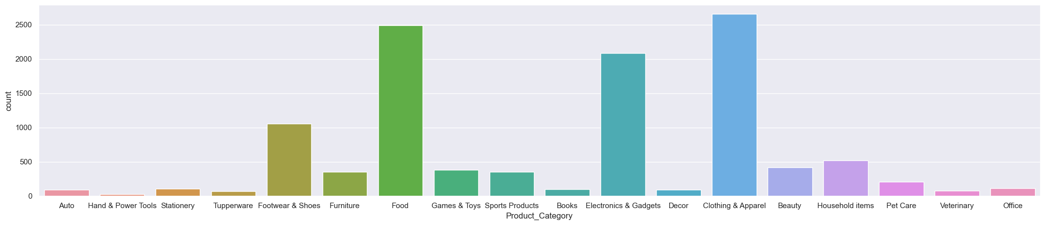
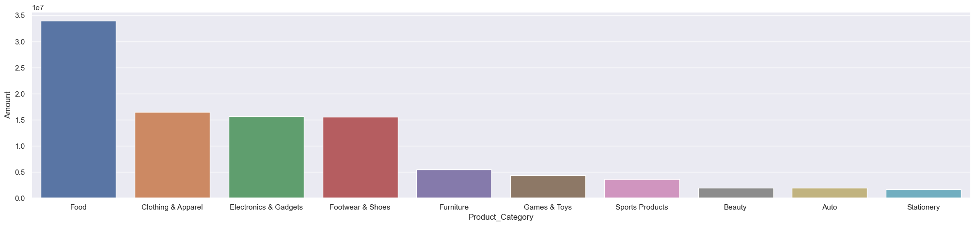
Product Category
Here in count of orders the Clothing and Apparel category is the highest. But in the Amount graph, we found the Food category is the highest.

Slide 12
conclusion
Married women of the age group 26-35 from UP, Maharashtra and Karnataka working in IT, Healthcare and Aviation are more likely to buy products from the food, clothing and electronics categories.
Learnings:
Performed data cleaning and manipulation.
Performed EDA using, Pandas, Matplotlib, and Seaborn libraries.
Improved customer experience by finding potential customers.
Improved sales by identifying the most selling product categories which helps in further planning.

