Slide 1

Title: Sales Dataset Analysis – Advanced Excel Project
M.LALITHAA
27.04.2025
DATA ANALYTICS AND DATA SCIENCE
Feb batch

Slide 2
Sales Data Analysis Project Overview
Project Objective:
To analyze sales data to identify trends, evaluate sales performance, and provide actionable insights for better decision-making.
Goals:
Analyze sales trends over time.
Identify top-performing products and sales channels.
Assess the impact of discounts.
Create a dynamic dashboard for key sales metrics.

Slide 3
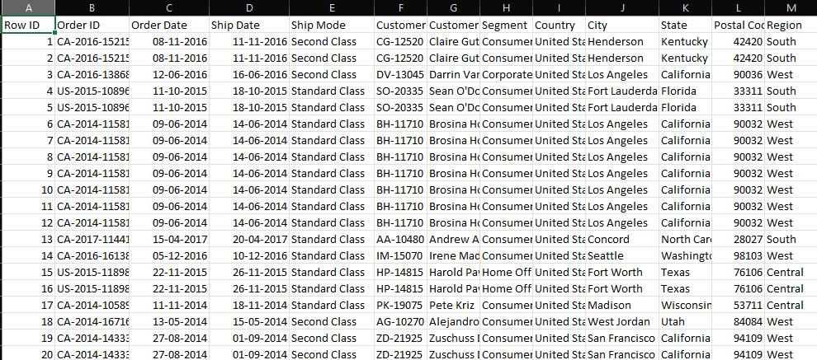
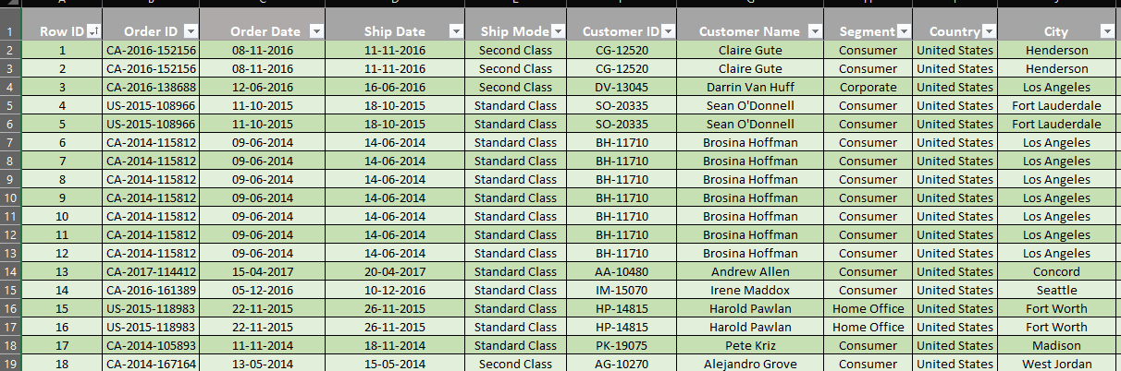
Data Description and Preparation
Dataset Overview: The dataset contains over 10,000 rows of sales transaction data, including fields such as Order ID, Product, Category, Sales, Discounts, Customer Info, and Shipping Mode.
Data Cleaning Steps:
Removed duplicate and blank entries.
Standardized date formats for Order and Ship Dates.
Validated data to eliminate negative Sales or Discounts.

Slide 4
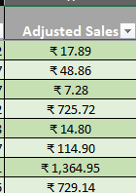
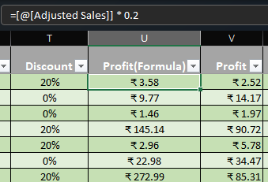
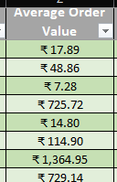
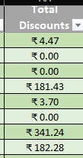
Metric Calculations & Insights
Metrics Calculated:
Adjusted Sales = Sales × (1 - Discount)
Total Gross & Adjusted Sales
Average Sales per Order
Total Discounts
Total Profit

Slide 5
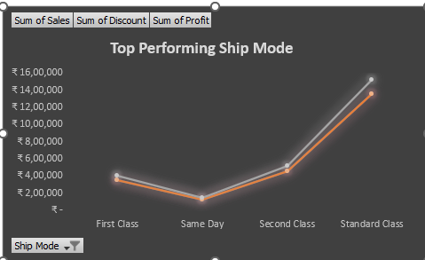
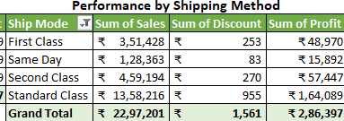
PivotTable Analysis
PivotTable Use:
Analyzed data by Product Category, Ship Mode, and Customer Segment.
Grouped sales by Month/Quarter to identify trends.
PivotCharts:
Bar chart showing Sales by Product Category.
Line chart showing Monthly Sales Trends.

Slide 6
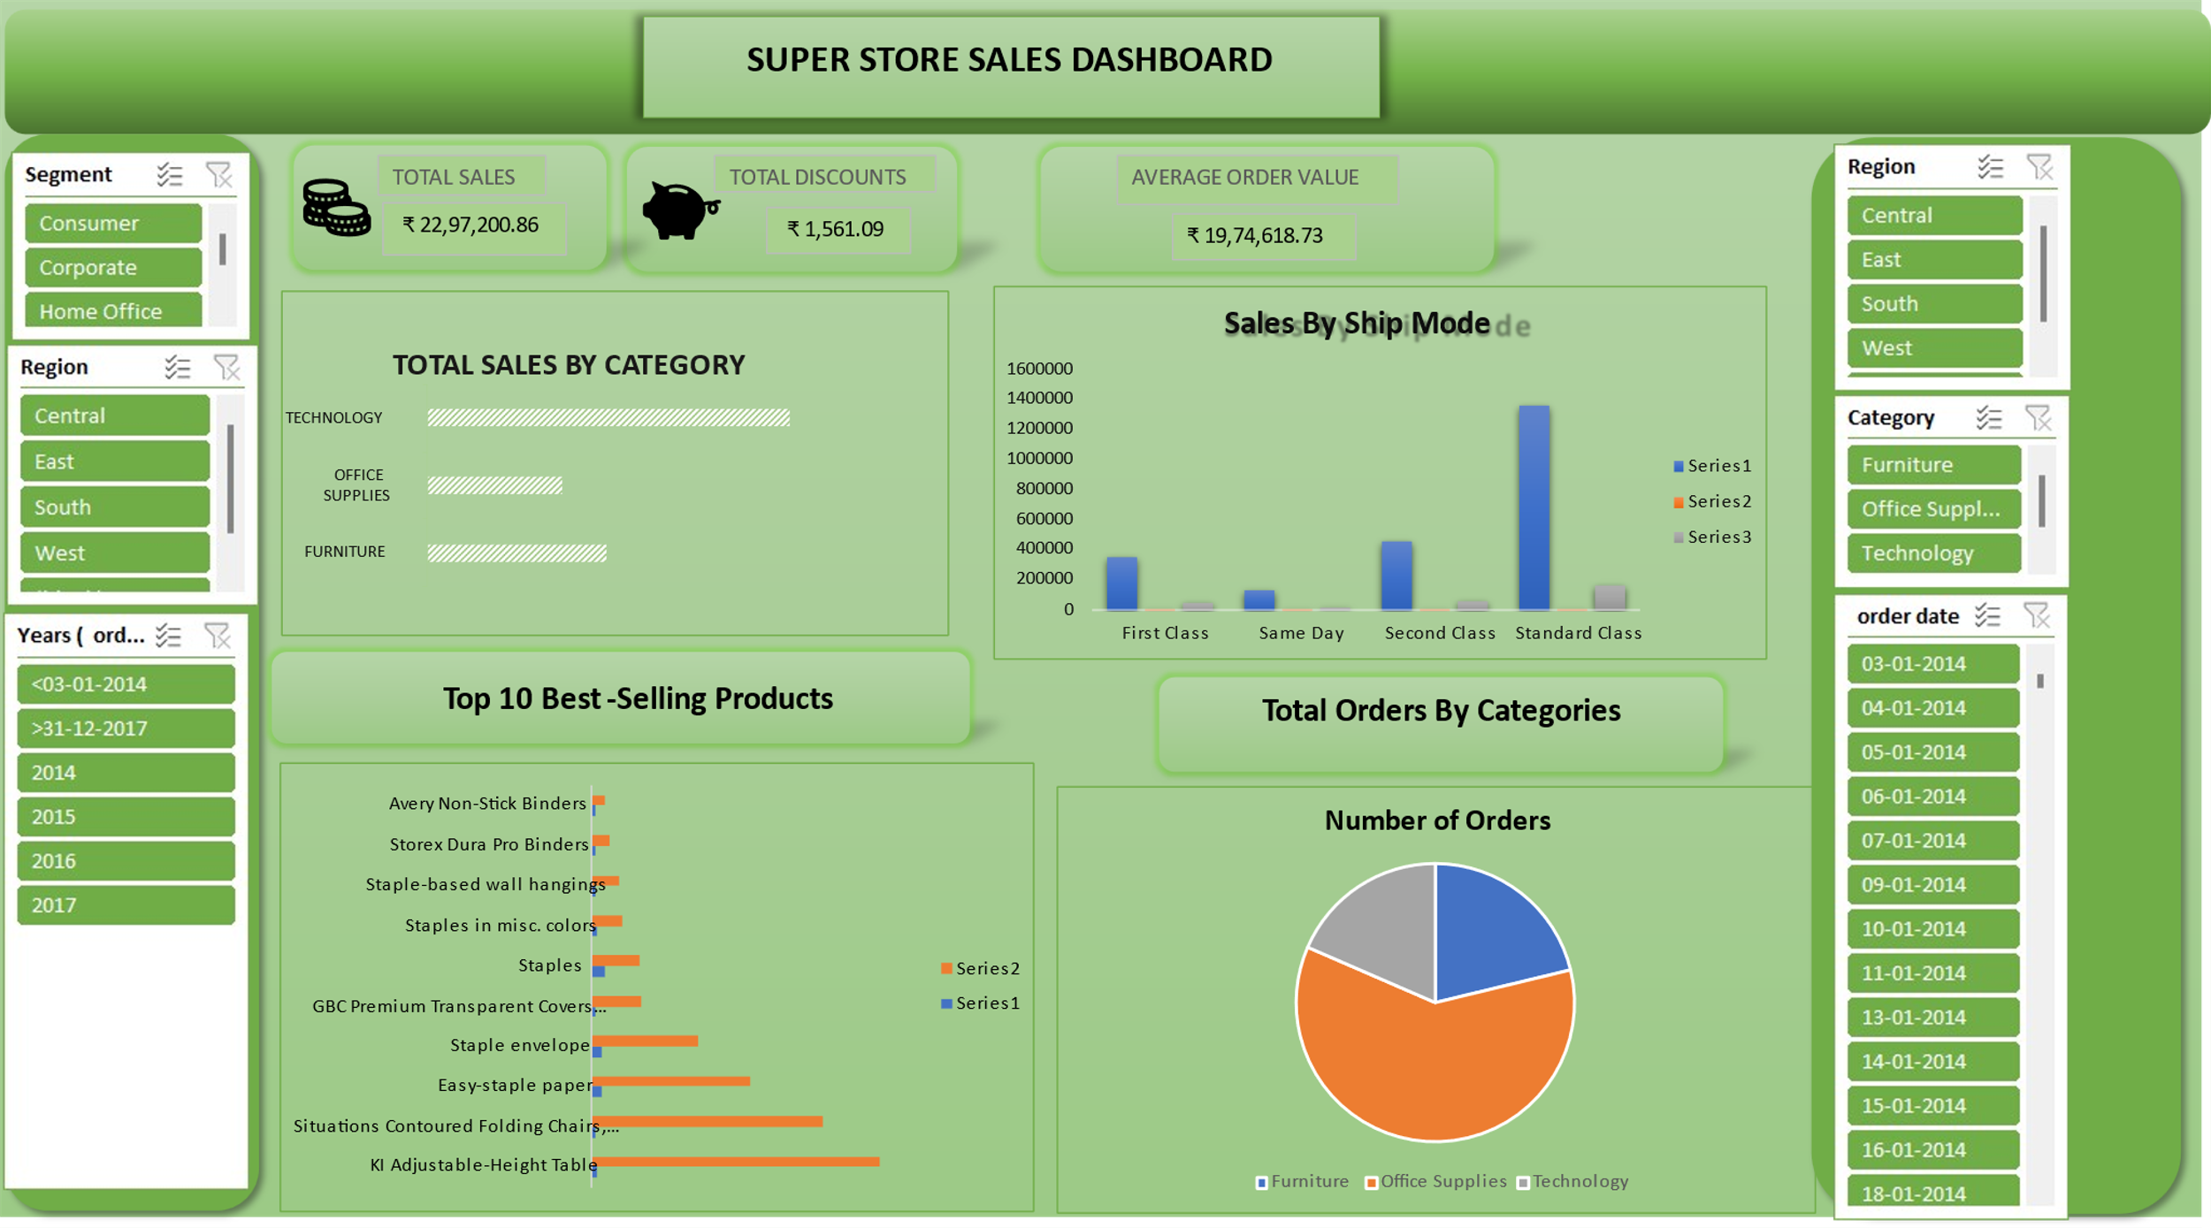
Interactive Sales Dashboard
Dashboard Elements:
KPIs: Total Sales, Avg. Order Value, Total Discounts, Best Products
Slicers for: Product Category, Ship Mode, Region
Dynamic charts that update based on slicer selections.

Slide 7
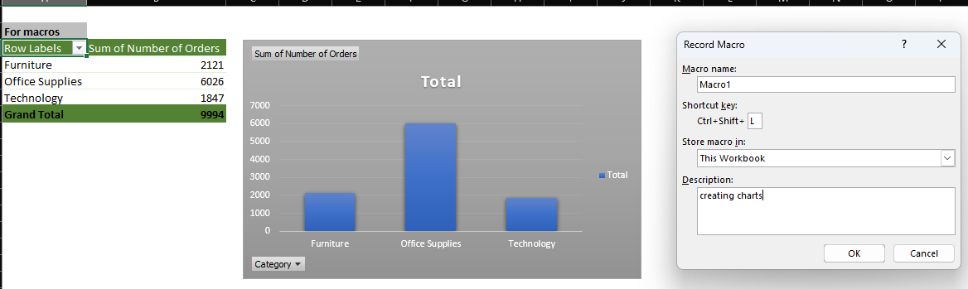
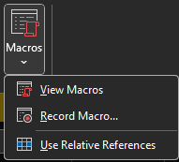
Automation with Macros
How Macros Were Used:
Formatting sheets automatically.
Updating PivotTables and Charts.
Creating buttons for quick analysis refresh.
Benefits:
Saves time, ensures consistency, reduces manual errors.

Slide 8
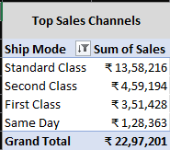
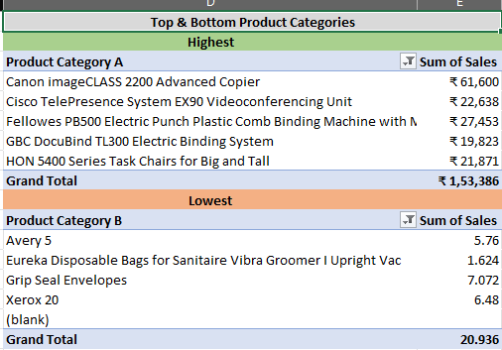
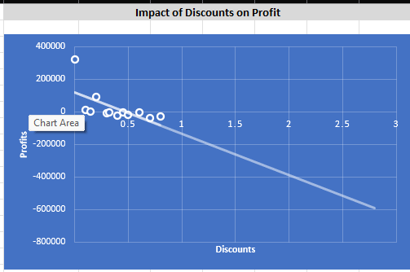
Key Insights
Insights:
Ship Mode “Standard Class" drives highest sales.
Top-performing sales and Tables underperform.
Discounts impact profitability.

Slide 9
Recommendations
Increase marketing spend on the Online Channel, which is the highest contributor to sales.
Reduce discounts on Top-Sales to improve overall profitability.
Focus on promoting Lower-Selling Products, which has the lowest sales.

Slide 10
Conclusion & Next Steps
The analysis provided valuable insights into sales performance, customer behavior, and discount impact.
Next Steps:
Forecast future sales using regression or trendline analysis.
Integrate external factors (e.g., marketing campaigns, holidays).
Expand dashboard to include return rate and customer satisfaction.

Slide 11
THANK YOU!

