Slide 1
Electricity Production and Supply Prediction
Bolem Siva Rama Lalitha Lakshmi
Kukutam Bharath Reddy
Date of Presentation: 17-04-2025

Slide 2
Presentation Outline
Introduction & Problem Statement
Objectives
Literature Review
Data Description
Methodology
Model Architectures
Results
Conclusion & Future Work
References

Slide 3
Introduction
Problem Statement:
Reducing expenses, fulfilling energy demand, and improving grid management all depend on accurate forecasting of electricity production and supply. The objective of this research is to construct a forecasting model in a comparison study employing time series approaches like ARIMA, SARIMA, SARIMAX, and techniques like neural networks such as LSTM, DNN. Prior research on electricity forecasting has mostly concentrated on conventional time series techniques like ARIMA and SARIMA, which work well for stationary and linear data but poorly for non-linear and dynamic patterns. Power producing firms will be able to optimize planning, pricing, and renewable energy initiatives with the help of improved forecasting accuracy, improved grid management, and support for sustainable energy systems.

Slide 4
Objectives:
The primary goal of the project is to build and evaluate the forecasting models for electricity production and supply by utilizing both traditional time series techniques and advanced neural network architectures. The performance of these models will be compared based on the prediction accuracy.
To gather and interpret energy related data along with influential variables such as weather conditions.
To clean, preprocess, and merge various datasets to create a comprehensive and usable dataset.
To use dimensionality reduction methods like Principal Component Analysis (PCA) to identify the most impactful features for accurate forecasting.
To design and implement a range of models including ARIMA, SARIMA, SARIMAX, Long Short-Term Memory (LSTM), and Deep Neural Networks (DNN).
To assess model performance using evaluation metrics such as Root Mean Square Error (RMSE), Mean Squared Error (MSE), and Mean Absolute Error (MAE) and to perform comparative analysis.
To generate future prediction visualizations that support effective energy management, intelligent and eco-friendly energy infrastructures.

Slide 5
Literature Review
SNo. | Title | Authors | Techniques | Accuracy | Abstract
1 | Time-series forecasting with deep learning: a survey | Bryan Lim, Stefan Zohren | RNNs, LSTMs, CNNs, Transformers, Hybrid models | Not specified | Reviews deep learning methods for time-series forecasting, their benefits, challenges, and future directions across various domains.
2 | Electricity demand estimation using ARIMA forecasting model | S. Sharma, S. K. Mishra | ARIMA | Fairly accurate for short-term | Explores ARIMA for electricity demand forecasting, noting its strengths in linear modeling and limitations with nonlinearity.

Slide 6
3 | Probabilistic Forecasting of Multidimensional Time Series for Electricity Load Analysis | Wenxiang Yin, Wen Ye, Guang Liu | Probabilistic forecasting | High accuracy & robustness | Uses probabilistic models to capture uncertainty and improve forecasting accuracy for complex electricity load data.
4 | ARIMA Forecasting of Enterprise Electric Energy Consumption | Yizhuo Liu, Weijia Sun | ARIMA | Accurate for short-term | Applies ARIMA to enterprise energy use, showing good short-term performance but limited handling of complex patterns.
5 | Charging Load Forecasting of EVs Based on VMD-SSA-SVR | Y. Wu, P. Cong, Y. Wang | VMD + SSA + SVR | Better than conventional models | Introduces a hybrid method for EV load forecasting that effectively manages nonlinearity and volatility in time-series data.
6 | EV Charging Load Forecasting via Hybrid Intelligence | S. Deng, J. Wang, L. Tao, S. Zhang, H. Sun | Hybrid intelligent algorithm | Enhanced predictive accuracy | Proposes an adaptive hybrid system for EV charging prediction, offering flexibility and improved accuracy for smart grid applications.

Slide 7
7 | Algorithms in Advanced Artificial Intelligence - Proceedings of ICAAAI-2024 | R. N. V. Jagan Mohan, B. H. V. S. Raju, V. C. Sekhar, T. V. K. P. Prasad | Various AI algorithms | Varies by paper | Conference proceedings covering recent AI algorithm advances with applications in various fields.
8 | Temporal Energy Consumption Exploration and Time Series Forecasting of Electricity Dynamics | Deepali Vora; Nilima Zade; Pransh Patwa; Akshay Kushwaha; Govinda Agrawal; Arjun Sharma | Time-series forecasting | Not specified | Analyzes historical electricity consumption trends and applies forecasting methods to model dynamic energy usage patterns over time.

Slide 8
Data Description
For this project we collected two datasets. One is related to energy production and supply of London City. The other is the weather dataset of the same city, which acts as the dependent factors for the energy production.
Energy Dataset:
This is a daily basis dataset.
It consists of columns: day, energy_median, energy_mean, energy_max, energy_count, energy_std, energy_sum, energy_min.
112 daily CSVs
2949624 rows × 7 columns (after merging, treating outliers, handling missing values)
Weather Dataset:
It contains the variables: 'temperatureMax', 'temperatureMaxTime', 'windBearing', 'icon', 'dewPoint', 'temperatureMinTime', 'cloudCover', 'windSpeed', 'pressure', 'apparentTemperatureMinTime', 'apparentTemperatureHigh', 'precipType', 'visibility', 'humidity', 'apparentTemperatureHighTime', 'apparentTemperatureLow', 'apparentTemperatureMax', 'uvIndex', 'time', 'sunsetTime', 'temperatureLow', 'temperatureMin', 'temperatureHigh', 'sunriseTime', 'temperatureHighTime', 'uvIndexTime', 'summary', 'temperatureLowTime', 'apparentTemperatureMin', 'apparentTemperatureMaxTime', 'apparentTemperatureLowTime', 'moonPhase‘.
882 rows × 32 columns ( before feature engineering)

Slide 9
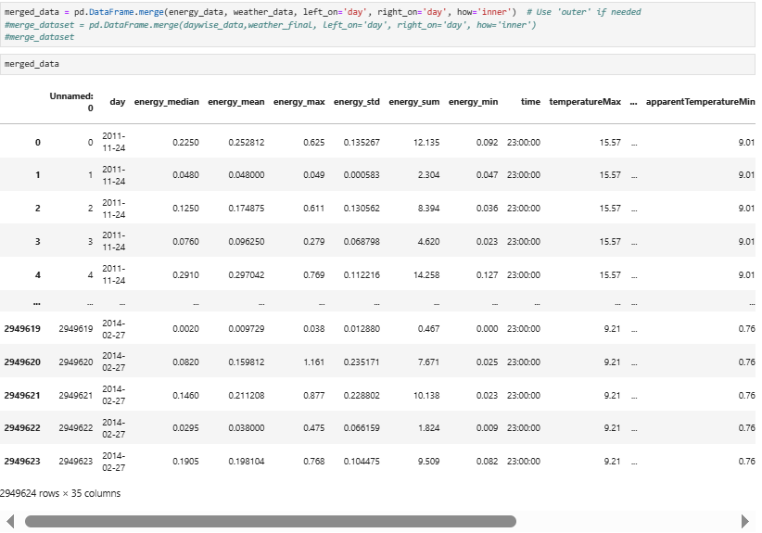
After performing one-hot encoding, add features and removing unnecessary features the shape of the weather dataset is 882 rows × 28 columns
Final Data:
After merging the processed energy data and weather data by considering the daya column as the common column to merge the datasets, the shape of the final dataset is 2949624 rows x 37 columns
Implementing PCA:
We performed dimensionality reduction technique Principal Component Analysis (PCA).
The total number of principal components, which are highly contributing are 17.
Saved the final dataframe into csv file in the local drive.

Slide 10
Methodology
Data Collection
Energy Data
Weather Data
Final Data (Merging)
Data pre-processing
Handling null values
Treating outliers
On-hot encoding
merging
Dimensionality Reduction
Principal Component Analysis (PCA)
Model Building
Statistical Models
Neural Network Models
Model Evaluation
Comparison

Slide 11
The project follows a structured pipeline:
Data Collection: Collected electricity production and supply data from public CSV files.
Data Preprocessing: Handled missing values, removed duplicates, and encoded categorical data.
Feature Engineering & Merging: Created new features and merged multiple datasets for a unified view.
Dimensionality Reduction: Applied PCA to reduce data complexity while retaining key patterns.
Model Building: Implemented ML and DL models including Linear Regression, Random Forest, and LSTM.
Predictions: Models forecasted electricity metrics using test data.
Evaluation: Compared model performance using MAE, MSE, and RMSE; LSTM performed best.

Slide 12
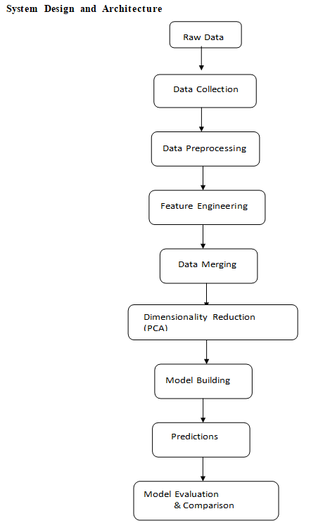

Slide 13
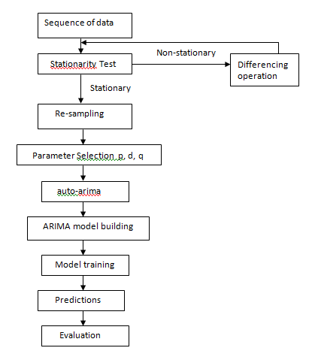
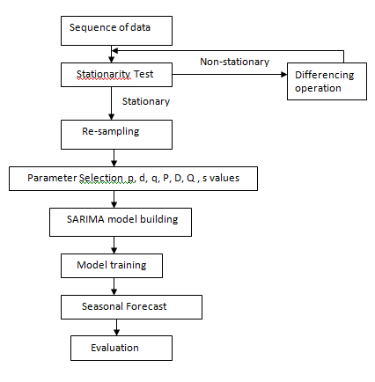
Architecture
ARIMA
SARIMA

Slide 14
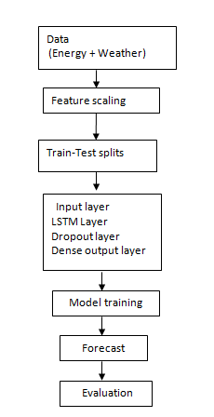
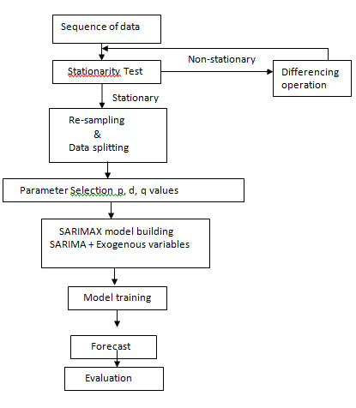
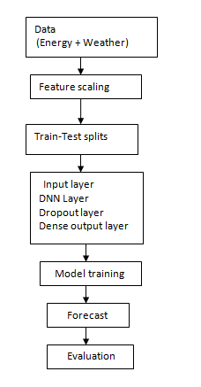
SARIMAX
LSTM
DNN

Slide 15
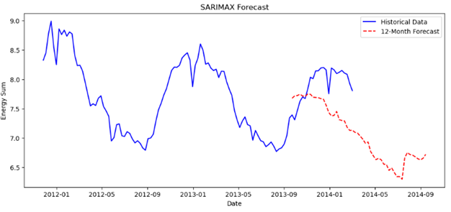
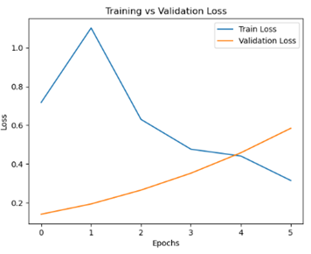
Results
 | ARIMA | SARIMA | SARIMAX | LSTM | DNN
MSE | 0.0292 | 0.6968 | 0.22 | 0.29 | 0.17
MAE | 0.1265 | 0.2162 | 0.08 | 0.12 | 0.04
RMSE | 0.1710 | 0.8347 | 0.28 | 0.35 | 0.21
All models performed well.
SARIMAX and DNN performed best.
External weather features crucial for accuracy.
Residuals mostly normal.

Slide 16
Conclusion & Future Scope
Conclusions
DL models effective for nonlinear trends
SARIMAX and DNN are top performers
Weather data inclusion boosts accuracy
Future Scope
Try hybrid models (ARIMA-LSTM)
Include more external features
Experiment with attention models
Lag analysis
Feature Engineering vs Dimensionality Reduction
Instead of PCA other techniques like multi ….

Slide 17
References
Bryan Lim and Stefan Zohren, "Time-series forecasting with deep learning: a survey", Philosophical Transactions of the Royal Society A, vol. 379, no. 2194, pp. 20200209, 2021.
S. Sharma and S. K. Mishra, "Electricity demand estimation using ARIMA forecasting model", 10.1109/MICAI46078.2018.00008, Jan. 2023.
Wenxiang Yin; Wen Ye; Guang Liu, “Applying Probabilistic Forecasting of Multidimensional Time Series to Electricity Load Analysis”, 10.1109/SEST61601.2024.10693985, July 2023
Yizhuo Liu; Weijia Sun, “ARIMA Time Series Modeling and Forecasting of Enterprise Electric Energy Consumption”, 10.1109/ICFEICT59519.2023.00087, May 2023
Y. Wu, P. Cong and Y. Wang, "Charging load forecasting of electric vehicles based on VMD-SSA-SVR", IEEE Transactions on Transportation Electrification, 2023
S. Deng, J. Wang, L. Tao, S. Zhang and H. Sun, "EV charging load forecasting model mining algorithm based on hybrid intelligence", Computers and Electrical Engineering, vol. 112, pp. 109010, 2023.
R. N. V. Jagan Mohan, B. H. V. S. Rama Krishnam Raju, V. Chandra Sekhar, T. V. K. P. Prasad. "Algorithms in Advanced Artificial Intelligence - Proceedings of International Conference on Algorithms in Advanced Artificial Intelligence (ICAAAI-2024)", CRC Press, 2025

