Slide 1

Global YouTube Statistics 2023
Data Source: https://www.kaggle.com/datasets/nelgiriyewithana/global-youtube-statistics-2023

Slide 2
Youtube Subscribers Prediction Analysis
Problem Statement: YouTube channel owners may not have adequate knowledge or expertise to assess the current subscription trend or predict the future growth. Need to identify factors such as video views, engagement, trends which will help prediction analysis.
Objective: The primary objective of this prediction analysis is to develop a statistical model(s) that can accurately forecast future subscriber numbers based on historical data and relevant predictor variables. The model should help identify key factors that significantly impact subscriber growth, allowing channel owners to tailor their content and marketing strategies effectively.

Slide 3
Youtube Subscribers Prediction Analysis
Response variable/output variable/labeled data/dependent (y) variable:
Y: Subscribers
Predictor variable/input attributes/ input features/ independent variables (x):
X1: Video Views
X2: Uploads
X3: video_views_for_the_last_30_days
X4: highest_monthly_earnings
X5: lowest_monthly_earnings
X6: highest_yearly_earnings
X7: lowest_yearly_earnings
X8: subscribers_for_last_30_days
X9: Gross.tertiary.education.enrollment....
X10: Population
X11: Unemployment.rate
X12: Urban_population

Slide 4
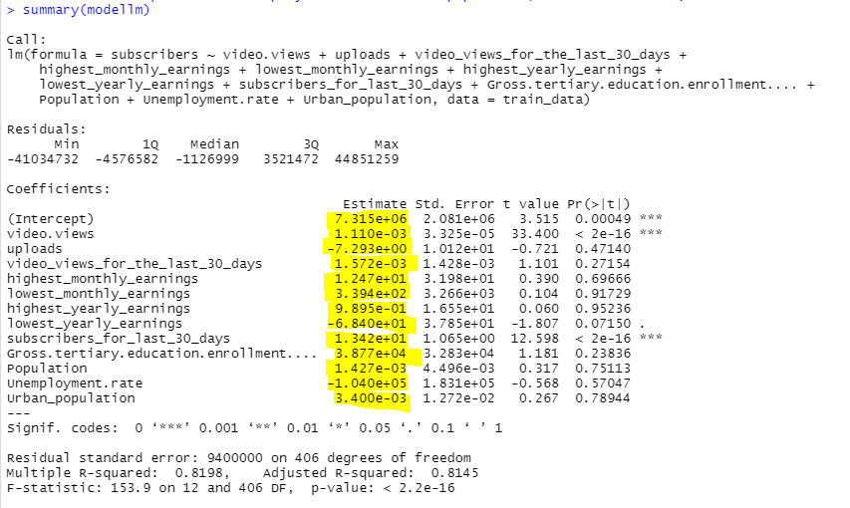
Multiple Linear Regression (statistical technique used to model the relationship between multiple independent variables and a dependent variable.
Performed data preprocessing techniques:
Remove rows with any missing values (NA) in training and testing data to avoid errors in model fitting and prediction values.
Fit a Multi Linear Regression model to the training data.
Regression model:
Y = β₀+ β1 x1 +β2 x2 + β3 x3 + β4 x4 + β5 x5 + β6 x6 + β7 x7 + β8 x8 + β9 x9 + β10 x10 + β11 x11+ β12 x12
Y = 7.315e+06+ 1.110e-03 x1 -7.293e+00 x2 + 1.572 e-03 x3 + 1.247e+01 x4 + 3.394e+02 x5 + 9.895e-01x6 -6.840e+01 x7 + 1.342e+01 x8 + 3.877e+04 x9 + 1.427e-03 x10 -1.040e+05 x11+ 3.400e-03 x12

Slide 5
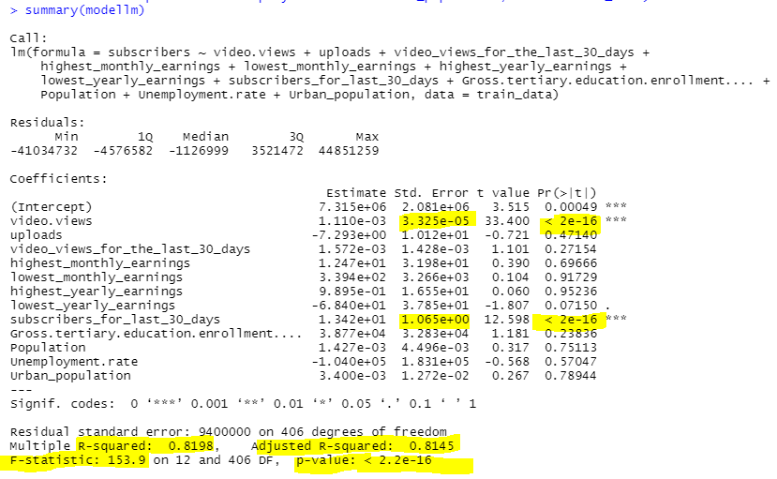
Multiple Linear Regression - Summary analysis
Highly significant predictor (Subscribers for last 30 days) with response variable (subscribers):
A smaller standard error suggests that the estimate is more likely to be close to the actual value. Considering smaller the standard error and p value is very small Subscribers for last 30 days is highly significant.
Model evaluation:
R^2 = 82%, adjusted R^2 = 81%
Indicates that the model building is good and model is a good fit.
F statistics:
As a overall significance of the model is really good. F = 154 and p value = 2.2e-16
Conclusion:
Since p value < alpha, we reject null hypothesis and conclude alternative hypothesis. We have significant evidence to say that at least one of the coefficients (betas) are equal to zero.

Slide 6
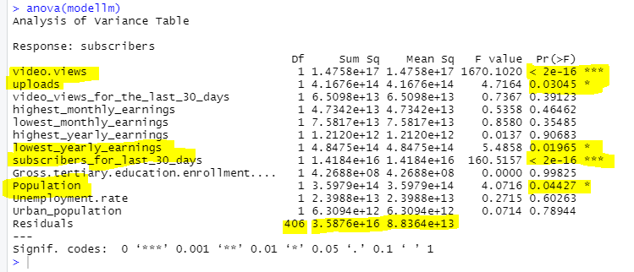
Multiple Linear Regression - Anova analysis
Video views (p value = 2e-16), subscribers for last 30 days (p value = 2e-16) are very significant as p value < alpha (0.05) suggesting that if the video views increases, the subscribers count also increases.
Predictors such as video views, uploads, lowest yearly earnings, subscribers for last 30 days, population are significant, important predictors and can not be dropped, other predictors can be dropped from the model.

Slide 7

Multiple Linear Regression – Confidence Interval
If we want to increase the number of video views, what is the range of subscribers we may expect, with 95% confidence?
The confidence interval for the coefficient of 'video.views’ (β1) in the linear model ranges from 0.00104514 to 0.001175862 at a 95% confidence level.
This interval suggests that for every video view, we can be 95% confident that the number of subscribers will increase by between approximately 0.00104514 and 0.001175862 units.

Slide 8
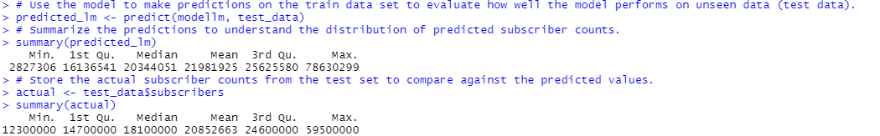
Multi Linear Regression Model - Predictions
Make predictions on the train data set to evaluate how well the model performs on unseen data (test data).
Summarized the predictions to understand the distribution of predicted subscriber counts.
The predicted subscriber counts have a minimum of 2,827,306, a median of 20,344,051, and a maximum of 78,630,299.
This wide range suggests that the dataset likely includes a diverse set of channels with varying popularity and reach.
Summarized actual subscriber counts from the test set to compare against the predicted values.
The actual subscriber counts have a minimum of 12,300,000, a median of 18,100,000, and a maximum of 59,500,000.
There seems to be overestimation across predicted when compared actual vs. predicted.

Slide 9
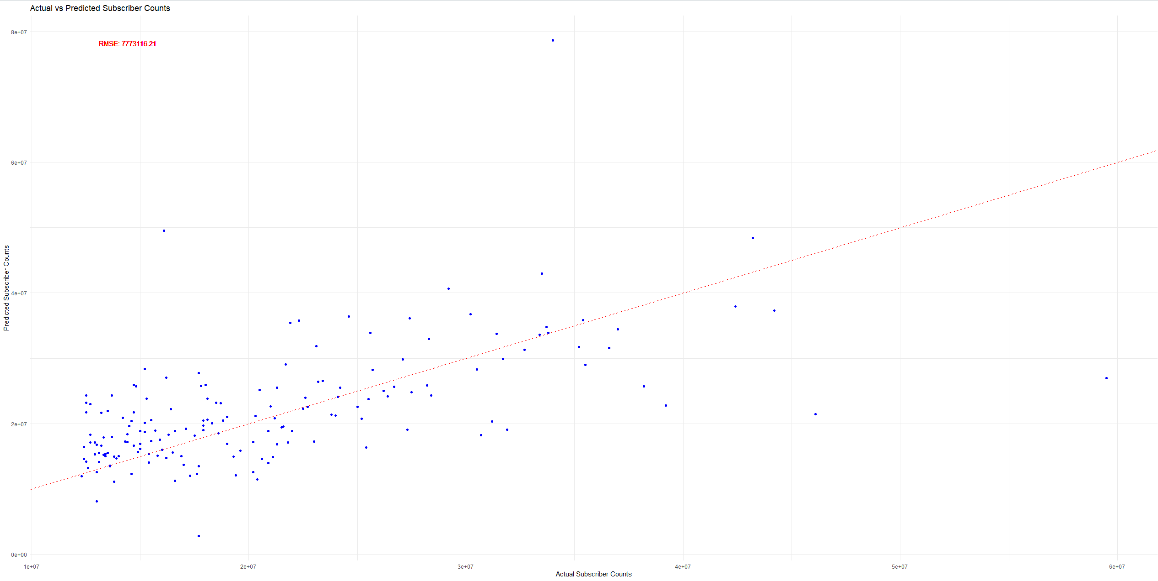
Multi Linear Regression Model - RMSE
Calculated the Root Mean Squared Error (RMSE) to measure the average magnitude of the errors between predictions and actual values.
The model's average prediction error is 7,773,116 subscribers, indicating significant inaccuracy.

Slide 10
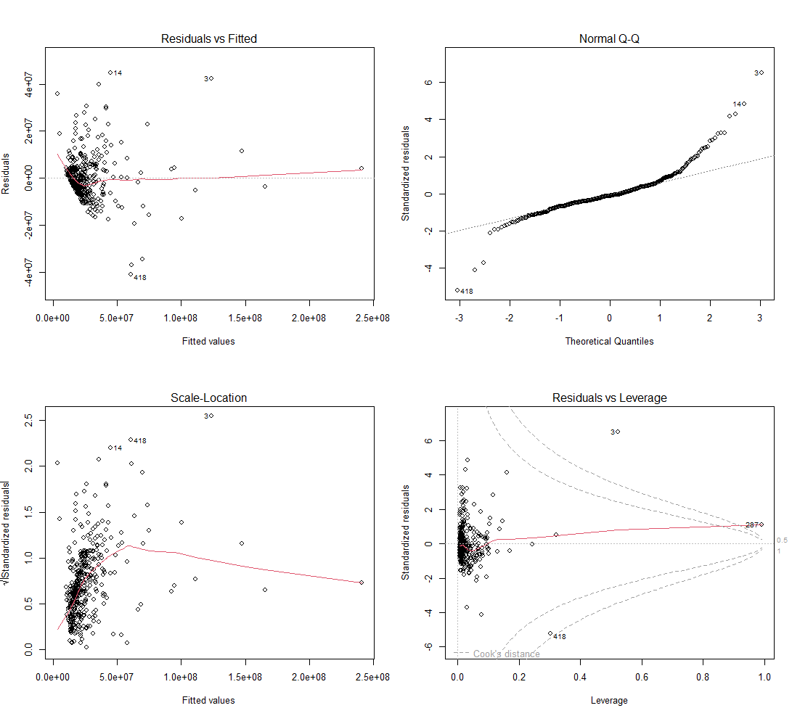
Multiple Linear Regression – Residual Analysis
Residual analysis to check linear model assumptions:
It looks to be there are problems with linear patterns, normality, constant variance. It is nonlinear pattern. There are outliers/unusual observations exists y=3, 418.

Slide 11
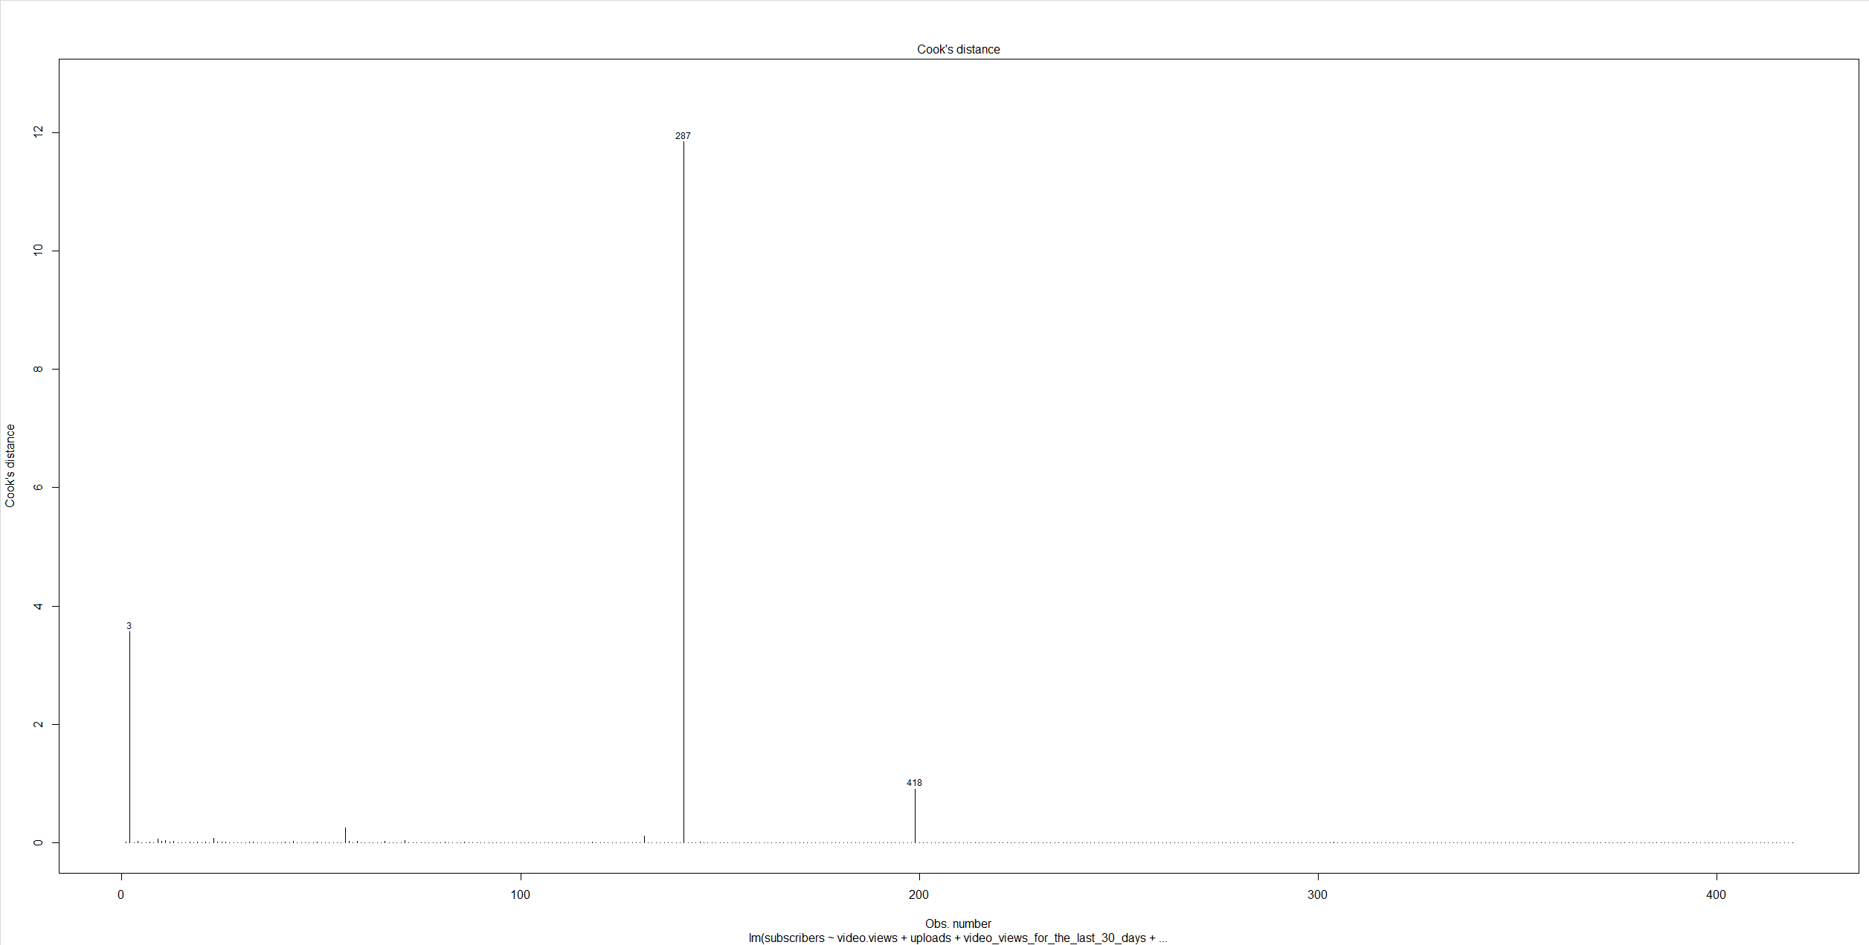
Multi Linear Regression Model – Cook’s Distance
Cook's distance was used to assess the impact of individual observations on the Linear regression model, revealing that the data point 287 at y=12 is and influential observation that affects the model's predictions.

Slide 12
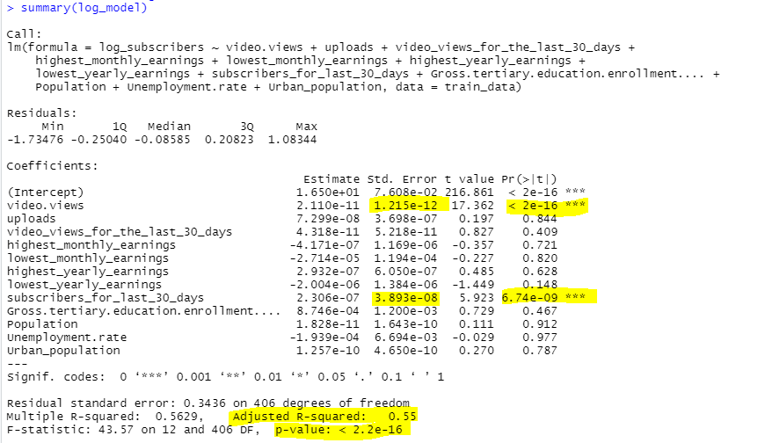
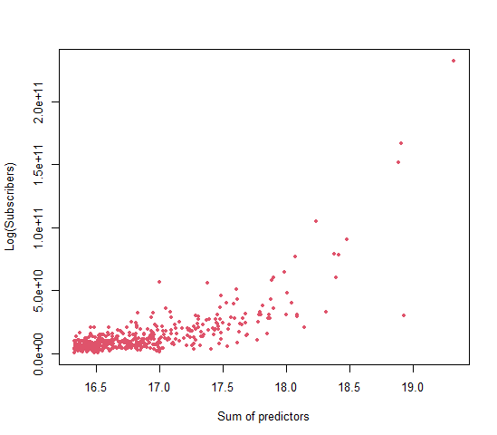
Multi Linear Regression – Log Transformations
Applied Log transformations to improve the model fit:
Video views is more significant. Adjusted R^2 is 55% which is not the best model. Overall model p value 2.2e-16 is significant.

Slide 13
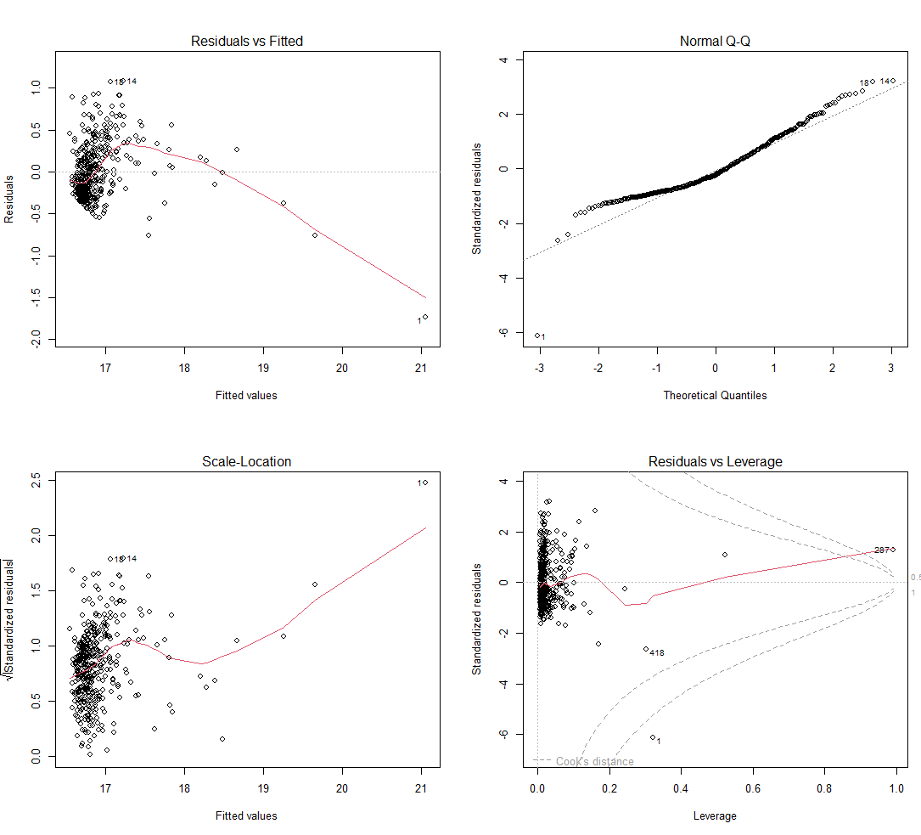
Multi Linear Regression – Log Transformations – Residual Analysis
Residual analysis to check linear model assumptions:
It looks to be there are problems with linear patterns, normality, constant variance. There are outliers exists y=1, 418.

Slide 14
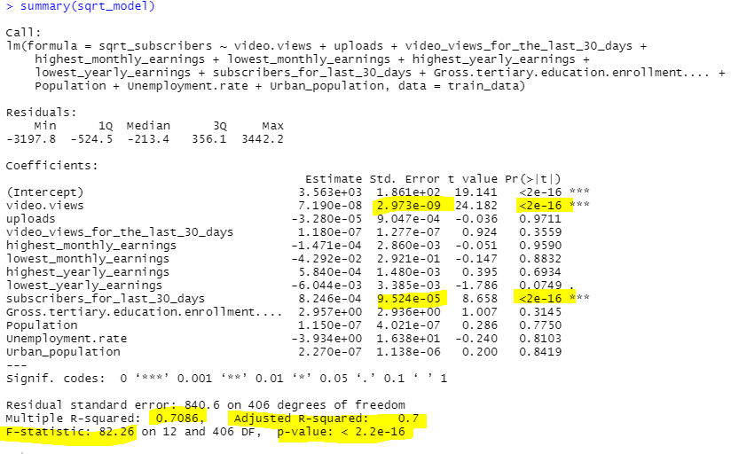
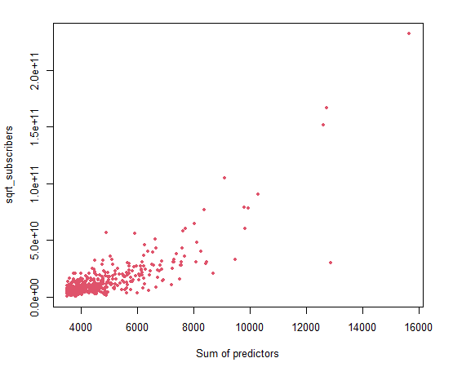
Multi Linear Regression – Sqrt Transformations
Applied Sqrt transformations to improve the model fit:
Video views is more significant (standard error = 2.973e-09, p value = 2e-16). Adjusted R^2 is 70% which is good model. Overall model p value 2.2e-16 is significant, F test = 82.26.
Sqrt transformations model is much better choice than Log transformations model.

Slide 15
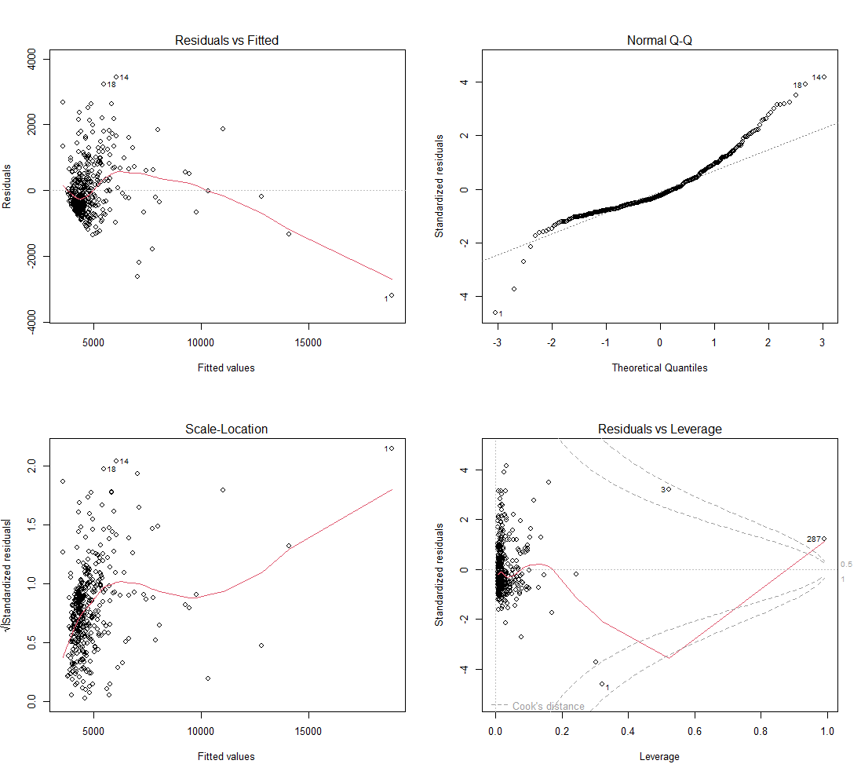
Multi Linear Regression – Sqrt Transformations - Residual Analysis
Residual analysis to check linear model assumptions:
It looks to be there are problems with linear patterns, normality, constant variance. There are outliers exists y=3, 1.

Slide 16
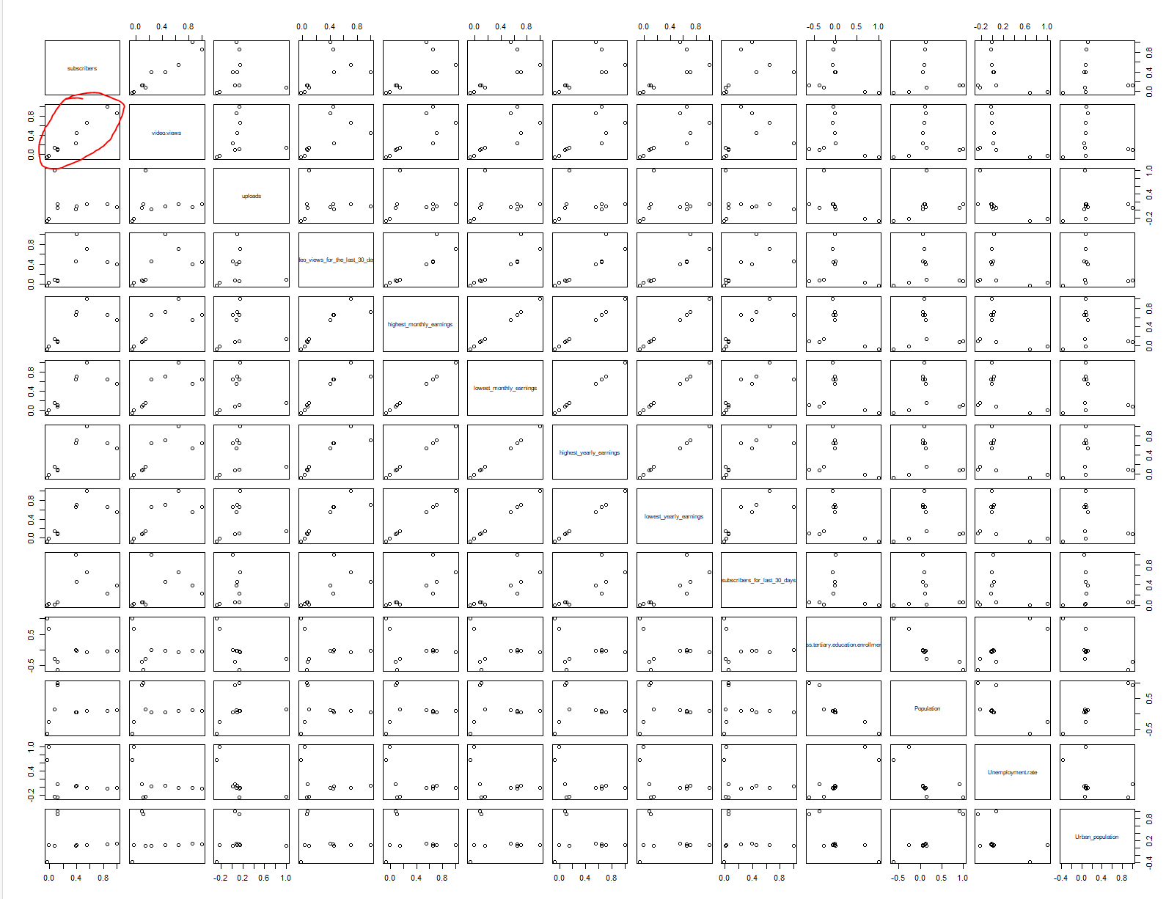
Multi Linear Regression – Correlation Analysis – Subscribers and Video Views highly correlated

Slide 17
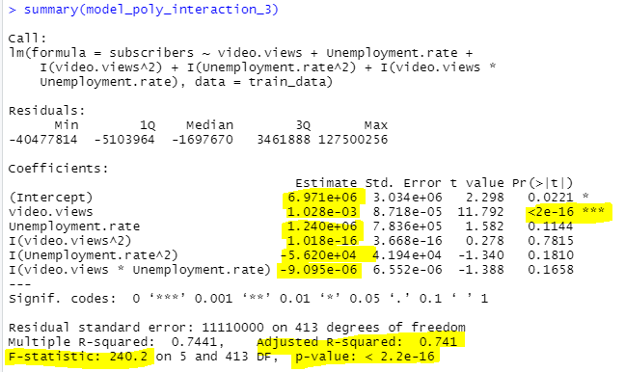
Polynomial Regression Model
How does the interaction between video views and unemployment rate influence the subscriber count?
Regression model:
Y= subscribers
X1 = Video Views, x2 = unemployment rate
Y = β₀+ β1 x1 +β2 x2 + β11 x1^2 + β22 x2^2 + β12 x1 x2
Y = 6.971e+06 + 1.028e-03 x1 + 1.240e+06 x2 + 1.018e-16 x1^2 – 5.620e+04 x2^2 – 9.095e-06 x1x2
Video views are more significant (p value = 2e-16). Adjusted R^2 is 74% which is good model. Overall model p value 2.2e-16 is significant, F test = 240 which is very high.
The interaction between video views and unemployment rate does not influence the subscriber count and as they are not significant predictors (p value 0.1658 > alpha 0.05).

Slide 18
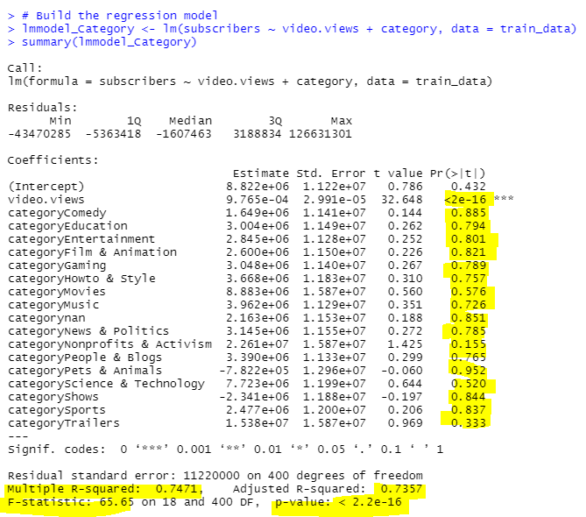
Multi Linear Regression Model: Video views, Categories
How does the significance of video views compare to content categories in predicting subscriber count?
Regression model:
Y= subscribers
X1 = Video Views, x2 = category
Y = 8.822e+06 + 9.765e-04 x1 + 1.649e+06 c1 + 3.004e+06 c2 + 2.845e+06 c3 + 2.600e+06 c4 + 3.048e+06 c5 + 3.668e+06 c6 + 8.883e+06 c7 + 3.962e+06 c8 + 2.163e+06 c9 + 3.145e+06 c10 + 2.261e+07 c11 + 3.390e+06 c12 - 7.822e+05 c13 + 7.723e+06 c14 - 2.341e+06 c15 + 2.477e+06 c16 + 1.538e+07 c17
To increase the subscriber growth, strategies should primarily aim to boost video views, as they show a significant relationship with subscribers count (p value 2e-16 < alpha 0.05).
Content categories, are not significant predictors in this analysis, it may still influence viewer engagement and should not be disregarded, as they might interact with other unexamined factors to affect subscriber growth.

Slide 19
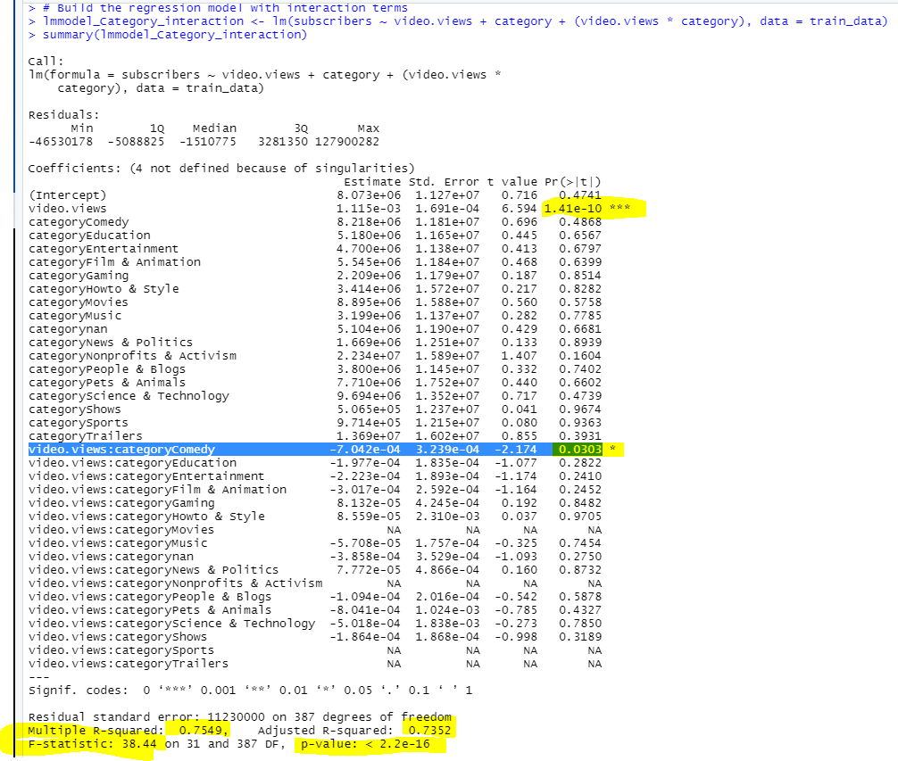
Multi Linear Regression Model: Video views, Categories
By including the interactive terms will the model be improved.
Yes, Model looks to be a good fit with Adjusted R^2 = 74%. Overall model p value (2.2e-16) < alpha (0.05).
Category comedy is significant (p value 0.0303 < alpha 0.05) predictor in the model.

Slide 20
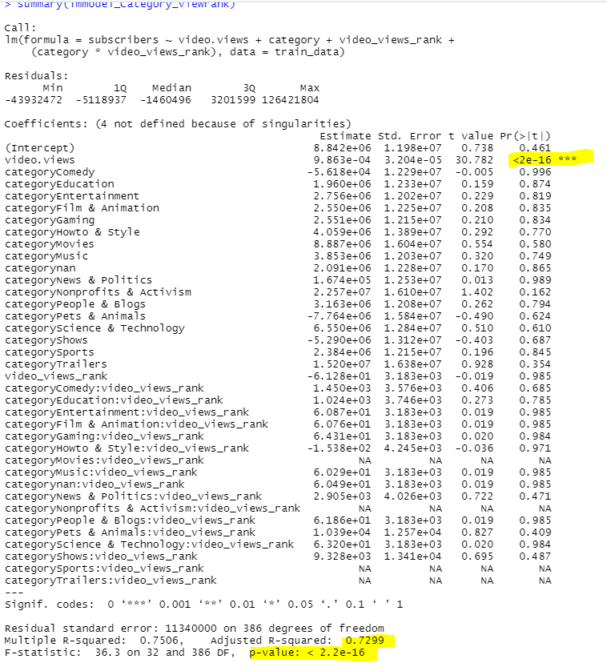
Multi Linear Regression Model: Video views, Categories, video views rank
How does the significance of video views compare to content categories, video views rank in predicting subscriber count?
Video views rank and its interaction with Categories is not significant for predicting subscribers count might need further reevaluation.
Adjusted R^2 = 73% model is a good fit. P value <2.2e-16 is very significant.

Slide 21
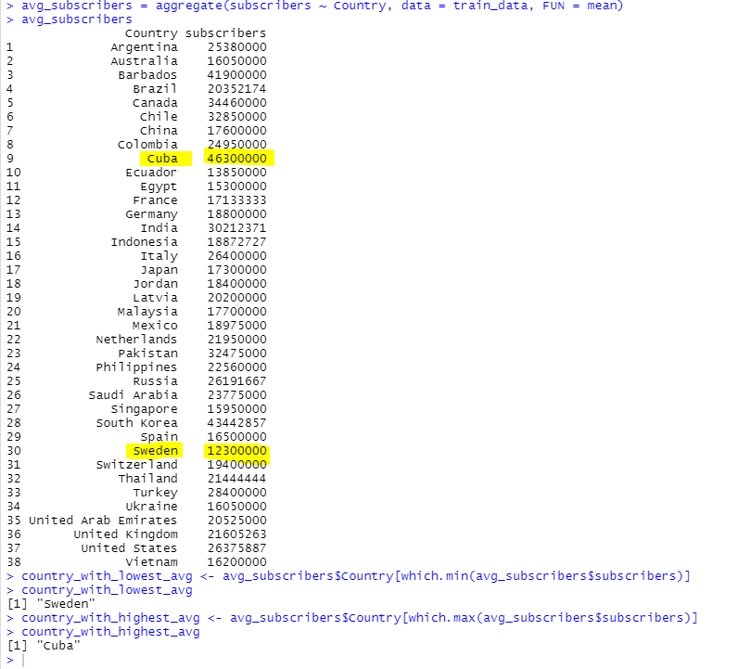
Average Subscribers for each country
The country with the highest average number of subscribers is Cuba, and the country with the lowest is Sweden. This could suggest a wide disparity in YouTube subscriber counts across countries.

Slide 22
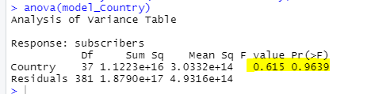
Anova – Subscribers, Country
Df: There are 37 df suggests that there are 38 countries in the dataset.
Sum of squares Regression (Country) is larger.
Mean square Regression (Country) is smaller.
F value = 0.615, P value (0.964) > alpha (0.05) we fail to reject null, and we do not have sufficient evidence to say that country is a significant variable, other factors need to be considered.

Slide 23
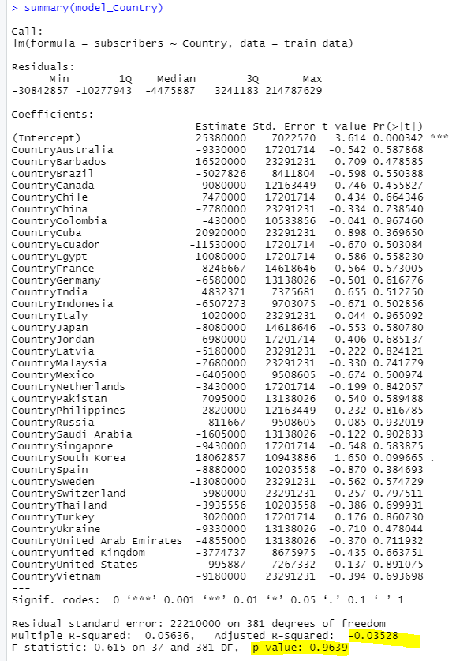
Summary - Subscribers, Country
Individual predictors for Country variable p values are not significant indicating that none of the Countries have direct effect on subscribers’ growth.
Adjusted R^2 is very low, indicating that model is not a good. P value is > alpha we do not have sufficient evidence to claim that Countries have direct effect on subscribers’ growth.

Slide 24

Conclusion
This layered approach to regression analysis aims to equip YouTube content creators with a data-driven strategy for growth

Slide 25
RCode
##############################################Model2##########################
setwd("C:\\Lalitha_UHCL\\Fall_2023\\datasets")
df = read.csv("Global YouTube Statistics.csv", header = TRUE, sep = ",")
Df
#check for columns names
print(names(df))
############################
##########Train and Test data split
##############################
#install.packages("caTools")
library(caTools)
# Set a random seed for reproducibility of results.
set.seed(123)
# Split the dataframe into training and testing sets using sample.split
# to ensure that approximately 70% of the data is used for training.
splitIndex <- sample.split(df$subscribers, SplitRatio = 0.7)
train_data <- df[splitIndex, ]
test_data <- df[!splitIndex, ]
# Removed rows with any missing values (NA) in training and testing data to avoid errors in model fitting and prediction.
# Missing data can lead to 'nan' in RMSE calculations because missing values in the predictors or response
# can't be used in model computations.
train_data <- na.omit(train_data)
test_data <- na.omit(test_data)
############################
##########Fit linear regression model and Residual Analysis
##############################
# create linear regression model
modellm <- lm(subscribers ~ video.views + uploads + video_views_for_the_last_30_days + highest_monthly_earnings + lowest_monthly_earnings +
highest_yearly_earnings + lowest_yearly_earnings + subscribers_for_last_30_days + Gross.tertiary.education.enrollment.... +
Population + Unemployment.rate + Urban_population, data = train_data)
summary(modellm)
anova(modellm)
###confidence interval##########
confint(modellm, 'video.views', level=0.95)
############################
##########predictions on linear regression model
##############################
# Use the model to make predictions on the train data set to evaluate how well the model performs on unseen data (test data).
predicted_lm <- predict(modellm, test_data)
# Summarize the predictions to understand the distribution of predicted subscriber counts.
summary(predicted_lm)
# Store the actual subscriber counts from the test set to compare against the predicted values.
actual <- test_data$subscribers
summary(actual)
# Calculate the Root Mean Squared Error (RMSE) to measure the average magnitude of the errors between our predictions and actual values.
# RMSE is a standard way to measure the error of a model in predicting quantitative data.
rmse <- sqrt(mean((actual - predicted_lm)^2))
# RMSE to see how much, on average, the predictions deviate from the actual subscriber counts.
print(rmse)
# Load necessary library
library(ggplot2)
# Create a data frame for plotting
plot_rmse_data <- data.frame(Actual = actual, Predicted = predicted_lm)
plot_rmse_data
# Create the scatter plot with ggplot2
ggplot(plot_rmse_data, aes(x = Actual, y = Predicted)) +
geom_point(color = 'blue') + # Add points
geom_abline(intercept = 0, slope = 1, linetype = "dashed", color = "red") + # Add a dashed line y=x
geom_text(aes(x = quantile(Actual, 0.1), y = max(Predicted), label = paste("RMSE:", round(rmse, 2))), hjust = 0, vjust = 1, color = "red") +
labs(x = "Actual Subscriber Counts", y = "Predicted Subscriber Counts", title = "Actual vs Predicted Subscriber Counts") +
theme_minimal() # Use a minimal theme
##########################
#Residual Analysis
############################
# Set up the graphics layout to a 2x2 grid
par(mfrow=c(2,2))
# Plot the four diagnostic plots
plot(modellm, which = 1) # Residuals vs. Fitted
plot(modellm, which = 2) # Normal Q-Q
plot(modellm, which = 3) # Scale-Location
plot(modellm, which = 4) # Cooks distance
plot(modellm, which = 5) # Residuals vs. Leverage
# Reset to default layout
par(mfrow=c(1,1))
############################
##########log transformation on Linear Model
##############################
#transformations on lm;
# Applied log transformation to 'subscribers'
train_data$log_subscribers = log(train_data$subscribers + 1)
train_data
# Fit the linear model with the log-transformed response variable
log_model <- lm(log_subscribers ~ video.views + uploads + video_views_for_the_last_30_days + highest_monthly_earnings +
lowest_monthly_earnings + highest_yearly_earnings + lowest_yearly_earnings + subscribers_for_last_30_days +
Gross.tertiary.education.enrollment.... + Population + Unemployment.rate + Urban_population,
data = train_data)
# Summarize the log-transformed model
summary(log_model)
# As the sum of predictors increases, the log-transformed subscribers also tend to increase.
plot(train_data$log_subscribers, train_data$video.views + train_data$uploads + train_data$video_views_for_the_last_30_days +
train_data$highest_monthly_earnings + train_data$lowest_monthly_earnings + train_data$highest_yearly_earnings +
train_data$lowest_yearly_earnings + train_data$subscribers_for_last_30_days + train_data$Gross.tertiary.education.enrollment.... +
train_data$Population + train_data$Unemployment.rate + train_data$Urban_population + 1, # Adding 1 to avoid log(0)
pch=20, col=2, xlab="Sum of predictors", ylab="Log(Subscribers)")
# Set up the graphics layout to a 2x2 grid
par(mfrow=c(2,2))
# Residuals vs. Fitted Values Plot
plot(log_model, which = 1)
# Normal Q-Q Plot
plot(log_model, which = 2)
# Scale-Location (Spread-Location) Plot
plot(log_model, which = 3)
# Residuals vs. Leverage Plot
plot(log_model, which = 5)
############################
##########sqrt transformations on Linear Model
##############################
# Applied square root transformation to 'subscribers'
train_data$sqrt_subscribers = sqrt(train_data$subscribers)
# Fit the linear model with the square root transformed response variable
sqrt_model <- lm(sqrt_subscribers ~ video.views + uploads + video_views_for_the_last_30_days + highest_monthly_earnings +
lowest_monthly_earnings + highest_yearly_earnings + lowest_yearly_earnings + subscribers_for_last_30_days +
Gross.tertiary.education.enrollment.... + Population + Unemployment.rate + Urban_population,
data = train_data)
summary(sqrt_model)
# Plot the original subscribers vs. the predictors (summed for simplicity)
plot(train_data$sqrt_subscribers, train_data$video.views + train_data$uploads + train_data$video_views_for_the_last_30_days +
train_data$highest_monthly_earnings + train_data$lowest_monthly_earnings + train_data$highest_yearly_earnings +
train_data$lowest_yearly_earnings + train_data$subscribers_for_last_30_days + train_data$Gross.tertiary.education.enrollment.... +
train_data$Population + train_data$Unemployment.rate + train_data$Urban_population,
pch=20, col=2, xlab="Sum of predictors", ylab="sqrt_subscribers")
# Set up the graphics layout to a 2x2 grid
par(mfrow=c(2,2))
# Residuals vs. Fitted Values Plot
plot(sqrt_model, which = 1)
# Normal Q-Q Plot
plot(sqrt_model, which = 2)
# Scale-Location (Spread-Location) Plot
plot(sqrt_model, which = 3)
# Residuals vs. Leverage Plot
plot(sqrt_model, which = 5)
############################
######Multicollinearity Issues
##############################
#created df with columns to check correlation
predictors_df <- train_data[, c("subscribers", "video.views", "uploads", "video_views_for_the_last_30_days", "highest_monthly_earnings", "lowest_monthly_earnings",
"highest_yearly_earnings", "lowest_yearly_earnings", "subscribers_for_last_30_days", "Gross.tertiary.education.enrollment....",
"Population", "Unemployment.rate", "Urban_population")]
# correlation matrix...
cor_matrix = round(cor(predictors_df),2)
cor_matrix
# correlation matrix...plotting
pairs(cor_matrix)
############################
######Polynomial Regression Model
##############################
#########################################
# Multiple models test to see which one is the best model
# Fit a linear model with the new polynomial and interaction terms
model_poly_interaction_1 <- lm(subscribers ~ uploads + highest_monthly_earnings +I(uploads^2) + I(highest_monthly_earnings^2) + I(uploads * highest_monthly_earnings) ,data = train_data)
# Summarize the new model
summary(model_poly_interaction_1)
anova(model_poly_interaction_1)
model_poly_interaction_2 <- lm(subscribers ~ video.views + Population +I(video.views^2) + I(Population^2) + I(video.views * Population) ,data = train_data)
# Summarize the new model
summary(model_poly_interaction_2)
model_poly_interaction_4 <- lm(subscribers ~ Urban_population + video.views +I(Urban_population^2) + I(video.views^2) + I(Urban_population * video.views) ,data = train_data)
# Summarize the new model
summary(model_poly_interaction_4)
model_poly_interaction_5 <- lm(subscribers ~ video.views + highest_monthly_earnings +I(video.views^2) + I(highest_monthly_earnings^2) + I(video.views * highest_monthly_earnings) ,data = train_data)
# Summarize the new model
summary(model_poly_interaction_5)
anova(model_poly_interaction_5)
########
model_poly_interaction_3 <- lm(subscribers ~ video.views + Unemployment.rate +I(video.views^2) + I(Unemployment.rate^2) + I(video.views * Unemployment.rate) ,data = train_data)
# Summarize the new model
summary(model_poly_interaction_3)
# Set up the graphics layout to a 2x2 grid
par(mfrow=c(2,2))
# Residuals vs. Fitted Values Plot
plot(model_poly_interaction_3, which = 1)
# Normal Q-Q Plot
plot(model_poly_interaction_3, which = 2)
# Scale-Location (Spread-Location) Plot
plot(model_poly_interaction_3, which = 3)
# Residuals vs. Leverage Plot
plot(model_poly_interaction_3, which = 5)
##########################
##########by category
##########################
# Convert Category to a factor if it's not already
df$category <- as.factor(df$category)
df$category
# Build the regression model
lmmodel_Category <- lm(subscribers ~ video.views + category, data = train_data)
summary(lmmodel_Category)
# Build the regression model with interaction terms
lmmodel_Category_interaction <- lm(subscribers ~ video.views + category + (video.views * category), data = train_data)
summary(lmmodel_Category_interaction)
##########################
##########by category and video view rank
##########################
# Convert Category to a factor if it's not already
df$category <- as.factor(df$category)
df$category
# Build the regression model with an interaction term
lmmodel_Category_viewrank <- lm(subscribers ~ video.views + category + video_views_rank + (category*video_views_rank), data = train_data)
summary(lmmodel_Category_viewrank)
##########################
#average subscribers count - by country
##########################
avg_subscribers = aggregate(subscribers ~ Country, data = train_data, FUN = mean)
avg_subscribers
country_with_lowest_avg <- avg_subscribers$Country[which.min(avg_subscribers$subscribers)]
country_with_lowest_avg
country_with_highest_avg <- avg_subscribers$Country[which.max(avg_subscribers$subscribers)]
country_with_highest_avg
##########################
#anova - by country
##########################
model_Country <- lm(subscribers ~ Country, data = train_data)
anova(model_Country)
summary(model_Country)

