Slide 1
OOPS Through C++ Capstone Project
on
Coding Platform / Student Progress Tracker
Presentation By
GADI V V LALITHA JAHANVI(25B11AI586)
NUJELLA PADMINI (25B11AI854)
PATNALA MEENAMRUTHA SRI NUKAMBIKA (25B11AI914)
ALLAKA JYOTHSNA (25B11AI027)
Under the Supervision of
Dr. Maganti Venkatesh
Associate Professor
Department of AIML

Slide 2
Index
Abstract
Introduction / Project Overview
Problem Statement
Objectives of Project
Users of the System
Coding Platforms Supported
Modules / Functionalities
System Architecture
Class Design and OOP Concepts
ER Diagram – Key Relationships
Planning and Timeline
Role of Each Individual

Slide 3
ABSTRACT
Coding Platform / Student Progress Tracker is an OOP-based C++ application built to manage coding practice activity and track student programming progress in one place.
The system defines three user roles – Admin, Faculty, and Student – each with a distinct set of responsibilities and permissions.
Admin maintains students, faculty, coding platforms, and the master problem list.
Faculty add and assign coding problems, monitor submissions, and generate performance reports.
Students view assigned problems, update their status, record submissions, and track their own solved/pending progress.
It supports popular platforms – LeetCode, CodeChef, HackerRank, GeeksforGeeks, and Codeforces – within a single interface.
The project demonstrates core C++ OOP concepts: encapsulation, inheritance, polymorphism, abstraction, classes, objects, and file handling.

Slide 4
INTRODUCTION
Students today practice on many different platforms, so their assigned work, submissions, and progress end up scattered across separate accounts.Faculty have no single place to assign problems, check submissions, or measure how a batch of students is actually improving.
This project brings both sides together in one C++ OOP application built around five real-world entities:
Person (Admin, Faculty, Student) – who uses the system and what they can do
  Platform – the external coding sites the problems come from
  Problem, Submission, Progress – the coding work itself and how it is measured
The goal is to replace manual tracking (spreadsheets, WhatsApp updates, memory) with a structured, centralized system.

Slide 5
PROBLEM STATEMENT
Students practice programming across multiple independent platforms – LeetCode, CodeChef, HackerRank, GeeksforGeeks, and Codeforces.
As a result, their assigned problems, submissions, solved problems, and overall progress remain scattered across different platforms with no single view.
Faculty members struggle to assign problems, monitor student activity, and prepare progress reports manually, which is slow and error-prone.
There is a clear need for a centralized Coding Platform / Student Progress Tracker where administrators and faculty can manage coding activity while students record and monitor their own progress in one system.

Slide 6
OBJECTIVES OF PROJECT
Develop a centralized coding-activity management system
Manage students and faculty records efficiently
Maintain coding problems sourced from multiple platforms
Allow faculty to assign coding problems to students
Record and store student submissions
Track the coding progress of individual students
Generate student performance reports
Reduce manual, spreadsheet-based record keeping
Encourage students to practice coding regularly
Demonstrate core OOP concepts using C++ in a real-world application

Slide 7
USERS OF THE SYSTEM
ADMIN
FACULTY
STUDENT

Slide 8
PURPOSE OF THE USERS IN THE SYSTEM
ADMIN
FACULTY
STUDENT
Manage students
Manage faculty
Manage coding platforms
Manage coding problems
Add / update / remove user records
Maintain the overall system
Add coding problems
Assign problems to students
View student submissions
Monitor student progress
Generate progress reports
View assigned problems
Update problem status
Record submissions
View personal progress
Track solved / pending problems

Slide 9
CODING PLATFORMS SUPPORTED
LeetCode
Practice coding and interview problems
Platform Class Stores
Platform ID
Platform Name
Website
Number of problems
CodeChef
Competitive programming and contests
HackerRank
Programming practice and skill assessment
GeeksforGeeks
Programming and DSA practice
Codeforces
Competitive programming contests

Slide 10
MODULES / FUNCTIONALITIES
1. Admin Management
2. Faculty Management
3. Student Management
Add / update / delete students & faculty
Manage coding platforms
Add / remove coding problems
Add problems, set difficulty
Assign problems to students
View submissions & progress, generate reports
Login and view assigned problems
Update status, record submissions
View solved / pending problems & overall progress
4. Problem Management
5. Submission Management
6. Progress Tracking
Stores ID, title, platform, topic
Tracks difficulty and status
e.g. P101 – Two Sum – LeetCode – Easy
Records student, problem, platform
Logs submission count & result
e.g. Accepted, Wrong Answer, TLE
Assigned / solved / pending counts
Total submissions & success rate
e.g. 20 assigned, 15 solved, 60% success

Slide 11
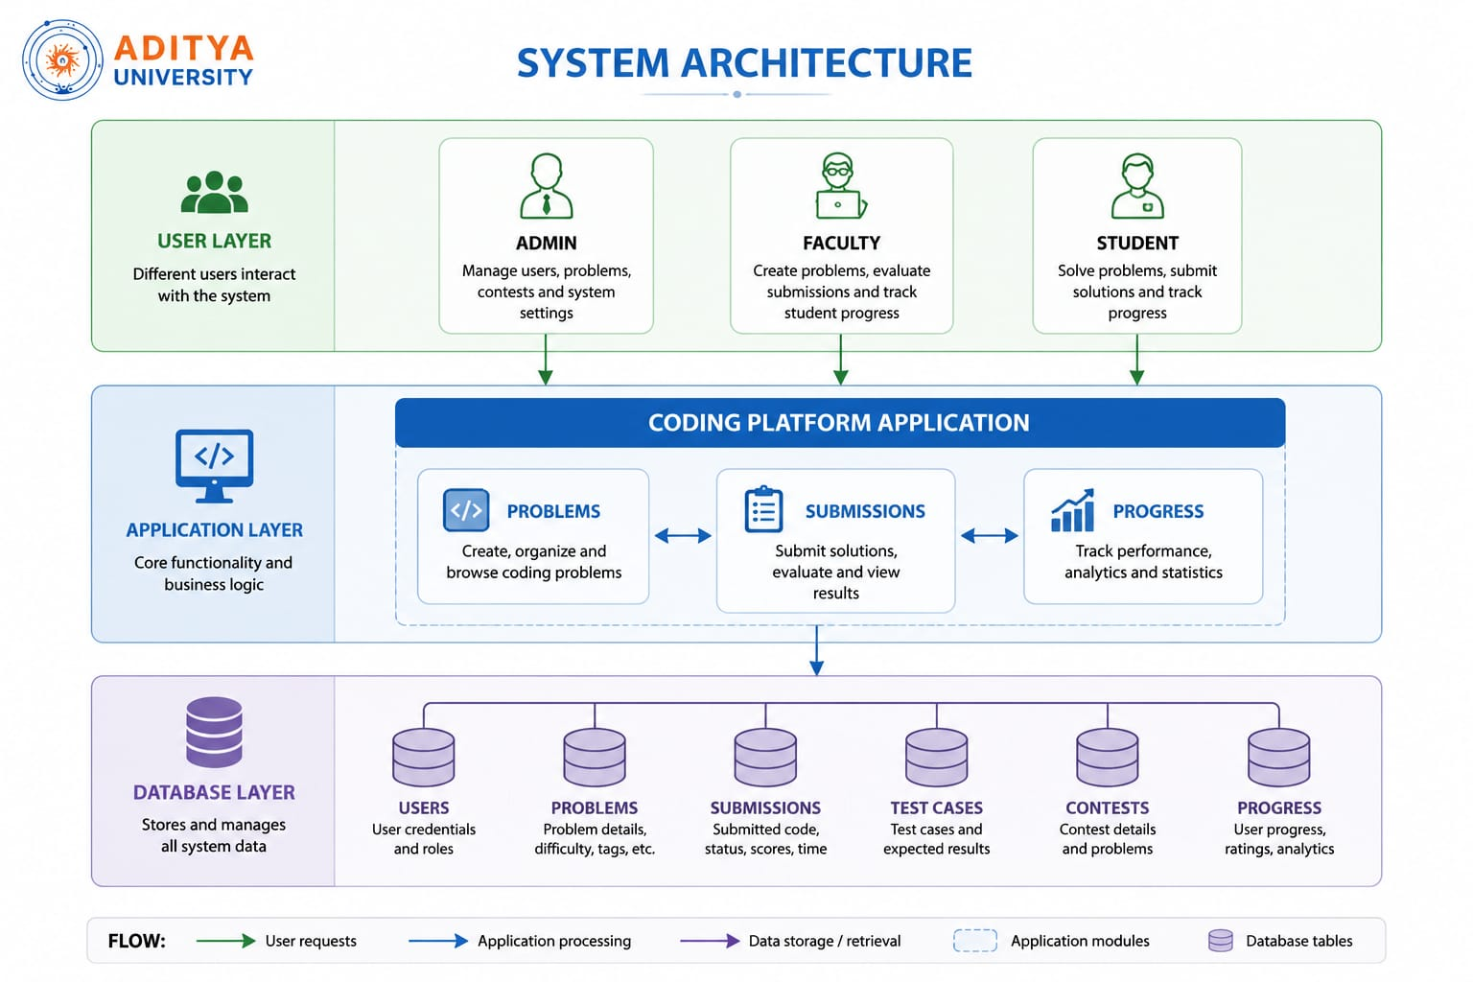
SYSTEM ARCHITECTURE

Slide 12
CLASS DESIGN & OOP CONCEPTS
Person
Encapsulation
Private data members (e.g. studentID) reached only through public get/set functions
Admin
Faculty
Student
Inheritance
Supporting Classes
Platform · Problem · Submission · Progress
Admin, Faculty and Student inherit shared fields and behavior from Person
Polymorphism
Each role overrides displayRole() with its own implementation
Abstraction
Student::recordSubmission() hides how a submission is stored internally

Slide 13
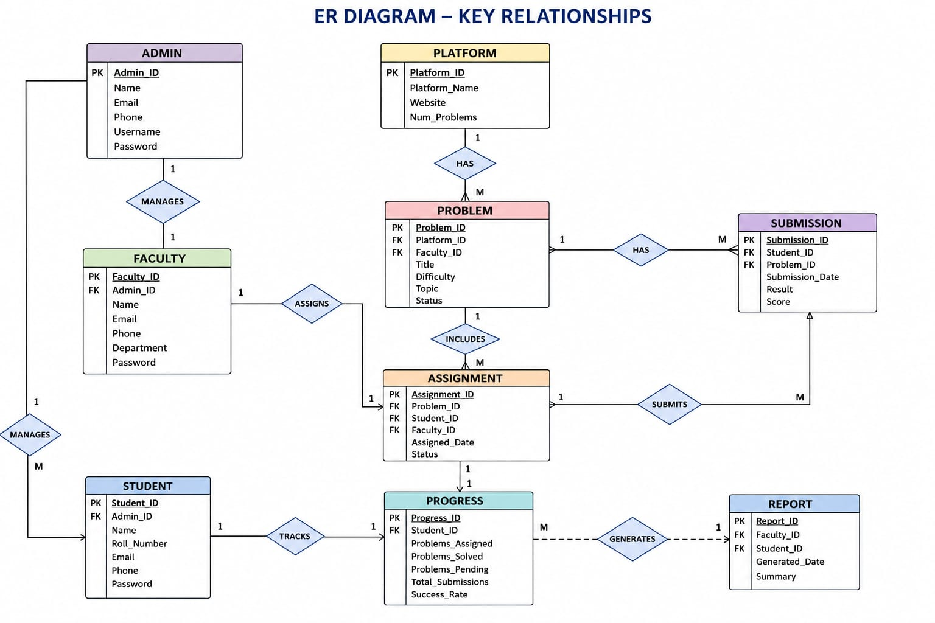

Slide 14
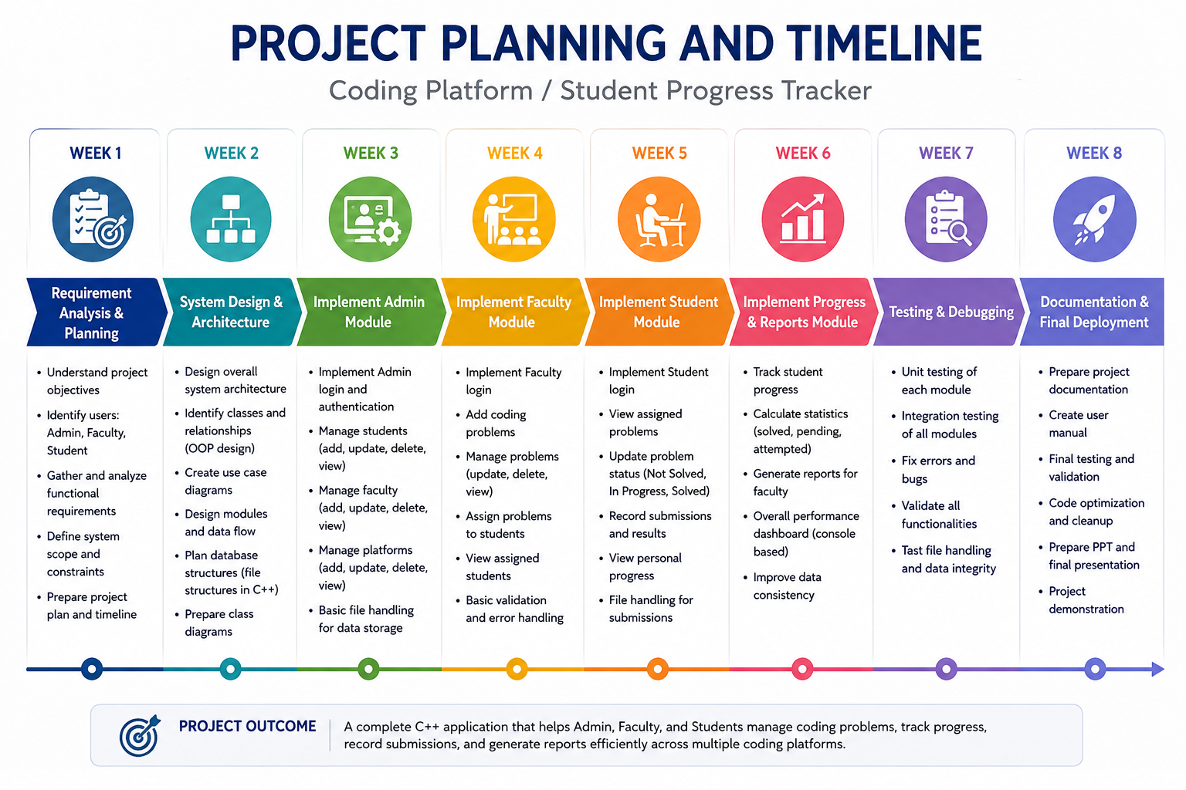

Slide 15
ROLE OF EACH INDIVIDUAL
Member 1 – Team Lead
Overall project coordination; Person and Admin classes , testing, documentation and PPT
Member 2
Faculty and Problem modules, File handling
Member 3
Student and Submission modules
Member 4
Platform and Progress modules

Slide 16
Thank You

