Slide 1
MongoDB – Aggregations
Lesson-04

Slide 2
The Aggregation Framework-What is Aggregation?
Aggregations operations process data records and return computed results.
Aggregation operations group values from multiple documents together, and can perform a variety of operations on the grouped data to return a single result.
In sql count(*) and with group by is an equivalent of mongodb aggregation.
Notes:
Create
The field name _id is reserved for use as a primary key; its value must be unique in the collection, is immutable, and may be of any type other than an array.
The field names cannot start with the $ character.
The field names cannot contain the . character.
Create with save
If the <document> argument does not contain the _id field or contains an _id field
with a value not in the collection, the save() method performs an insert of the document.
Otherwise, the save() method performs an update.

Slide 3
The Aggregation Framework-What Types of Aggregations
$match,
$unwind
$group,
$project
$skip,
$limit
$sort,
$first
$last,
$sum
$avg,
$min,
$max
$push,
$addToSet

Slide 4
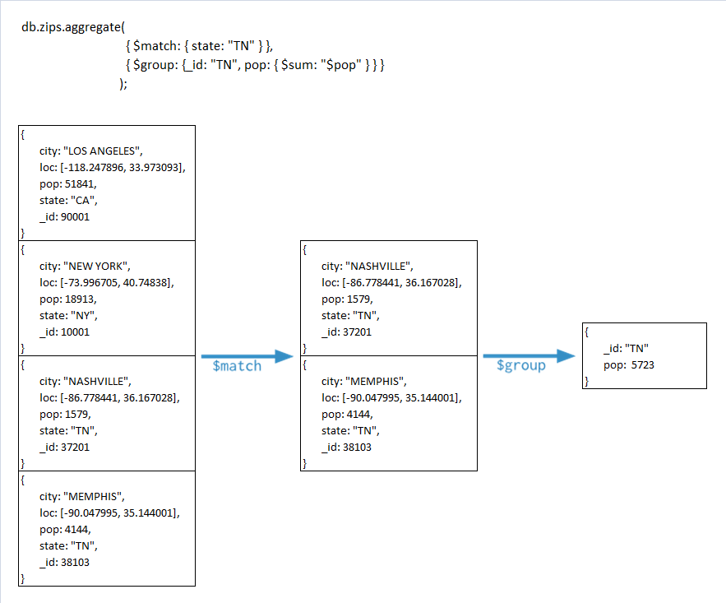
The Aggregation Framework-What is Aggregation? (contd.)

Slide 5
The Aggregation Framework-The Aggregate() Method
For the aggregation in MongoDB you should use aggregate() method.
Syntax:
Basic syntax of aggregate() method is as follows:
>db.COLLECTION_NAME.aggregate(AGGREGATE_OPERATION)

Slide 6
Pipeline Operations-Pipeline Concept
The aggregation framework is based on pipeline concept, just like Unix pipeline.
There can be N number of operators.
Output of first operator will be fed as input to the second operator. Output of second operator will be fed as input to the third operator and so on.

Slide 7
Pipeline Operations-Pipelines
Modeled on the concept of data processing pipelines.
Provides:
Provides tools for:
Filters that operate like queries.
Document transformations that modify the form of the output document.
Grouping and sorting by field.
Aggregating the contents of arrays, including arrays of documents.
Can use operators for tasks such as calculating the average or concatenating a string.

Slide 8

Pipeline Operations-Pipeline Flow

Slide 9
Pipeline Operations- Pipeline Operators
The basic pipeline operators are:
$match
$unwind
$group
$project
$skip
$limit
$sort

Slide 10
Pipeline Operations-$match
This is similar to MongoDB Collection's find method and SQL's WHERE clause.
Example: : Lets try and get the employees with female gender
db.employees.aggregate([{ $match: {"gender": "female" }}]);
Notes:
$match-
Filters the documents to pass only the documents that match the specified condition(s) to the next pipeline stage.
The $match stage has the following prototype form:
-{ $match: { <query> } }
$match takes a document that specifies the query conditions
----------------------------------------------------------------------------
-Find employees with female gender
> db.employees.aggregate([{ $match: {"gender": "female" }}]);

Slide 11
Pipeline Operations-$unwind
This will be very useful when the data is stored as list.
When the unwind operator is applied on a list data field, it will generate a new record for each and every element of the list data field on which unwind is applied.
It basically flattens the data.
Notes:
$unwind-
Deconstructs an array field from the input documents to output a document for each element.
Each output document is the input document with the value of the array field replaced by the element.
{ $unwind: <field path> }
Points to remember:
If the value of a field is not an array, db.collection.aggregate() generates an error.
If the specified path for a field does not exist in an input document, the pipeline ignores the input document and displaying no output.
If the array is empty in an input document, the pipeline ignores the input document and displaying no output.
db.employees.aggregate( [ { $unwind : "$contacts" } ] ).pretty()

Slide 12
Pipeline Operations-$unwind-Example
Separate Contacts of employees
db.employees.aggregate( [ { $unwind : "$contacts" } ] ).pretty()
Notes:
Separate Contacts of employees
db.employees.aggregate( [ { $unwind : "$contacts" } ] ).pretty()
-------------------OutPut----------------------------------------------
{
"_id" : 6,
"firstname" : "Uma",
"lastname" : "P",
"deptinfo" : {
"_id" : 30,
"deptname" : "java"
},
"mgrcode" : 8,
"gender" : "female",
"age" : 53,
"salary" : 300000,
"address" : {
"street" : "MgRoad",
"city" : "Mysoor",
"state" : "KA"
},
"contacts" : "9430087878",
"annlGrossSal" : [
{
"year" : 2001,
"gross" : "900000
},
{
"year" : 2002,
"gross" : "300000
},
{
"year" : 2003,
"gross" : "200000
}
]
}
{
"_id" : 6,
"firstname" : "Uma",
"lastname" : "P",
"deptinfo" : {
"_id" : 30,
"deptname" : "java"
},
"mgrcode" : 8,
"gender" : "female",
"age" : 53,
"salary" : 300000,
"address" : {
"street" : "MgRoad",
"city" : "Mysoor",
"state" : "KA"
},
"contacts" : "011-888888",
"annlGrossSal" : [
{
"year" : 2001,
"gross" : "900000
},
{
"year" : 2002,
"gross" : "300000
},
{
"year" : 2003,
"gross" : "200000
}
]
}

Slide 13
Pipeline Operations-$group
The group pipeline operator is similar to the SQL's GROUP BY clause.
Example: Show Count Of Male and Female from employees collections
->db.employees.aggregate([{$group : {_id : "$gender", NoOfEmp : {$sum : 1}}}])
Notes:
Grouping Documents
Once we've filtered out the documents we don't want, we can start grouping together the ones that
we do into useful subsets. We can also use groups to perform operations across a common field in all documents,
such as calculating the sum of a set of transactions and counting documents.
-Show Count Of Male and Female from employees
->db.employees.aggregate([{$group : {_id : "$gender", NoOfEmp : {$sum : 1}}}])
-Show Count Of Only Female from employees collections
db.employees.aggregate([{$match:{gender:"female"}},{$group:{_id: null,count:{$sum:1}}}])

Slide 14
Pipeline Operations-$group (contd.)
In this aggregation example, we have specified an _id element .
The _id element tells MongoDB to group the documents based on gender field.
The NoOfEmp uses an aggregation function $sum, which basically counts up both gender and returns the sum.

Slide 15
Pipeline Operations-$project
The project operator is similar to SELECT in SQL.
We can use this to rename the field names and select / deselect the fields to be returned, out of the grouped fields.
If we specify 0 for a field, it will NOT be sent in the pipeline to the next operator.
Notes:
$project − Used to select some specific fields from a collection.
The $project function in MongoDB passes along the documents with only the
specified fields to the next stage in the pipeline. This may be the existing fields from the input documents or newly computed fields.
Syntax:
{ $project: { <specifications>
The specification for $project command contain the inclusion of fields, the suppression of the _id field, the addition of new fields, and the resetting the values of existing fields.
Parameters:
Specification Description<field>: <1 or true>Specify the inclusion of a field. _id: <0 or false>Specify the suppression of the _id field.<field>: <expression>Add a new field or reset the value of an existing field.
Points to remember:
By default, the _id field is included in the output documents. To exclude the _id field from the output documents, you must explicitly specify the suppression of the _id field in $project.
A field that does not exist in the document are going to include, the $project ignores that field inclusion;
A new field can be added and value of an existing field can be reset by specifying the field name and set

Slide 16
Pipeline Operations-$Sort
This is similar to SQL's ORDER BY clause. To sort a particular field in descending order specify -1 and specify 1 if that field has to be sorted in ascending order.
Convert lastname in Uppercase and sort in ascending order
>db.employees.aggregate([{ $project:{lname:{$toUpper:"$lastname"},_id:0}},{$sort:{lname:1}}])
Notes:
-Convert lastname in Uppercase and sort in ascending order
>db.employees.aggregate([{ $project:{lname:{$toUpper:"$lastname"},_id:0}},{$sort:{lname:1}}])

Slide 17
Pipeline Operations-$limit and $skip
These two operators can be used to limit the number of documents being returned. They will be more useful when we need pagination support.
Notes:
$skip-
Skips over the specified number of documents that pass into the stage and
passes the remaining documents to the next stage in the pipeline.
The $skip stage has the following prototype form:
{ $skip: <positive integer> }
Ex.-db.employees.aggregate( { $skip : 5 } );
----------------------------------------------------------------------------
The limit() function in MongoDB is used to specify the maximum number of results to be returned.
Only one parameter is required for this function.to return the number of the desired result.
Sometimes it is required to return a certain number of results after a certain number of documents.
The skip() can do this job.
---------------------------------------------------------
> db.employees.aggregate({$limit : 5 }).pretty()

Slide 18
Pipeline Operations-$first
Returns the value that results from applying an expression to the first document in a group of documents that share the same group by key. Only meaningful when documents are in a defined order.
$first is only available in the $group stage.

Slide 19
Pipeline Operations-$first- Example
Grouping the documents by the item field, the following operation uses the $first accumulator to compute the first sales date for each item.

Slide 20
Pipeline Operations-$last
$last returns the value that results from applying an expression to the last document in a group of documents that share the same group by a field.
Only meaningful when documents are in a defined order.
$last is only available in the $group stage.

Slide 21
Pipeline Operations-$last (contd.)
The following operation first sorts the documents by item and date, and then in the following $group stage, groups the now sorted documents by the item field and uses the $last accumulator to compute the last sales date for each item:

Slide 22
Pipeline Operations-$sum
Calculates and returns the sum of numeric values. $sum ignores non-numeric values.
When used in the $group stage, $sum has the following syntax and returns the collective sum of all the numeric values that result from applying a specified expression to each document in a group of documents that share the same group by key.

Slide 23
Pipeline Operations-$sum
Grouping the documents by the day and the year of the date field, the following operation uses the $sum accumulator to compute the total amount and the count for each group of documents.
->db.employees.aggregate([{$group : {_id : "$gender", NoOfEmp : {$sum : 1}}}])
Notes:
Show Count Of Male and Female from employees
->db.employees.aggregate([{$group : {_id : "$gender", NoOfEmp : {$sum : 1}}}])

Slide 24
Pipeline Operations-$avg
Returns the average value of the numeric values. $avg ignores non-numeric values.
$avg returns the collective average of all the numeric values that result from applying a specified expression to each document in a group of documents that share the same group by key.
Notes:
Q1)-Find Department wise average salary
Ans-db.employees.aggregate([{$group : {_id : "$deptinfo._id", AvgSal : {$avg : "$salary"}}}])

Slide 25
Pipeline Operations-$avg -Example
Grouping the documents by the item field, the following operation uses the $avg accumulator to compute the average amount and average quantity for each grouping.
->db.employees.aggregate([{$group : {_id : "$deptinfo._id", AvgSal : {$avg : "$salary"}}}])

Slide 26
Pipeline Operations-$max
Returns the maximum value. $max compares both value and type, using the specified BSON comparison order for values of different types.
Grouping the documents by the item field, the following operation uses the $max accumulator to compute the maximum total amount and maximum quantity for each group of documents.
> db.employees.aggregate([{$group:{_id: "$deptinfo._id",maxSal: {$max:"$salary"}}}])
Notes:
$max¶-
Returns the maximum value. $max compares both value and type, using the specified BSON comparison order for values of different types.
Changed in version 3.2: $max is available in the $group and $project stages.
In previous versions of MongoDB, $max is available in the $group stage only.
When used in the $group stage, $max has the following syntax and returns the maximum value that
results from applying an expression to each document in a group of documents that share the same group by key:
-----------------------------------------------------------------------------------------------------------------------------------------------
Ex-Find Department wise Maximum salary
> db.employees.aggregate([{$group:{_id: "$deptinfo._id",maxSal: {$max:"$salary"}}}])
{ "_id" : null, "maxSal" : 1200000 }
{ "_id" : 20, "maxSal" : 47000 }
{ "_id" : 40, "maxSal" : 20000 }
{ "_id" : 30, "maxSal" : 300000 }
>

Slide 27
Pipeline Operations-$min
Returns the minimum value. $min compares both value and type, using the specified BSON comparison order for values of different types.
Grouping the documents by the item field, the following operation uses the $min accumulator to compute the minimum amount and minimum quantity for each grouping.

Slide 28
Pipeline Operations-$push
Returns an array of all values that result from applying an expression to each document in a group of documents that share the same group by key.
Grouping the documents by the day and the year of the date field, the following operation uses the $push accumulator to compute the list of items and quantities sold for each group:
db.employees.aggregate([{$group:{_id:"$deptinfo._id",ListOfEmp:{$push:{fname:"$firstname",lname:"$lastname"}}}}]).pretty()
Notes:
$push -
Returns an array of all values that result from applying an expression to each document in a group of documents that share the same group by key.
$push is only available in the $group stage.
$push has the following syntax:
{ $push: <expression> }
For more information on expressions, see Expressions
----------------------------------------------------------------------------------------------
Print Depart wise first and last name
->db.employees.aggregate([{$group:{_id:"$deptinfo._id",ListOfEmp:{$push:{fname:"$firstname",lname:"$lastname"}}}}])

Slide 29
Pipeline Operations-$addToSet
Returns an array of all unique values that results from applying an expression to each document in a group of documents that share the same group by key. Order of the elements in the output array is unspecified.
If the value of the expression is an array, $addToSet appends the whole array as a single element.
If the value of the expression is a document, MongoDB determines that the document is a duplicate if another document in the array matches the to-be-added document exactly; i.e. the existing document has the exact same fields and values in the exact same order.
Notes:
$addToSet-
Returns an array of all unique values that results from applying an expression to each document in a
group of documents that share the same group by key. Order of the elements in the output array is unspecified.
$addToSet is only available in the $group stage.

Slide 30
Projection using Mongo Template in Spring
Spring Data MongoDB provides simple high-level abstractions to MongoDB native query language
In MongoDB, Projections are a way to fetch only the required fields of a document from a database.
This reduces the amount of data that has to be transferred from database server to client and hence increases performance.
With Spring Data MongDB, projections can be used both with MongoTemplate and MongoRepository.

Slide 31
Projection using Mongo Template in Spring-Annotations
@Document(collection = "users")
public class User
{
@Id
private String id;
private String name;
------
}
Refer SpringMobgoDb Demo
Notes:
id fits the standard name for a MongoDB id so it doesn’t require any special annotation to tag it for Spring Data MongoDB.
There are two ways to manage the collection name that is used for the documents. The default collection name that is used is the class name changed to start with a lower-case letter. So a com.cg.User class is stored in the person collection. One can customize this by providing a different collection name with the @Document annotation. One can also override the collection name by providing your own collection name as the last parameter for the selected MongoTemplate method calls.

Slide 32
Summary
$match,
$unwind
$group,
$project
$skip,
$limit
$sort,
$first
$last,
$sum
$avg,
$min,
$max
$push,
$addToSet

