Slide 1
Dependency Injection

Slide 2
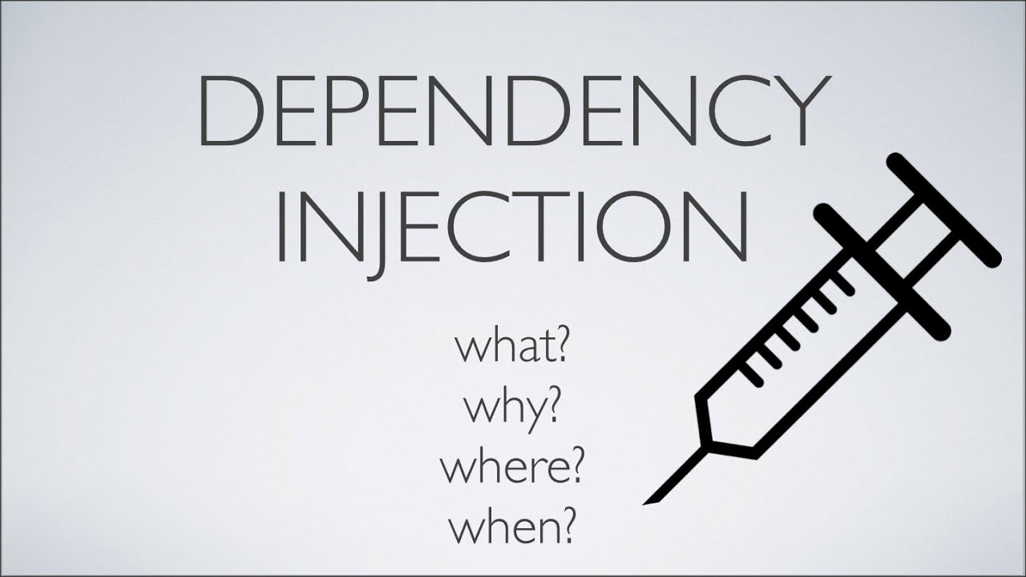
Dependency Injection (DI) is a software design pattern that implements inversion of control for resolving dependencies. An injection is the passing of a dependency to a dependent object that would use it. DI is a process where by objects define their dependencies.

Slide 3
Dependency lookup
Dependency Inversion
Loose coupling

Slide 4
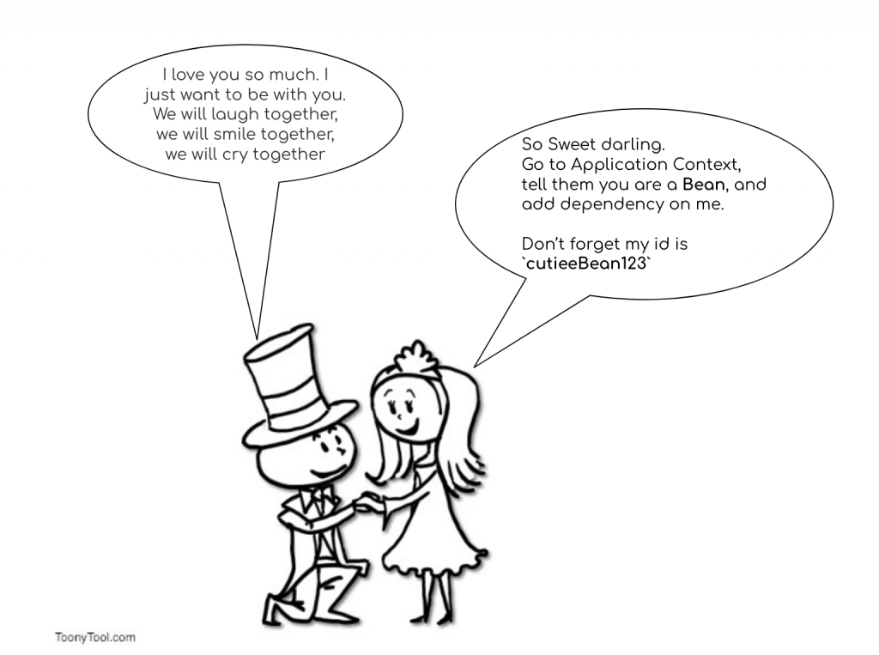
Example:

Slide 5


