Slide 1
MACHINE LEARNING USING PYTHON

Slide 2
Index
Introduction
History in brief
AI, ML and Deep Learning
Levels in AI
Types of ML algorithms
Some applications in real world
Future with ML
How to build a career in ML/AI

Slide 3
History of Machine Learning
Arthur Samuel, an American pioneer in the field of computer gaming and artificial intelligence, coined the term "Machine Learning" in 1959 while at IBM. As a scientific endeavour, machine learning grew out of the quest for artificial intelligence.
Machine learning, reorganized as a separate field, started to flourish in the 1990s. The field changed its goal from achieving artificial intelligence to tackling solvable problems of a practical nature.

Slide 4
AI, ML and Deep Learning
AI
ML
Deep Learning

Slide 5
What is Artificial Intelligence?

Slide 6
Artificial Intelligence
Computer science defines AI research as the study of "intelligent agents": any device that perceives its environment and takes actions that maximize its chance of successfully achieving its goals.
Generally, the term "artificial intelligence" is used to describe machines that mimic "cognitive" functions that humans associate with other human minds, such as "learning" and "problem solving".

Slide 7
Levels in Artificial Intelligence?

Slide 8
Levels of Artificial Intelligence:
ANI

Slide 9
Levels of Artificial Intelligence:
ANI
AGI

Slide 10
Levels of Artificial Intelligence:
ANI
AGI
ASI

Slide 11
What is Machine Learning?

Slide 12
Machine Learning
Machine Learning is a subset of artificial intelligence which focuses mainly on the learning from their experience and making predictions based on its experience.
It enables the computers or the machines to make data-driven decisions rather than being explicitly programmed for carrying out a certain task. These programs or algorithms are designed in a way that they learn and improve over time when are exposed to new data.

Slide 13
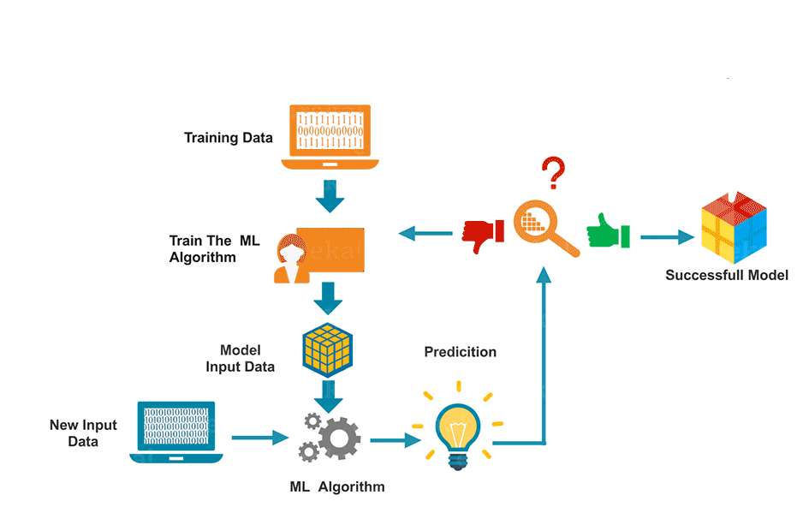
Machine Learning

Slide 14
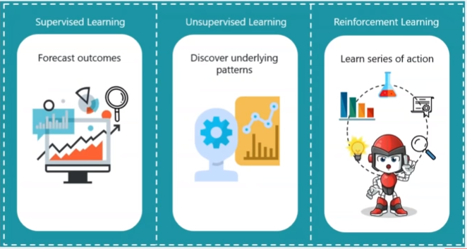
Machine Learning AIM:

Slide 15
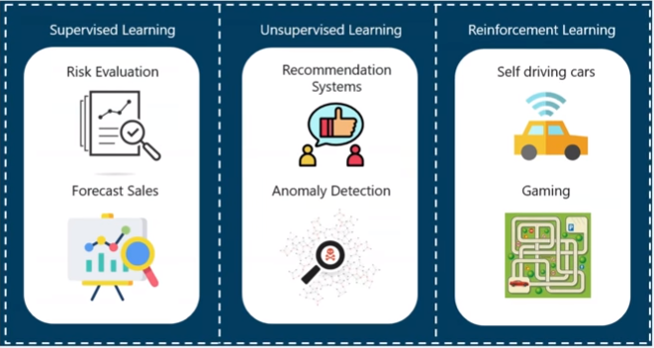
Machine Learning Applications:

Slide 16
Types of Machine Learning Algorithms

Slide 17
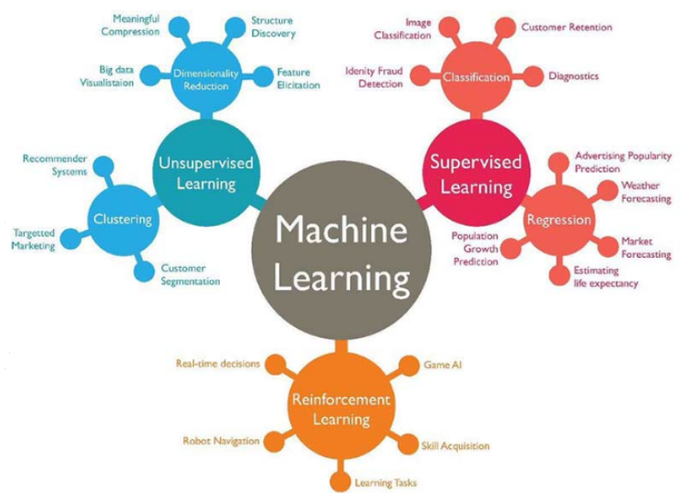
Types of Machine Learning Algorithms

Slide 18
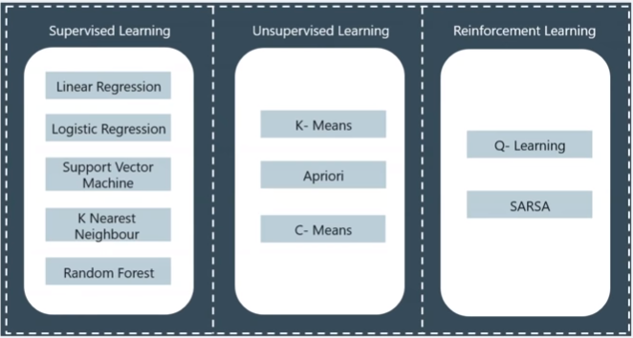
Machine Learning Algorithms:

Slide 19
What is Deep Learning?

Slide 20
Deep Learning
Deep learning (also known as deep structured learning or hierarchical learning) is part of a broader family of machine learning methods based on artificial neural networks. Learning can be supervised, semi-supervised or unsupervised.
Deep learning architectures such as deep neural networks, deep belief networks, recurrent neural networks and convolutional neural networks have been applied to fields including computer vision, speech recognition, natural language processing, audio recognition, social network filtering, machine translation etc, where they have produced results comparable to and in some cases superior to human experts.

Slide 21
Traditional Computing vs Machine Learning Systems

Slide 22
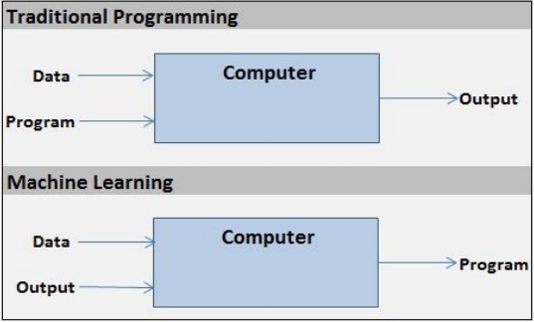
Traditional Computing vs Machine Learning System

Slide 23
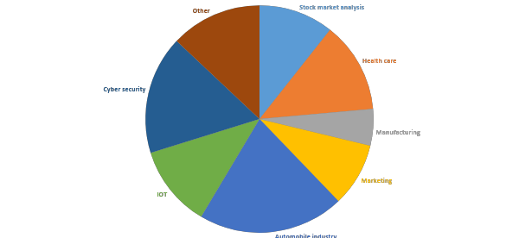
Use of AI/ML in today’s world

Slide 24
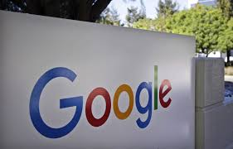
Use of AI/ML in today’s world
Google

Slide 25
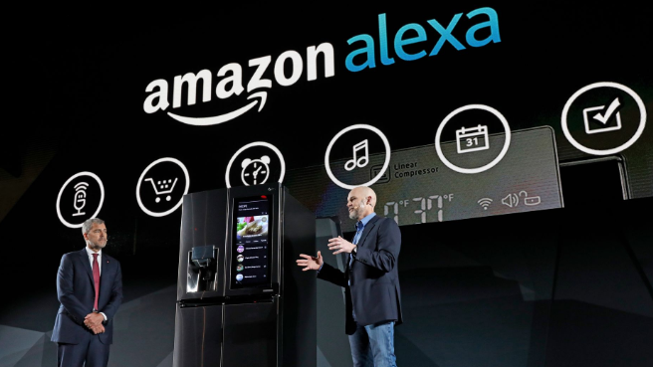
Use of AI/ML in today’s world
Google
Amazon

Slide 26

Use of AI/ML in today’s world
Google
Amazon
Facebook

Slide 27
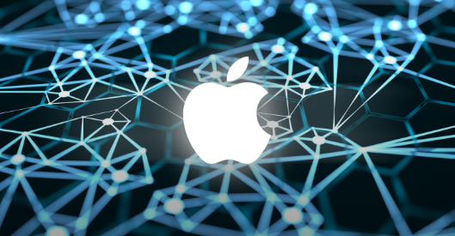
Use of AI/ML in today’s world
Google
Amazon
Facebook
Apple

Slide 28
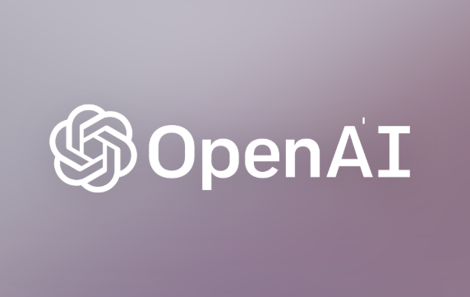
Use of AI/ML in today’s world
Google
Amazon
Facebook
Apple
Open AI

Slide 29

Use of AI/ML in today’s world
Google
Amazon
Facebook
Apple
Open AI
IBM

Slide 30
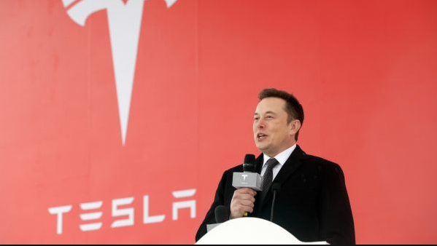
Use of AI/ML in today’s world
Google
Amazon
Facebook
Apple
Open AI
IBM
Tesla

Slide 31
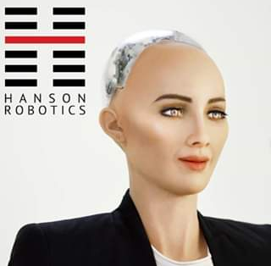
Use of AI/ML in today’s world
Google
Amazon
Facebook
Apple
Open AI
IBM
Tesla
Hanson Robotics

Slide 32
Future with AI/ML
Self driving cars
Improved medical care
Help in various research teams
Military services
Bomb squad replacement
Space exploration
etc

Slide 33
How to build a career in AI/ML ?
Choose a language of your comfort
Learn some basics of AI/ML through any online course
Join a community or form one
Compete on Kaggle making projects
Apply for internships/jobs

