Slide 1
Classification
Logistic Regression

Slide 2
Index
Supervised Learning –
Regression
Linear, Polynomial and Non Linear
Classification
Logistic Regression
K Nearest Neighbour
Support Vector Machines
Decision Tree
Unsupervised & Semi-Supervised Learning
Clustering (K-means, GMMS)
Factor Analysis (PCA, LDA)

Slide 3
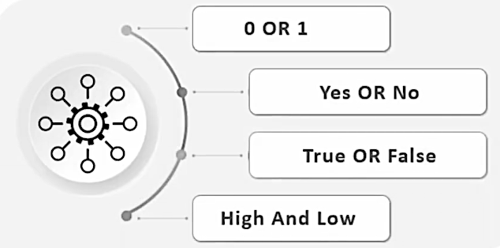
Logistic Regression
Its a classification algorithm used to assign observations to a discrete set of classes.
Unlike linear regression which outputs continuous number values, logistic regression transforms its output using the logistic sigmoid function to return a probability value which can then be mapped to two or more discrete classes.

Slide 4
Comparison of linear & logistic regression
Example Given data on time spent studying and exam scores. Linear Regression and logistic regression can predict different things:
Linear Regression could help us predict the student’s test score on a scale of 0 - 100. Linear regression predictions are continuous (numbers in a range).
Logistic Regression could help use predict whether the student passed or failed. Logistic regression predictions are discrete (only specific values or categories are allowed). We can also view probability scores underlying the model’s classifications.

Slide 5
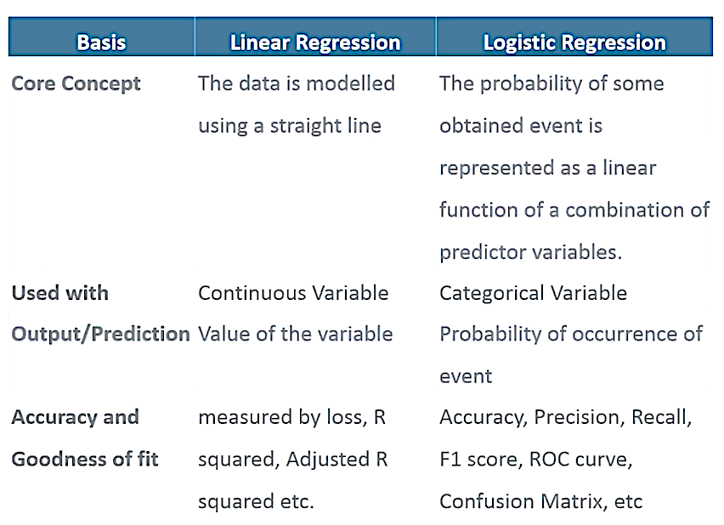
Comparison of linear & logistic regression

Slide 6
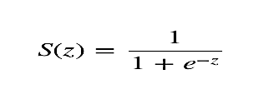
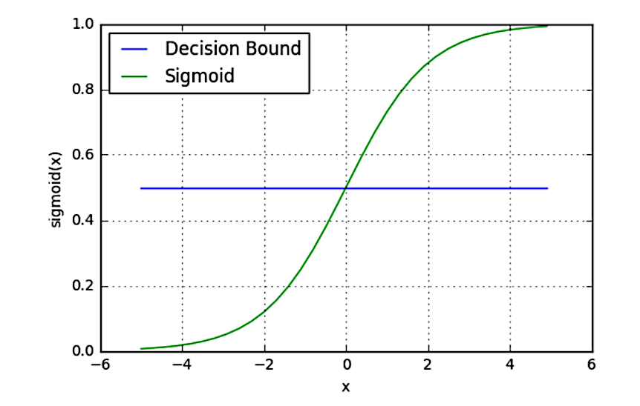
In order to map predicted values to probabilities, we use the sigmoid function. The function maps any real value into another value between 0 and 1. In machine learning, we use sigmoid to map predictions to probabilities.
Sigmoid Activation
S(z) = output between 0 and 1 (probability estimate) z = input to the function (your algorithm’s prediction e.g. mx + b)
e = base of natural log

Slide 7
Decision Boundary
Our current prediction function returns a probability score between 0 and 1. In order to map this to a discrete class (true/false, cat/dog), we select a threshold value or tipping point above which we will classify values into class 1 and below which we classify values into class 2.
p ≥ 0.5,class = 1
p < 0.5,class = 0
For example, if our threshold was .5 and our prediction function returned .7, we would classify this observation as positive. If our prediction was .2 we would classify the observation as negative. For logistic regression with multiple classes we could select the class with the highest predicted probability.

Slide 8
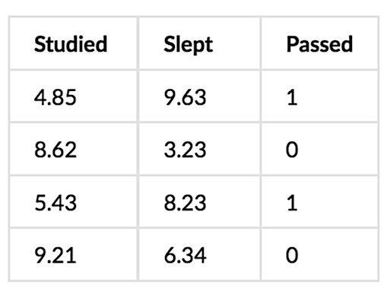
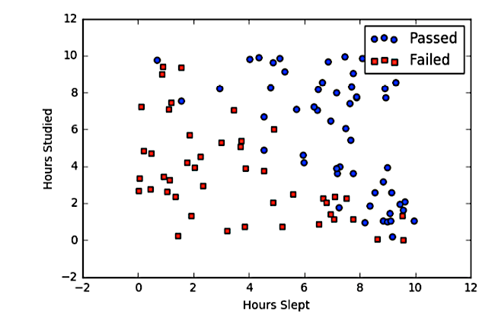
Binary Logistic Regression
Say we’re given data on student exam results and our goal is to predict whether a student will pass or fail based on number of hours slept and hours spent studying. We have two features (hours slept, hours studied) and two classes: passed (1) and failed (0).

Slide 9
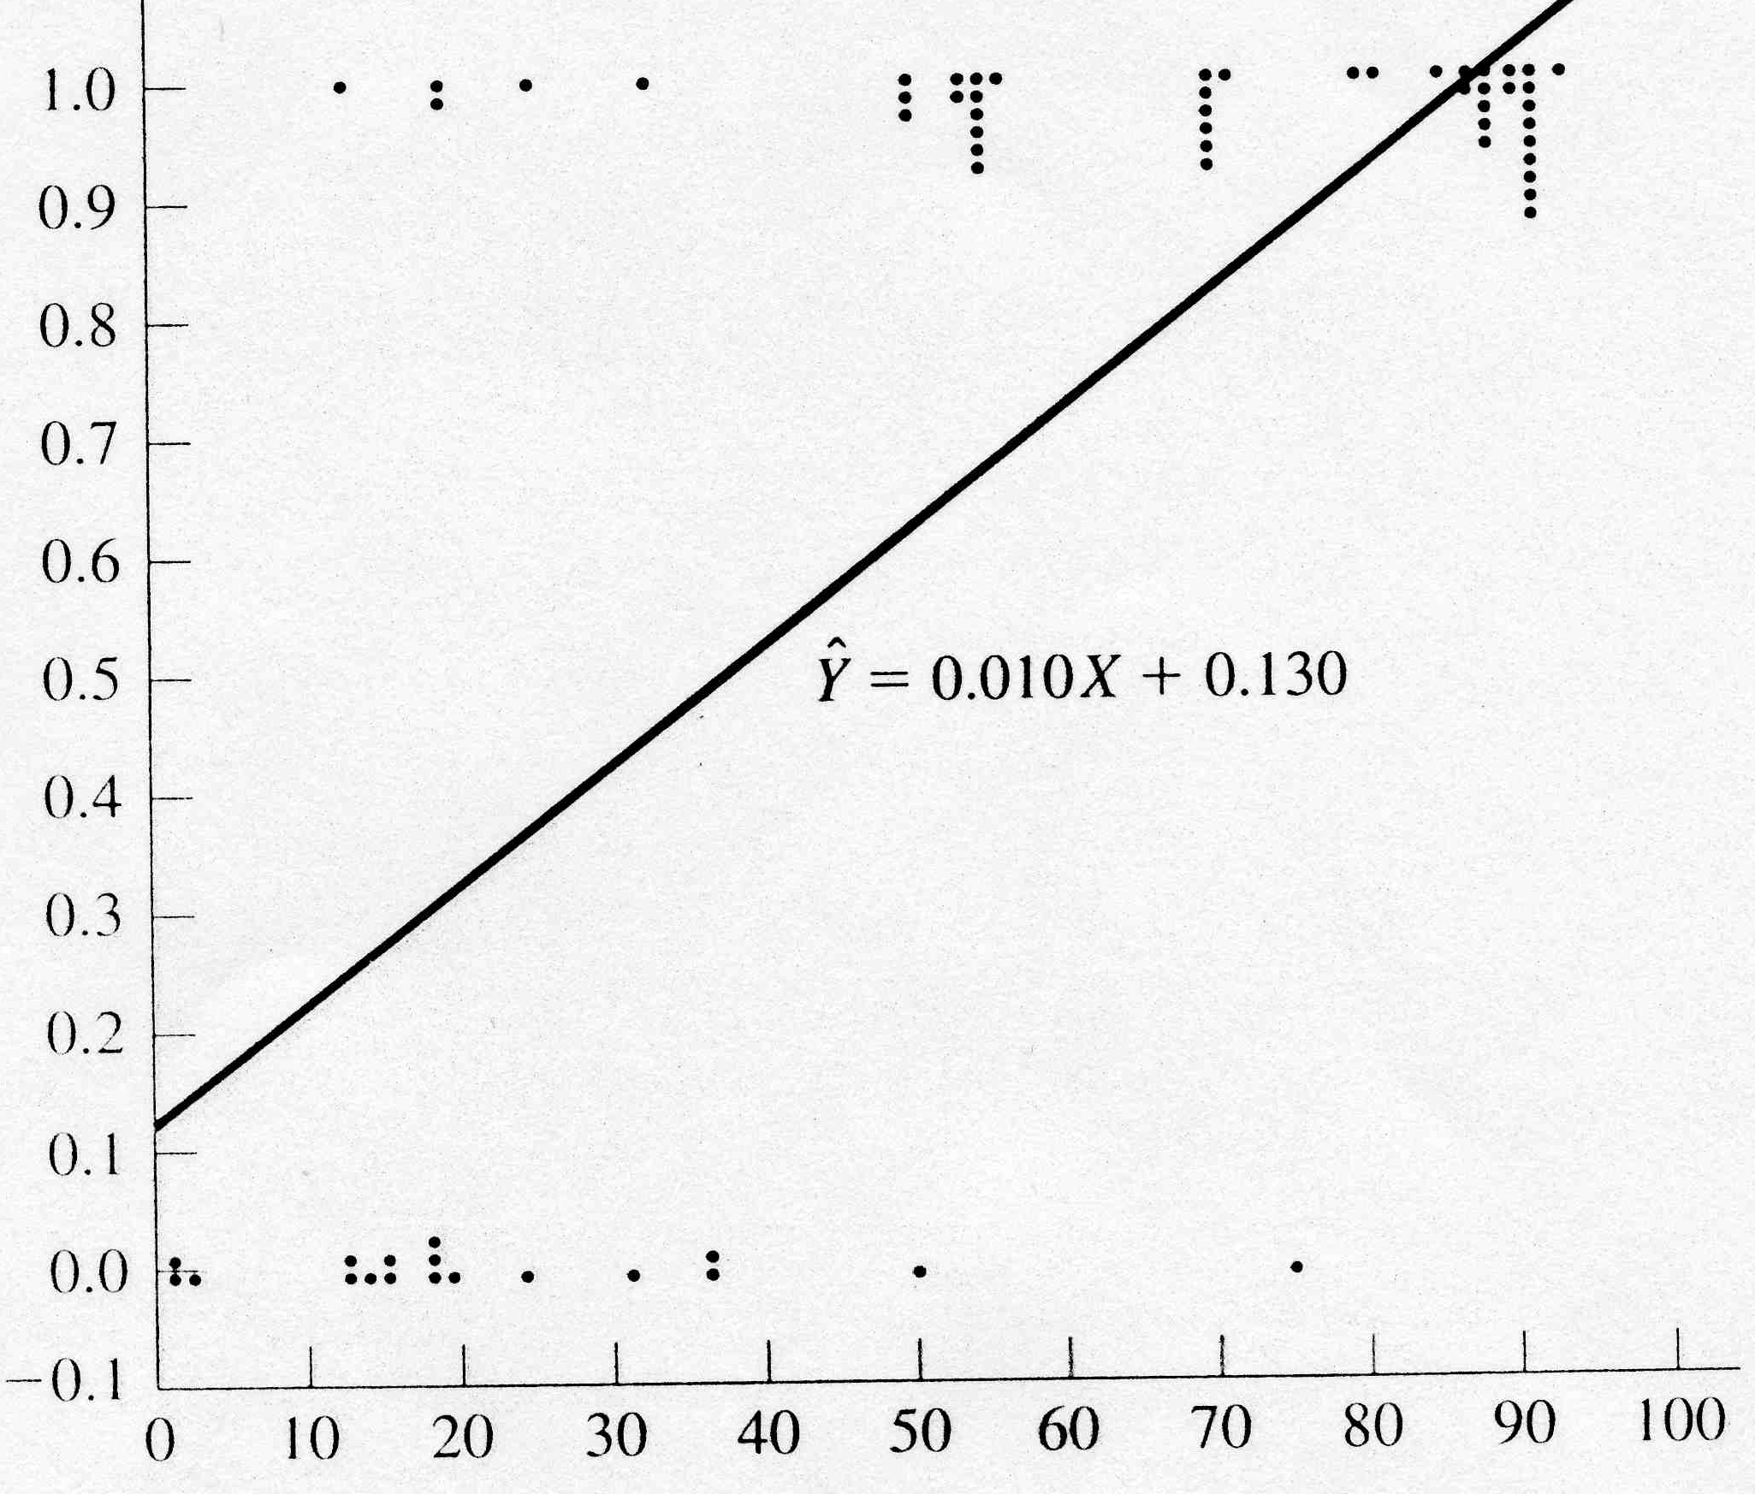
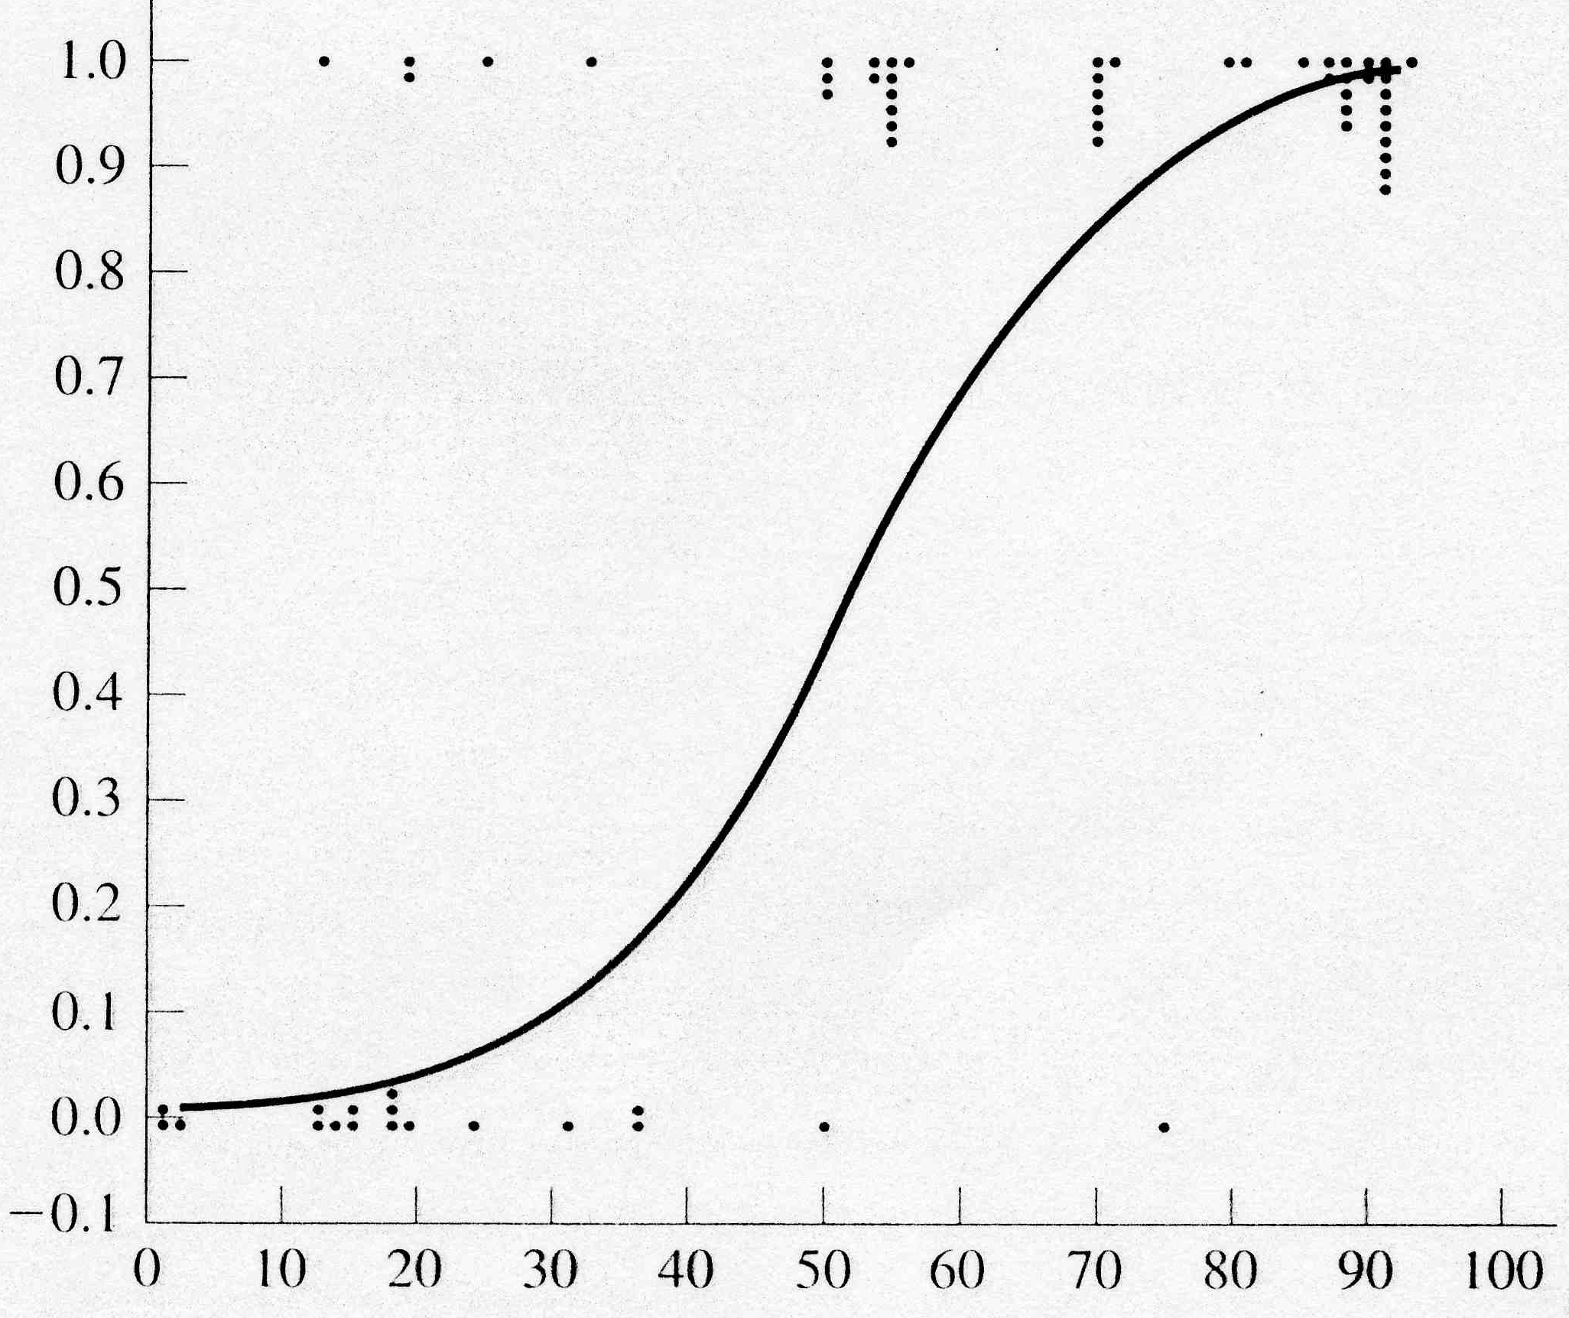
Linear vs Logistic Regression

Slide 10
Logistic Regression Approach
Learning
Transform initial input probabilities into log odds (logit)
Do a standard linear regression on the logit values
This effectively fits a logistic curve to the data, while still just doing a linear regression with the transformed input (ala quadric machine, etc.)
Generalization
Find the value for the new input on the logit line
Transform that logit value back into a probability

Slide 11
Summary
Linear Regression and Logistic Regression are nice tools for many simple situations
But both force us to fit the data with one shape (line or sigmoid) which will often underfit
When problem includes more arbitrary non-linearity then we need more powerful models which we will introduce
Though non-linear data transformation can help in these cases while still using a linear model for learning
These models are commonly used in data mining applications and also as a "first attempt" at understanding data trends, indicators, etc.

