Slide 1
Support Vector Machines

Slide 2
SVM
A Support Vector Machine is a supervised algorithm that classifies cases by finding a separator.
It works by mapping the data into higher dimensional feature space so that the data points can be categorized even when they are linearly non separable.
Then finding a separator which can classify that data

Slide 3
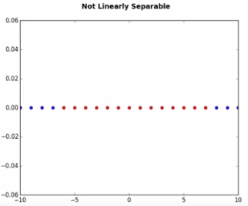
Linearly non separable

Slide 4
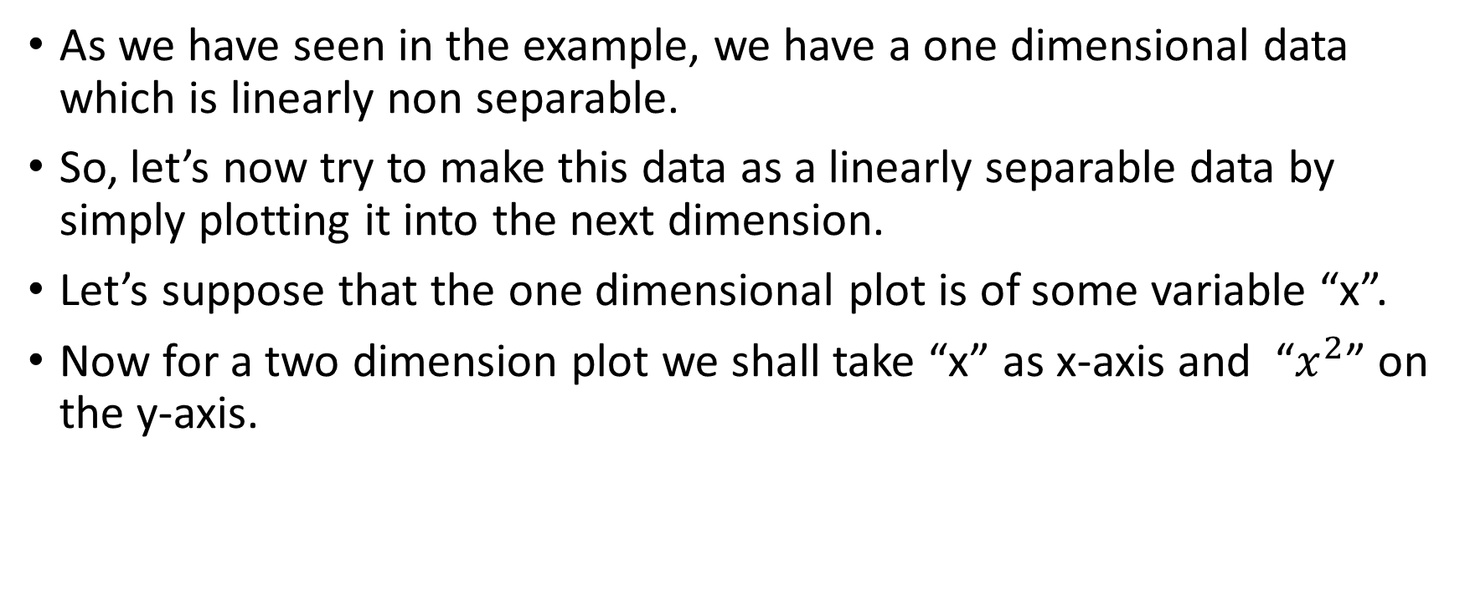
Linearly non separable
As we have seen in the example, we have a one dimensional data which is linearly non separable.
So, let’s now try to make this data as a linearly separable data by simply plotting it into the next dimension.
Let’s suppose that the one dimensional plot is of some variable “x”.
Now for a two dimension plot we shall take “x” as x-axis and “$x^{2}$” on the y-axis.

Slide 5
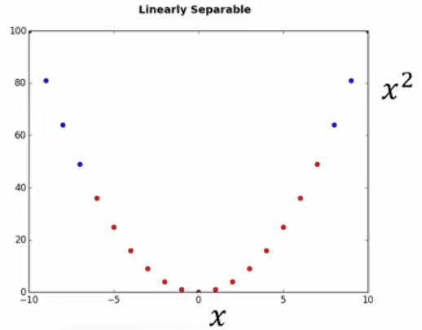
Linearly separable

Slide 6
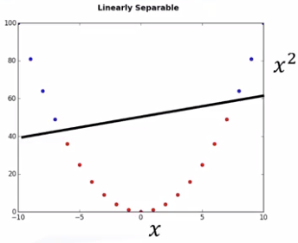
Linearly separable

Slide 7
Linearly separable
As we are now in 2D space, the hyper plane is a line that divides the plane into two parts.
This process of mapping data into higher dimensional space is called Kernelling.
Kernelling can be of many types-
Linear
Polynomial, etc.
What we have used is a Linear Kernelling with kernel function as
K(x)=[x,x^2]

Slide 8
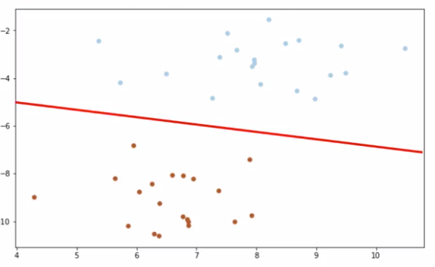
Example-2

Slide 9
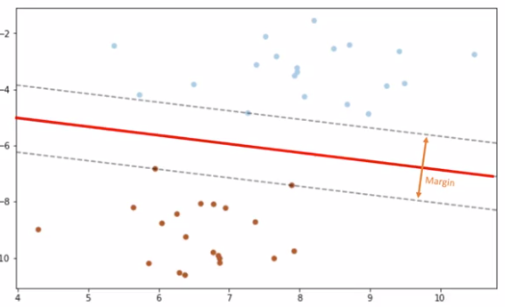
Example-2

Slide 10
Example-2
Margin:
Higher the margin, better the model.
The goal is to choose the hyper plane with as bigger value as possible.
The points closest to the hyper plane are called as support vectors.

Slide 11
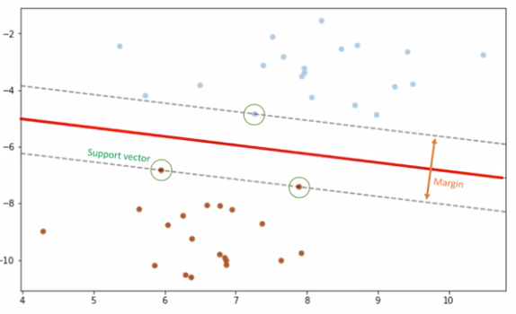
Example-2

Slide 12
Advantages of SVM
Accurate in high-dimensional spaces
Memory efficient
Dis-advantages of SVM
Prone to over-fitting
Doesn’t suit for large datasets.

Slide 13
Applications of SVM
Bioinformatics
Classification of Images
Hand-written characters can be recognized using SVM
Etc.

