Slide 1
OPEN CV

Slide 2
OpenCV – Introduction
OpenCV stands for the Open Source Computer Vision Library.
It was founded at Intel in 1999, went through some lean years after the .bust but is now under active development, now receiving ongoing support from Willow Garage.
OpenCV is free for commercial and research use.
It has a BSD license. The library runs across many platforms and actively supports Linux, Windows and Mac OS.
OpenCV was founded to advance the field of computer vision.
It gives everyone a reliable, real time infrastructure to build on. It collects and makes available the most useful algorithms.

Slide 3
OpenCV - Features
Cross Platform
Windows, Linux, Mac OS
Portable
iPhone
Android.
Language Support
C/C++
Python

Slide 4
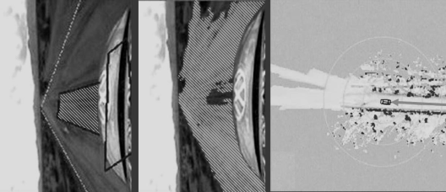
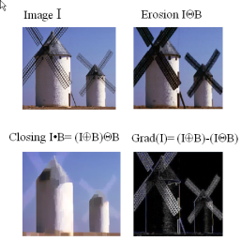
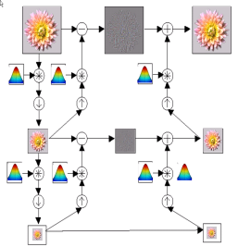
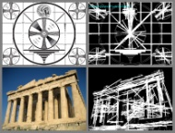
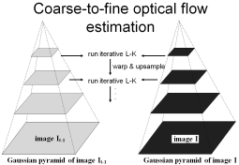
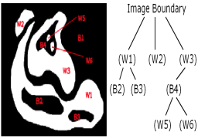
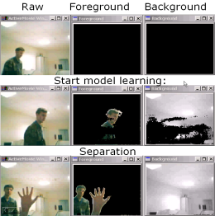
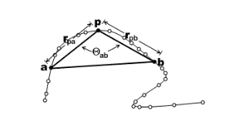
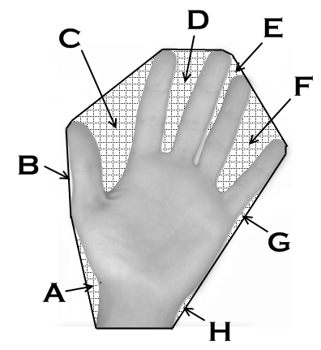
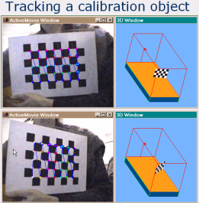
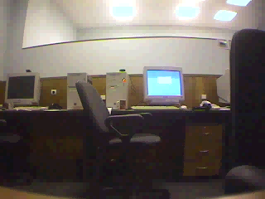
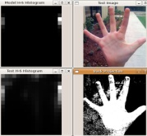
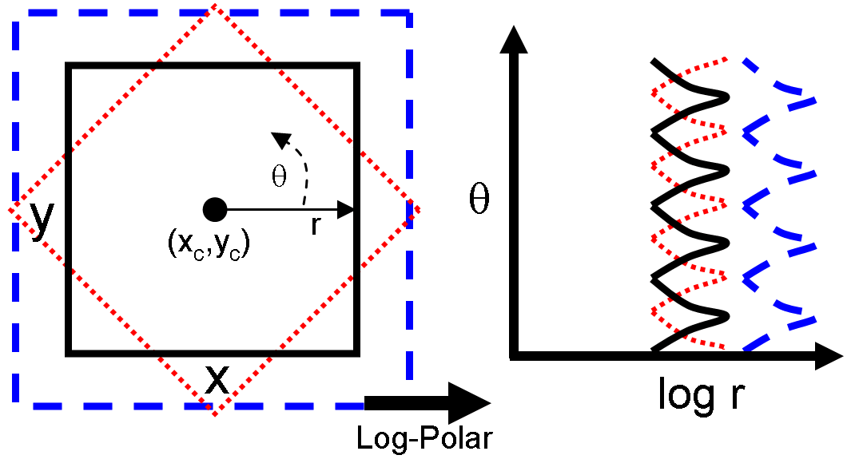
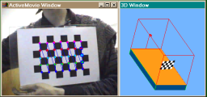
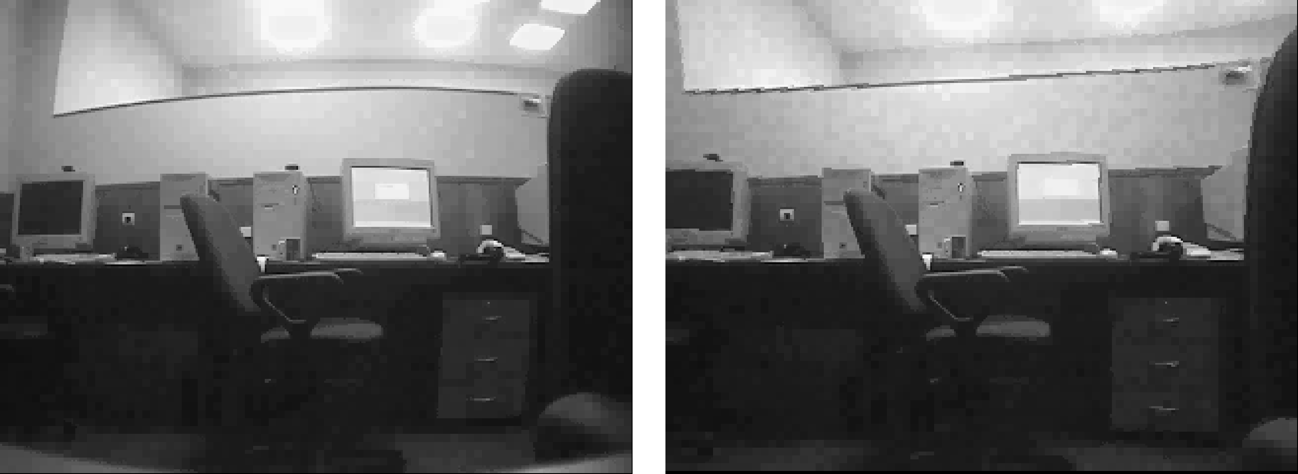
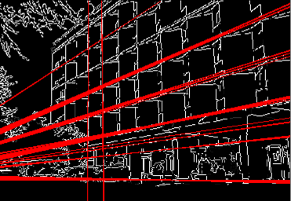
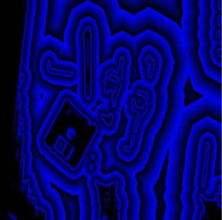
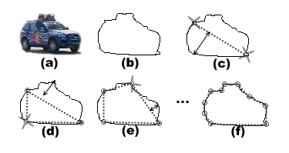
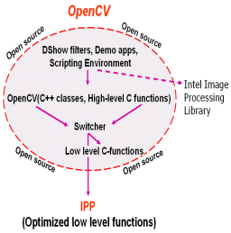
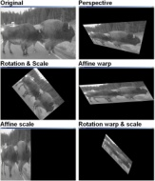
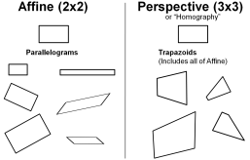
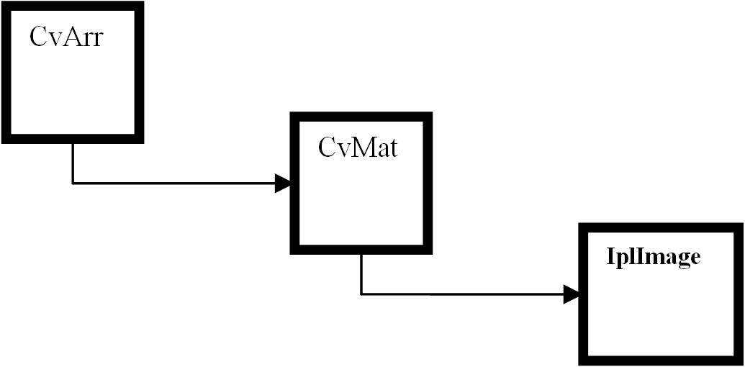
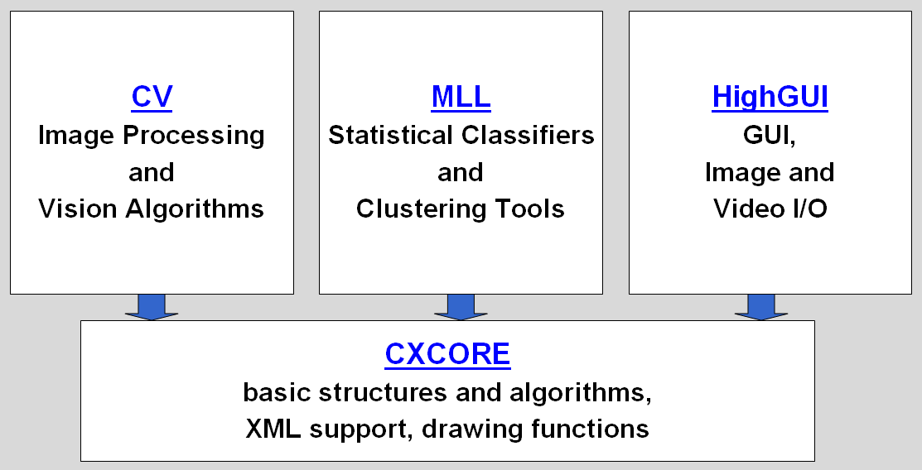
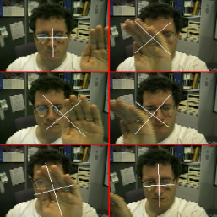
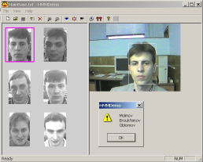
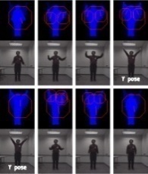
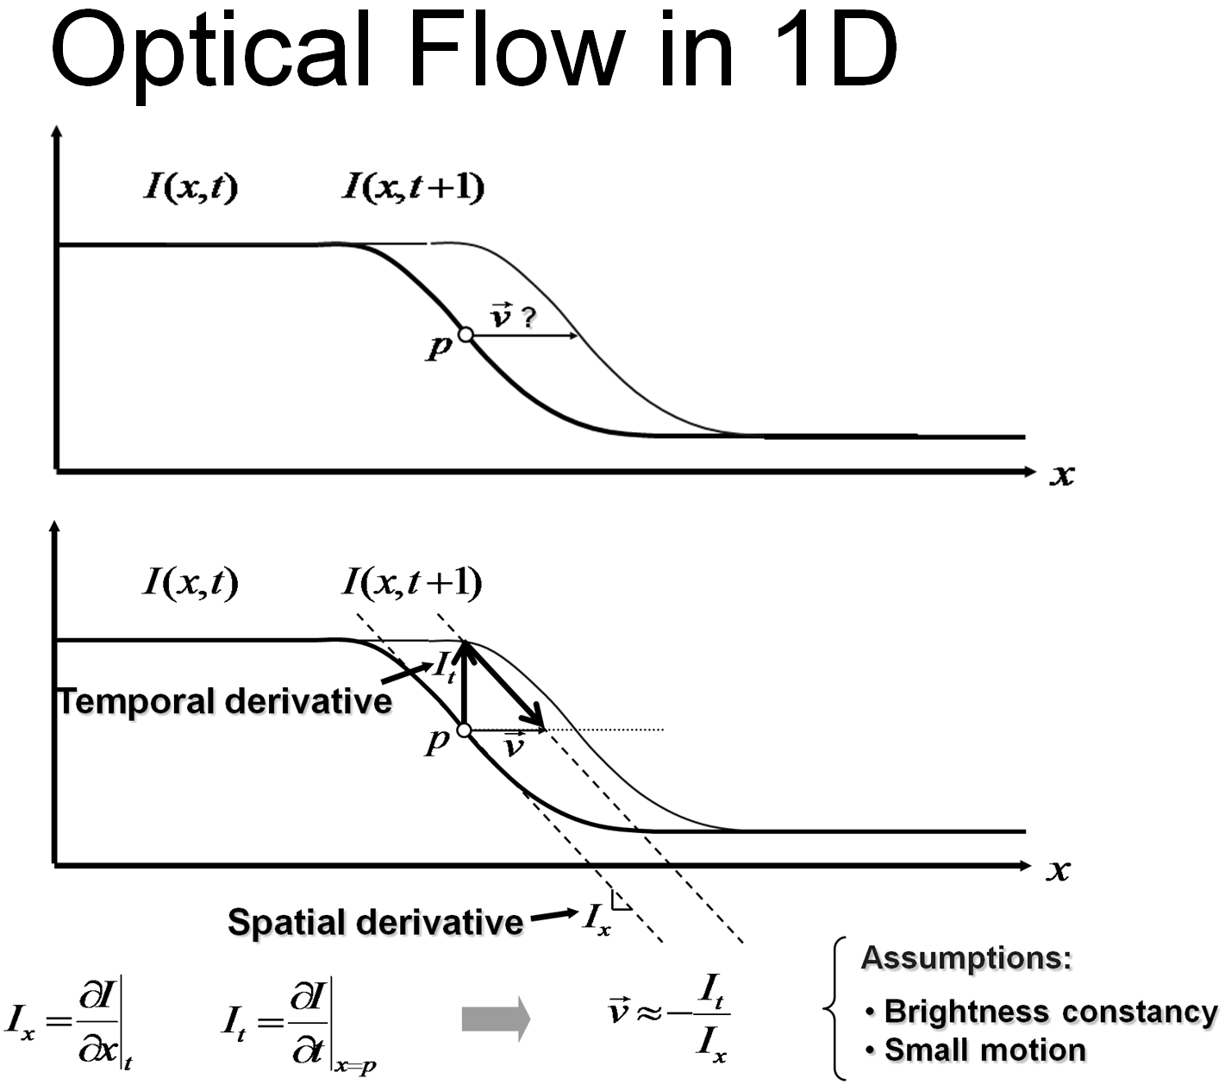
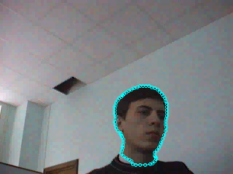
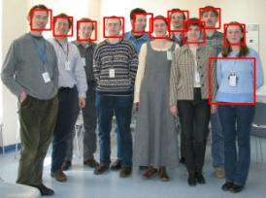
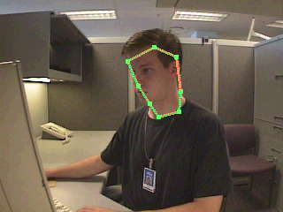
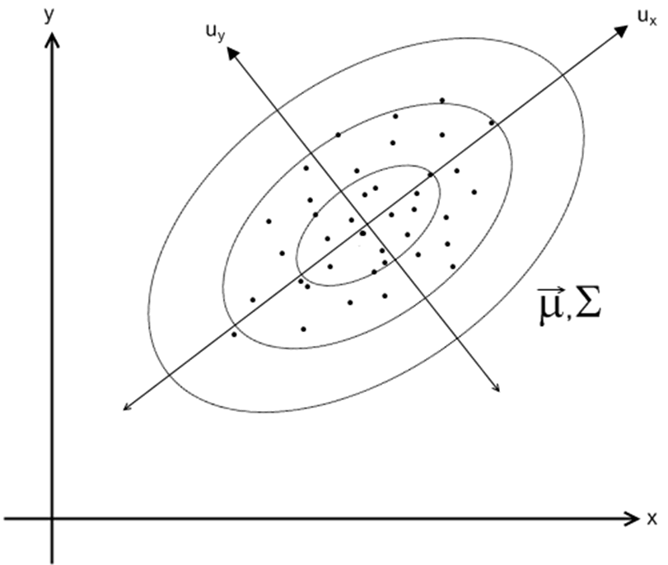
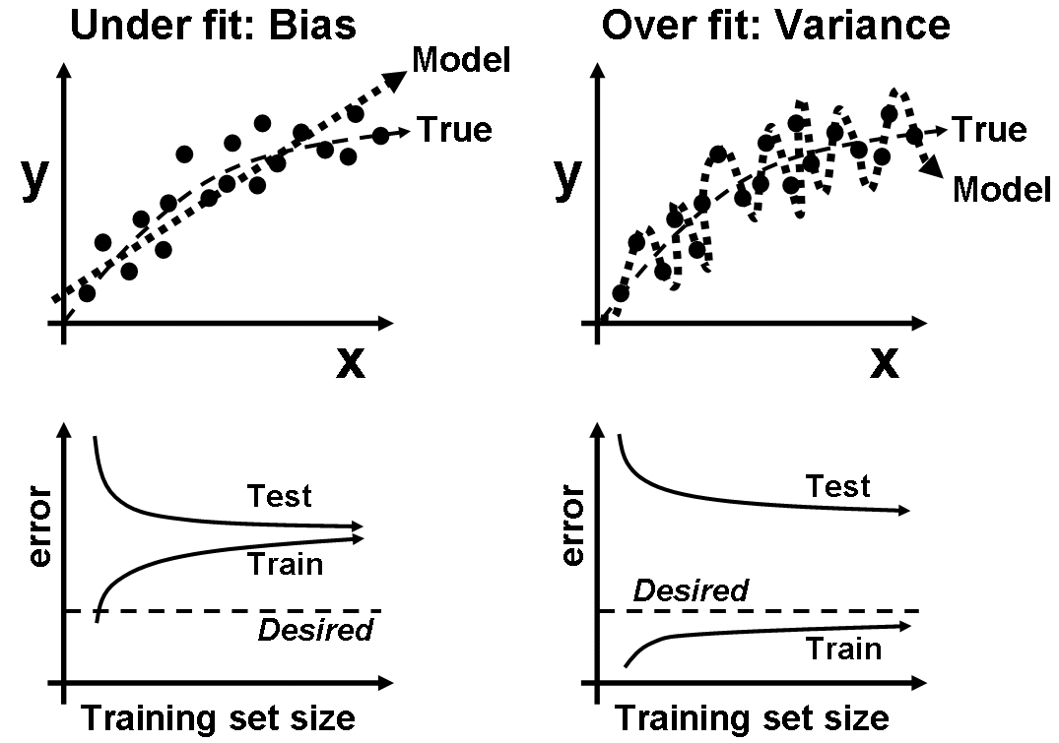
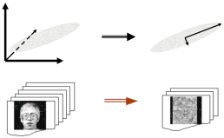
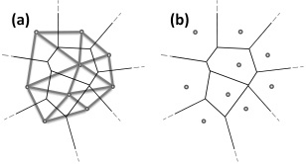
OpenCV Overview:
Robot support
> 500 functions
opencv.willowgarage.com
General Image Processing Functions
Image Pyramids
Geometric
Descriptors
Segmentation
Camera
Calibration,
Stereo, 3D
Features
Transforms
Utilities and
Data Structures
Tracking
Machine Learning:
Detection,
Recognition
Fitting
Matrix Math
Slide Courtesy OpenCV Tutorial Gary Bradski

Slide 5

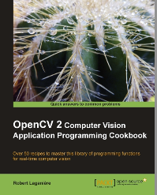
OpenCV – Getting Started
Download OpenCV
http://opencv.org
Install from macports/aptitude
Setting up
Comprehensive guide on setting up OpenCV in various environments at the official wiki.
Online Reference:
http://docs.opencv.org
Two books

Slide 6
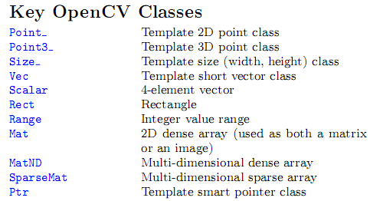
Key Classes

Slide 7
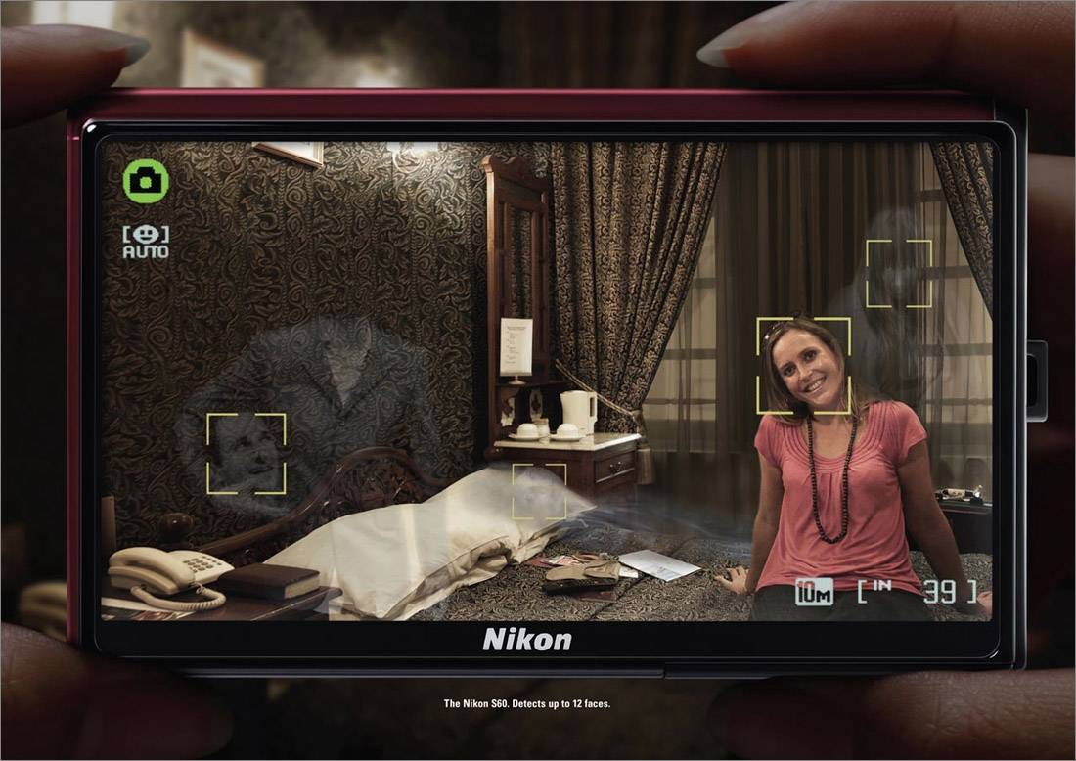
Face Detection
Photo Courtesy Nikon Corp.

Slide 8

Face Detection
Slide a window over the image
Also change the size of the window
Extract features for each window
Classify each window into face/non-face
?
Features
Classify
+1 face
?
-1 not face
?
x
F(x)
y

Slide 9
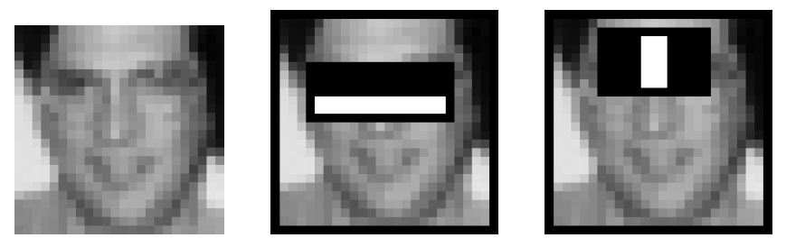
Face Detection: Viola-Jones
Robust and fast
Introduced by Paul Viola and Michael Jones
http://research.microsoft.com/~viola/Pubs/Detect/violaJones_CVPR2001.pdf
Haar-like Features
Use AdaBoost to select good classifiers and combine them

Slide 10
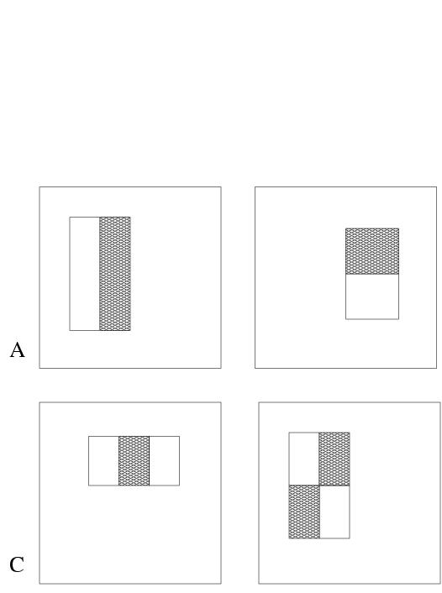
Face Detection: Viola-Jones
Haar-like features
Rectangular blocks, white or black
3 types of features:
two rectangles: horizontal/vertical
three rectangles
four rectangles
In 24x24 window: 180,000 possible features
Simple weak classifier

Slide 11
Face Detection: Cascaded Classifier
A 1 feature classifier achieves 100% detection rate and about 50% false positive rate.
A 5 feature classifier achieves 100% detection rate and 40% false positive rate (20% cumulative)
using data from previous stage.
A 20 feature classifier achieve 100% detection rate with 10% false positive rate (2% cumulative)
IMAGE
SUB-WINDOW
50%
20%
2%
1 Feature
5 Features
20 Features
FACE
F
F
F
NON-FACE
NON-FACE
NON-FACE

Slide 12
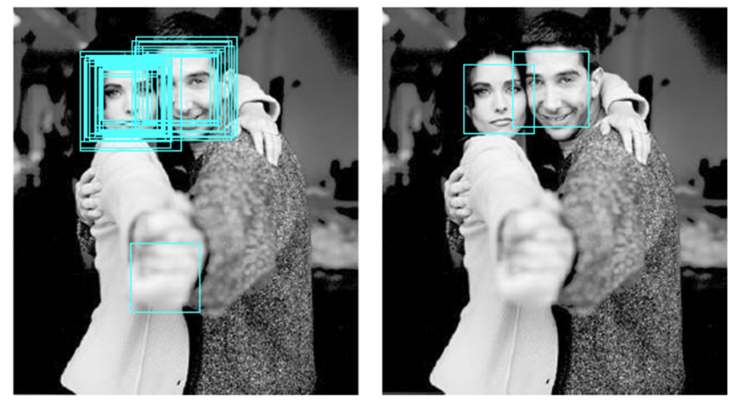
Face Detection: Non-Maximum Suppression
Thin out the multiple responses.
Suppress spurious responses.

Slide 13
Face Detection
Good news – OpenCV comes with an implementation of Viola-Jones!
Training
The training face images are provided.
opencv_traincascade (supports Harr and LBP features).
Details are at http://docs.opencv.org/trunk/doc/user_guide/ug_traincascade.html
Detection
A good reference: http://docs.opencv.org/doc/tutorials/objdetect/cascade_classifier/cascade_classifier.html

Slide 14
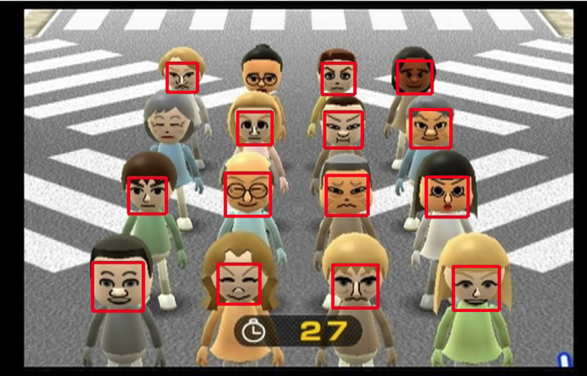
Face Detection: Example

