Slide 1
Haar cascades

Slide 2
What is Haar?
A Haar Cascade is basically a classifier which is used to detect the object for which it has been trained for, from the source.
The Haar Cascade is trained by superimposing the positive image over a set of negative images.
The training is generally done on a server and on various stages.

Slide 3
Haar features
Haar wavelet is a sequence of rescaled square-shaped functions.
Proposed by Alfred Haar 1909
Works on main two types:
Edge features
Line features

Slide 4
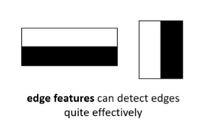
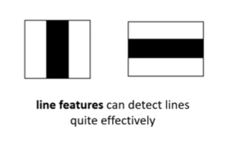
Haar features
Edge features :
Line features :

Slide 5
What is cascading
Cascading works on super imposing positive images over negative images and finding the similarity in them.
Positive images are the images in which the desired object which is to be detected is present.
Else the image is a negative image.

Slide 6
Learning References:
https://en.wikipedia.org/wiki/Haar-like_feature
https://en.wikipedia.org/wiki/Cascading_classifiers
https://en.wikipedia.org/wiki/Viola%E2%80%93Jones_object_detection_framework
Data source:
There are various sources on web to download the data we need.
For example,
https://github.com/opencv/opencv/tree/master/data/haarcascades

