Slide 1
Clustering

Slide 2
Clustering
Clustering is a type of un-supervised machine learning approach which deals with un labelled data.
In other words clustering means finding clusters in a dataset, unsupervised.
So what is a cluster??
A cluster is a group of data points or objects in a dataset that are similar to other objects in the group, and dissimilar to data points in other clusters.

Slide 3
Clustering - Types
Clustering is of three main types:
1. Partition Based Clustering (e.g. K-means)
Efficient
2. Hierarchical Clustering (e.g. Agglomerative)
Produces trees of clusters
3. Density Based Clustering (e.g. DBSCAN)
Produces arbitrary shaped clusters

Slide 4
K-Means Clustering

Slide 5
FORMULAE AND METHODOLOGY
By using same Basic Mathematical formulas and Programming iterations, We conclude.
The formulas are :
Euclidean Distance Formula
Centroid Changing Formula
Loops are Used for the iteration process unless the least square of distance between points is made.

Slide 6
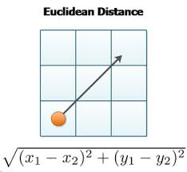
Euclidean Distance
This formula Helps us to find the distance between the data points to cluster them..

Slide 7
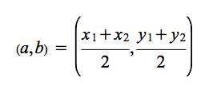
Centroid of Two points
This formula Helps us to find the distance midpoint/ Centroid between the data points to cluster them..
The centroid between
(x1,y1) and (x2,y2) is as :-

Slide 8
METHODOLOGY
The methodology is simple , first we take any k points as the initial points, then apply the Euclidean distance formula to cluster.
The data that is to be clustered will be clustered using this algorithm by reducing intra cluster distance and increasing inter cluster distances.
So, that the similar data will be clustered at one point, we can see the difference between them and the intra distance should be minimum and inter distance will be maximum.
This is iterative process until we complete the full clustering.

Slide 9
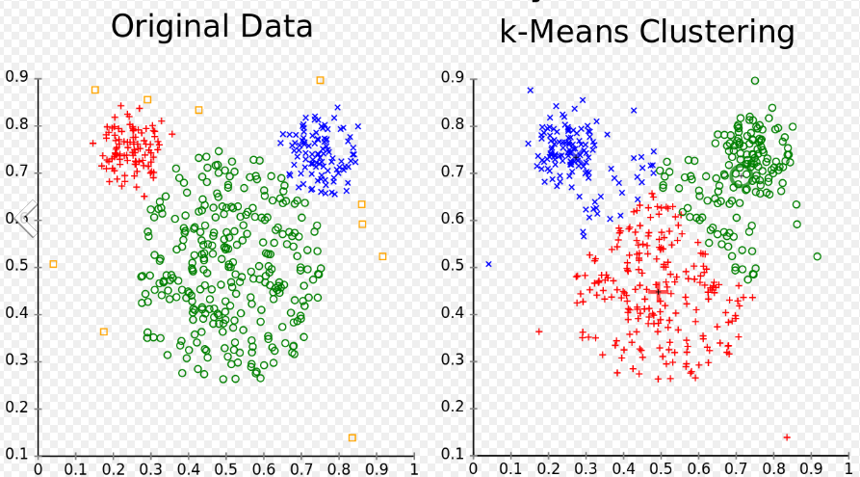
Diagramatic View of K means Clustering

Slide 10
Working of K means Clustering

Slide 11
Applications of K-means
Market research
Pattern recognition
Data analysis
Image processing
Medicine
Business and marketing , etc.

Slide 12
THANK YOU

