Slide 1

Contribution-Aware Trust Mechanism for
Poisoning Attack Detection in Swarm Learning
Major Project Review - 1
Batch ID: AIM-A14
Project Guide
Project Batch Members
Mrs. B. Lalitha Rajeswari
Assistant Professor, CSM, VVIT
D.THRIPURA– 23BQ1A6129
G.HARSHA – 23BQ1A6136
CH.TEJASRI – 23BQ1A6123
– 24BQ5A6125

Slide 2
Contribution-Aware Trust Mechanism for Poisoning Attack Detection in Swarm Learning
Guide: Mrs. B. Lalitha Rajeswari
Batch ID: A14
23BQ1A6129(TL), 23BQ1A6136,
23BQ1A6123, 24BQ5A6125
Problem statement:
In an ideal Swarm Learning environment, participating nodes should securely contribute to a global model while accurately distinguishing malicious poisoning updates from legitimate updates generated by honest participants. However, existing detection approaches that rely primarily on update similarity may incorrectly identify honest participants as malicious when their local data distributions are Non-IID, while sophisticated malicious updates may remain undetected. This can increase the false positive rate, attack success rate, and degradation of global model accuracy. Therefore, an effective mechanism is required to evaluate participant contribution and behavioural characteristics using multiple factors such as contribution, validation performance, update magnitude, similarity, and historical behaviour, thereby improving poisoning detection while preserving the contributions of honest Non-IID participants.

Slide 3
Contribution-Aware Trust Mechanism for Poisoning Attack Detection in Swarm Learning
Guide: Mrs. B. Lalitha Rajeswari
Batch ID: A14
23BQ1A6129(TL), 23BQ1A6136,
23BQ1A6123, 24BQ5A6125
Literature Review
Byzantine robust federated learning for heterogeneous brain MRI using multisignal gradient fingerprinting and adaptive trust aggregation
Mohammad Karami1, Hamed Kebriaei1, Fatemeh Ghassemi1 & Hamid Azadegan2 | www.nature.com/scientificreports
| Proposed Method | Data & Setup | key Results | Strengths & Limitations | Relevance to my research |
Multi-signal gradient fingerprinting characterizes client updates using cosine similarity, peer similarity, gradient norm, sign consistency, and contribution.
Client contribution assessment evaluates the functional impact of each update on the global model.
A trust-aware aggregation mechanism combines these signals to assign adaptive trust weights.
Trust weights reduce the influence of malicious or unreliable updates during aggregation.
The framework improves Byzantine robustness under Non-IID data while maintaining model performance.
Experiments demonstrate improved robustness against multiple poisoning attacks.

Slide 4
Contribution-Aware Trust Mechanism for Poisoning Attack Detection in Swarm Learning
Guide: Mrs. B. Lalitha Rajeswari
Batch ID: A14
23BQ1A6129(TL), 23BQ1A6136,
23BQ1A6123, 24BQ5A6125
Literature Review
Byzantine robust federated learning for heterogeneous brain MRI using multisignal gradient fingerprinting and adaptive trust aggregation
Mohammad Karami1, Hamed Kebriaei1, Fatemeh Ghassemi1 & Hamid Azadegan2 | www.nature.com/scientificreports
| Proposed Method | Data & Setup | key Results | Strengths & Limitations | Relevance to my research |
Datasets: MNIST, CIFAR-10, Alzheimer’s MRI, and OASIS MRI.
Models: 3-layer CNN for MNIST; ResNet-18 for CIFAR-10 and MRI datasets.
Data split: 80% training and 20% testing across clients.
Non-IID setting: Dirichlet-based heterogeneous data distribution.
Federation: Up to 50 clients and 25–30 communication rounds.
Attacks: Scaling, partial scaling, sign-flipping, Gaussian noise, and label-flipping attacks.

Slide 5
Contribution-Aware Trust Mechanism for Poisoning Attack Detection in Swarm Learning
Guide: Mrs. B. Lalitha Rajeswari
Batch ID: A14
23BQ1A6129(TL), 23BQ1A6136,
23BQ1A6123, 24BQ5A6125
Literature Review
Byzantine robust federated learning for heterogeneous brain MRI using multisignal gradient fingerprinting and adaptive trust aggregation
Mohammad Karami1, Hamed Kebriaei1, Fatemeh Ghassemi1 & Hamid Azadegan2 | www.nature.com/scientificreports
| Proposed Method | Data & Setup | Key Results | Strengths & Limitations | Relevance to my research |
Improved robustness against five types of Byzantine poisoning attacks.
Higher global accuracy compared with FedAvg and other baseline defences.
Effective under Non-IID data with heterogeneous client distributions.
Trust-based aggregation successfully reduces the influence of malicious updates.
Shapley contribution was identified as the most impactful component.

Slide 6
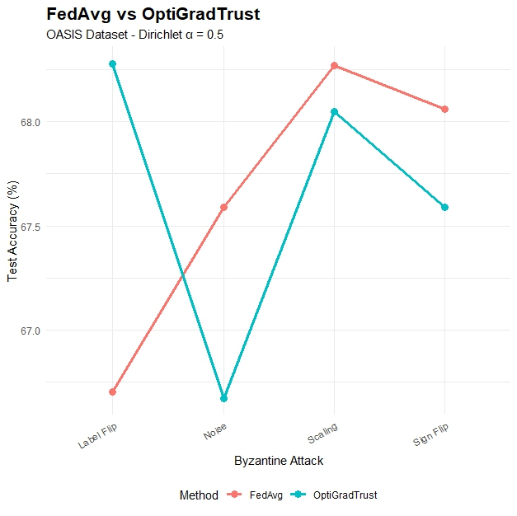
Contribution-Aware Trust Mechanism for Poisoning Attack Detection in Swarm Learning
Guide: Mrs. B. Lalitha Rajeswari
Batch ID: A14
23BQ1A6129(TL), 23BQ1A6136,
23BQ1A6123, 24BQ5A6125
Literature Review
Byzantine robust federated learning for heterogeneous brain MRI using multisignal gradient fingerprinting and adaptive trust aggregation
Mohammad Karami1, Hamed Kebriaei1, Fatemeh Ghassemi1 & Hamid Azadegan2 | www.nature.com/scientificreports
| Proposed Method | Data & Setup | Key Results | Strengths & Limitations | Relevance to my research |
Comparision of FegAvg and OptiGradTrust for 4 types if attacks that are mentioned below:
    Label-Flip
    Noise
    Scaling
    Sign-Flip

Slide 7
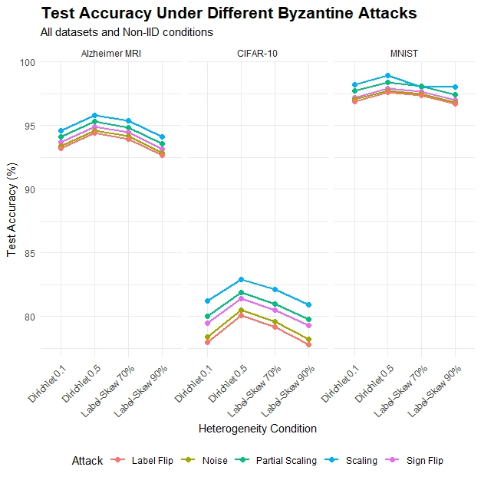
Contribution-Aware Trust Mechanism for Poisoning Attack Detection in Swarm Learning
Guide: Mrs. B. Lalitha Rajeswari
Batch ID: A14
23BQ1A6129(TL), 23BQ1A6136,
23BQ1A6123, 24BQ5A6125
Literature Review
Byzantine robust federated learning for heterogeneous brain MRI using multisignal gradient fingerprinting and adaptive trust aggregation
Mohammad Karami1, Hamed Kebriaei1, Fatemeh Ghassemi1 & Hamid Azadegan2 | www.nature.com/scientificreports
| Proposed Method | Data & Setup | Key Results | Strengths & Limitations | Relevance to my research |
The graph shows test accuracy for all five Byzantine attacks across different datasets and Non-IID conditions.
It shows that the impact of each attack varies depending on the dataset and data heterogeneity.
The Attacks mentioned in the Graphs are:
    Scaling
    Partial Scaling
    Sign-Flipping
    Gaussian Noise
    Label-Flipping

Slide 8
Contribution-Aware Trust Mechanism for Poisoning Attack Detection in Swarm Learning
Guide: Mrs. B. Lalitha Rajeswari
Batch ID: A14
23BQ1A6129(TL), 23BQ1A6136,
23BQ1A6123, 24BQ5A6125
Literature Review
Byzantine robust federated learning for heterogeneous brain MRI using multisignal gradient fingerprinting and adaptive trust aggregation
Mohammad Karami1, Hamed Kebriaei1, Fatemeh Ghassemi1 & Hamid Azadegan2 | www.nature.com/scientificreports
| Proposed Method | Data & Setup | key Results | Strengths & Limitations | Relevance to my research |
Strengths
Limitations
Multi-signal detection provides comprehensive client assessment.
Adaptive trust scoring adjusts to changing client behavior.
Robust under Non-IID data and heterogeneous distributions.
Trust-weighted aggregation limits malicious update influence.
Evaluated against multiple attacks and strong baselines.
Multi-signal effectiveness: The impact of individual signals varies across attack types.
Adaptive attacks: More investigation is needed against attackers that manipulate multiple trust signals.
Subtle attacks: Some attacks, such as sign-flipping, remain difficult to detect in certain settings.
Non-IID behavior: The interaction between data heterogeneity and adversarial behavior needs further study.

Slide 9
Contribution-Aware Trust Mechanism for Poisoning Attack Detection in Swarm Learning
Guide: Mrs. B. Lalitha Rajeswari
Batch ID: A14
23BQ1A6129(TL), 23BQ1A6136,
23BQ1A6123, 24BQ5A6125
Literature Review
Byzantine robust federated learning for heterogeneous brain MRI using multisignal gradient fingerprinting and adaptive trust aggregation
Mohammad Karami1, Hamed Kebriaei1, Fatemeh Ghassemi1 & Hamid Azadegan2 | www.nature.com/scientificreports
| Proposed Method | Data & Setup | key Results | Strengths & Limitations | Relevance to my research |
Provides a multi-signal trust-based approach relevant to poisoning detection.
Shows that client contribution can complement similarity-based detection.
Addresses Non-IID data, which is a key concern in our project.
Supports the use of trust-weighted aggregation to reduce malicious influence.
Our project extends this direction by focusing on Leave-One-Out contribution and reducing false positives for honest Non-IID participants.

Slide 10
Contribution-Aware Trust Mechanism for Poisoning Attack Detection in Swarm Learning
Guide: Mrs. B. Lalitha Rajeswari
Batch ID: A14
23BQ1A6129(TL), 23BQ1A6136,
23BQ1A6123, 24BQ5A6125
Literature Review
Beyond Leave-One-Out: Private and Robust Contribution Evaluation in Federated Learning | Jaramillo Velez et al., 2026 | arXiv Preprint
| Proposed Method | Data & Setup | key Results | Strengths & Limitations | Relevance to my research |
Introduces two privacy-preserving contribution evaluation methods: Fair-Private (FP) and Everybody-Else (EE).
FP combines Leave-One-Out (LOO) and Include-One-In (IOI) evaluations to provide fair client contribution scores.
EE evaluates a client's contribution based on the performance impact observed by other clients, avoiding direct self-evaluation.
Both methods are designed to work with Secure Aggregation, keeping individual client updates private.
FP satisfies key fairness properties such as efficiency, symmetry, and null-player.
EE improves robustness against contribution-score manipulation.
The resulting contribution scores can be used for client ranking, reward allocation, and misbehavior detection.

Slide 11
Contribution-Aware Trust Mechanism for Poisoning Attack Detection in Swarm Learning
Guide: Mrs. B. Lalitha Rajeswari
Batch ID: A14
23BQ1A6129(TL), 23BQ1A6136,
23BQ1A6123, 24BQ5A6125
Literature Review
Beyond Leave-One-Out: Private and Robust Contribution Evaluation in Federated Learning | Jaramillo Velez et al., 2026 | arXiv Preprint
| Proposed Method | Data & Setup | key Results | Strengths & Limitations | Relevance to my research |
Datasets: ISIC2019, Brain MRI, PCam, and CIFAR-10.
Cross-silo Federated Learning environment with multiple clients.
Secure Aggregation is used to protect private client updates.
Non-IID data is used to represent different data distributions among clients.
Different numbers of clients and communication rounds are tested.
FP and EE are compared with LOO, COS, and Multi-Round Shapley Value.
Contribution ranking is evaluated using Spearman, Kendall, Pearson correlation, and L2 distance.

Slide 12
Contribution-Aware Trust Mechanism for Poisoning Attack Detection in Swarm Learning
Guide: Mrs. B. Lalitha Rajeswari
Batch ID: A14
23BQ1A6129(TL), 23BQ1A6136,
23BQ1A6123, 24BQ5A6125
Literature Review
Beyond Leave-One-Out: Private and Robust Contribution Evaluation in Federated Learning | Jaramillo Velez et al., 2026 | arXiv Preprint
| Proposed Method | Data & Setup | key Results | Strengths & Limitations | Relevance to my research |
FP and EE achieved more accurate contribution rankings than LOO and COS.
Contribution rankings showed strong agreement with the Multi-Round Shapley Value.
Effective performance under Non-IID data with different client distributions.
EE improved robustness against contribution-score manipulation.
Contribution-based aggregation improved global model performance.
Effective in identifying misbehaving and low-quality clients.
Achieved privacy-preserving contribution evaluation using Secure Aggregation.

Slide 13
Contribution-Aware Trust Mechanism for Poisoning Attack Detection in Swarm Learning
Guide: Mrs. B. Lalitha Rajeswari
Batch ID: A14
23BQ1A6129(TL), 23BQ1A6136,
23BQ1A6123, 24BQ5A6125
Literature Review
Beyond Leave-One-Out: Private and Robust Contribution Evaluation in Federated Learning | Jaramillo Velez et al., 2026 | arXiv Preprint
| Proposed Method | Data & Setup | key Results | Strengths & Limitations | Relevance to my research |
Strengths
Limitations
Compatible with Secure Aggregation | EE can still be vulnerable to strategic misreporting
FP satisfies important fairness properties | Exact Shapley computation remains computationally expensive
EE avoids direct self-evaluation | Current work focuses on specific cross-silo/full-participation settings
EE provides manipulation resistance | Client sampling and asynchronous training are not fully addressed
Performs well under Non-IID data | Further robust aggregation/anomaly detection can improve resistance
Better contribution ranking than LOO and COS | More investigation is needed for additional adversarial strategies

Slide 14
Contribution-Aware Trust Mechanism for Poisoning Attack Detection in Swarm Learning
Guide: Mrs. B. Lalitha Rajeswari
Batch ID: A14
23BQ1A6129(TL), 23BQ1A6136,
23BQ1A6123, 24BQ5A6125
Literature Review
Beyond Leave-One-Out: Private and Robust Contribution Evaluation in Federated Learning | Jaramillo Velez et al., 2026 | arXiv Preprint
| Proposed Method | Data & Setup | key Results | Strengths & Limitations | Relevance to my research |
Provides a privacy-preserving contribution evaluation approach relevant to client trust assessment.
Shows that client contribution can be used to identify useful and low-quality participants.
Addresses Non-IID data, which is important for our project.
Supports contribution-based evaluation to reduce the influence of misbehaving clients.
Our project extends this direction by using Leave-One-Out contribution with trust-based poisoning attack detection.

Slide 15
Contribution-Aware Trust Mechanism for Poisoning Attack Detection in Swarm Learning
Guide: Mrs. B. Lalitha Rajeswari
Batch ID: A14
23BQ1A6129(TL), 23BQ1A6136,
23BQ1A6123, 24BQ5A6125
Literature Review
Ref 03 – Deep Learning-Based Zero-Trust Empowered Decentralized Security Defense against Poisoning Attacks in SL-IoT: Joint Distance-Accuracy Detection Approach
| Proposed Method | Data & Setup | key Results | Strengths & Limitations | Relevance to my research |
Uses Zero-Trust Architecture (ZTA) for Swarm Learning.
Continuously calculates risk and node scores.
Uses Manhattan distance to detect abnormal model updates.
Uses accuracy difference to identify poisoning that distance detection may miss.
Uses two headers:
Aggregation Header: aggregates local model parameters.
Detection Header: checks the new global model.
Includes an extra-defense mechanism when malicious nodes are numerous.

Slide 16
Contribution-Aware Trust Mechanism for Poisoning Attack Detection in Swarm Learning
Guide: Mrs. B. Lalitha Rajeswari
Batch ID: A14
23BQ1A6129(TL), 23BQ1A6136,
23BQ1A6123, 24BQ5A6125
Literature Review
Ref 03 – Deep Learning-Based Zero-Trust Empowered Decentralized Security Defense against Poisoning Attacks in SL-IoT: Joint Distance-Accuracy Detection Approach
| Proposed Method | Data & Setup | key Results | Strengths & Limitations | Relevance to my research |
Datasets: MNIST and CIFAR-10.
• Framework: Flower framework for decentralized learning experiments.
• Nodes: 8 machine-learning nodes participating in Swarm Learning.
• Data Distribution: Each node receives approximately 3% of the MNIST training data and 8% of the CIFAR-10 training data.
• Federation: Experiments are conducted with multiple participating nodes under Swarm Learning.
• Attacks: Random Attacker (RA) and Specialized Aggregation Attacker (SA).
• Hardware: Intel Xeon Gold 6226R CPU and NVIDIA RTX A5500 GPU.

Slide 17
Contribution-Aware Trust Mechanism for Poisoning Attack Detection in Swarm Learning
Guide: Mrs. B. Lalitha Rajeswari
Batch ID: A14
23BQ1A6129(TL), 23BQ1A6136,
23BQ1A6123, 24BQ5A6125
Literature Review
Ref 03 – Deep Learning-Based Zero-Trust Empowered Decentralized Security Defense against Poisoning Attacks in SL-IoT: Joint Distance-Accuracy Detection Approach
| Proposed Method | Data & Setup | key Results | Strengths & Limitations | Relevance to my research |
• Improved global model accuracy compared with existing defense schemes in most experimental cases.
• Effective against Random Attacker (RA) and Specialized Aggregation Attacker (SA) poisoning attacks.
• Successfully handles malicious header nodes in the Swarm Learning environment.
• Joint distance-accuracy detection improves the identification of abnormal or poisoned model updates.
• Risk/credit-based header selection reduces the possibility of repeatedly selecting unreliable or malicious nodes.
• Achieved better robustness under high attack ratios, although specialized attacks and many-attacker scenarios remain challenging.

Slide 18
Contribution-Aware Trust Mechanism for Poisoning Attack Detection in Swarm Learning
Guide: Mrs. B. Lalitha Rajeswari
Batch ID: A14
23BQ1A6129(TL), 23BQ1A6136,
23BQ1A6123, 24BQ5A6125
Literature Review
Ref 03 – Deep Learning-Based Zero-Trust Empowered Decentralized Security Defense against Poisoning Attacks in SL-IoT: Joint Distance-Accuracy Detection Approach
| Proposed Method | Data & Setup | key Results | Strengths & Limitations | Relevance to my research |
Strengths
Limitations
Uses a Zero-Trust Architecture.
Protects against malicious headr nodes.
Combines distance and accuracy detection.
Uses node risk/credit and historical behave+
or.
Maintains decentralized learning.
Provides an extra defense mechanism when detection becomes unreliable.
Manhattan distance can still be affected by Non-IID data distributions.
Honest nodes with naturally different updates may appear abnormal.
Detection mainly focuses on parameter distance and accuracy.
Participant contribution is not explicitly considered.
Similarity alone/distance-based detection may not fully identify sophisticated poisoning.

Slide 19
Contribution-Aware Trust Mechanism for Poisoning Attack Detection in Swarm Learning
Guide: Mrs. B. Lalitha Rajeswari
Batch ID: A14
23BQ1A6129(TL), 23BQ1A6136,
23BQ1A6123, 24BQ5A6125
Literature Review
Ref 03 – Deep Learning-Based Zero-Trust Empowered Decentralized Security Defense against Poisoning Attacks in SL-IoT: Joint Distance-Accuracy Detection Approach
| Proposed Method | Data & Setup | key Results | Strengths & Limitations | Relevance to my research |
Provides a Zero-Trust-based approach that is relevant to poisoning attack detection in Swarm Learning.
Shows that model update distance and validation accuracy can be combined to improve poisoning detection.
Considers node risk, credit, and historical behavior, which are important for evaluating participant trust.
Addresses malicious header nodes, which is an important security issue in decentralized Swarm Learning.
Our project extends this direction by considering contribution, validation performance, update magnitude, similarity,
and historical behavior to reduce false positives for honest Non-IID participants.

Slide 20
Contribution-Aware Trust Mechanism for Poisoning Attack Detection in Swarm Learning
Guide: Mrs. B. Lalitha Rajeswari
Batch ID: A14
23BQ1A6129(TL), 23BQ1A6136,
23BQ1A6123, 24BQ5A6125
Literature Review - Summary
Reference | Year | Main Idea | Strengths | Limitation
Zhu et al. | 2024 | Cosine-based attack detection | Private, Byzantine-resilient | Weak for Non-IID
Karami et al. | 2026 | Multi-signal trust + Shapley | Robust under Non-IID | Subtle attacks
Kavuri et al. | 2025 | Multi-factor client trust | Adaptive detection | FL, not SL
Vélez et al. | 2026 | LOO contribution evaluation | Simple, Non-IID aware | Limited adversarial study

Slide 21
Contribution-Aware Trust Mechanism for Poisoning Attack Detection in Swarm Learning
Guide: Mrs. B. Lalitha Rajeswari
Batch ID: A14
23BQ1A6129(TL), 23BQ1A6136,
23BQ1A6123, 24BQ5A6125
Review – 1
Questions?

