Slide 1

Contribution-Aware Trust Mechanism for
Poisoning Attack Detection in Swarm Learning
Major Project Review - 1
Batch ID: AIM-A14
Project Guide
Project Batch Members
Mrs. B. Lalitha Rajeswari
Assistant Professor, CSM, VVIT
Student 1 – 23BQ1A6129
Student 2 – 23BQ1A6136
Student 3 – 23BQ1A6123
Student 4 – 24BQ5A6125

Slide 2
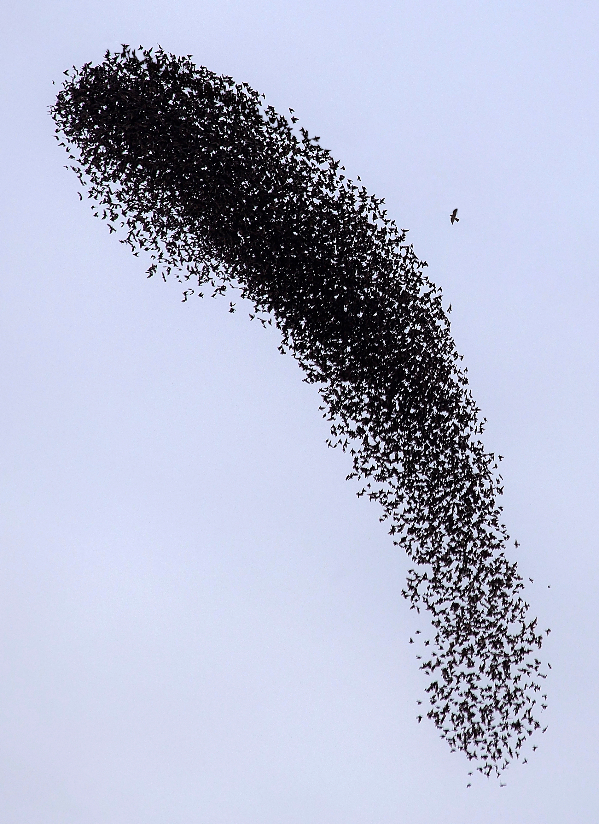
What is Swarm Learning?
Contribution-Aware Trust Mechanism for Poisoning Attack Detection in Swarm Learning
Guide: Mrs. B. Lalitha Rajeswari
Batch ID: A14
23BQ1A6129(TL), 23BQ1A6136,
23BQ1A6123, 24BQ5A6125
Swarm Learning enables multiple organizations(Hospitals, financial institutions, e-commerce), to collaboratively train an AI model without sharing their private data.
This image shows a swarm of birds flying in the air, with peer to peer interactions.
peer-to-peer collaboration without needing a central coordinator

Slide 3
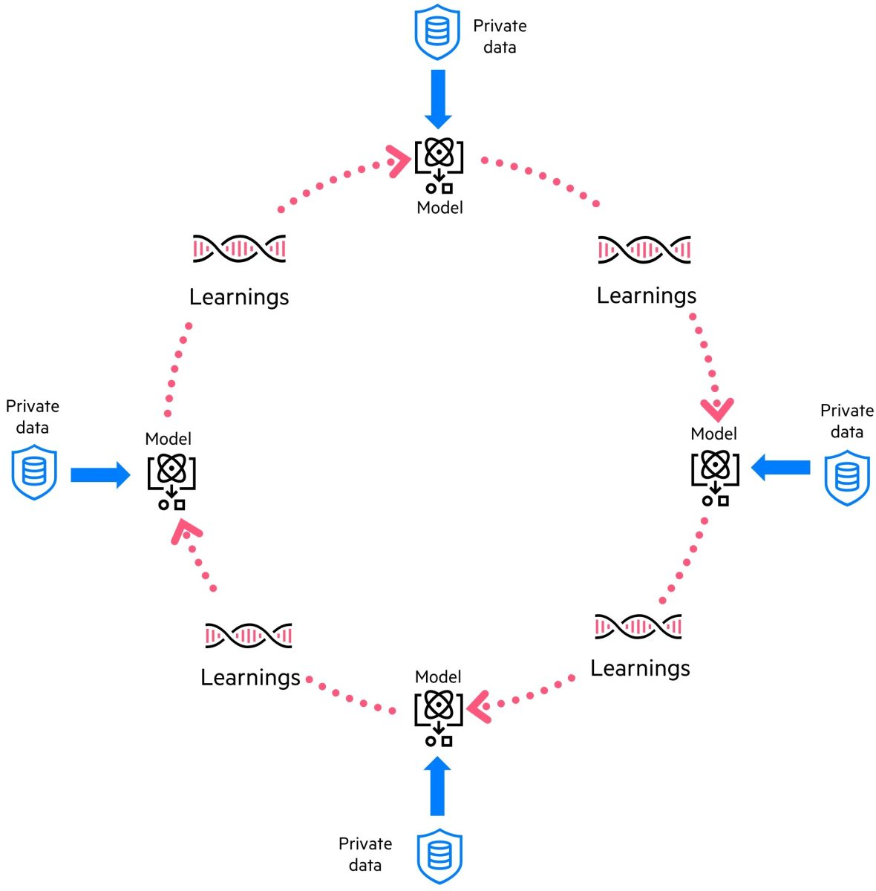
Contribution-Aware Trust Mechanism for Poisoning Attack Detection in Swarm Learning
Guide: Mrs. B. Lalitha Rajeswari
Batch ID: A14
23BQ1A6129(TL), 23BQ1A6136,
23BQ1A6123, 24BQ5A6125
Purpose of Swarm Learning
Swarm Learning enables multiple organizations(Hospitals, financial institutions, e-commerce), to collaboratively train an AI model without sharing their private data.
The main purpose is to enable collaborative machine learning while maintaining data privacy .
  Raw data remains at the local participant.
  Participants can learn from each other’s updates

Slide 4
Applications of Swarm Learning
Contribution-Aware Trust Mechanism for Poisoning Attack Detection in Swarm Learning
Guide: Mrs. B. Lalitha Rajeswari
Batch ID: A14
23BQ1A6129(TL), 23BQ1A6136,
23BQ1A6123, 24BQ5A6125
Healthcare and Diagnostics
  Multi-Institutional Disease Detection
  Medical Imaging
Cybersecurity
  Threat Detection
  Autonomous Response
Autonomous Systems
  Intelligent Edge and Drones
Manufacturing and Industry
  Production Scheduling

Slide 5
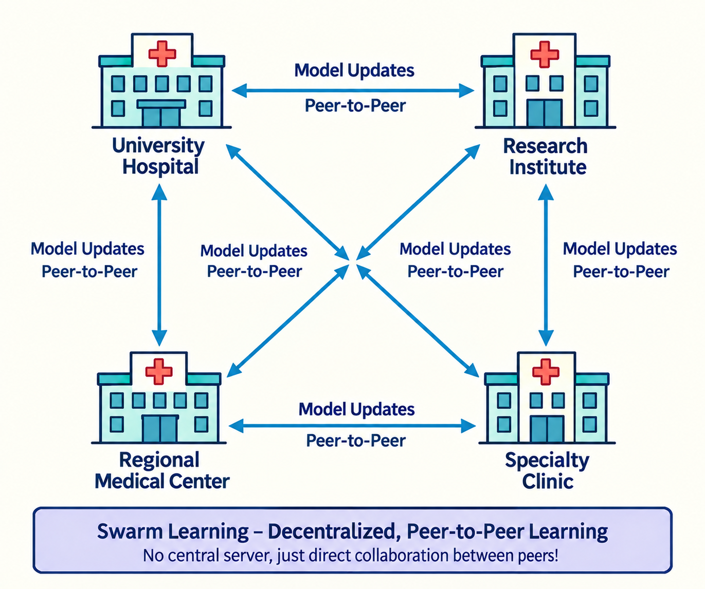
Role Of Swarm Learning in Health care
Contribution-Aware Trust Mechanism for Poisoning Attack Detection in Swarm Learning
Guide: Mrs. B. Lalitha Rajeswari
Batch ID: A14
23BQ1A6129(TL), 23BQ1A6136,
23BQ1A6123, 24BQ5A6125
It is mainly used in Health Care Applications
Data is distributed
  Patient data exists in different hospitals and medical centre's
Data is highly sensitive
  Patient information cannot simply be shared publicly.
More data can improve AI
  One hospital may not have enough data to train a highly accurate model.
SL allows hospitals to learn collaboratively without directly sharing patient data

Slide 6
Contribution-Aware Trust Mechanism for Poisoning Attack Detection in Swarm Learning
Guide: Mrs. B. Lalitha Rajeswari
Batch ID: A14
23BQ1A6129(TL), 23BQ1A6136,
23BQ1A6123, 24BQ5A6125
Connection with the project
Swarm Learning is vulnerable to poisoning attacks, where a malicious participant can submit harmful model updates.
At the same time, differences in data distribution between organizations can make honest model updates look suspicious.
To address this challenge, an adaptive multi-factor trust mechanism evaluates participants using cosine similarity, data distribution, validation performance, update magnitude, and participation history.
A trust score is then assigned to each participant, giving greater importance to reliable updates and reducing the impact of suspicious ones.
The system aims to improve the security, reliability, and fairness of Swarm Learning across different application domains.

Slide 7
Contribution-Aware Trust Mechanism for Poisoning Attack Detection in Swarm Learning
Guide: Mrs. B. Lalitha Rajeswari
Batch ID: A14
23BQ1A6129(TL), 23BQ1A6136,
23BQ1A6123, 24BQ5A6125
Literature Table
Paper | Trust Techniques | Attacks Used | Key Limitation / Gap
Zhu et al. (2024) | Cosine similarity, secure aggregation, blockchain-based trust | Byzantine / poisoning attacks | Similarity-only; weak for Non-IID; can misclassify legitimate updates
Kavuri et al. (2025) | Gradient consistency, update stability, historical behavior, contribution-based trust | Poisoning / Byzantine attacks | Built for Federated Learning, not Swarm Learning
Karami et al. (2026) | Cosine, peer similarity, gradient norm, sign consistency, Shapley contribution, adaptive trust | Scaling, partial scaling, sign-flipping, Gaussian noise, label-flipping | Shapley is costly; subtle attacks; Non-IID adversarial behaviour needs more study
Vélez et al. (2026) | LOO, Include-One-In, Everybody-Else, secure aggregation | Contribution manipulation / adversarial behaviour | Focused on contribution evaluation → limited poisoning-attack detection

Slide 8
Contribution-Aware Trust Mechanism for Poisoning Attack Detection in Swarm Learning
Guide: Mrs. B. Lalitha Rajeswari
Batch ID: A14
23BQ1A6129(TL), 23BQ1A6136,
23BQ1A6123, 24BQ5A6125
Literature Review
Zero-Trust Empowered Decentralized Security Defense against Poisoning Attacks in SL-IoT: Joint Distance-Accuracy Detection Approach
| Proposed Method | Data & Setup | key Results | Strengths & Limitations | Relevance to my research |
Uses Zero-Trust Architecture (ZTA) for Swarm Learning.
Continuously calculates risk and node scores.
Uses Manhattan distance to detect abnormal model updates.
Uses accuracy difference to identify poisoning that distance detection may miss.
Uses two headers:
Aggregation Header: aggregates local model parameters.
Detection Header: checks the new global model.
Includes an extra-defense mechanism when malicious nodes are numerous.

Slide 9
Contribution-Aware Trust Mechanism for Poisoning Attack Detection in Swarm Learning
Guide: Mrs. B. Lalitha Rajeswari
Batch ID: A14
23BQ1A6129(TL), 23BQ1A6136,
23BQ1A6123, 24BQ5A6125
Literature Review
Zero-Trust Empowered Decentralized Security Defense against Poisoning Attacks in SL-IoT: Joint Distance-Accuracy Detection Approach
| Proposed Method | Data & Setup | key Results | Strengths & Limitations | Relevance to my research |
Datasets: MNIST and CIFAR-10.
• Framework: Flower framework for decentralized learning experiments.
• Nodes: 8 machine-learning nodes participating in Swarm Learning.
• Data Distribution: Each node receives approximately 3% of the MNIST training data and 8% of the CIFAR-10 training data.
• Federation: Experiments are conducted with multiple participating nodes under Swarm Learning.
• Attacks: Random Attacker (RA) and Specialized Aggregation Attacker (SA).

Slide 10
Contribution-Aware Trust Mechanism for Poisoning Attack Detection in Swarm Learning
Guide: Mrs. B. Lalitha Rajeswari
Batch ID: A14
23BQ1A6129(TL), 23BQ1A6136,
23BQ1A6123, 24BQ5A6125
Literature Review
Zero-Trust Empowered Decentralized Security Defense against Poisoning Attacks in SL-IoT: Joint Distance-Accuracy Detection Approach
| Proposed Method | Data & Setup | key Results | Strengths & Limitations | Relevance to my research |
It achieved about 40% higher accuracy than related methods when fewer attackers were present. It achieved about 18 percentage points higher accuracy under header attacks with 60–80% attackers.
• Effective against Random Attacker (RA) and Specialized Aggregation Attacker (SA) poisoning attacks.
• Successfully handles malicious header nodes in the Swarm Learning environment.
• Joint distance-accuracy detection improves the identification of abnormal or poisoned model updates.
• Achieved better robustness under high attack ratios, although specialized attacks and many-attacker scenarios remain challenging.

Slide 11
Contribution-Aware Trust Mechanism for Poisoning Attack Detection in Swarm Learning
Guide: Mrs. B. Lalitha Rajeswari
Batch ID: A14
23BQ1A6129(TL), 23BQ1A6136,
23BQ1A6123, 24BQ5A6125
Literature Review
Zero-Trust Empowered Decentralized Security Defense against Poisoning Attacks in SL-IoT: Joint Distance-Accuracy Detection Approach
| Proposed Method | Data & Setup | key Results | Strengths & Limitations | Relevance to my research |
Strengths
Limitations
Uses a Zero-Trust Architecture.
Protects against malicious header nodes.
Combines distance and accuracy detection.
Uses node risk/credit and historical behave
Maintains decentralized learning.
Provides an extra defense mechanism when detection becomes unreliable.
Manhattan distance can still be affected by Non-IID data distributions.
Honest nodes with naturally different updates may appear abnormal.
Detection mainly focuses on parameter distance and accuracy.
Participant contribution is not explicitly considered.
Similarity alone/distance-based detection may not fully identify sophisticated poisoning.

Slide 12
Contribution-Aware Trust Mechanism for Poisoning Attack Detection in Swarm Learning
Guide: Mrs. B. Lalitha Rajeswari
Batch ID: A14
23BQ1A6129(TL), 23BQ1A6136,
23BQ1A6123, 24BQ5A6125
Literature Review
Zero-Trust Empowered Decentralized Security Defense against Poisoning Attacks in SL-IoT: Joint Distance-Accuracy Detection Approach
| Proposed Method | Data & Setup | key Results | Strengths & Limitations | Relevance to my research |
Provides a Zero-Trust-based approach that is relevant to poisoning attack detection in Swarm Learning.
The paper shows that model update distance and validation accuracy can be combined to improve poisoning detection.
Considers node risk, credit, and historical behaviour, which are important for evaluating participant trust.
Addresses malicious header nodes, which is an important security issue in decentralized Swarm Learning.
Our project extends this direction by considering contribution, validation performance, update magnitude, similarity, and historical behaviour to reduce false positives for honest Non-IID participants.

Slide 13
Contribution-Aware Trust Mechanism for Poisoning Attack Detection in Swarm Learning
Guide: Mrs. B. Lalitha Rajeswari
Batch ID: A14
23BQ1A6129(TL), 23BQ1A6136,
23BQ1A6123, 24BQ5A6125
Literature Review
SwarmShield: A Fully Decentralized Trust-Based Defense Against Adversarial Poisoning in Federated Learning
| Proposed Method | Data & Setup | key Results | Strengths & Limitations | Relevance to my research |
• Decentralized local training without sharing private data.
• Similarity analysis using PCA, clustering and cosine similarity.
• Leave-One-Out contribution to measure each client's impact on global performance.
• Multi-factor trust score combining contribution, similarity and validation performance.
• Malicious clients identified using multiple behavioural signals.
• Trust-based aggregation reduces the influence of suspicious updates.
• Continuous trust updates across communication rounds.
• Maintains decentralized Swarm Learning while improving poisoning-attack detection.

Slide 14
Contribution-Aware Trust Mechanism for Poisoning Attack Detection in Swarm Learning
Guide: Mrs. B. Lalitha Rajeswari
Batch ID: A14
23BQ1A6129(TL), 23BQ1A6136,
23BQ1A6123, 24BQ5A6125
Literature Review
SwarmShield: A Fully Decentralized Trust-Based Defense Against Adversarial Poisoning in Federated Learning
| Proposed Method | Data & Setup | key Results | Strengths & Limitations | Relevance to my research |
Datasets: CIFAR-10, Derma MNIST, TwoLeadECG.
Models: ResNet-50 for image datasets; model for TwoLeadECG classification.
Nodes: 3 decentralized peer nodes; one malicious peer.
Federation: Swarm Learning with decentralized leader election and aggregation.
Defense : PCA + K-means clustering + cosine similarity + trust scoring + trust-weighted aggregation + blockchain.
Attacks: Label flipping, Extreme Noise, PGD, and FGSM.
Rounds: 50 rounds in the ablation study.

Slide 15
Contribution-Aware Trust Mechanism for Poisoning Attack Detection in Swarm Learning
Guide: Mrs. B. Lalitha Rajeswari
Batch ID: A14
23BQ1A6129(TL), 23BQ1A6136,
23BQ1A6123, 24BQ5A6125
Literature Review
SwarmShield: A Fully Decentralized Trust-Based Defense Against Adversarial Poisoning in Federated Learning
| Proposed Method | Data & Setup | key Results | Strengths & Limitations | Relevance to my research |
• Robust against 4 poisoning attacks: Label Flipping, Extreme Noise, Fast gradient sign method, and Projected gradient descent.
• Achieved approximately 24.8% average accuracy improvement on CIFAR-10 under attacks.
• Trust-based aggregation reduced the effect of malicious peers.
• PCA + k-means + cosine similarity helped detect suspicious updates.
• Eliminated the central aggregator, providing a fully decentralized defense.
It improved average Canadian Institute for Advanced Research 10-class dataset accuracy by 24.8% under attacks. It maintained 74.71% clean accuracy on the Dermatology Modified National Institute of Standards and Technology database.

Slide 16
Contribution-Aware Trust Mechanism for Poisoning Attack Detection in Swarm Learning
Guide: Mrs. B. Lalitha Rajeswari
Batch ID: A14
23BQ1A6129(TL), 23BQ1A6136,
23BQ1A6123, 24BQ5A6125
Literature Review
SwarmShield: A Fully Decentralized Trust-Based Defense Against Adversarial Poisoning in Federated Learning
| Proposed Method | Data & Setup | key Results | Strengths & Limitations | Relevance to my research |
Strengths
Limitations
• Fully decentralized trust-based architecture
• Detects and reduces malicious peer influence
• Uses PCA, clustering and cosine similarity
• Dynamic trust scoring and trust-weighted aggregation
• Supports multiple poisoning attacks
• Dynamic leader election without a central aggregator
• Honest heterogeneous nodes may appear suspicious.
• Similarity-based detection may miss sophisticated attacks.
• Additional communication and computation are required.
• PGD attacks may resemble natural data variations.
• Participant contribution is not explicitly considered.

Slide 17
Contribution-Aware Trust Mechanism for Poisoning Attack Detection in Swarm Learning
Guide: Mrs. B. Lalitha Rajeswari
Batch ID: A14
23BQ1A6129(TL), 23BQ1A6136,
23BQ1A6123, 24BQ5A6125
Literature Review
SwarmShield: A Fully Decentralized Trust-Based Defense Against Adversarial Poisoning in Federated Learning
| Proposed Method | Data & Setup | key Results | Strengths & Limitations | Relevance to my research |
Similarity-based detection supports malicious update identification.
Trust scoring provides a basis for trust-based attack detection.
Trust-weighted aggregation reduces malicious influence.
Decentralized learning matches our Swarm Learning approach.
PCA + k-means + cosine similarity detect abnormal updates.
Our project extends SwarmShield by adding client contribution (Leave-One-Out) for improved poisoning detection.

Slide 18
Contribution-Aware Trust Mechanism for Poisoning Attack Detection in Swarm Learning
Guide: Mrs. B. Lalitha Rajeswari
Batch ID: A14
23BQ1A6129(TL), 23BQ1A6136,
23BQ1A6123, 24BQ5A6125
Literature Review
Beyond Leave-One-Out: Private and Robust Contribution Evaluation in Federated Learning | Jaramillo Velez et al., 2026 | arXiv Preprint
| Proposed Method | Data & Setup | key Results | Strengths & Limitations | Relevance to my research |
Introduces two privacy-preserving contribution evaluation methods: Fair-Private (FP) and Everybody-Else (EE).
FP combines Leave-One-Out (LOO) and Include-One-In (IOI) evaluations to provide fair client contribution scores.
EE evaluates a client's contribution based on the performance impact observed by other clients, avoiding direct self-evaluation.
Both methods are designed to work with Secure Aggregation, keeping individual client updates private.
FP satisfies key fairness properties such as efficiency, symmetry, and null-player.
EE improves robustness against contribution-score manipulation.
The resulting contribution scores can be used for client ranking, reward allocation, and misbehavior detection.

Slide 19
Contribution-Aware Trust Mechanism for Poisoning Attack Detection in Swarm Learning
Guide: Mrs. B. Lalitha Rajeswari
Batch ID: A14
23BQ1A6129(TL), 23BQ1A6136,
23BQ1A6123, 24BQ5A6125
Literature Review
Beyond Leave-One-Out: Private and Robust Contribution Evaluation in Federated Learning | Jaramillo Velez et al., 2026 | arXiv Preprint
| Proposed Method | Data & Setup | key Results | Strengths & Limitations | Relevance to my research |
Datasets: ISIC2019, Brain MRI, PCam, and CIFAR-10.
Cross-silo Federated Learning environment with multiple clients.
Non-IID data is used to represent different data distributions among clients.
Different numbers of clients and communication rounds are tested.
FP and EE are compared with LOO, COS, and Multi-Round Shapley Value.
Contribution ranking is evaluated using Spearman, Kendall, Pearson correlation, and L2 distance.
Trust Techniques: LOO, Include-One-In, Everybody-Else, secure aggregation.
Attacks: Contribution manipulation.

Slide 20
Contribution-Aware Trust Mechanism for Poisoning Attack Detection in Swarm Learning
Guide: Mrs. B. Lalitha Rajeswari
Batch ID: A14
23BQ1A6129(TL), 23BQ1A6136,
23BQ1A6123, 24BQ5A6125
Literature Review
Beyond Leave-One-Out: Private and Robust Contribution Evaluation in Federated Learning | Jaramillo Velez et al., 2026 | arXiv Preprint
| Proposed Method | Data & Setup | key Results | Strengths & Limitations | Relevance to my research |
Everybody-Else achieved a Spearman’s rank correlation coefficient of 0.942 on the International Skin Imaging Collaboration dataset. Fair-Private achieved an L2 norm error of 0.112 on the International Skin Imaging Collaboration dataset.
FP(Fair-Private )and EE(Everybody-Else) achieved more accurate contribution rankings than LOO and COS.
Contribution rankings showed strong agreement with the Multi-Round Shapley Value.
Effective performance under Non-IID data with different client distributions.
Contribution-based aggregation improved global model performance.

Slide 21
Contribution-Aware Trust Mechanism for Poisoning Attack Detection in Swarm Learning
Guide: Mrs. B. Lalitha Rajeswari
Batch ID: A14
23BQ1A6129(TL), 23BQ1A6136,
23BQ1A6123, 24BQ5A6125
Literature Review
Beyond Leave-One-Out: Private and Robust Contribution Evaluation in Federated Learning | Jaramillo Velez et al., 2026 | arXiv Preprint
| Proposed Method | Data & Setup | key Results | Strengths & Limitations | Relevance to my research |
Strengths
Limitations
Compatible with Secure Aggregation | EE can still be vulnerable to strategic misreporting
FP satisfies important fairness properties | Exact Shapley computation remains computationally expensive
EE avoids direct self-evaluation | Current work focuses on specific cross-silo/full-participation settings
Performs well under Non-IID data | Client sampling and asynchronous training are not fully addressed
Better contribution ranking than LOO and COS | More investigation is needed for additional adversarial strategies

Slide 22
Contribution-Aware Trust Mechanism for Poisoning Attack Detection in Swarm Learning
Guide: Mrs. B. Lalitha Rajeswari
Batch ID: A14
23BQ1A6129(TL), 23BQ1A6136,
23BQ1A6123, 24BQ5A6125
Literature Review
Beyond Leave-One-Out: Private and Robust Contribution Evaluation in Federated Learning | Jaramillo Velez et al., 2026 | arXiv Preprint
| Proposed Method | Data & Setup | key Results | Strengths & Limitations | Relevance to my research |
Provides a privacy-preserving contribution evaluation approach relevant to client trust assessment.
Shows that client contribution can be used to identify useful and low-quality participants.
Addresses Non-IID data, which is important for our project.
Supports contribution-based evaluation to reduce the influence of misbehaving clients.
Our project extends this direction by using Leave-One-Out contribution with trust-based poisoning attack detection.

Slide 23
Contribution-Aware Trust Mechanism for Poisoning Attack Detection in Swarm Learning
Guide: Mrs. B. Lalitha Rajeswari
Batch ID: A14
23BQ1A6129(TL), 23BQ1A6136,
23BQ1A6123, 24BQ5A6125
Literature Review
Byzantine robust federated learning for heterogeneous brain MRI using multisignal gradient fingerprinting and adaptive trust aggregation
Mohammad Karami1, Hamed Kebriaei1, Fatemeh Ghassemi1 & Hamid Azadegan2 | www.nature.com/scientificreports
| Proposed Method | Data & Setup | key Results | Strengths & Limitations | Relevance to my research |
Multi-signal fingerprint is a combined profile of a client’s model update based on multiple signals such as similarity, magnitude, consistency, and contribution.
It characterizes client updates using cosine similarity, peer similarity, gradient norm, sign consistency, and contribution.
Client contribution assessment evaluates the functional impact of each update on the global model.
A trust-aware aggregation mechanism combines these signals to assign adaptive trust weights.
Trust weights reduce the influence of malicious or unreliable updates during aggregation.
The framework improves Byzantine robustness under Non-IID data while maintaining model performance.
Experiments demonstrate improved robustness against multiple poisoning attacks.

Slide 24
Contribution-Aware Trust Mechanism for Poisoning Attack Detection in Swarm Learning
Guide: Mrs. B. Lalitha Rajeswari
Batch ID: A14
23BQ1A6129(TL), 23BQ1A6136,
23BQ1A6123, 24BQ5A6125
Literature Review
Byzantine robust federated learning for heterogeneous brain MRI using multisignal gradient fingerprinting and adaptive trust aggregation
Mohammad Karami1, Hamed Kebriaei1, Fatemeh Ghassemi1 & Hamid Azadegan2 | www.nature.com/scientificreports
| Proposed Method | Data & Setup | key Results | Strengths & Limitations | Relevance to my research |
Datasets: MNIST, CIFAR-10, Alzheimer’s MRI, and OASIS MRI.
Models: 3-layer CNN for MNIST; ResNet-18 for CIFAR-10 and MRI datasets.
Non-IID setting: Dirichlet-based heterogeneous data distribution.
Nodes: 10 Nodes for each dataset.
Attacks: Scaling, partial scaling, sign-flipping, Gaussian noise, and label-flipping attacks.
Trust mechanisms used: Cosine similarity, peer similarity, gradient norm, sign consistency, and client contribution assessment.

Slide 25
Contribution-Aware Trust Mechanism for Poisoning Attack Detection in Swarm Learning
Guide: Mrs. B. Lalitha Rajeswari
Batch ID: A14
23BQ1A6129(TL), 23BQ1A6136,
23BQ1A6123, 24BQ5A6125
Literature Review
Byzantine robust federated learning for heterogeneous brain MRI using multisignal gradient fingerprinting and adaptive trust aggregation
Mohammad Karami1, Hamed Kebriaei1, Fatemeh Ghassemi1 & Hamid Azadegan2 | www.nature.com/scientificreports
| Proposed Method | Data & Setup | Key Results | Strengths & Limitations | Relevance to my research |
It reached 98.95% accuracy on the Modified National Institute of Standards and Technology database under Non-Independent and Identically Distributed attacks.
It achieved an F1-score of 0.98 for scaling-attack detection on the Open Access Series of Imaging Studies.
Trust-based aggregation successfully reduces the influence of malicious updates.
Achieved 10.4% computational overhead with scalability up to 50 clients

Slide 26
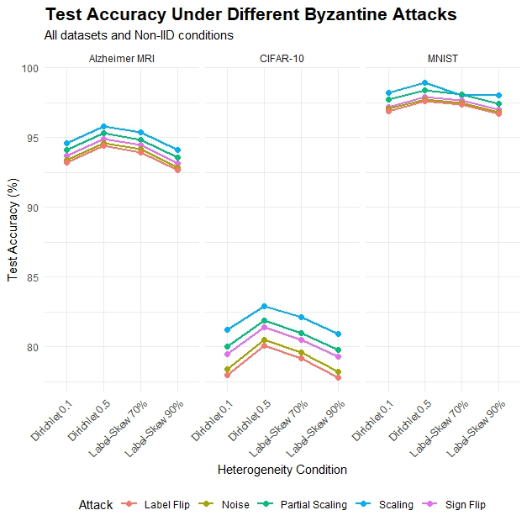
Contribution-Aware Trust Mechanism for Poisoning Attack Detection in Swarm Learning
Guide: Mrs. B. Lalitha Rajeswari
Batch ID: A14
23BQ1A6129(TL), 23BQ1A6136,
23BQ1A6123, 24BQ5A6125
Literature Review
Byzantine robust federated learning for heterogeneous brain MRI using multisignal gradient fingerprinting and adaptive trust aggregation
Mohammad Karami1, Hamed Kebriaei1, Fatemeh Ghassemi1 & Hamid Azadegan2 | www.nature.com/scientificreports
| Proposed Method | Data & Setup | Key Results | Strengths & Limitations | Relevance to my research |
The graph shows test accuracy for all five Byzantine attacks across different datasets and Non-IID conditions.
It shows that the impact of each attack varies depending on the dataset and data heterogeneity.
The Attacks mentioned in the Graphs are:
    Scaling
    Partial Scaling
    Sign-Flipping
    Gaussian Noise
    Label-Flipping

Slide 27
Contribution-Aware Trust Mechanism for Poisoning Attack Detection in Swarm Learning
Guide: Mrs. B. Lalitha Rajeswari
Batch ID: A14
23BQ1A6129(TL), 23BQ1A6136,
23BQ1A6123, 24BQ5A6125
Literature Review
Byzantine robust federated learning for heterogeneous brain MRI using multisignal gradient fingerprinting and adaptive trust aggregation
Mohammad Karami1, Hamed Kebriaei1, Fatemeh Ghassemi1 & Hamid Azadegan2 | www.nature.com/scientificreports
| Proposed Method | Data & Setup | key Results | Strengths & Limitations | Relevance to my research |
Strengths
Limitations
Multi-signal detection provides comprehensive client assessment.
Adaptive trust scoring adjusts to changing client behaviour.
Robust under Non-IID data and heterogeneous distributions.
Trust-weighted aggregation limits malicious update influence.
Evaluated against multiple attacks and strong baselines.
Multi-signal effectiveness: The impact of individual signals varies across attack types.
Adaptive attacks: More investigation is needed against attackers that manipulate multiple trust signals.
Subtle attacks: Some attacks, such as sign-flipping, remain difficult to detect in certain settings.
Non-IID behaviour: The interaction between data heterogeneity and adversarial behaviour needs further study.

Slide 28
Contribution-Aware Trust Mechanism for Poisoning Attack Detection in Swarm Learning
Guide: Mrs. B. Lalitha Rajeswari
Batch ID: A14
23BQ1A6129(TL), 23BQ1A6136,
23BQ1A6123, 24BQ5A6125
Literature Review
Byzantine robust federated learning for heterogeneous brain MRI using multisignal gradient fingerprinting and adaptive trust aggregation
Mohammad Karami1, Hamed Kebriaei1, Fatemeh Ghassemi1 & Hamid Azadegan2 | www.nature.com/scientificreports
| Proposed Method | Data & Setup | key Results | Strengths & Limitations | Relevance to my research |
Provides a multi-signal trust-based approach relevant to poisoning detection.
Shows that client contribution can complement similarity-based detection.
Addresses Non-IID data, which is a key concern in our project.
Supports the use of trust-weighted aggregation to reduce malicious influence.
Our project extends this direction by focusing on Leave-One-Out contribution and reducing false positives for honest Non-IID participants.

Slide 29
Contribution-Aware Trust Mechanism for Poisoning Attack Detection in Swarm Learning
Guide: Mrs. B. Lalitha Rajeswari
Batch ID: A14
23BQ1A6129(TL), 23BQ1A6136,
23BQ1A6123, 24BQ5A6125
Literature Review - Summary
Reference | Year | Main Idea | Strength | Limitation
Zhu et al. | 2024 | Cosine-based attack detection | Byzantine resistant | Weak for Non-IID
Kavuri et al. | 2025 | Multi-factor trust | Adaptive detection | FL, not SL
Karami et al. | 2026 | Multi-signal trust And Shapley Contribution | Good for Non-IID | Subtle attacks
Vélez et al. | 2026 | LOO contribution evaluation | Simple, Non-IID aware | Limited attack study

Slide 30
Contribution-Aware Trust Mechanism for Poisoning Attack Detection in Swarm Learning
Guide: Mrs. B. Lalitha Rajeswari
Batch ID: A14
23BQ1A6129(TL), 23BQ1A6136,
23BQ1A6123, 24BQ5A6125
Problem statement:
In an ideal Swarm Learning environment, participating nodes should securely contribute to a global model while accurately distinguishing malicious poisoning updates from legitimate updates generated by honest participants. However, existing detection approaches that rely primarily on update similarity may incorrectly identify honest participants as malicious when their local data distributions are Non-IID, while sophisticated malicious updates may remain undetected. This can increase the false positive rate, attack success rate, and degradation of global model accuracy. Therefore, an effective mechanism is required to evaluate participant contribution and behavioural characteristics using multiple factors such as contribution, validation performance, update magnitude, similarity, and historical behaviour, thereby improving poisoning detection while preserving the contributions of honest Non-IID participants.

Slide 31
Contribution-Aware Trust Mechanism for Poisoning Attack Detection in Swarm Learning
Guide: Mrs. B. Lalitha Rajeswari
Batch ID: A14
23BQ1A6129(TL), 23BQ1A6136,
23BQ1A6123, 24BQ5A6125
Review – 1
Questions?

