Slide 1
Azure Virtual Machine Scale Set
with Autoscale Rules
Automatic scaling based on CPU utilization
2400031861 — TEAM LEAD
2400031849 — TEAM MEMBER
2400031814 — TEAM MEMBER
2400031810 — TEAM MEMBER
TEAM NUMBER — T105

Slide 2
1. Problem Statement
Why automatic scaling is needed
Low traffic
High traffic
Manual scaling
Fewer resources are needed
CPU and workload can increase
Slow and difficult to manage
• Applications can experience changing workloads during normal use, peak hours, or special events.
• Running a fixed number of virtual machines can waste resources during low demand.
• Too few instances during high demand can reduce application performance.
• VM Scale Sets with Autoscale provide an automatic way to adjust capacity.
Azure VMSS Autoscale | Project Presentation 2

Slide 3
2. VM and VM Scale Set
Simple concept before the implementation
Virtual Machine
VM Scale Set
A computer running in Azure
A group of similar VMs managed together
VM 1
VM 2
VM 3
• Instead of managing each VM separately, VMSS manages instances as one group.
• Your project starts with 2 instances and allows Azure to scale between 2 and 5.
• Ubuntu Server 24.04 LTS was used for the VMSS instances.
Azure VMSS Autoscale | Project Presentation 3

Slide 4
3. Project Architecture
Monitoring and autoscaling workflow
Azure Resource Group
VMSS-Autoscale-RG
VM Scale Set
vmss-autoscale-demo
VM Instance 1
Ubuntu 24.04
VM Instance 2
Ubuntu 24.04
Azure Monitor
Percentage CPU
Autoscale Rules
>70% → +1 | <30% → -1
Azure VMSS Autoscale | Project Presentation 4

Slide 5
4. Azure Configuration
Key values used in the project
2
5
2
70%
Minimum instances
Maximum instances
Default instances
Scale-out threshold
• Scale out: Average Percentage CPU > 70% → increase instance count by 1.
• Scale in: Average Percentage CPU < 30% → decrease instance count by 1.
• Minimum = 2 ensures the VMSS does not scale below 2 instances.
• Maximum = 5 prevents the VMSS from growing beyond 5 instances.
Azure VMSS Autoscale | Project Presentation 5

Slide 6
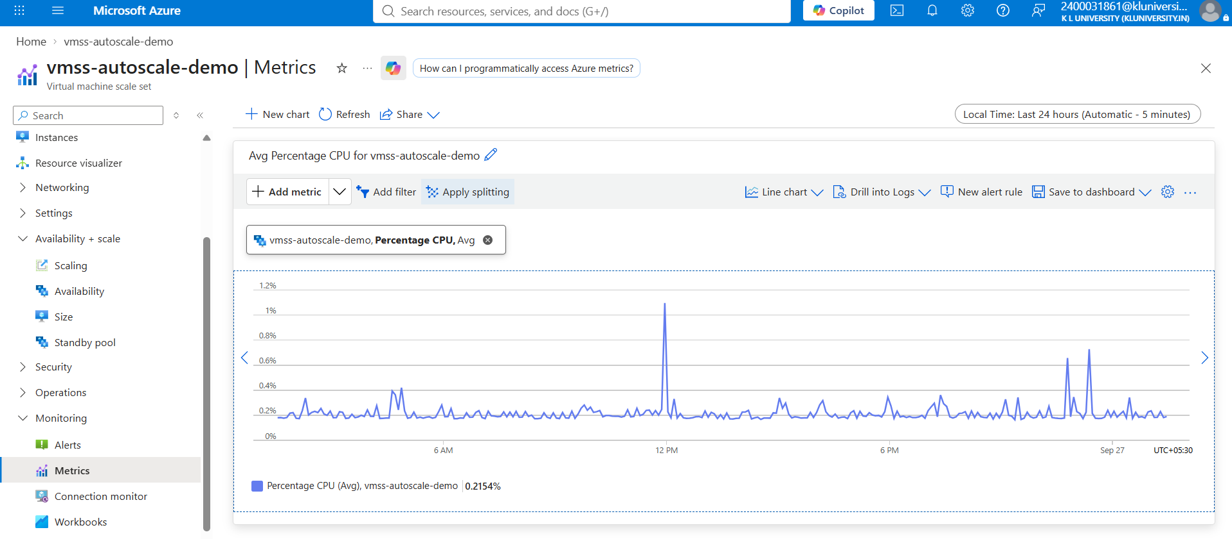
5. Azure Monitor
Percentage CPU is the metric used by Autoscale
The graph shows CPU utilization over time. Azure Autoscale uses this metric to decide whether to add or remove instances.
Azure VMSS Autoscale | Project Presentation 6

Slide 7
6. How Autoscaling Works
The core logic of the project
CPU > 70%
Scale Out
+1 Instance
Maximum 5
CPU < 30%
Scale In
-1 Instance
Minimum 2
• Azure Monitor continuously observes the Percentage CPU metric.
• Autoscale applies the configured thresholds and changes the number of instances automatically.
Azure VMSS Autoscale | Project Presentation 7

Slide 8
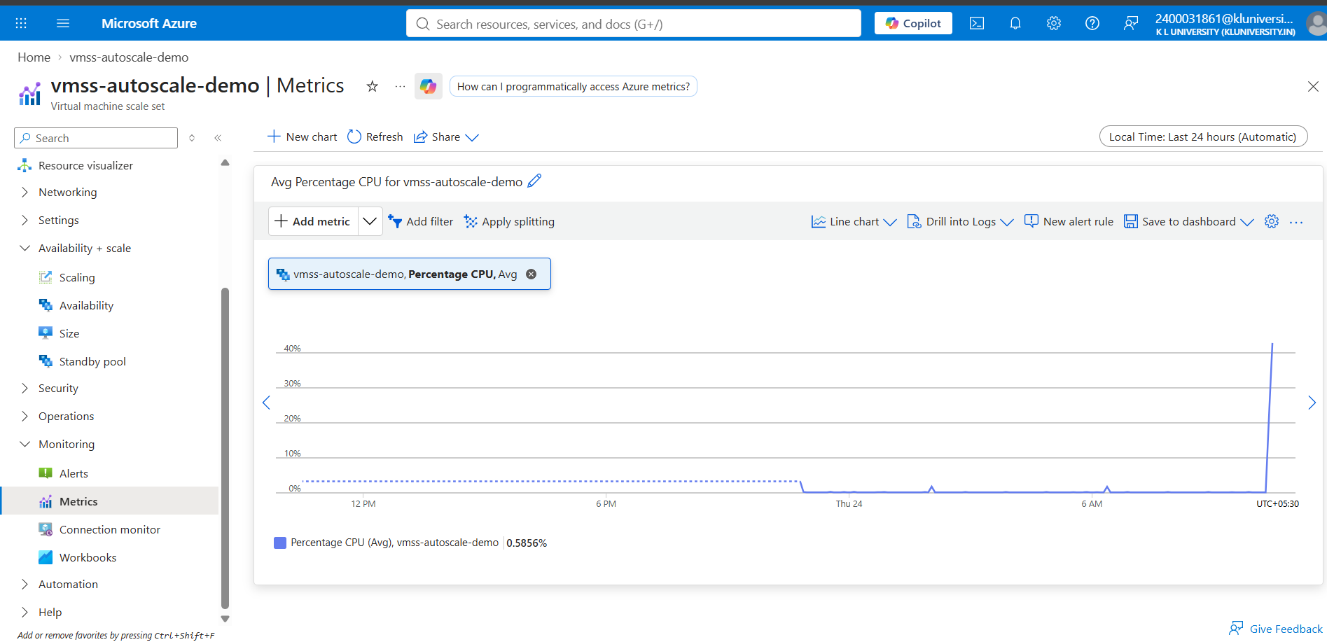
7. Testing Approach
Verifying monitoring and autoscaling behavior
• Checked the VMSS instance count in Azure Portal.
• Viewed the Percentage CPU metric under Monitoring → Metrics.
• Configured the autoscale rules and verified the 2 / 5 / 2 instance limits.
• Used a Linux CPU-load test approach to create higher CPU utilization.
• Observed Azure Monitor for changes in CPU utilization and documented the results.
Evidence: Azure Monitor CPU metric
Azure VMSS Autoscale | Project Presentation 8

Slide 9
8. Result
What the project demonstrates
2 → 5
5 → 2
CPU
Scale-out capacity
Scale-in capacity
Metric-driven decision
• The VMSS was configured with CPU-based autoscaling.
• Azure Monitor provides the CPU metric used by the autoscale policy.
• The project demonstrates automatic capacity management while respecting minimum and maximum limits.
• Project documentation, screenshots, and commands were pushed to GitHub.
Azure VMSS Autoscale | Project Presentation 9

Slide 10
9. Benefits and Real-World Use
Why this architecture is useful
Performance
Efficiency
Automation
More capacity when workload rises
Fewer instances when workload falls
Less manual VM management
• Example: an online shopping application can have more users during a sale.
• High demand can increase CPU usage, triggering scale-out.
• After the demand falls, scale-in can reduce unnecessary instances.
• The same concept can be used for web applications, APIs, and other variable workloads.
Azure VMSS Autoscale | Project Presentation 10

Slide 11
Conclusion
• Implemented an Azure VM Scale Set with CPU-based autoscaling.
• Configured 2 minimum, 5 maximum, and 2 default instances.
• Used Azure Monitor Percentage CPU as the scaling metric.
• Configured scale-out at >70% CPU and scale-in at <30% CPU.
• Documented the implementation and pushed the project to GitHub.
Thank You | Questions?

