Slide 1

Peterbilt OPTIMIZATION
Team Sunrisers Hyderabad

Slide 2

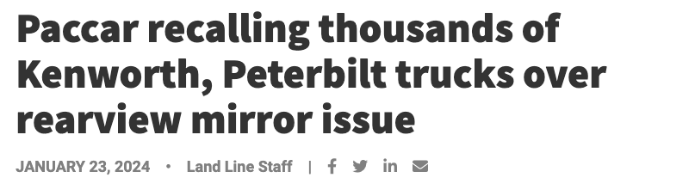

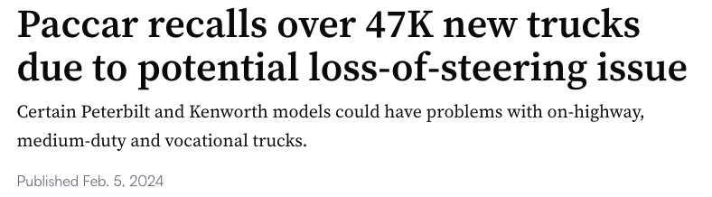
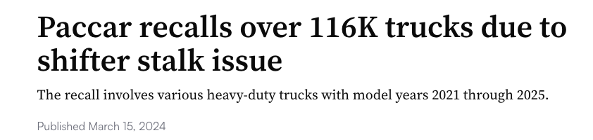

AIM :
Identify configuration patterns that lead to warranty claims and reduce claims through optimized configurations.
The Peterbilt 567 and 579 models have been consistently involved in multiple recalls, indicating potential vulnerabilities in these specific configurations.

Slide 3
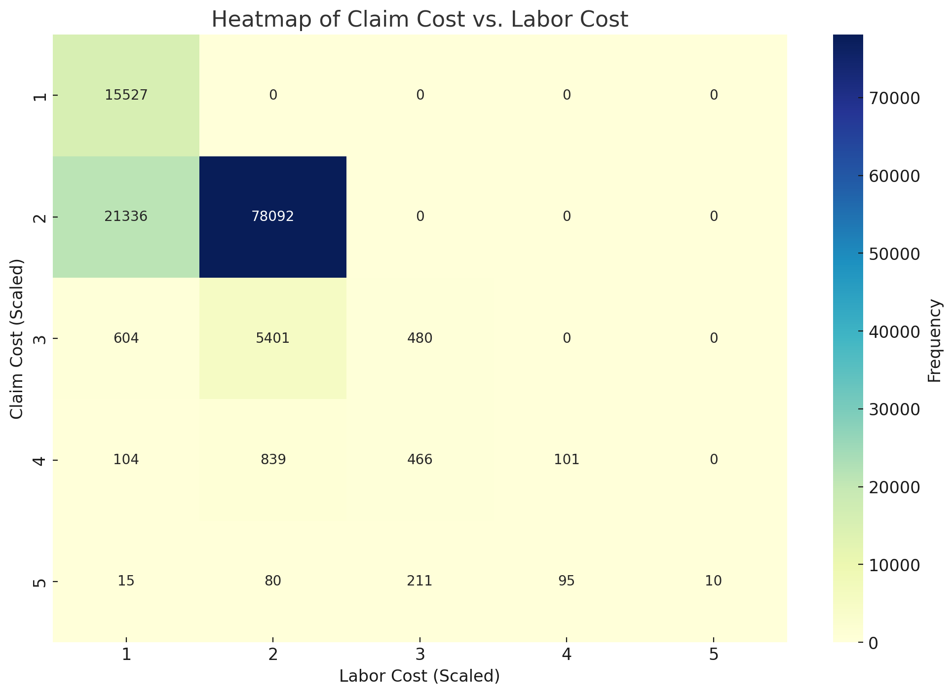
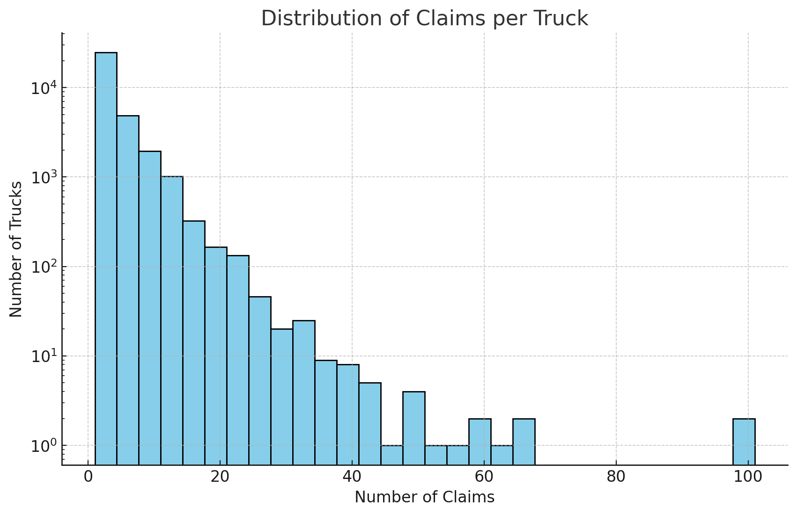


Slide 4
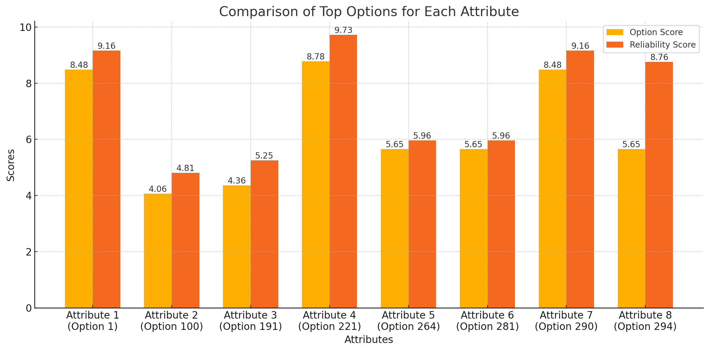
Higher Reliability score indicates higher average claim per truck for that option.
Lower difference between option score and reliability score indicates the option might have greater chances to be the reason for claim.

Slide 5
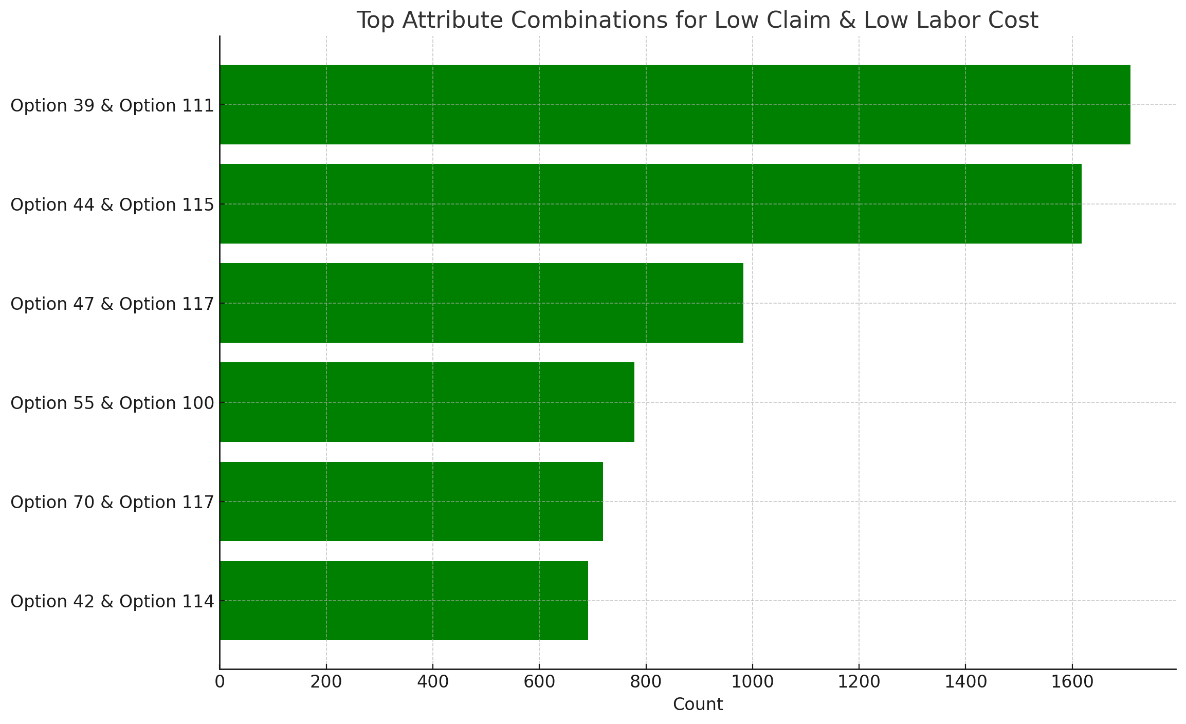
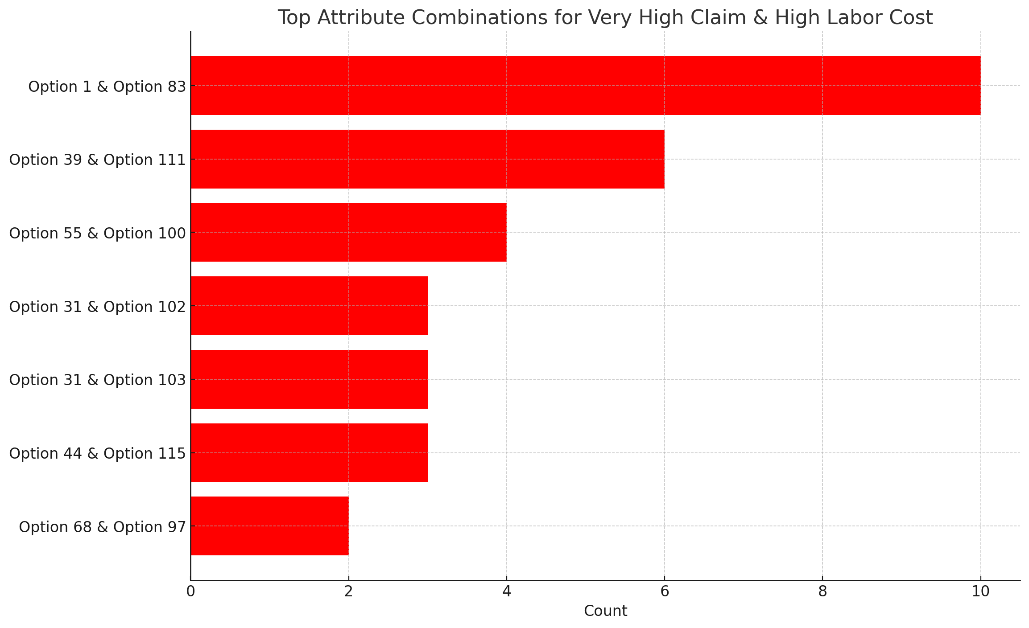
Attribute 1 & Attribute 4: Certain combinations show higher average predicted warranty costs, indicating possible configurations to avoid for cost management.
Attribute 2 & Attribute 5: This pair similarly shows distinct cost patterns, with specific value combinations contributing more significantly to warranty costs.

Slide 6
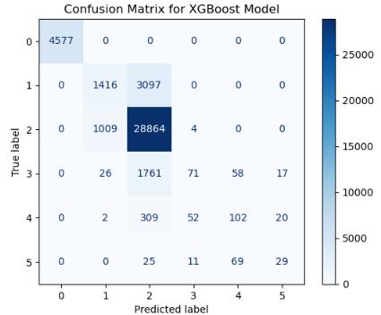
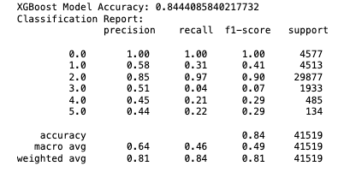
Key Findings - XGBoost model’s
Accuracy: 84.4%%
Insight: model that can predict warranty costs for new vehicle configurations based on their attributes
Results : Class 0 (No Claims)- Precision and Recall: Both are very high, indicating the model is correctly identifying cases with no claims almost perfectly.
Impact:
Helps target configurations with higher warranty claims for proactive improvements.

Slide 7
Recommendations
Optimize configurations to minimize claims
Investigate high-claim configurations for improvement
Focus on effective parts to reduce claim costs
Potential Impact:
Reduced warranty claims and enhanced vehicle reliability.

Slide 8

Q&A
Questions?

Slide 9

Reference
Land Line Staff (October 28, 2024) Cummins X15 recall affects thousands of Kenworth, Peterbilt trucks. https://landline.media/cummins-x15-recall-affects-thousands-of-kenworth-peterbilt-trucks/#:~:text=According%20to%20National%20Highway%20Traffic,Kenworth%20C500
David Taube(March 15, 2024) Paccar recalls over 116K trucks due to shifter stalk issue. https://www.truckingdive.com/news/paccar-recall-peterbilt-kenworth-2021-to-2024-models/710463/
David Taube(Feb. 5, 2024) Paccar recalls over 47K new trucks due to potential loss-of-steering issue. https://www.truckingdive.com/news/paccar-recalls-kenworth-peterbilt-2024-2025-models-steering-assembly/706521/
Land Line Staff(January 23, 2024) Paccar recalling thousands of Kenworth, Peterbilt trucks over rearview mirror issue. https://landline.media/paccar-recalling-thousands-of-kenworth-peterbilt-trucks-over-rearview-mirror-issue/

