Slide 1
Project Goal
To understanding the shopper behavior on e-commerce website to predict the likelihood of purchase and shopping cart abandonment.
Data
To help with our investigation, we took Online Shoppers Purchasing Intention Dataset from UCI repository. The data set had 7 float type attributes, 7 integer type attributes, 2 object types attributes and 2 Boolean type attributes and 12,330 entries collected over a year from various users.
Processing Steps
Data preparation
The data set was tested for missing values, outliers, spelling errors and whitespaces during initial exploration steps. Around 125 duplicate records were observed and removed.
Understanding and Predicting Online Shopper’s Purchase Intention
Bodiyabaduge Dewsri Lalithi Perera(S3762890)
Divya Ulaganathan(S3759465)

Slide 2
2. Data Exploration
All the quantitative attributes were independently analysed using histograms and the class variable was explored using a pie chart. To identify the features for the classification model pairwise tests were conducted using box plots and to analyse the relationship between quantitative variables scatter plots were used.
Selected feature Set for the two classifiers:
Amount of time spent on the Administrative pages.
Amount of time spent on the Information pages.
Amount of time spent on the Product related pages.
Bounce Rate
Exit Rate
Visitor types
Special days of a month
Traffic Type
Class Variable
We used the variable “Revenue” as the class variable which says whether the visitor has made a purchase or not.

Slide 3
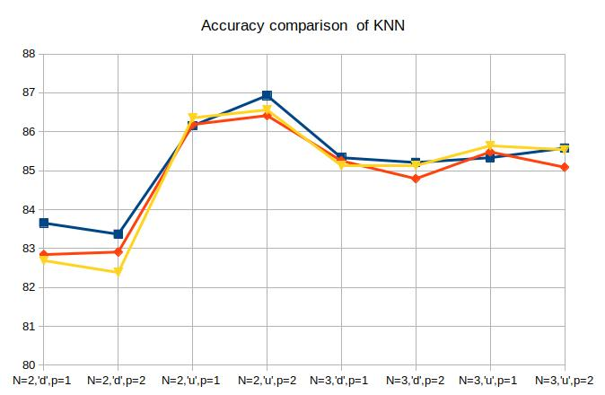
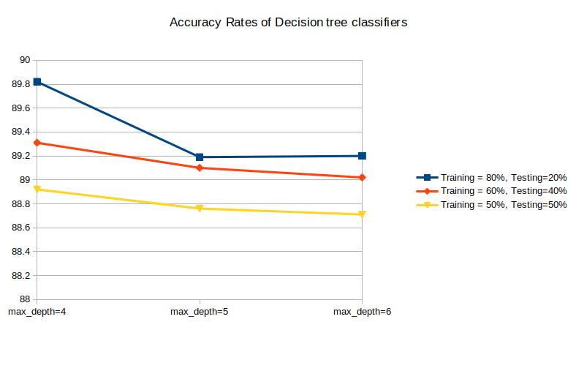
3. Data modelling with KNN and Decision tree classifiers
Accuracy comparison on different splitting and parameters of the two classifiers
Conclusion:
With 89.7% decision tree algorithm wins over K-nearest neighbors classifier. However the two classifiers scores accuracy rates exceeding 82% in all the models fitted for different training-test splits and for different argument values. Training 80% testing 20% split has obtained the highest accuracies among other splits.
Finally it can be concluded that the purchase intention of a person can be described/predicted using his/her behavior on e-commerce website.

