Slide 1
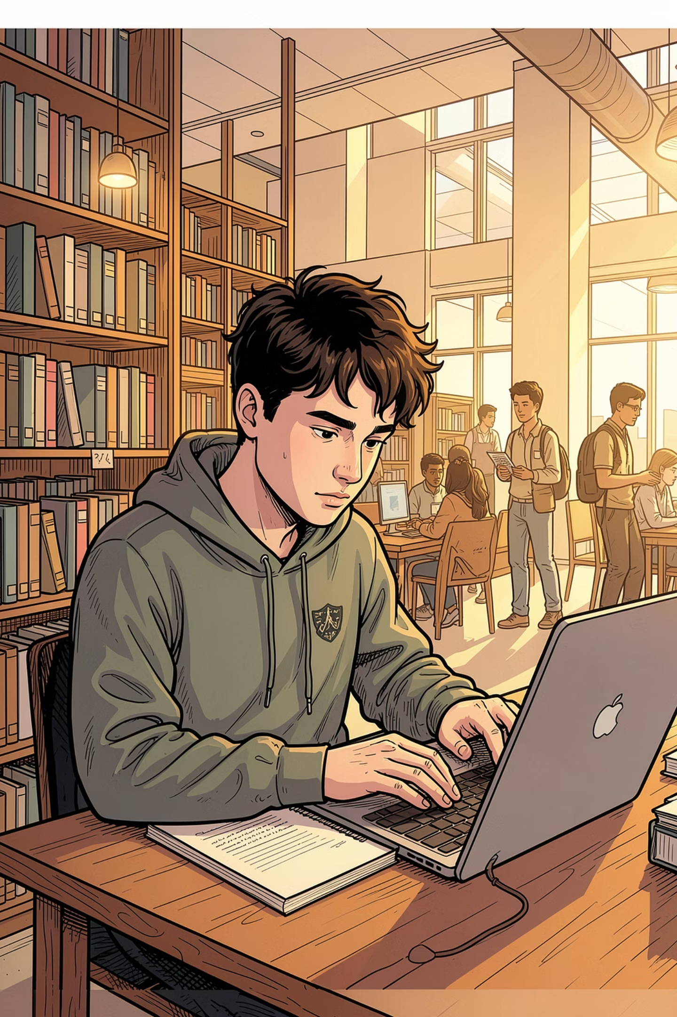
Cybersecurity Habits for Students
What are the most effective, low-effort cybersecurity habits non-technical students can adopt to lower their risk of phishing and attacks — without spending money on tools?
RESEARCH PROJECT
CAMPUS CYBERSECURITY

Slide 2
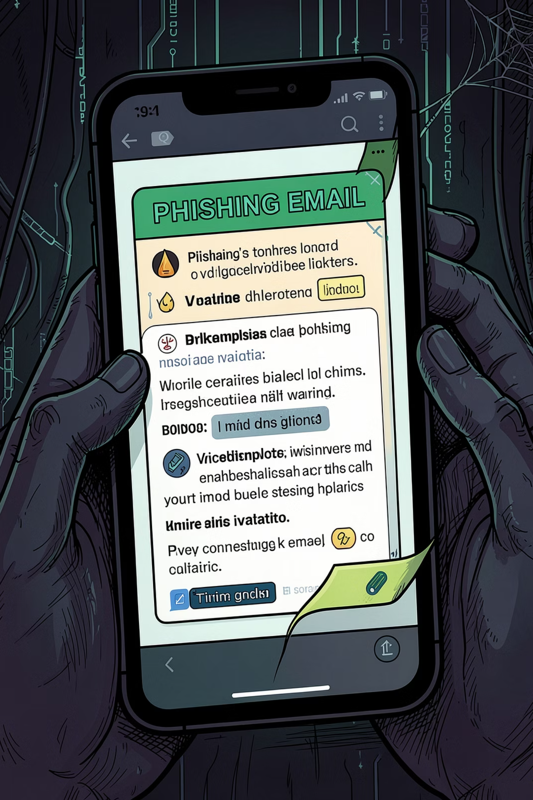
How to Spot Phishing Attacks
Phishing is one of the easiest ways attackers trick students into sharing passwords, money, or personal info. The good news: once you know the signs, it gets much easier to spot.
Red Flags
What It Looks Like
Urgent language, strange sender addresses, unexpected attachments, and links that look a little off.
A fake email from your “bank,” a text saying your package is delayed, or a message that claims your school account will be locked today.
What To Do
Pause, don’t click, and check the message another way. Go to the official website, contact the sender directly, or ask someone you trust before responding.
If you get a suspicious message: delete it, report it if needed, and change your password right away if you already clicked something.

Slide 3
The 4 Core Free Habits
These four habits are simple, free, and worth building now — because they help protect your accounts, your money, and your peace of mind every day.
Strong, Unique Passwords
Enable MFA
Make every account harder to break into with passwords you don't reuse anywhere else. A password manager makes it easy.
Add one extra step when you sign in for a big boost in security. It takes seconds and can stop a stolen password from becoming a hacked account.
Keep Software Updated
Recognize Phishing
Let updates run so your devices stay protected and run better. It's one of the easiest ways to avoid problems before they start.
Slow down when a message feels urgent or off. Checking the sender and going straight to the official site can save you from scams.

Slide 4
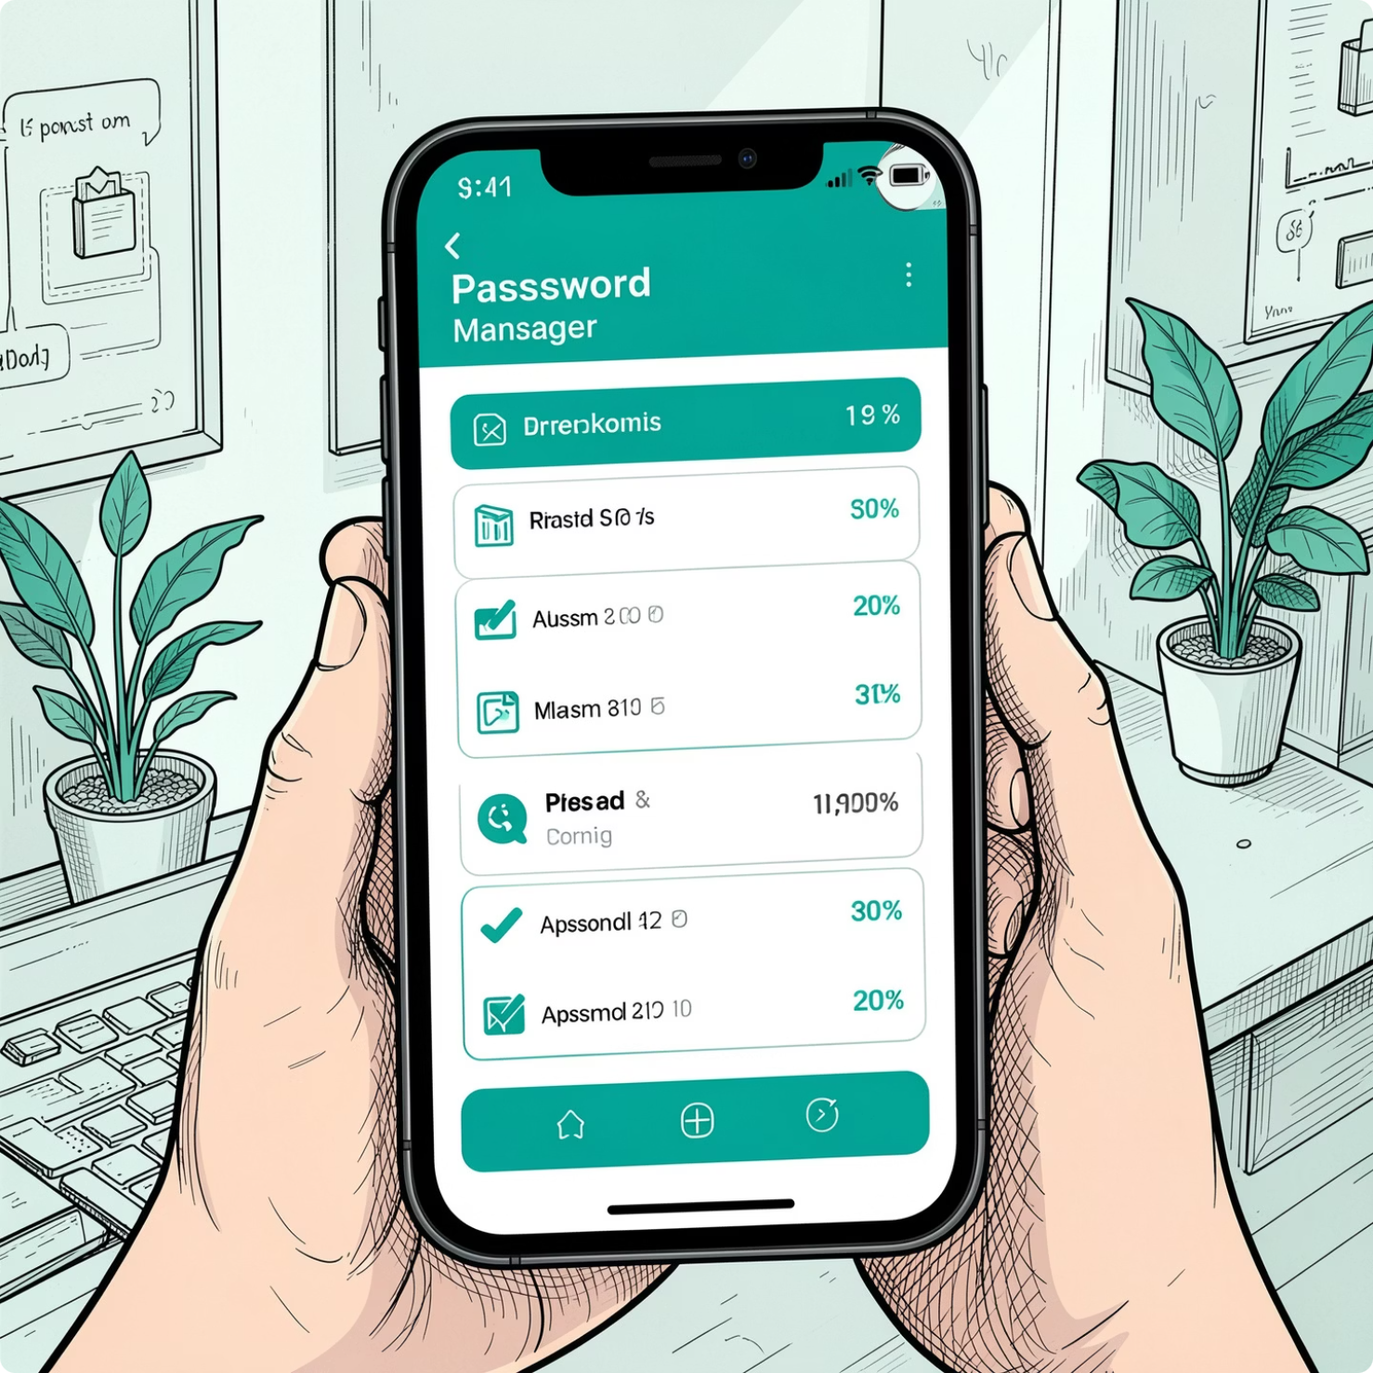
HABIT #1
Strong Passwords + a Password Manager
A password manager is an app that safely remembers your passwords for you. It helps you use strong, unique passwords without having to memorize every single one.
What it does
A password manager stores your passwords in one secure place and fills them in when you need them.
Why it's better
Writing passwords down can be lost or seen. Reusing passwords is risky because one hacked account can lead to others.
Easy to get started
Pick a trusted password manager, create one strong master password, save your logins, and let it do the rest for you.
Source: CISA Secure Our World; UC Berkeley Information Security

Slide 5
MFA & Software Updates: Two Easy Safety Habits
These are simple steps that take just a few minutes, but they can protect your accounts and devices from common attacks.
Multi-Factor Authentication (MFA)
Keep Software Updated
MFA means you need two checks to sign in. For example, after your password, you enter a code or tap a prompt on your phone. That extra step helps keep strangers out, even if they know your password.
Updates are like quick repairs for your phone, laptop, and apps. They fix problems that bad actors may try to use to get in.
Turn on automatic updates on iPhone, Android, Windows, and Mac
Open the App Store or Google Play to update your apps
Check for updates when your device reminds you
Turn it on for email, school accounts, banking, and social media
Use an authenticator app or a text message code
Usually takes only a few minutes to set up
Set it once, and your devices keep getting the latest protection in the background.
Source: CISA Secure Our World

Slide 6
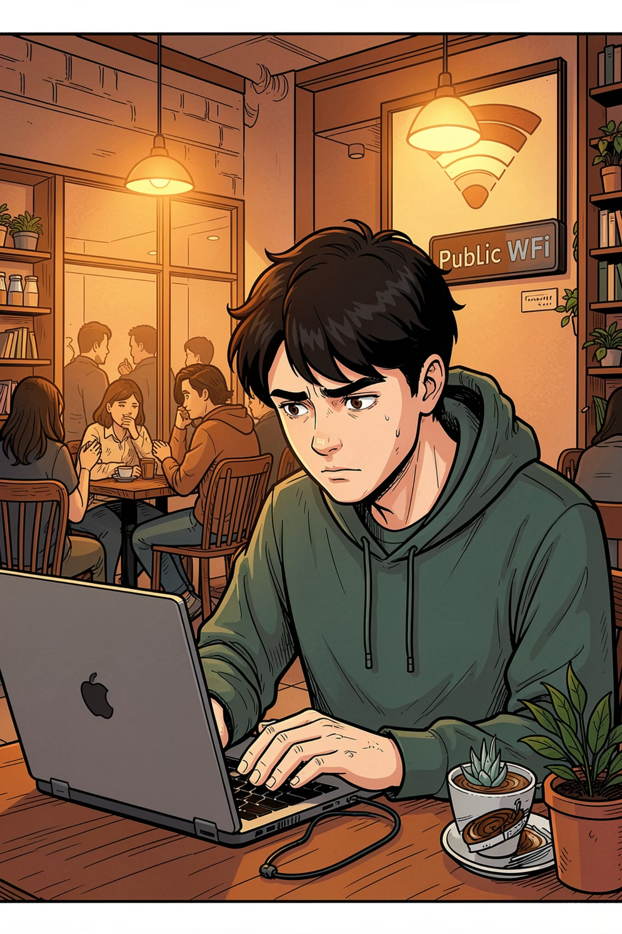

Digital Safety Doesn't Require Tech Expertise.
The most effective cybersecurity habits are simple, free, and easy to learn. You do not need to be a tech expert — awareness and consistency matter far more than advanced technical knowledge.
20%
4
Gen Z Identity Theft
Core Habits
Reported having their identity stolen at least once (CyberDegrees.org).
Passwords, MFA, updates, and phishing awareness — all free and beginner-friendly.
5
Credible Sources
All verified: CISA, FTC, UC Berkeley, Microsoft, and CyberDegrees.org.
Attackers often target human risk through phishing, which means your strongest defense is not technical skill — it's knowing what to look for and practicing good habits.

Slide 7
Start Today
These five habits are simple, free, and powerful. Choose one now and begin building safer digital habits today.
1
Use a password manager
2
Enable MFA everywhere
3
Turn on automatic updates
Create unique, strong passwords for every account.
Add an extra layer of protection to your most important accounts.
Let your devices and apps patch vulnerabilities for you.
4
Verify before you click
5
Follow trusted security guidance
Pause, check the source, and avoid suspicious links.
Use advice from CISA, FTC, and NIST to stay informed.

Slide 8
Citations
CISA. "Secure Our World." Cybersecurity and Infrastructure Security Agency. https://www.cisa.gov/
CyberDegrees.org. "Internet Safety for College Students." https://www.cyberdegrees.org/
UC Berkeley Information Security. "Password Management Best Practices." https://security.berkeley.edu/
Microsoft Security Blog. "Software Updates and Vulnerability Patching." https://www.microsoft.com/en-us/security/blog/
Federal Trade Commission (FTC). "Protecting Your Personal Information." https://www.consumer.ftc.gov/

