Slide 1
Data Visualization and
Preprocessing
Result and
Inference
Raw Data
Feature
Extraction
ML Model

Slide 2
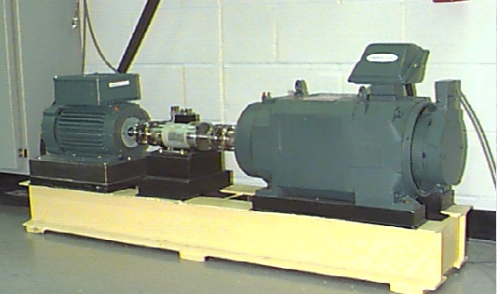

Slide 3
je
suis
une
fille
Word embedding
Fully encoded input
Translation output
LSTM
LSTM
LSTM
LSTM
Bidirectional LSTM
LSTM
Decoder
LSTM
LSTM
LSTM
LSTM
I
am
a
girl
Encoder

