Slide 1
⚡ ODISHA AI NEXUS
Local Innovation. Global Impact.
Unifying Odisha's 30 districts, premier academic institutes, heavy industries, and overseas markets on a 100% local, multilingual AI ecosystem platform.
🌐 Tri-Lingual (English | ଓଡ଼ିଆ | हिन्दी) • 🔒 100% Local SQLite / Zero Cloud • 🎙️ Web Speech Voice AI
Notes:
Good morning, respected judges. Odisha is an industrial powerhouse with world-class technical institutes like IIT Bhubaneswar, NIT Rourkela, and VSSUT, alongside legendary disaster management leadership. Yet, its AI talent, university research, and heavy industries operate in disconnected silos. Today, we introduce Odisha AI Nexus — a fully functional, multilingual, and 100% local platform that bridges grassroots innovators across Odisha's 30 districts with regional challenges and global markets.

Slide 2
The Regional Paradox: High Capability, Disconnected Silos
Why Odisha's brightest tech innovations struggle to reach adoption and global scale
🎓 Academic Silos
Student models at IIT, NIT, and VSSUT remain confined to college labs and GitHub repos, lacking exposure to local enterprise buyers.
🏭 Heavy Industry Bottlenecks
Steel plants in Kalinganagar, mines in Keonjhar, and ports in Paradip face critical bottlenecks but lack access to local AI solvers.
🗣️ Linguistic Exclusion
Standard AI platforms are 100% English-only, cutting off local artisans, farmers, and grassroots entrepreneurs who speak Odia or Hindi.
🌐 The Export Vacuum
Early-stage prototypes lack structured compliance frameworks (DPDP Act 2023, GDPR, Edge latency) to reach international buyers.
Notes:
Why do great student projects stay as college assignments while local industries look outside the state for solutions? Because there is no discovery bridge. Furthermore, language barriers keep non-English speakers out of the AI conversation. We set out to solve this fundamental gap.

Slide 3
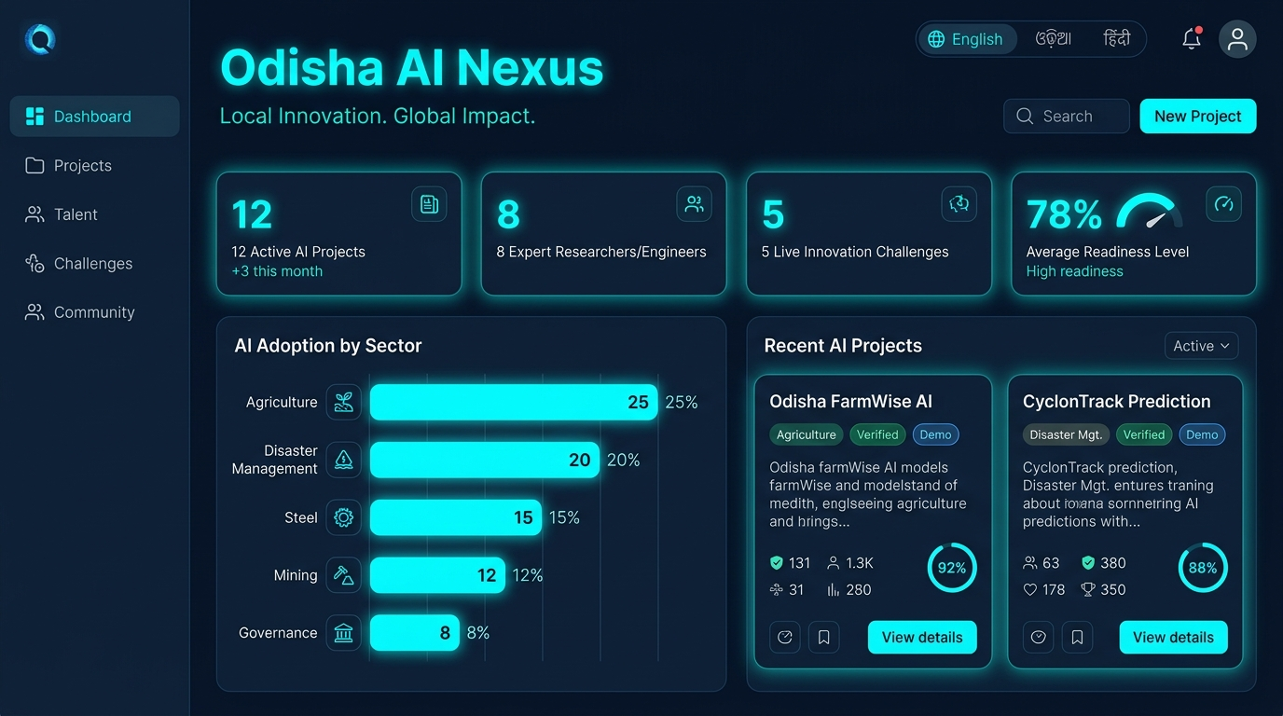
Executive Command Center & Responsive Analytics
One unified discovery and decision-support layer for regional applied intelligence
🎯 Core Capabilities
• Real-Time Ecosystem KPIs: Instant counts of registered projects, verified talent, industry challenges, and global readiness.
• De-Clustered Analytics: Ranked horizontal bar chart eliminating label crowding across all 8 strategic economic sectors.
• Verified vs. Demo Modes: Clear toggle to isolate genuine verified submissions from seed baseline datasets.
• Multi-Device Fluid Layout: Responsive design tested on mobile phones, tablets, and desktop workstations.
Notes:
As you can see on the screen, this is our live Executive Dashboard. It gives instant visibility into the state's AI assets. Notice the de-clustered sector analytics and verified project badges — all engineered to adapt smoothly across mobile, tablet, and PC screens.

Slide 4
Culturally Grounded in Odisha's Strategic Sectors
Solving genuine high-impact problems across the state's economic backbone
🌾 PaddyShield AI (Bargarh / Western Odisha)
Edge-quantized CNN for early blast and planthopper detection in paddy fields, running offline on low-cost smartphones.
🌊 CycloneEye Odisha (Puri & Coastal Zone)
Physics-guided neural networks for storm surge height and inundation modeling using Doppler weather radar telemetry.
🏭 Kalinganagar Slag AI (Jajpur Industrial Corridor)
Computer vision for high-temperature blast furnace slag foaming detection with sub-50ms latency for worker safety.
🧵 Sambalpuri Heritage AI (Bargarh & Sonepur)
Authenticates traditional handloom weave geometry and provides immutable digital IP protection for weaver cooperatives.
Notes:
Every demonstration project in our platform is culturally and economically grounded in Odisha's real challenges — from paddy pest mitigation in Bargarh to blast furnace safety in Kalinganagar and Sambalpuri handloom protection.

Slide 5
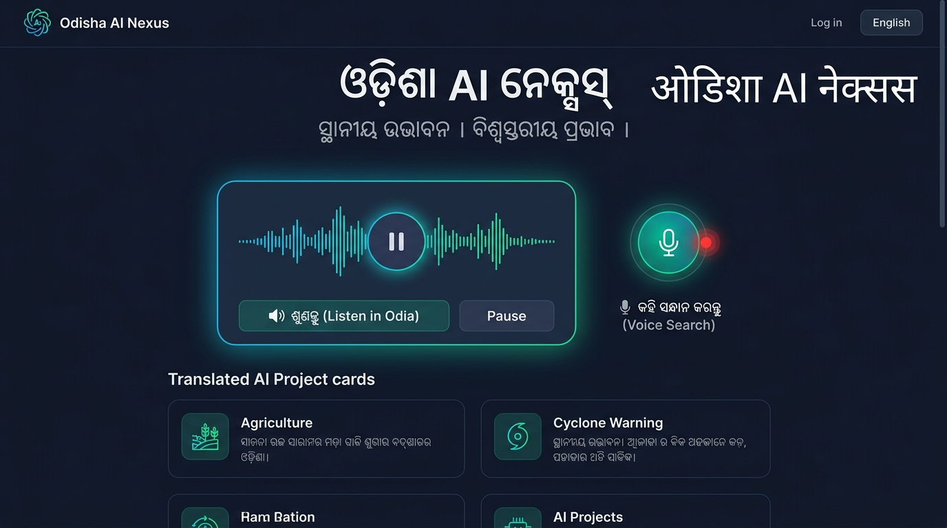
Inclusive Accessibility: Odia, Hindi & Web Speech Audio
Breaking the digital divide for rural entrepreneurs, artisans, and non-English speakers
🗣️ Voice & Native Language
• Tri-Lingual Localization: Full native script translation for English, Odia (ଓଡ଼ିଆ), and Hindi (हिन्दी) with authentic fonts (Noto Sans Oriya/Devanagari).
• Web Speech Audio Reader (TTS): Embedded browser narrator speaking page briefings aloud in Odia or Hindi with play/pause wave animation.
• Voice Microphone Search (STT): Tap the mic to speak search queries in Odia (or-IN) or Hindi (hi-IN) without typing English keywords.
• Inclusive Grassroots Adoption: Enables rural artisans and farmers to discover and utilize applied AI.
Notes:
Not every innovator or beneficiary in Odisha communicates in English. We built native tri-lingual support and an interactive Web Speech companion. Users can listen to page briefings aloud in Odia or speak their search queries directly into the microphone.

Slide 6
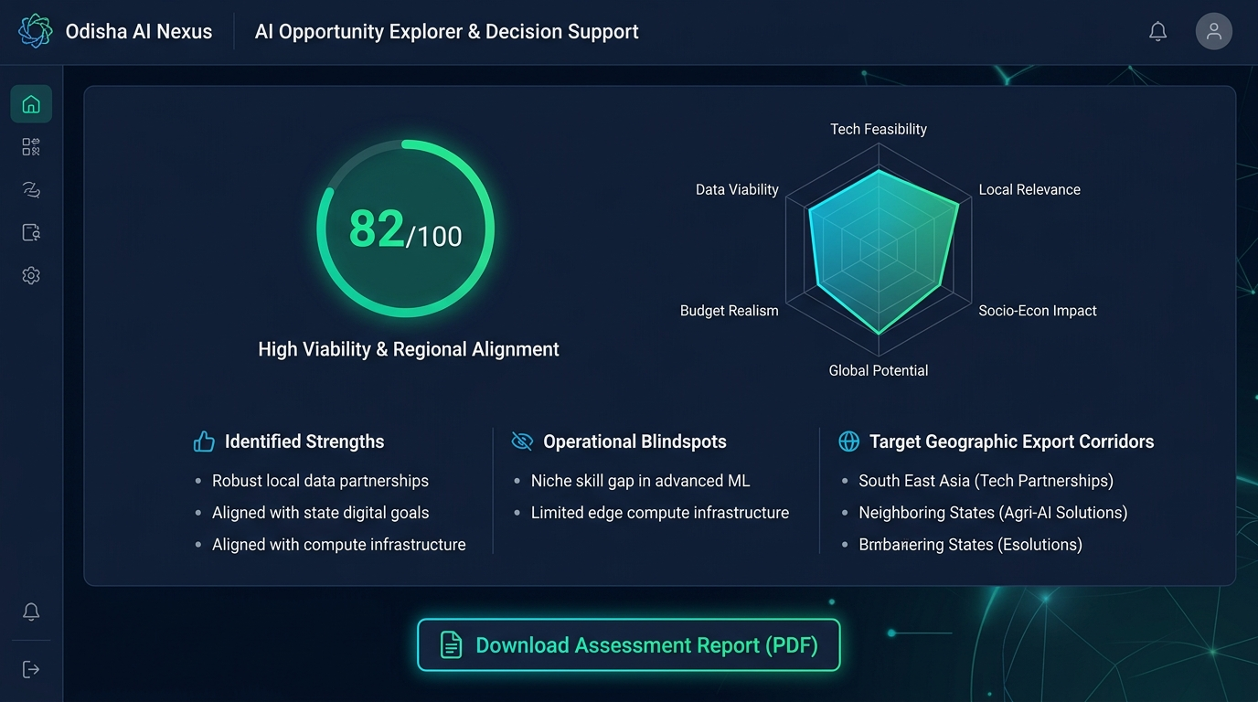
AI Opportunity Explorer & 6-Factor Decision Support
Transparent, explainable heuristic scoring to stress-test regional AI product viability
📊 Transparent Intelligence
• Composite 0–100 Score Gauge: Weighted multi-criteria decision analysis across technical, economic, and operational dimensions.
• 6-Factor Radar Polygon Chart: Evaluates Feasibility, Relevance, Socio-Economic Impact, Global Potential, Budget, and Data Viability.
• Actionable Diagnoses: Automatically highlights identified strengths, operational blindspots, and missing telemetry.
• Export Corridor Hypotheses: Automatically links solutions to international target regions (e.g. ASEAN, Coastal Europe).
Notes:
We deliberately avoid black-box proprietary APIs that cost money and hallucinate. Our Opportunity Explorer uses transparent, weighted multi-criteria decision analysis. Innovators get a concrete 0-to-100 score, a 6-factor radar breakdown, identified blindspots, and target export corridors.

Slide 7
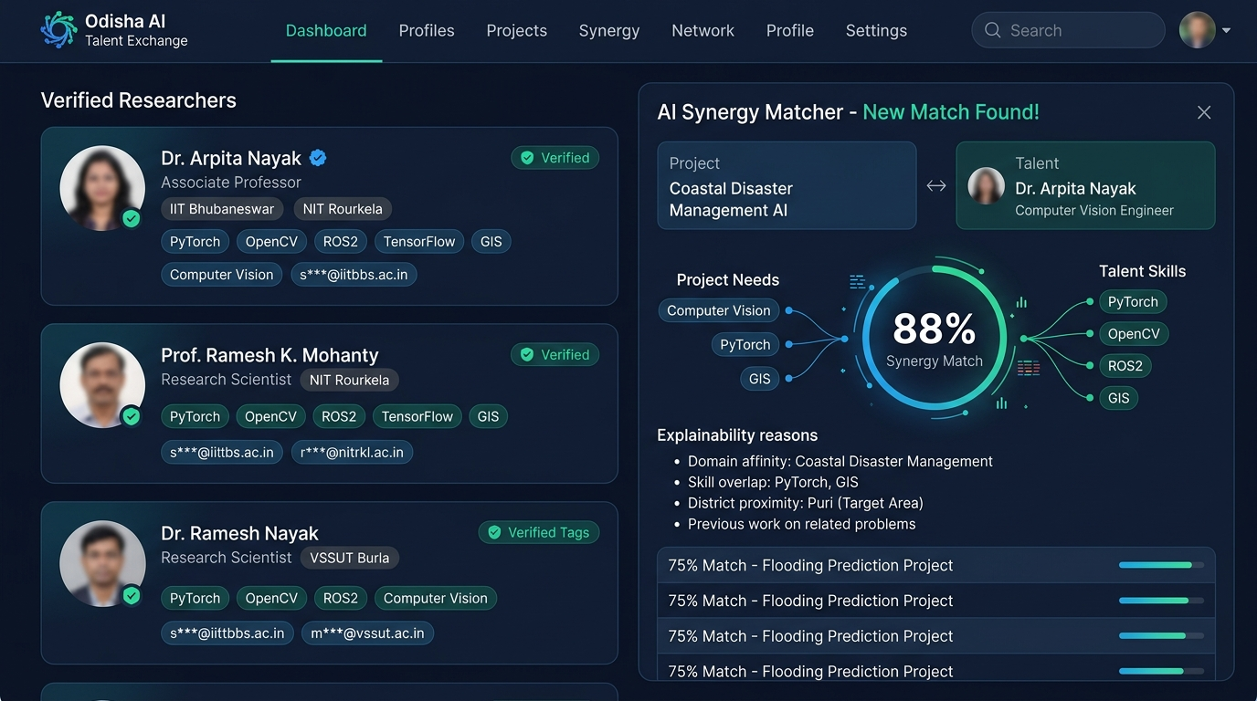
Talent Exchange & Bidirectional Synergy Matcher
Connecting 30 districts of students, ML engineers, and researchers with real projects
👥 Privacy-First Matchmaking
• Privacy Safeguards: Direct contact emails masked by default (s*@iitbbs.ac.in) to stop scraping while keeping portfolios accessible.
• Mathematical Synergy Scoring: Matches skills, domain affinity, and district proximity with explainable match reasons.
• Bidirectional Perspective: Pair projects with top researchers OR pair researchers with live industry challenges.
• Cross-District Cohorts: Connecting IIT Bhubaneswar, NIT Rourkela, and VSSUT with MSMEs in remote districts.
Notes:
On the left, verified researcher profiles with masked emails for privacy protection. On the right, our automated AI Synergy Matcher pairing candidate skills with project requirements, complete with explainable matching reasons.

Slide 8
100% Local Autonomous Architecture & Tight Security
Zero secondary cloud or Firebase lock-in; robust local cryptography and RBAC
🔒 Zero Cloud Dependency
100% local SQLite database running offline on personal hardware. Zero Firebase, zero external subscriptions. PostgreSQL-ready via psycopg2-binary.
🛡️ Tamper-Proof Sessions
Sessions signed with internal HMAC-SHA256 tokens and sliding expiration. Modifying client claims triggers immediate cryptographic rejection.
👥 Role-Based Access (RBAC)
Strict authorization hierarchy: Guest, Talent, Innovator, Industry, and Admin with enforced granular permissions.
📋 Immutable Audit Trails
Every sign-in, permission denial, and data update is recorded persistently in local SQLite auth_audit_logs for forensics.
Notes:
We engineered this system to run 100% on a laptop without requiring expensive cloud subscriptions or Firebase credentials. Even Google Sign-In is verified locally, backed by HMAC-SHA256 session signatures and persistent immutable audit logs.

Slide 9
10-Point Global Export Readiness & PDF Dossiers
Guiding local innovations to international commercial readiness and compliance
📋 10-Point Global Readiness Framework
✓ Data Privacy: DPDP Act 2023 & GDPR compliance
✓ Explainability: SHAP/LIME feature attribution
✓ Edge / Offline Fit: Low latency under dust/intermittent network
✓ Multilingual UI: Odia, Hindi, English accessibility
✓ Security & Bias: OWASP LLM Top 10 + benchmark tests
✓ Export Packaging: Docker containers & CI/CD readiness
📑 Executive Dossiers & Data Exports
• One-Click PDF Dossiers: Multi-page executive intelligence briefings compiled via ReportLab with ecosystem stats.
• RFC 4180 CSV Exports: Download full datasets for projects, talent, challenges, and evaluations.
• Audit Snapshot Table: Complete breakdown of verified real user submissions vs demonstration data.
• Cross-Border Hypotheses: Mapping disaster tech to ASEAN and metallurgy AI to global industrial corridors.
Notes:
For investors and government leaders, the platform compiles publication-ready executive PDF dossiers in one click, diagnosing compliance gaps and mapping solutions directly to international markets like the Indo-Pacific and Southeast Asia.

Slide 10
Strategic Execution Roadmap & Pitch Conclusion
Odisha AI Nexus: Empowering local talent to solve regional problems and create global impact
Phase 1: Core Platform Foundation — [COMPLETED]
Persistent SQLite architecture, Project Registry, Challenge Board, Opportunity Explorer, ReportLab PDF generation.
Phase 2: Multilingual Odia & Hindi UI — [COMPLETED]
Native Odia and Hindi scripts, Web Speech audio narration companion, and voice microphone search.
Phase 3: University Hackathons & MSME Pilots — [PLANNED (H2 2026)]
Onboarding engineering cohorts from IIT, NIT, VSSUT, and pairing them with local MSME challenges.
Phase 4: Open Public Hydrology & Satellite Telemetry — [PLANNED (2027)]
Integration with open data (ISRO Bhuvan satellite feeds, OSDMA sensors) for live model benchmarking.
Notes:
Odisha AI Nexus is not just an idea — it is a production-tested, fully operational MVP with 37 passing unit tests, responsive UI across all devices, and genuine multilingual voice capabilities. We invite you to join us in powering Odisha's AI future. Thank you!

