Slide 1
Data Analysis Case Study
Customer Retention

Slide 2
Requirements Brief
Client
  Business team at A Spanish bank
Bounty of analysed features
  Demographics
  Product portfolio
  Activity level
Business Objective
  Gaining an insight about the customer behaviour by measuring the retention rate with respect to various factors

Slide 3
Understanding of the problem
The customer (cx) retention rate is to be gauged from the two activity levels of cx i.e. active to inactive and inactive to active, if more cxs are turning from active to inactive, and what kind of cx profile are more prone, it can be inferred.
  Although, we are more inclined from the business point of view that what kind of cxs became active from inactive state but we can make a sense of the analysis by finding an optimal model as to what percentage of cxs remained attached to the services, product or facility offered by the business doer company or it can be concluded by the finding the cxs profiles which have remained in active state after the finish of the semester window.

Slide 4
High Level Approach
Using Exploratory Data analysis approach after data health review in order to find insights to the type of customers to be approached more specifically related to various features and if possible generate KPIs for the team and have easy and data driven answers to the open ended questions posed per se
Use of various function and libraries which suffice to the above target

Slide 5
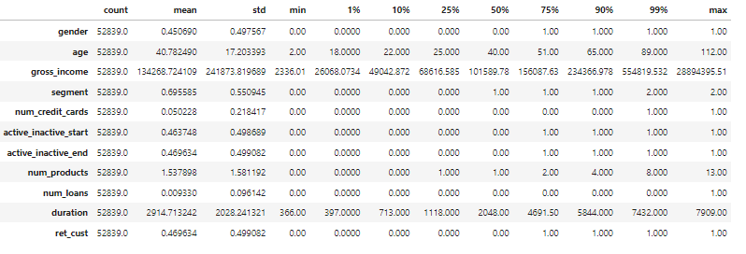
Extended Data Dictionary (EDD)

Slide 6
Data Health Review
No
✖Missing values
1191
🎎 duplicate records
54030 records, 10 variables
Shape of the dataset
Data-Type conversion
active_inactive_end | Number of credit cards
Number of products | Number of loans
4.1MB ➕
Memory used by dataset
Mem
ret_cust
Additional column added by Feature Engg.

Slide 7
Analysis and recommendations
VIPs should have more income to spend and have high rate for credit cards purchase and hence individual customers with moderate income should be encouraged to take credit cards
All segments customers remained in inactive state even after six months. Hence, they should be contacted with more propensity and some bounties attached with
Female customers should encouraged to take up the services of the bank through CSR as it negatively pitches the Bank when Equality is concerned. The policies should be relaxed for them.
Bank is doing good with the customers having high income as far as the retentions are concerned

Slide 8
Thank You for your time !

