Slide 1
Project : Movie Recommendation System
TEAM MEMBERS :-
Lalit Kumar (2307350130034)
Priyanshu Kumar (2307350130046)
Vipin Yadav (2307350130068)

Slide 2
PROBLEM STATEMENT
Nowadays, people spend a lot of time searching for movies they might like. With thousands of options available on streaming platforms, it becomes confusing to decide which movie to watch. That's where a recommendation system comes into play.

Slide 3
Movie Recommendation System - Project Overview
Introduction:
A Movie Recommendation System is an application of machine learning and data science that suggests movies to users based on their interests, preferences, and past behavior. Instead of manually searching through thousands of movies, the system helps users discover films they are likely to enjoy. It works by analyzing user data, such as ratings, reviews, or viewing history, and then applying algorithms to recommend similar or popular movies. These systems are widely used by platforms like Netflix, Amazon Prime, and YouTube to improve user experience and engagement.

Slide 4
Methodology:
Data Collection (Kaggle dataset / IMDb dataset)
Python Libraries (Pandas , Numpy , Skitlearn and many more)
Preprocessing (Cleaning, Feature Extraction)
Model (Collaborative ( in future planning to make HYBRID Model )
Evaluation (Accuracy, Precision)

Slide 5
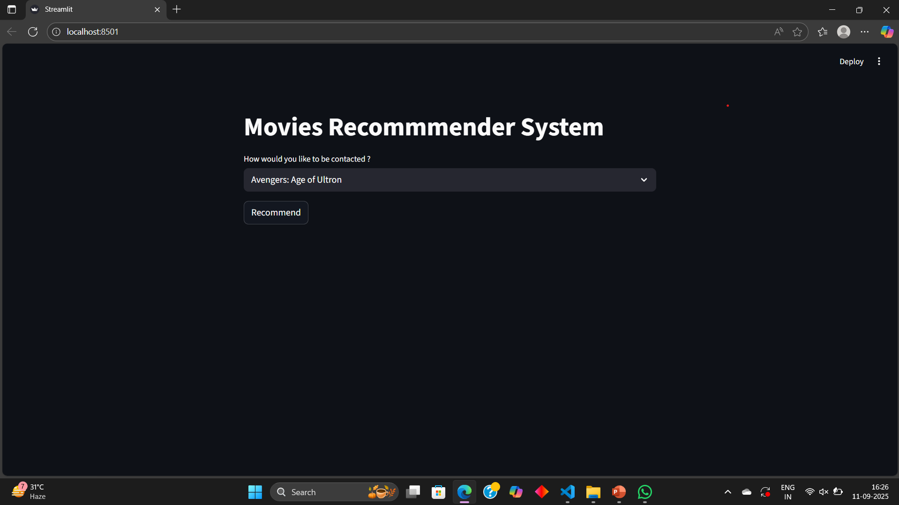

Slide 6
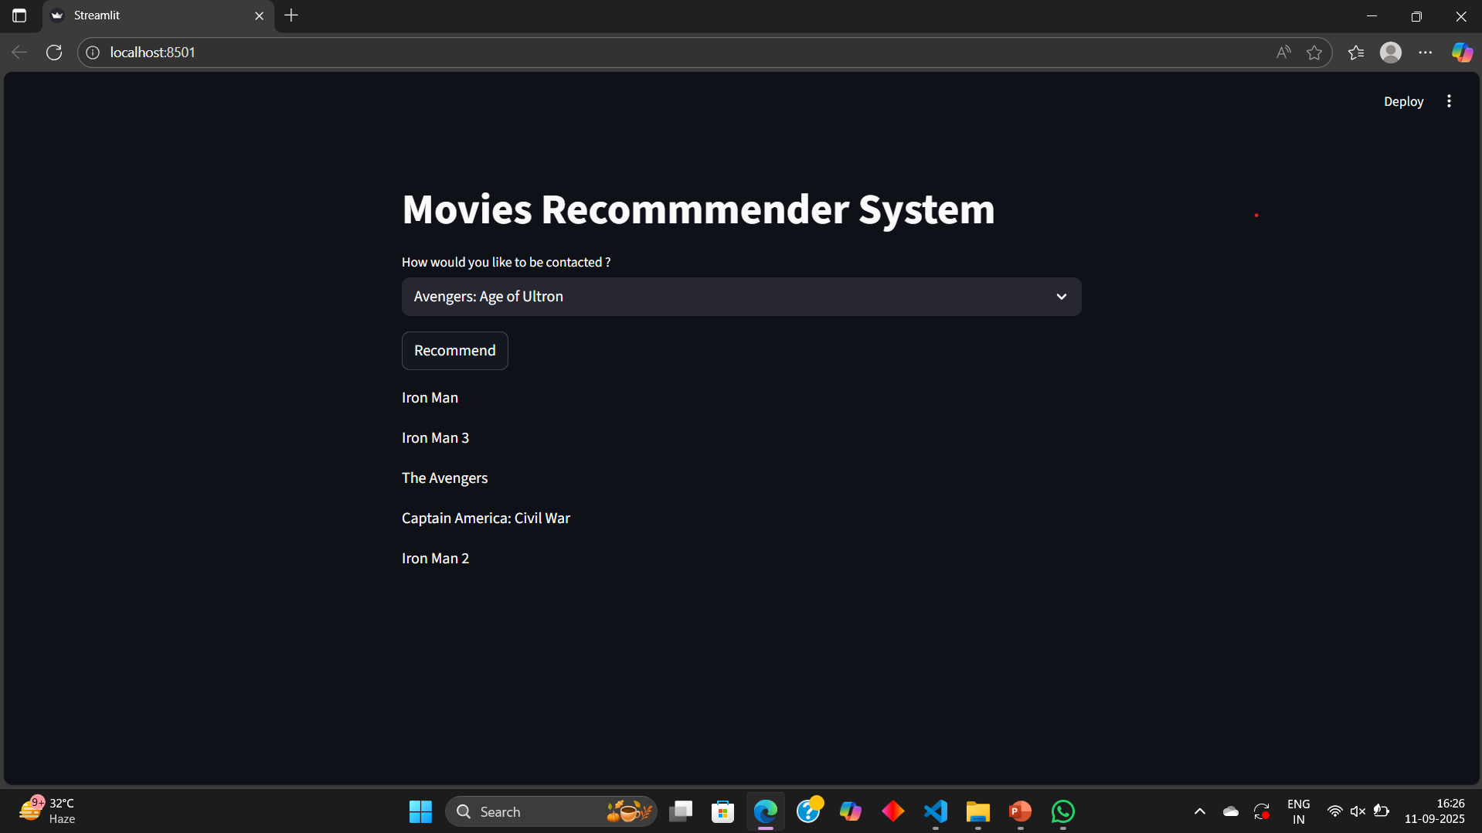

Slide 7
Results & Conclusion:
Hybrid model improves accuracy & personalization but right now we are using Collaborative based filtering.
Future scope: Deep learning & real-time recommendations.

Slide 8
THANK YOU!

