Slide 1
ABC.COM
Furniture Sales/Conversion Analysis

Slide 2
Basic Terminology
Conversion:
Conversion = (Number Of Items Sold / Number Of Visits )*100
Average Selling Price (ASP):
ASP = The Total Sales Value / Number Of Item Sold
Channels:
Direct, Newsletter, Google, SEO, Affiliate, Social Media

Slide 3
Overall Revenue generated by the Furniture Category by Channel
Overall revenue generated by furniture category by all the channels is ₹ 81,901,748.
Direct Channel is the top-performing channel having highest of Sold items and Revenue followed by SEO.
Google channel is with highest ASP channel, the most attracting channel for premium customer buying luxury items.
Affiliate channel is having highest conversion rate among all, being able to get the targeted customers.
Channel | Overall Sold Items | Overall Revenue | Percentage of total Revenue | Overall ASP | Overall Visits | Overall Conversion
Direct | 7502 | ₹ 32,076,315 | 39.16% | ₹ 4,276 | 258135 | 2.91%
SEO | 5327 | ₹ 30,977,940 | 37.82% | ₹ 5,815 | 177574 | 3.00%
Google | 946 | ₹ 13,810,483 | 16.86% | ₹ 14,599 | 79995 | 1.18%
Affiliate | 869 | ₹ 4,093,933 | 5.00% | ₹ 4,711 | 28167 | 3.09%
Newsletter | 213 | ₹ 859,365 | 1.05% | ₹ 4,035 | 24707 | 0.86%
Social Media | 27 | ₹ 83,712 | 0.10% | ₹ 3,100 | 5511 | 0.49%
All-Channel | 14884 | ₹ 81,901,748 | 100.00% | ₹ 5,503 | 574089 | 2.59%
Fig 1

Slide 4
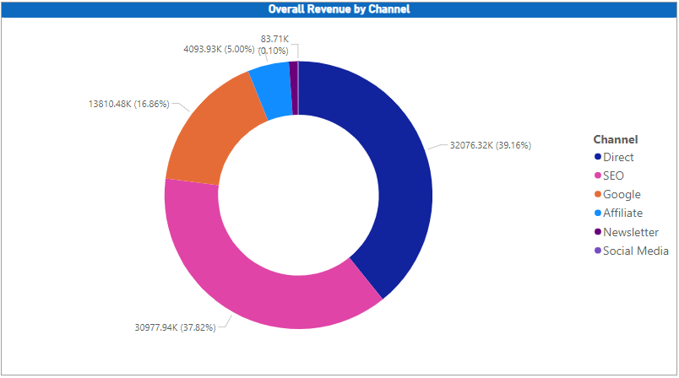
Overall Revenue Generated by all the Channel
The most of the revenue (77.98%) is being generated from two channels, Direct and SEO.
Direct is the top-performing channel, generating the most revenue (39.16%) followed by SEO (37.82%).
This indicates that these two channels are the most effective in driving sales and should be prioritized in marketing efforts.
Fig 2

Slide 5
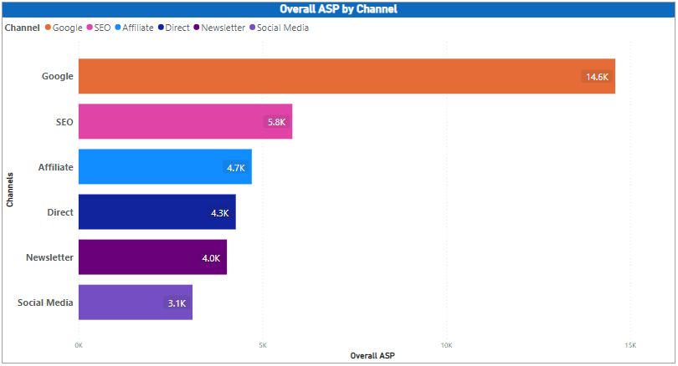
Overall ASP (average selling price) for Furniture Category
Overall ASP for furniture category by all the channels is ₹ 5,503.(Fig1)
The customers which are coming through google channel and tend to buy more expensive furniture as compare to other channels.
The customers which are coming through Social Media channel and tend to buy more cheaper furniture as compare to other channels.
Fig 3

Slide 6
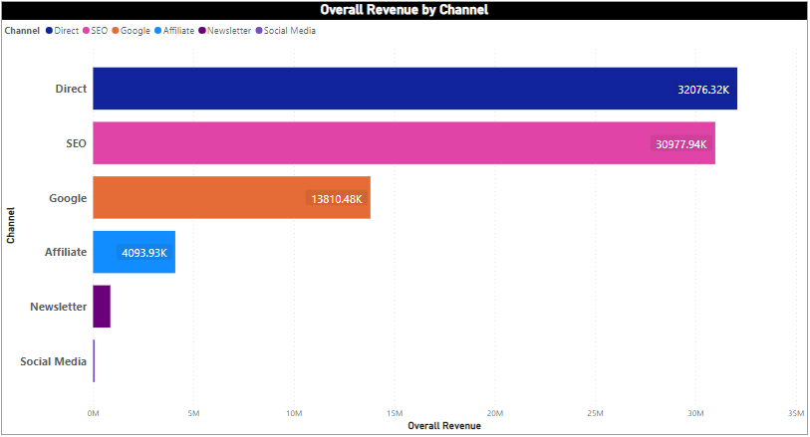
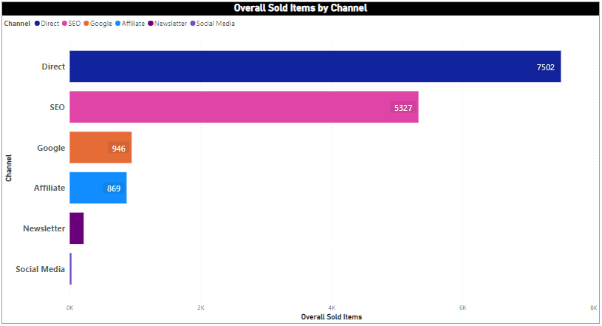
Best Metric to Measure channel Performance
The best metric to measure channel performance can be subject to the Objectives and Goals of the business.
Overall revenue can be considered as the best metric to measure the performance followed by over all sales quantity.
Fig 4
Fig 5

Slide 7
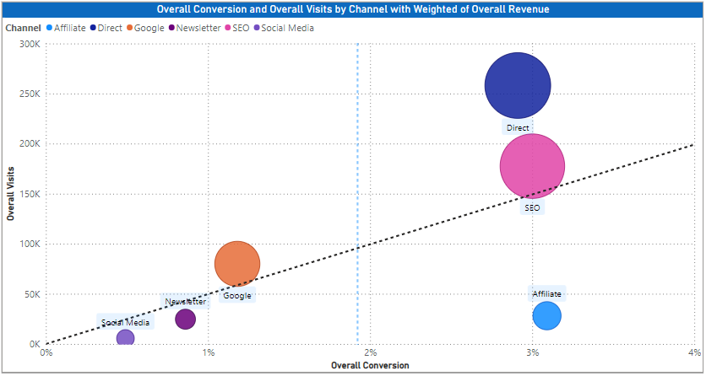
Channel Performance based on Conversion, Visits and Revenue
Scatter plot is defined with X axis as Overall Conversion, Y-axis as Overall Visits, dot represents the channel and Size of the dot represents the overall revenue generated by channel.
Ratio line is defined with black dotted line and Average Conversion line is defined with blue dotted line. Both lines are dividing the graph in 4 sections.
Fig 6

Slide 8
Channel Performance based on Conversion, Visits and Revenue
As shown in the Fig 6:
The best performing metric Direct and SEO are with high conversions and high visits having the majority of the revenue and sold items.
We should be more focused on these channels as these are the channels generating most of the revenue.
Affiliate channel has the higher conversions and low visits, it shows that our affiliates are able to get us the targeted audience.
We can focus on getting more affiliates with our business to increase the customer visits which will result in revenue increment.
Fig 7

Slide 9
Channel Performance based on Conversion, Visits and Revenue
Google channel has slightly high visits but low conversion and highest ASP, which simply shows that Google is able to target the premium customers but failing to convert most of the visitors.
We can review the google ad-sense for right keywords and provide it with the better keywords and provide it the better dataset for increasing the conversions.
Social media and News letters are performing worst having the lowest conversion and lowest visit resulting in generating the lowest revenue.
We can further analyze these metric if we can get a better output from these to increase the revenue.
Fig 7

Slide 10
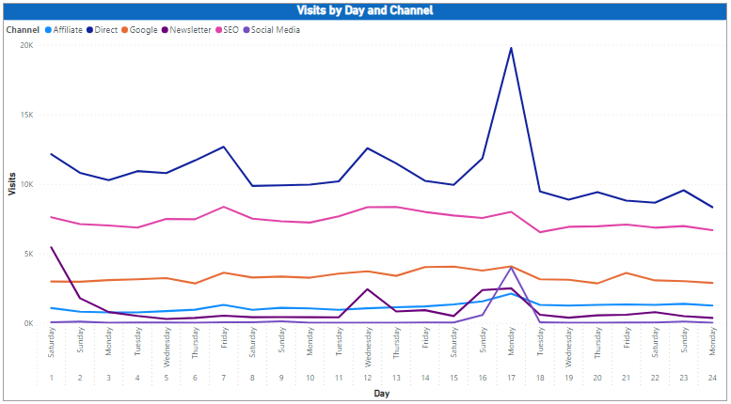
Daily Trends for Visits
Visitors are more active on Sunday, Monday for direct , social media and news letter channel
Highest visitors count for a day is 19,778 for Direct Channel on 17th of Jul.
Lowest visitor count for a day is 20 for Social media channel on 20th of Jul
There is overall downward Trend in Direct channel by the end of the month, We should keep our eyes on this.
Fig 8

Slide 11
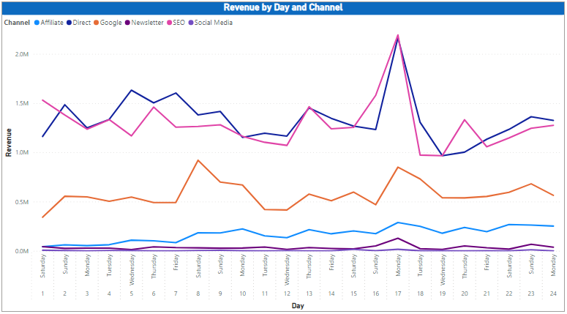
Daily Trends for Sales
There is spike on Saturday, Sunday, Monday for direct , SEO, Google and News letter channel.
Revenue by Affiliate channel is increasing gradually day by day having a overall positive trend , we should seek this as an opportunity.
Highest Revenue is ₹2,192,832 by SEO channel .
Lowest Revenue is ₹0 by Social Media channel.
Fig 9

Slide 12
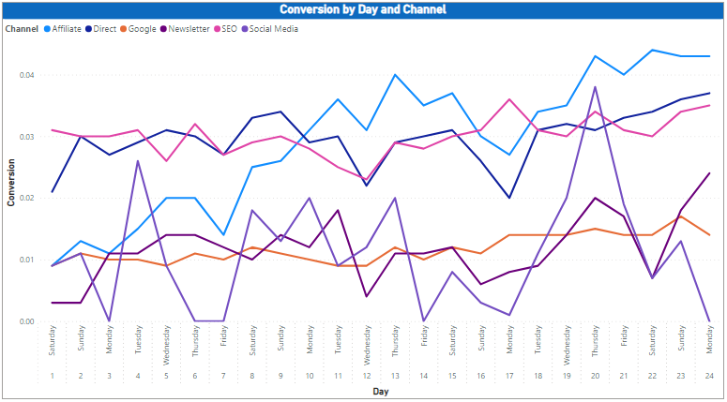
Daily Trends for Conversions
Affiliate conversion trend is increasing gradually, having the highest positive trend , we should work more on this channel.
Direct and SEO channel’s conversion are performing good in positive trends.
Google channel trend is mostly liner throughout, we should focus on to increase it.
Social Media channel is mostly unstable having a spike in the last week and with decreasing trend by the end of month.
Fig 10

Slide 13
Suggested Strategies
Affiliate and Google channels are showing potential and great opportunity to increase the revenue, we should analyse and take proper actions for these channels.
Direct and SEO channels are deriving the majority of sales , We should continuously monitor the trends and analyse the same, so that any issue could be identified before causing much downturn.
Social Media channel should be analysed to target the appropriate audience as it looks like there are some gap in targeting the audience.
We should analyse revenue with cost on the channels to make the decision related to channels.

Slide 14
Recommendation for Improving Registrations Page/Tests
We can have mobile application details on Registration page.
Mobile application should be an alternate for appearing the scholarship test as most of the students do not have Personal computers.
Getting mobile application installed in the students mobile will provide us ease to connect with the students via push notification.
With the help of mobile application it will be easy to provide free seminars, discussions and consultation quite effectively as compare to sending out email invitations.

Slide 15
Thank you…

