Slide 1
Naïve Bayes Email Classification
Group 02 – Jia Khot, Lalit Maurya, Rachit Kumar

Slide 2
Table of contents
01
02
03
04
05
Dataset Review
Training Pipeline
Standard Naïve Bayes
TF-IDFAware
Bayes
Evaluation
Metrics

Slide 3

01
Dataset Review

Slide 4
Dataset Review
The dataset used can be found on Kaggle. Having 83448 datapoints. Used in an 80-20 Train-Test split.

Slide 5
02
Training Pipeline

Slide 6
Training Pipeline
Preprocessing & Tokenization:
Convert all text to lowercase and tokenize using a regex-based whitespace tokenizer
Found to be as effective as word_tokenize() from NLTK, while being more computationally efficient
Removal of stopwords showed no effect on evaluation metrics, however the process does reduce dimensionality, hence we chose to eliminate stopwords from our documents.
Vocabulary Construction
Build a vocabulary from the tokenized documents
Assign a unique integer index to each word (word to index mapping)
Feature Extraction:
Represent documents using word count features
Store features as sparse matrices to avoid excessive memory usage (given large dimensionality: 66,758 × 274,575)

Slide 7
Training Pipeline
Probability Estimation:
Compute prior probabilities for each class
Calculate inverse document frequency (IDF) scores for all terms
Model Evaluation
Evaluate the Naive Bayes model on a held-out test dataset

Slide 8
03
Standard Naïve Bayes

Slide 9
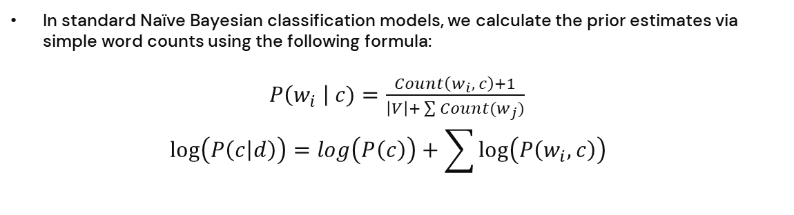
Standard Naïve Bayes
In standard Naïve Bayesian classification models, we calculate the prior estimates via simple word counts using the following formula:
$P\left(w_{i} \right| c)=\frac{Count\left(w_{i}, c\right)+1}{\left|V\right|+ \sum{Count(w_{j})}}$
$$log\left(P\left(c | d\right)\right)=log\left(P\left(c\right)\right)+\sum{\log\left(P\left(w_{i},c\right)\right)}$$

Slide 10
04
TF-IDF Aware Bayes

Slide 11
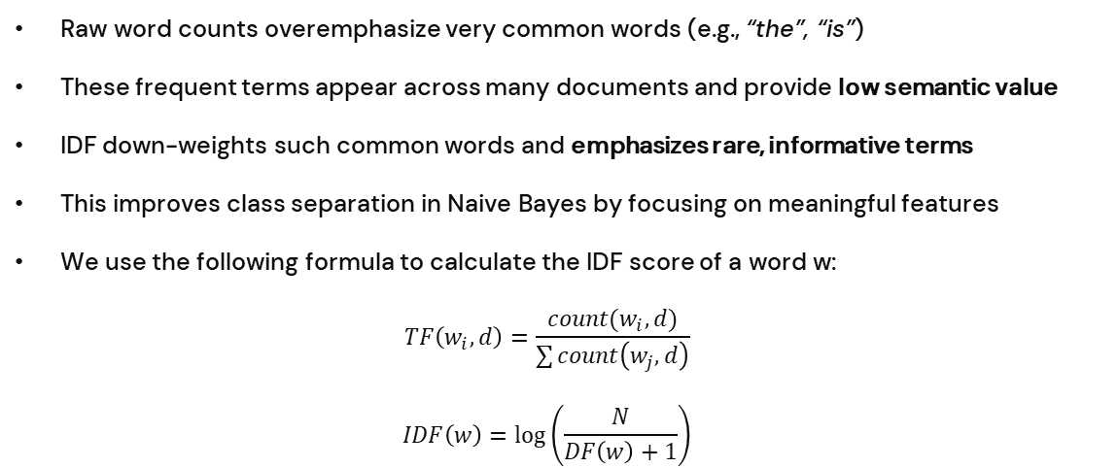
Why TF-IDF?
Raw word counts overemphasize very common words (e.g., “the”, “is”)
These frequent terms appear across many documents and provide low semantic value
IDF down-weights such common words and emphasizes rare, informative terms
This improves class separation in Naive Bayes by focusing on meaningful features
We use the following formula to calculate the IDF score of a word w:
$$TF\left(w_{i},d\right)=\frac{count(w_{i},d)}{\sum{count\left(w_{j},d\right)}}$$
$$IDF\left(w\right)=\log\left(\frac{N}{DF\left(w\right)+1}\right)$$

Slide 12
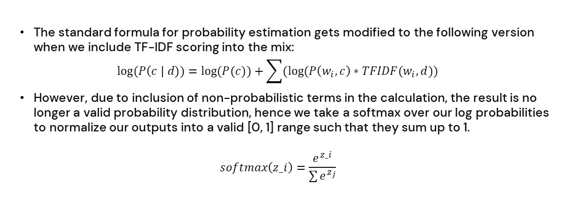
How we use TF-IDF Scores?
The standard formula for probability estimation gets modified to the following version when we include TF-IDF scoring into the mix:
$$log⁡(P\left(c \right| d))=log⁡(P(c))+\sum{(log⁡(P\left(w_{i}, c\right)∗TFIDF(w_{i}, d))}$$
However, due to inclusion of non-probabilistic terms in the calculation, the result is no longer a valid probability distribution, hence we take a softmax over our log probabilities to normalize our outputs into a valid [0, 1] range such that they sum up to 1.
$$softmax\left(z_i\right)=\frac{e^{z_i}}{\sum{e^{z_{j}}}}$$

Slide 13
05
Evaluation Metrics

Slide 14
Evaluation Metrics
Test Set Metrics | Labelled Ham | Labelled Spam
True Ham | 8557 | 137
True Spam | 234 | 7762
Train Set Metrics | Labelled Ham | Labelled Spam
True Ham | 34708 | 338
True Spam | 411 | 31301
Accuracy : 0.9778
Precision : 0.9842
Recall : 0.9734
F1 Score : 0.9788
Accuracy : 0.9888
Precision : 0.9904
Recall : 0.9883
F1 Score : 0.9893

