Slide 1
Hot Garbage, Cool Design
DES211 Capstone Project
Shashwat Shukla, Lalit Maurya, Jia Khot, Aditya Ahuja, Siddharth Aggarwal

Slide 2
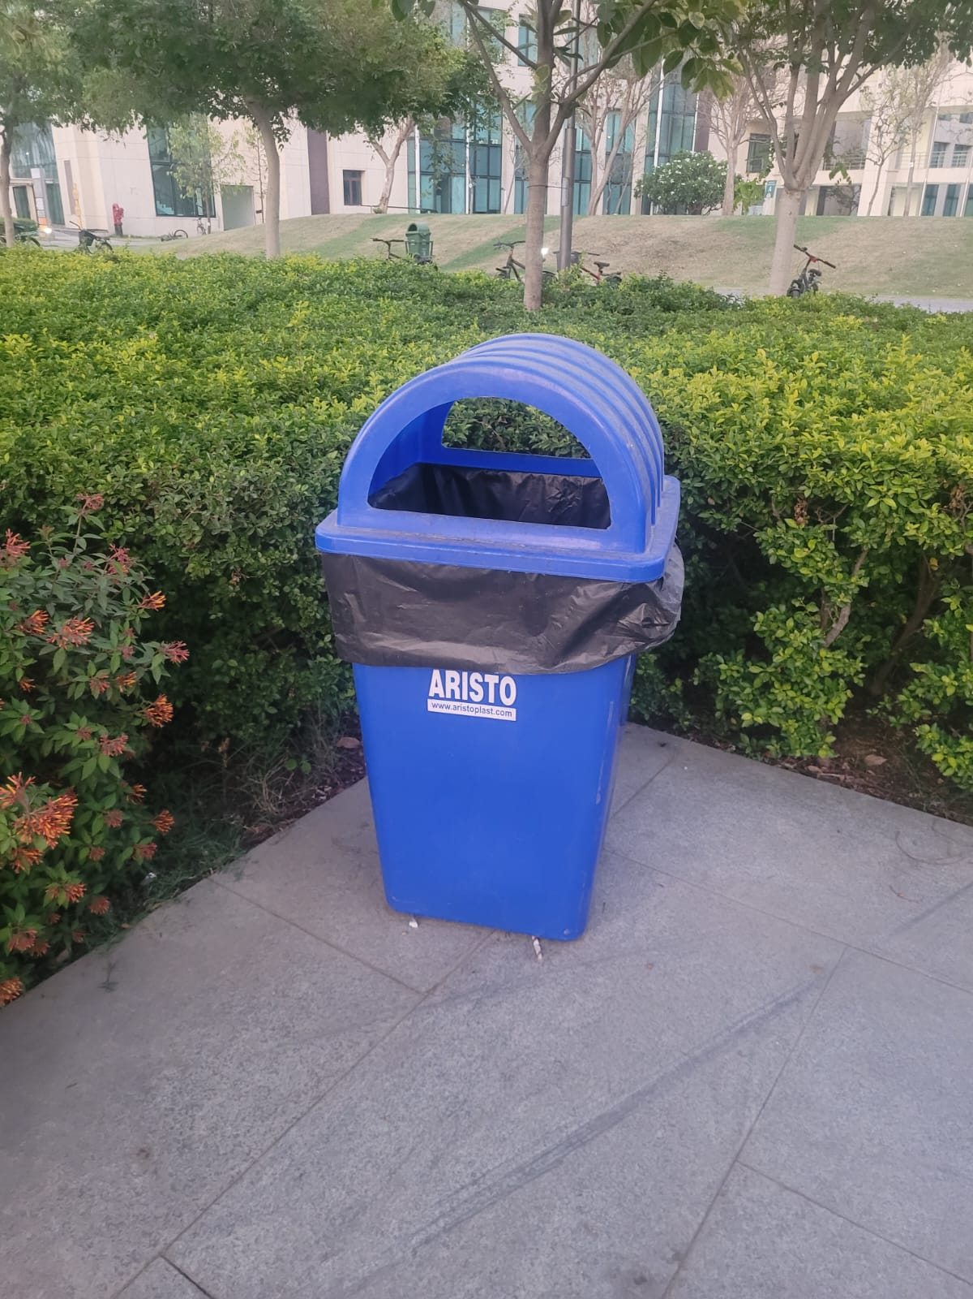
Introduction
What’s the Topic?
Rethinking Waste Segregation Systems on Campus
Why does this matter?
Waste segregation is essential for clean, functional shared spaces. But most bins today are poorly designed, confusing, and counterproductive.
What’s broken?
No cues for correct disposal leads to frequent misuse since separation isn't intuitive or enforced.
Design "fixes" often make things worse.
DES211 CAPSTONE PROJECT

Slide 3
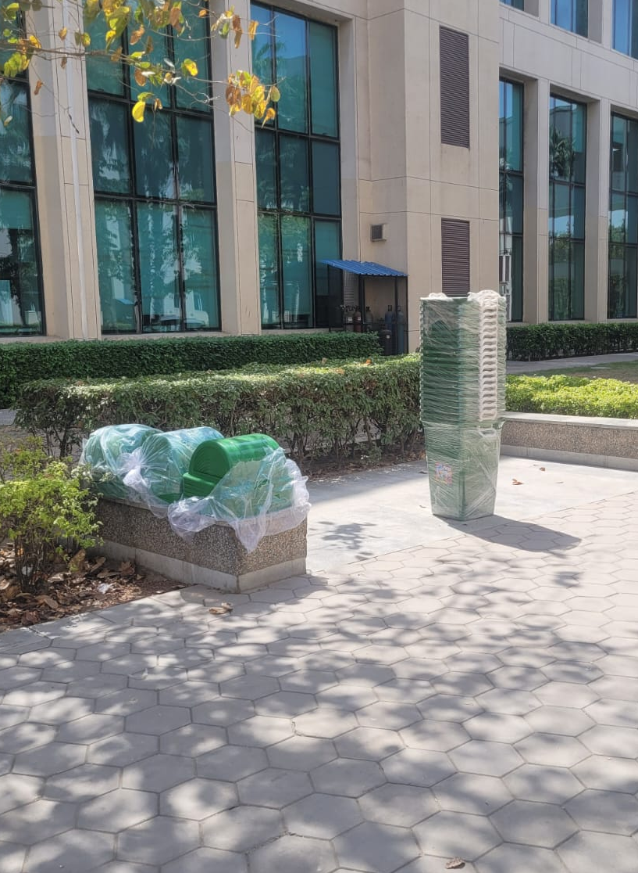
Why Focus on Campus?
High foot traffic, constant movement, and daily waste generation.
Students juggle snacks, coffee, notebooks, e-waste, and more.
A clean environment directly affects quality of life and morale.
This affects everyone: students, faculty, admin, cleaning staff.
A bad bin system hurts hygiene, efficiency, and morale.
Bins are often standalone, unlabeled, and unnoticeable.
Mixed waste is the norm, not the exception.
DES211 CAPSTONE PROJECT
3

Slide 4

What does this project do?
Investigates the root causes of improper waste segregation in public spaces, especially on campus.
Applies human-centered design methods to understand user pain points and behavior through direct observation and interviews.
Reframes the problem with a refined, empathy-driven problem statement and focused design brief.
Generates multiple creative ideas using brainstorming and sketching techniques to solve core waste disposal issues.
Delivers a final solution that’s not only practical and modular, but also easy to scale across high-footfall environments.
DES211 CAPSTONE PROJECT

Slide 5
Empathy Phase
The empathy phase is the first step in the Human Centred Design process
It focuses on understanding users’ needs, emotions, experiences, and challenges from their perspective
Observation: Pain points in real settings
Interviews: Open-ended dialog about experiences
Shadowing: Seeing issues firsthand
Surveys: Broader feedback and validating patterns
DES211 CAPSTONE PROJECT

Slide 6
Key Observations
Bins are mostly lone-standing → mixed waste everywhere
E-waste disposal is unclear → zero awareness
Hazardous waste (e.g., glass shards) lacks proper options
Book disposal is a challenge post-semester
Graduating students generate bulk waste, no system to handle it
Unlabelled bins = no clarity on what goes where
Dogs tip bins over, ruining segregation efforts
DES211 CAPSTONE PROJECT

Slide 7
User Insights via Survey
Most users struggle with classifying waste
E-waste disposal points unknown to majority
Plastic bottles + notebooks heavily used; recyclable but untracked
Users frequently see fallen or misused bins
Low awareness, low engagement in day-to-day waste habits
DES211 CAPSTONE PROJECT

Slide 8
Existing Solutions
Prop Up Rails | Color Coded Bins
Pros: • Adds stability against tipping • Durable & low-maintenance (stainless steel) • Swinging bins ease trash removal Cons: • Bins swing too freely — waste may fall out • Heavy, hard to assemble/transport • Rarely implemented campus-wide | Pros: • Clear color distinctions aid sorting Cons: • Over-reliance on color — bad for colorblind users • Poor labeling; often placed alone, leading to mixed waste
DES211 CAPSTONE PROJECT

Slide 9
Existing Solutions
Meme Campaign | Trashcan Lids
Pros: • Creative, non-guilt-based engagement • Targeted high-litter zones Cons: • Unfunny memes (had to say it) • Memes were too verbose. • Poor pasting led to fungal growth (biohazard) | Pros: • Reduces fly exposure • Visually conceals waste Cons: • Loose-fitting, fall off easily • Hinders trash removal • Design causes spills, poor accessibility
DES211 CAPSTONE PROJECT

Slide 10
Definition Phase
The Definition phase is the second step in the Human-Centered Design process.
Insights from the Empathy phase are used to clearly define the user’s core problem or need.
Define the real problem.
Write a clear design brief.
List broad solution specs.
Focus on user needs.
DES211 CAPSTONE PROJECT

Slide 11
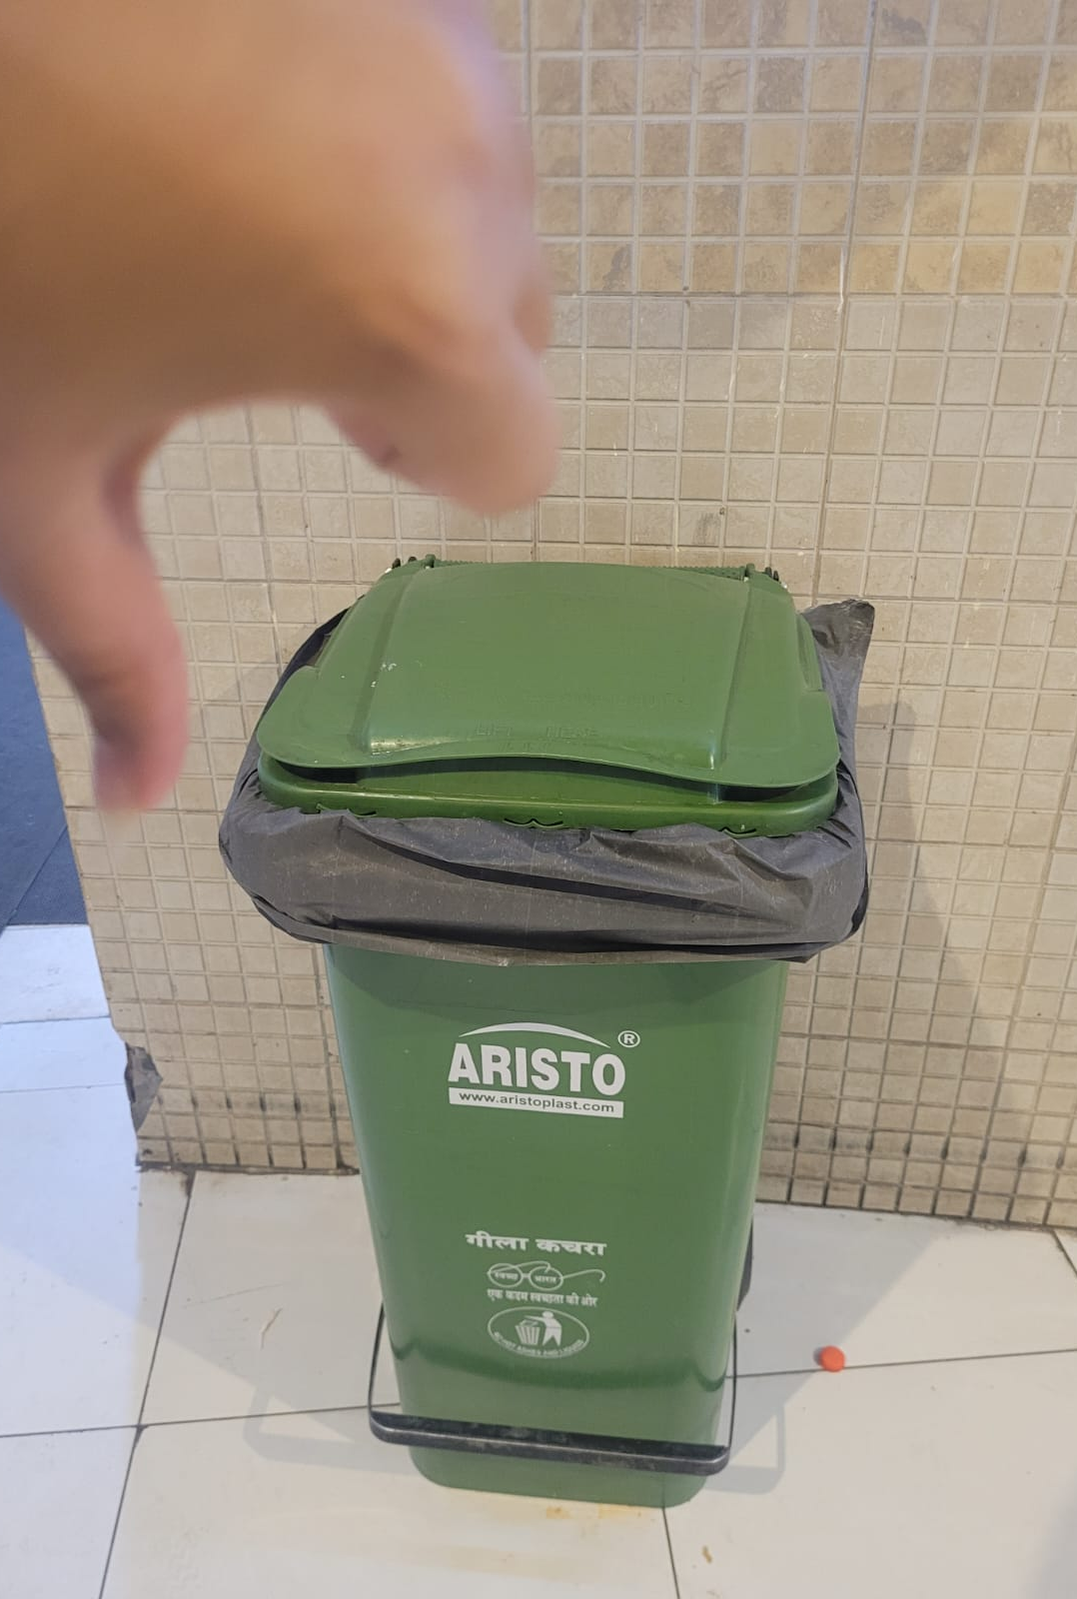
Specification of Problem Statement
No clear bin purpose or labeling
Tipping nullifies waste segregation
Lone bins lack modularity & expansion
Must be low-cost, high-capacity, and easy to install
Floor-wise segregation needed (room-wise unfeasible)
No incentive system for segregation
Bin placement often ignores foot traffic patterns, reducing visibility and usage opportunities.
DES211 CAPSTONE PROJECT

Slide 12
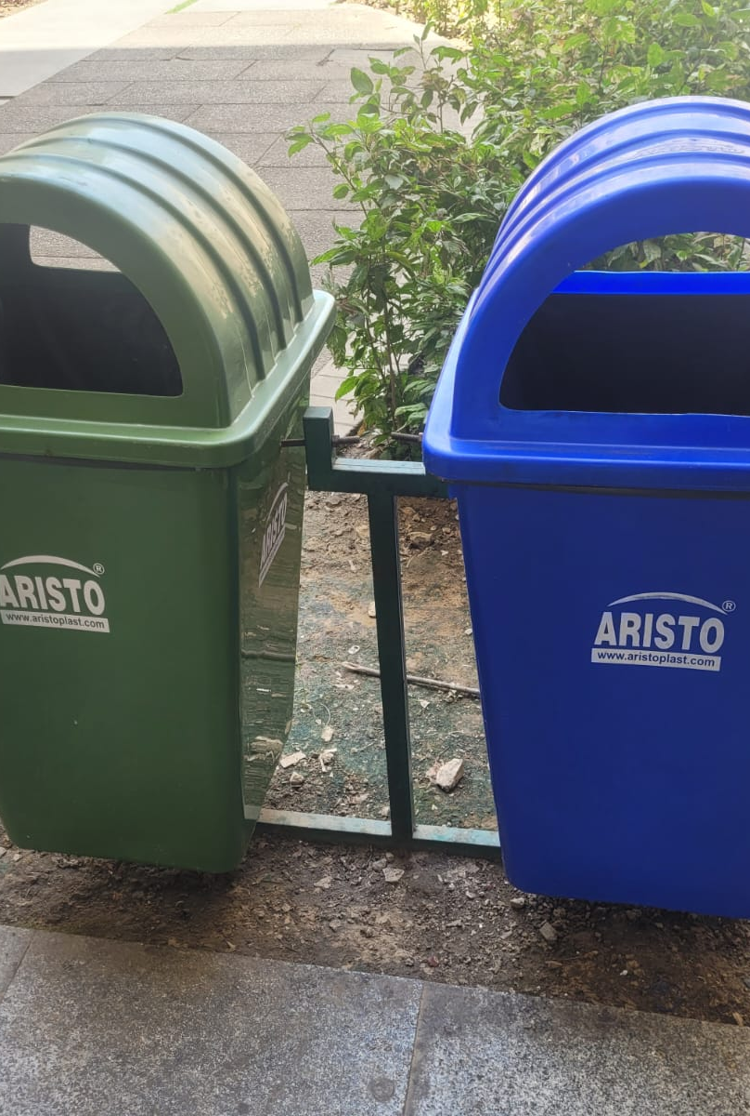
Design Brief
Compatible with all bin types (single/multi, supported/unsupported)
Quick lid install/removal for reconfiguration
Angled (non-vertical) openings to prevent overflow
Low-contact user interaction
Clear visual cues: color, text, and design
Flexible segregation logic based on context/location
Swappable labels for dynamic use cases
Multiple color options for intuitive sorting
DES211 CAPSTONE PROJECT

Slide 13
Definition Process Iterations
Iteration 1
- Needs stability and sturdy design
Iteration 2
- Touch = gross
Iteration 3
- Needs adaptable, attachable design
- Needs convenient lids
- Low steepness openings required
- Color + text cues required
- Needs modularity
- Needs floor-wise sorting
- Not enough segregation push
- Lids are badly designed due to vertical openings
- Need to hide trash
- Hygiene issues due to insects

Slide 14
Prototype Phase
DES211 CAPSTONE PROJECT

Slide 15
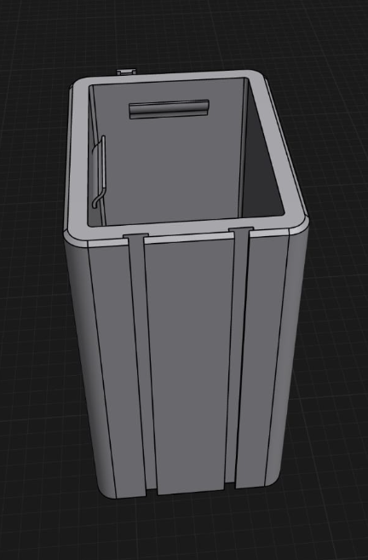
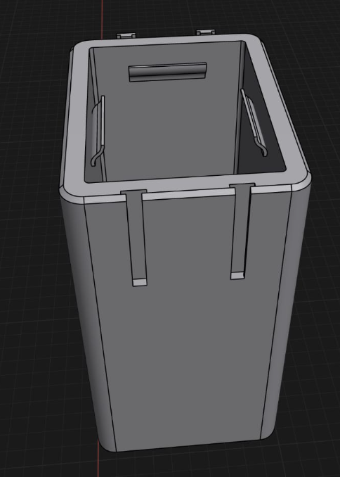
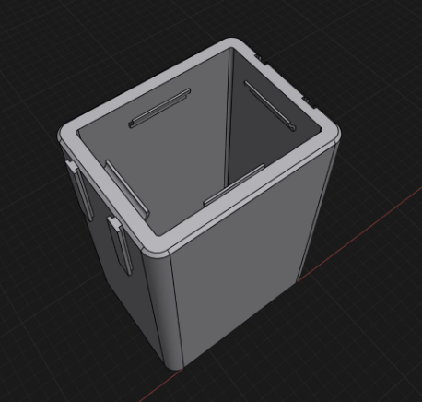
Grooves for infinite chaining
Reduced groove depth for
better user experience
Bag clips to ensure garbage bins
are always open

Slide 16
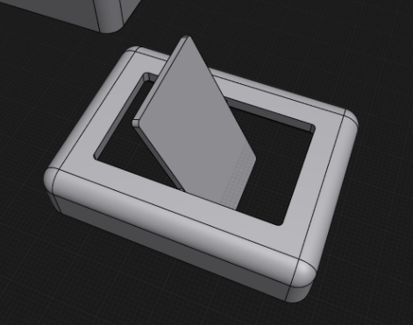
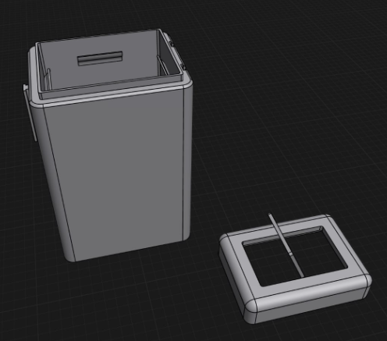
Optional rotating lid to minimize user contact
Bin and Lid together

Slide 17
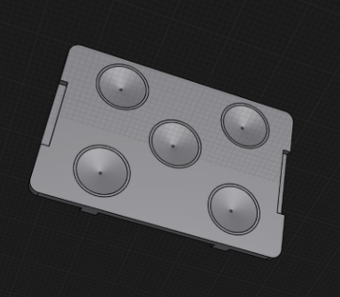
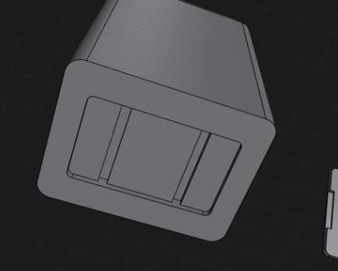
Detachable suction bottom to
ensure bin doesn’t tip over
Attachment point for
Suction bottom

Slide 18
DES211 CAPSTONE PROJECT

Slide 19
DES211 CAPSTONE PROJECT

Slide 20
DES211 CAPSTONE PROJECT

Slide 21
DES211 CAPSTONE PROJECT

Slide 22
DES211 CAPSTONE PROJECT

Slide 23
Testing Phase
DES211 CAPSTONE PROJECT

Slide 24
DES211 CAPSTONE PROJECT

Slide 25
DES211 CAPSTONE PROJECT

