Slide 1
Hot Garbage, Cool Design
DES211 Capstone Project
Shashwat Shukla, Lalit Maurya, Jia Khot, Aditya Ahuja, Siddharth Aggarwal

Slide 2
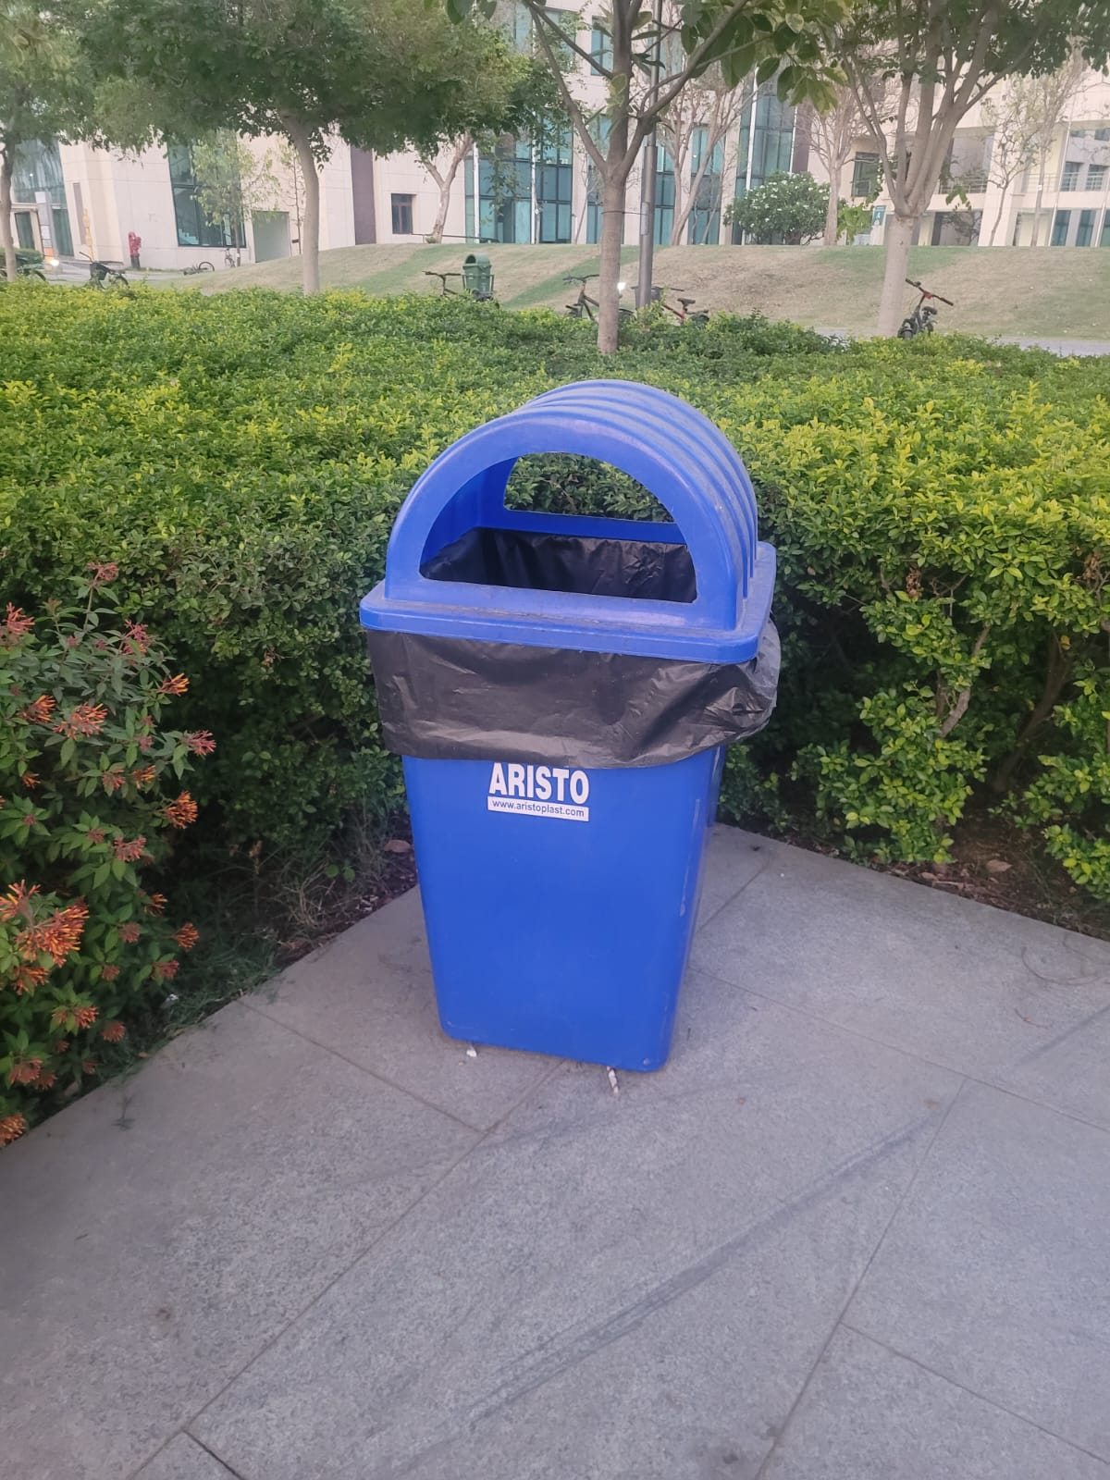
Introduction
What’s the Topic?
Rethinking Waste Segregation Systems on Campus
Why does this matter?
Waste segregation is essential for clean, functional shared spaces. But most bins today are poorly designed, confusing, and counterproductive.
What’s broken?
No cues for correct disposal leads to frequent misuse since separation isn't intuitive or enforced.
Design "fixes" often make things worse.
DES211 CAPSTONE PROJECT

Slide 3
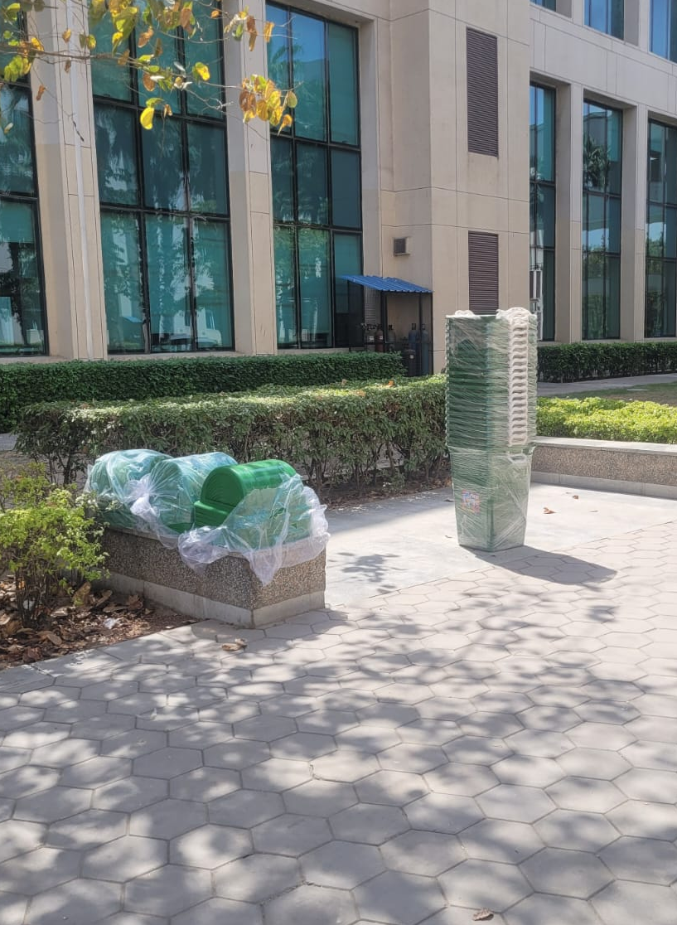
Why Focus on Campus?
High foot traffic, constant movement, and daily waste generation.
Students juggle snacks, coffee, notebooks, e-waste, and more.
A clean environment directly affects quality of life and morale.
This affects everyone: students, faculty, admin, cleaning staff.
A bad bin system hurts hygiene, efficiency, and morale.
Bins are often standalone, unlabelled, and unnoticeable.
Mixed waste is the norm, not the exception.
DES211 CAPSTONE PROJECT
3

Slide 4

What does this project do?
Investigates the root causes of improper waste segregation in public spaces, especially on campus.
Applies human-centered design methods to understand user pain points and behavior through direct observation and interviews.
Reframes the problem with a refined, empathy-driven problem statement and focused design brief.
Generates multiple creative ideas using brainstorming and sketching techniques to solve core waste disposal issues.
Delivers a final solution that’s not only practical and modular, but also easy to scale across high-footfall environments.
DES211 CAPSTONE PROJECT

Slide 5
Empathy Phase
The empathy phase is the first step in the Human Centred Design process
It focuses on understanding users’ needs, emotions, experiences, and challenges from their perspective
Observation: Pain points in real settings
Interviews: Open-ended dialog about experiences
Shadowing: Seeing issues firsthand
Surveys: Broader feedback and validating patterns

Slide 6
Key Observations
Bins are mostly lone-standing → mixed waste everywhere
E-waste disposal is unclear → zero awareness
Hazardous waste (e.g., glass shards) lacks proper options
Book disposal is a challenge post-semester
Graduating students generate bulk waste, no system to handle it
Unlabelled bins = no clarity on what goes where
Dogs tip bins over, ruining segregation efforts

Slide 7
User Insights via Survey
Most users struggle with classifying waste
E-waste disposal points unknown to majority
Plastic bottles + notebooks heavily used; recyclable but untracked
Users frequently see fallen or misused bins
Low awareness, low engagement in day-to-day waste habits

Slide 8
Existing Solutions

Slide 9
Definition Phase

Slide 13
Prototype Phase

Slide 19
Testing Phase

