Slide 1

MID TERM PROJECT REVIEW
CSD438
JIA KHOT LALIT MAURYA
Reaching a consensus: Comparing RAFT and ZAB

Slide 2
MID TERM PROJECT REVIEW
CSD438
REFERENCES
https://zookeeper.apache.org
https://github.com/etcd-io/raft
https://distributedalgorithm.wordpress.com/2015/06/20/architecture-of-zab-zookeeper-atomic-broadcast-protocol
https://cwiki.apache.org/confluence/display/ZOOKEEPER/Zab1.0
Raft
ZAB
In Search of an Understandable Consensus Algorithm
Zab: High-performance broadcast for
primary-backup systems

Slide 3
MID TERM PROJECT REVIEW
CSD438
CONSENSUS ALGORITHMS
Consensus = agreement among distributed nodes on a single value or sequence of actions
Ensures the system behaves like one reliable machine despite crashes or message delays
Critical for replicated databases, config stores, and distributed coordination
Guarantees two key properties:
Safety: no two nodes ever decide different values
Liveness: the system eventually reaches a decision
Achieved through majority voting (quorums) to maintain overlap between decisions
Used by consensus algorithms like Paxos and Raft to replicate logs consistently across servers

Slide 4


MID TERM PROJECT REVIEW
CSD438
Leader-based consensus designed for clarity and implementability
Purpose: replicate a log consistently across servers, even with failures
Server states: Leader, Follower, Candidate
Key components:
Leader Election: random timeouts → candidate → majority votes → leader
Log Replication: leader appends entries → replicates to followers → commit on majority
Safety: no conflicting commits; leader contains all committed entries
RAFT

Slide 5
MID TERM PROJECT REVIEW
CSD438
RAFT: STEP BY STEP
1. System Setup
Cluster of servers; each can be a Follower, Candidate, or Leader
Time is divided into terms; each term begins with a new election
Every server stores: current term, votedFor, and a replicated log

Slide 6
MID TERM PROJECT REVIEW
CSD438
RAFT: STEP BY STEP
2. Normal Operation (Follower)
Followers stay passive and respond to RPCs from others
Expect heartbeats (AppendEntries) from the leader
If no heartbeat within election timeout → become Candidate

Slide 7
MID TERM PROJECT REVIEW
CSD438
RAFT: STEP BY STEP
3. Leader Election
Candidate increments its term and votes for itself
Sends RequestVote RPCs to all other servers
Servers grant vote if candidate’s log is at least as up-to-date as theirs
If candidate gets majority votes, it becomes Leader
If election times out (split vote), starts a new term with a randomized timeout

Slide 8
MID TERM PROJECT REVIEW
CSD438
RAFT: STEP BY STEP
4. Log Replication (Leader)
Leader receives client commands and appends them to its log
Sends AppendEntries RPCs to followers to replicate entries
Followers append new entries to their logs if they match the leader’s log
Once an entry is stored on a majority of servers, the leader commits it
The leader and followers apply committed entries to their state machines

Slide 9
MID TERM PROJECT REVIEW
CSD438
RAFT: STEP BY STEP
5. Maintaining Consistency
Log Matching Property: If two logs share the same index and term, all preceding entries are identical
Conflict Resolution: If follower’s log conflicts, it deletes mismatched entries and appends the leader’s version
Leader Completeness: Leader’s log always contains all committed entries from previous terms

Slide 10
MID TERM PROJECT REVIEW
CSD438
RAFT: STEP BY STEP
6. Heartbeats and Timeouts
Leader sends periodic heartbeats (empty AppendEntries) to maintain authority
If followers stop receiving heartbeats → they trigger a new election
Randomized timeouts reduce risk of simultaneous elections

Slide 11
MID TERM PROJECT REVIEW
CSD438
RAFT: STEP BY STEP
7. Safety and Recovery
Only entries replicated on a majority are considered committed
Persistent storage ensures state survives crashes
If a leader fails, a new leader is elected, preserving all committed entries

Slide 12

MID TERM PROJECT REVIEW
CSD438
ZAB (ZooKeeper Atomic Broadcast) ensures a consistent, totally ordered broadcast of updates across all ZooKeeper servers
Ensures all replicas apply the same sequence of state changes, even after crashes or restarts
Operates in two main modes:
Recovery Phase: elect leader and sync followers after failure
Broadcast Phase: leader commits updates in total order
Used by Apache ZooKeeper for maintaining consistent metadata and coordination in distributed systems
ZAB

Slide 13
MID TERM PROJECT REVIEW
CSD438
ZAB: STEP BY STEP
1. Purpose and Role
ZAB ensures total order broadcast of updates across a ZooKeeper ensemble.
Guarantees all servers deliver the same sequence of transactions, even after crashes or restarts.
Focuses on broadcasting state changes reliably, not arbitrary commands.

Slide 14
MID TERM PROJECT REVIEW
CSD438
ZAB: STEP BY STEP
2. System Model
One Leader, multiple Followers (and Observers)
Leader handles all write requests; followers serve read requests.
Uses epochs (or “Zxid” prefixes) to order operations uniquely

Slide 15
MID TERM PROJECT REVIEW
CSD438
ZAB: STEP BY STEP
3. Protocol Phases
Recovery Phase: establish a new leader and synchronize state after a failure.
Broadcast Phase: normal operation — broadcast and deliver updates in order.

Slide 16
MID TERM PROJECT REVIEW
CSD438
ZAB: STEP BY STEP
4. Broadcast Phase (Atomic Broadcast)
Only entries replicated on a majority are considered committed
Persistent storage ensures state survives crashes
If a leader fails, a new leader is elected, preserving all committed entries

Slide 17
MID TERM PROJECT REVIEW
CSD438
ZAB: STEP BY STEP
5. Recovery Phase (Leader Election & Synchronization)
Followers detect leader failure (via heartbeat timeout).
Enter *election mode* and vote for a new leader (based on latest history).
Once a leader is chosen:
    - Leader starts a new epoch and collects followers’ last Zxids to find the latest state.
    - Leader broadcasts a NEWLEADER message and becomes active after majority acknowledgment.

Slide 18
MID TERM PROJECT REVIEW
CSD438
ZAB: STEP BY STEP
6. Consistency and Guarantees
Total order: All servers deliver transactions in the same sequence.
Prefix consistency: No server ever commits an unacknowledged transaction.
Leader stability: A leader never commits a transaction from a previous epoch.

Slide 19
MID TERM PROJECT REVIEW
CSD438
ZAB: STEP BY STEP
7. Handling Failures
If leader crashes → return to Recovery Phase.
Uncommitted transactions are discarded to maintain global order.
New leader re-synchronizes followers before broadcasting again.

Slide 20


MID TERM PROJECT REVIEW
CSD438
TECH STACK
Rust
RPC (gRPC)
- Memory safety guarantees make it a better pick than C/C++
- Lack of a garbage collector makes it a better pick than Go
- Personal Curiosity!
- MPI targets tightly-coupled HPC workloads
- RPC/TCP mirrors real-world distributed systems
- Production-ready library support

Slide 21
MID TERM PROJECT REVIEW
CSD438
Cluster Configuration
Base Cluster: 5 nodes (3 for quorum, 2 spares) [Extended to 7 and 9 nodes]
Workloads Tested: Both read/write heavy and mixed operation workloads
Fault Inject scenarios:
Leader Crashes
Follower Delays

Slide 22
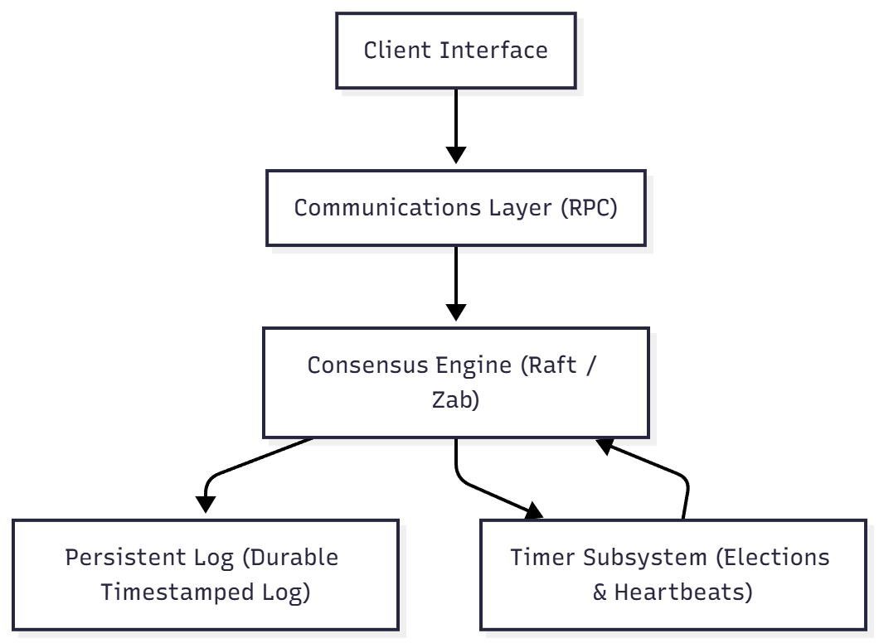
MID TERM PROJECT REVIEW
CSD438
System Architecture
Each node includes:
Consensus Engine: Runs Raft or ZAB logic
Communications Layer: Uses RPC to communicate and handle AppendEntries/Commit messages
Client Interface
Persistent Log: Durable and persistent timestamped log
Timer Subsystem: Controls elections and heartbeats

