Slide 1
Student Name – Lalit Kamar Roll Number - 21f3001013 Email : 21f3001013@ds.study.iitm.ac.in
Brief Description : I am a serving Air Force officer pursuing BSc Data Science degree from IIT Madras

Slide 2
TICKETSHOW APP
project to develop a web application using Flask to book movie tickets with CRUD operations for admin on venues and shows,
and give functionality to the user to register, login, book tickets, see my_bookings and delete his bookings.

Slide 3
SOFTWARE PACKAGES USED
Flask==2.2.3
Flask-Login==0.6.2
Flask-RESTful==0.3.9
Flask-SQLAlchemy==3.0.3
Flask-Uploads==0.2.1
Flask-WTF==1.1.1
Jinja2==3.1.2
SQLAlchemy==2.0.7
Werkzeug==2.2.3
WTForms==3.0.1
Flask-Reuploaded
secret
datetime
Flask-Migrate
** Software packages required listed in requirements.txt for installation using pip

Slide 4
MODELS & FORMS
MODELS
FORMS
USER
VENUE
SHOW
BOOKING
UserLoginForm
AdminLoginForm
VenueForm
ShowForm
BookingForm
RegistrationForm

Slide 5
CONFIGURATION , DATABASE & CONTROLLERS
Configuration in config.py
Database configuration in database.py
Login & Registration routes in login.py using Blueprint
CRUD routes for Admin & User in Controllers.py using Blueprint

Slide 6
Main.py
Function to create app
Database initialization inside app
Routes registration
Importing all routes
Running the app

Slide 7
TEMPLATES
All templates in templates folder
Template for each route

Slide 8
ADMIN LOGIN AND USER LOGIN VENUE MANAGEMENT SHOW MANAGEMENT BOOKING SHOW TICKETS SEARCH FOR SHOWS/VENUES, FORM FOR USERNAME AND PASSWORD FOR USER SEPARATE FORM FOR ADMIN LOGIN PROPER LOGIN FRAMEWORK SUITABLE MODEL FOR USER, CORE - VENUE MANAGEMENT (ONLY FOR ADMIN) CREATE A NEW VENUE EDIT A VENUE CHANGE TITLE/CAPTION REMOVE A VENUE WITH A CONFIRMATION FROM THE ADMIN
FUNCTIONALITY
CORE - SHOW MANAGEMENT (ONLY FOR ADMIN) CREATE A NEW SHOW EDIT A SHOW CHANGE TITLE/CAPTION OR IMAGE REMOVE A SHOW WITH A CONFIRMATION FROM THE ADMIN ALLOCATE VENUES WHILE CREATING SHOWS DIFFERENT PRICING FOR EACH VENUE CORE - SEARCH FOR SHOWS/VENUES ABILITY TO BOOK TICKETS FOR A SHOW AT A GIVEN VENUE

Slide 9
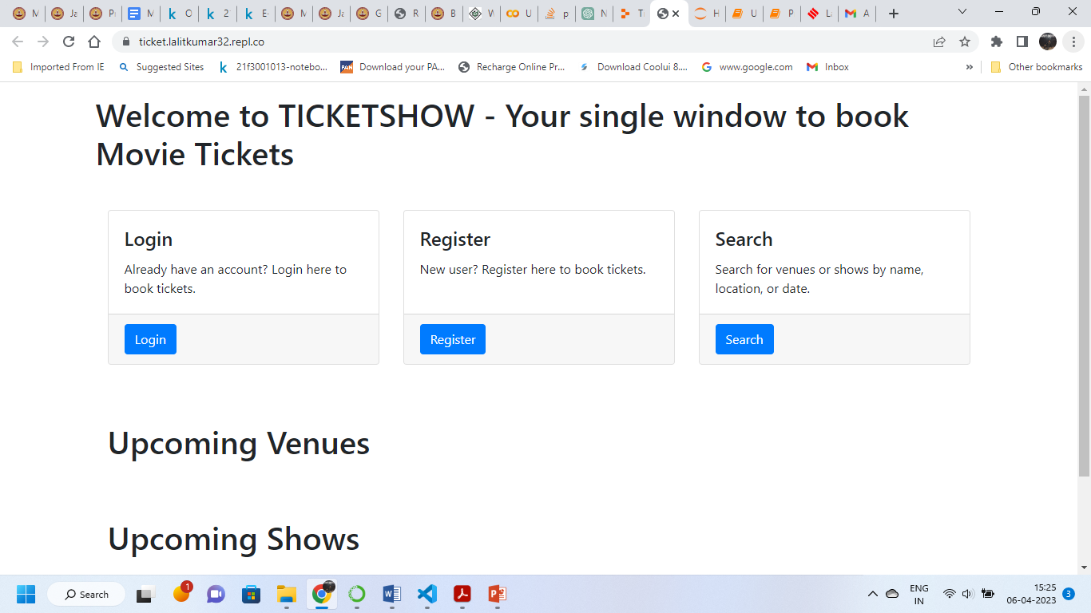
HOME PAGE

Slide 10
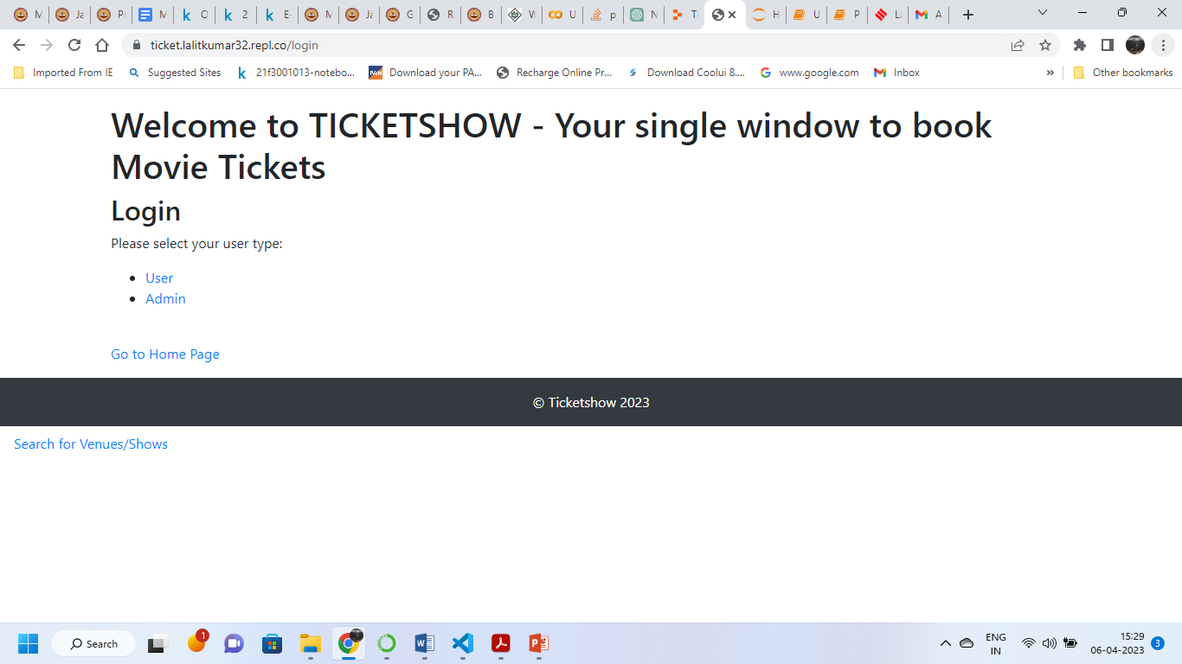
LOGIN PAGE

Slide 11
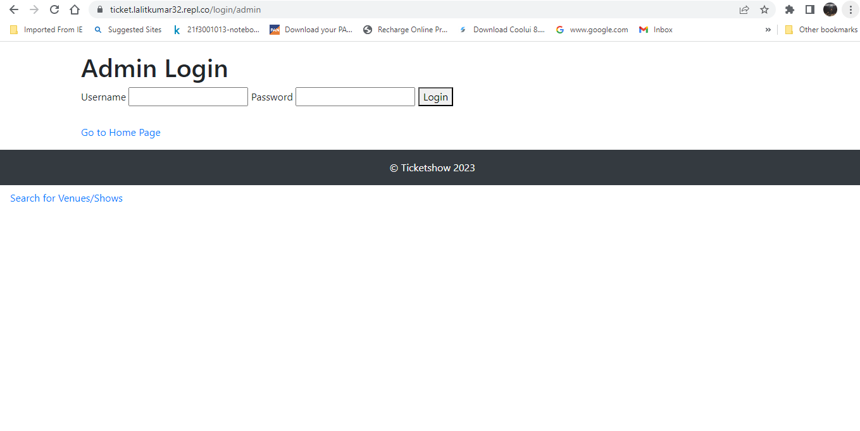
ADMIN LOGIN PAGE

Slide 12
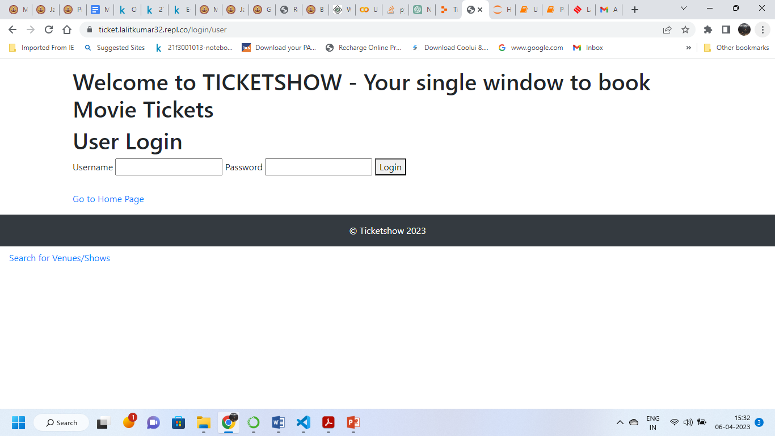
USER LOGIN PAGE

Slide 13
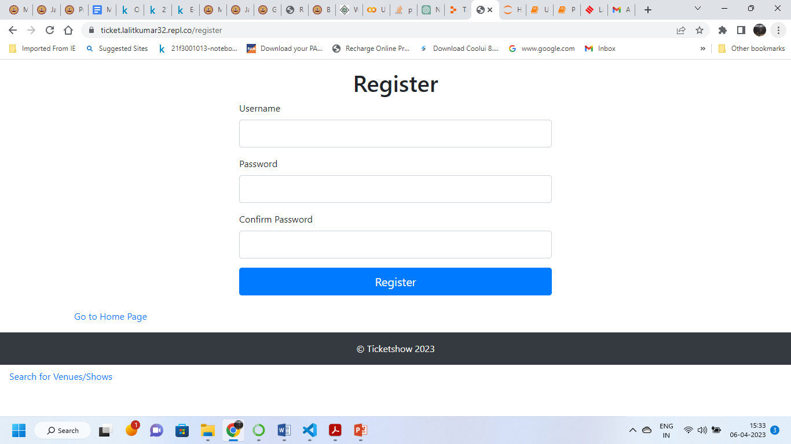
USER REGISTRATION PAGE

Slide 14
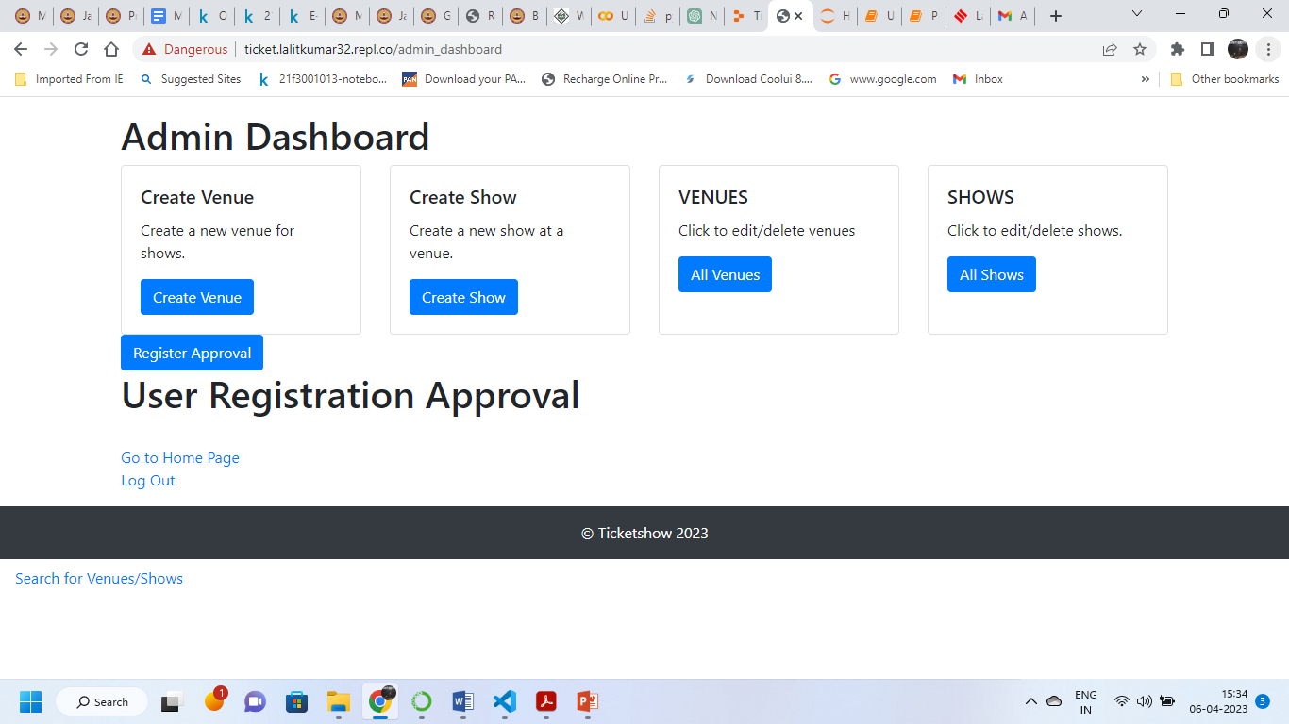
ADMIN DASHBOARD PAGE

Slide 15
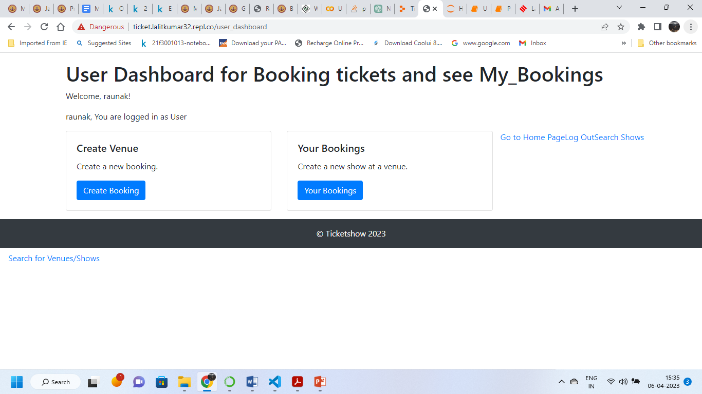
USER DASHBOARD PAGE

Slide 16
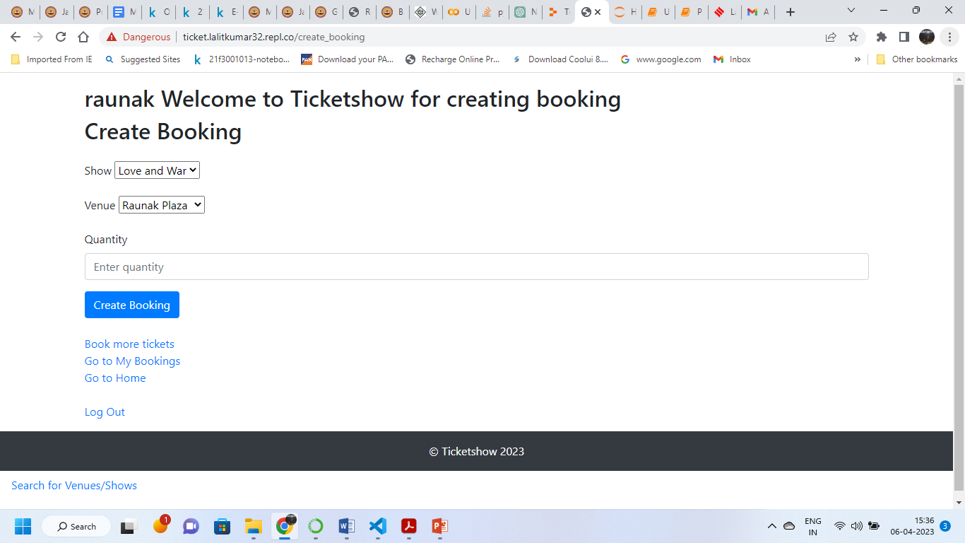
CREATE BOOKING PAGE

Slide 17
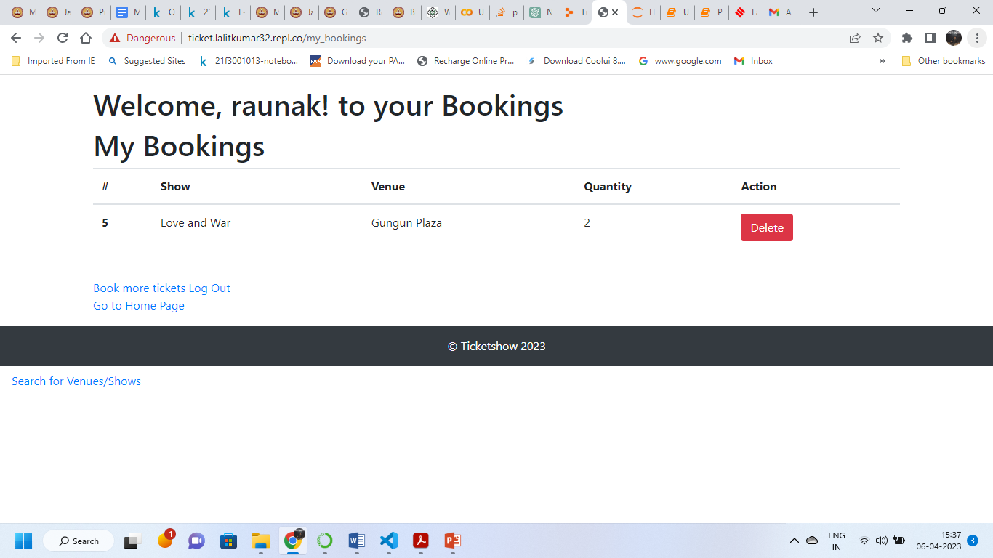
MY BOOKING PAGE

Slide 18
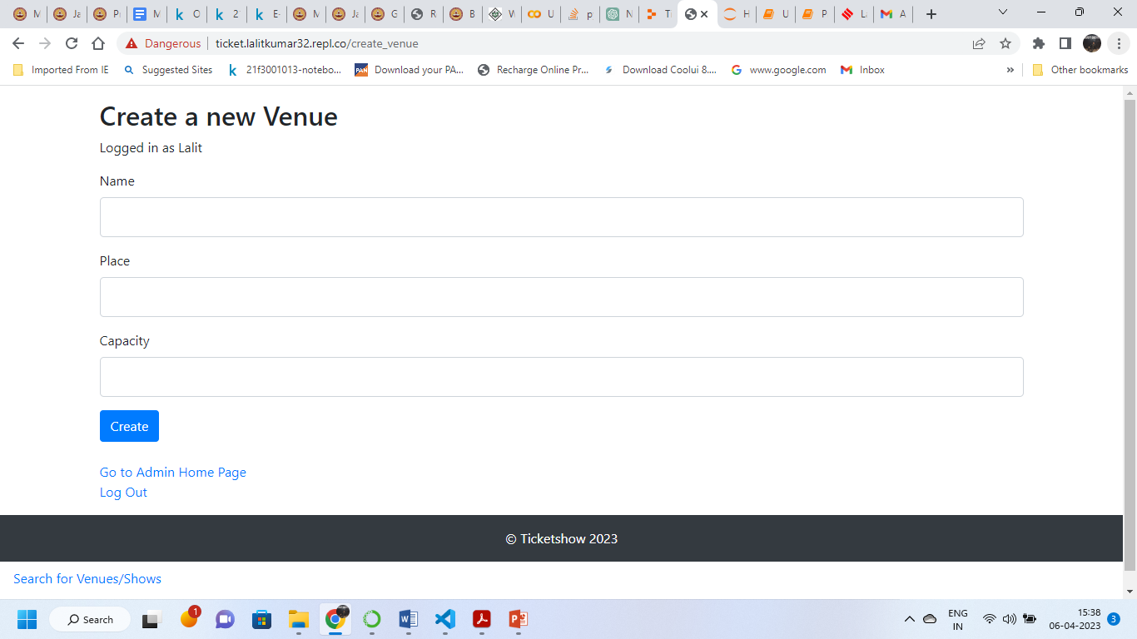
CREATE VENUE PAGE

Slide 19
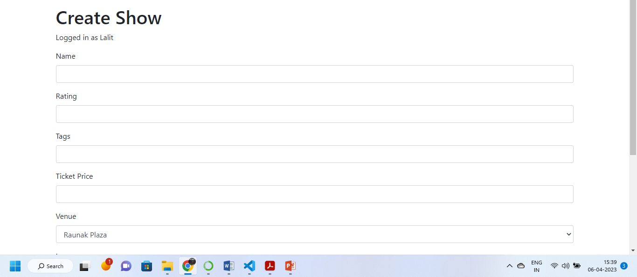
CREATE SHOW PAGE

Slide 20
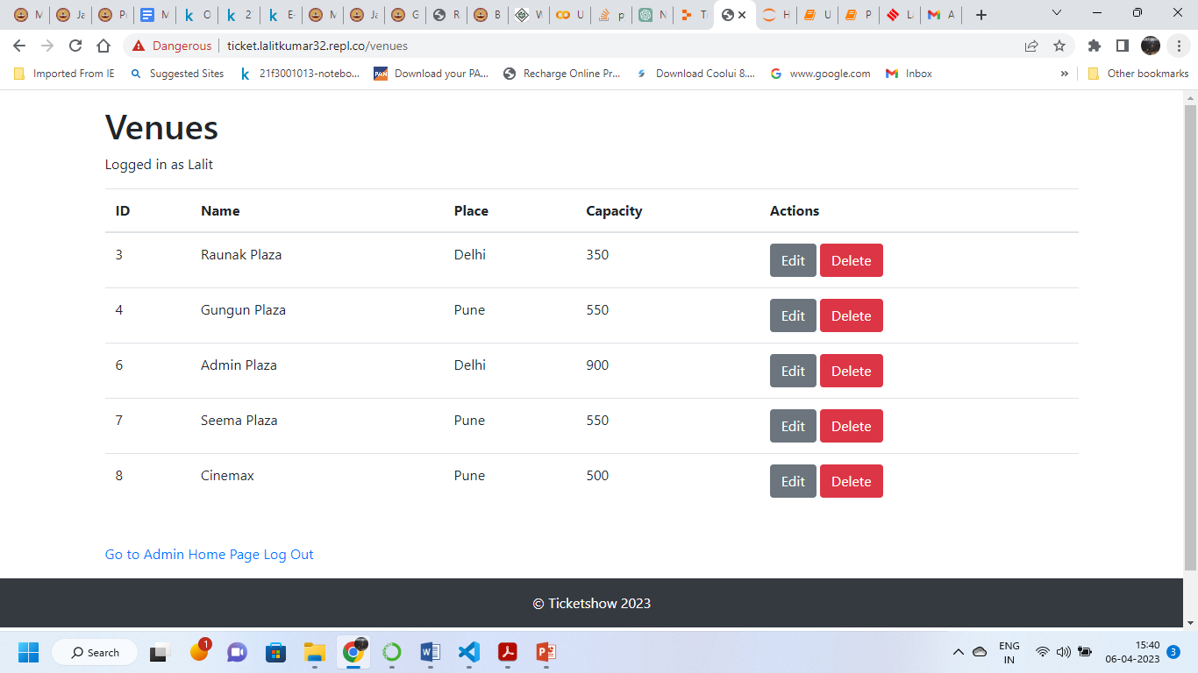
EDIT/DELETE VENUE PAGE

Slide 21
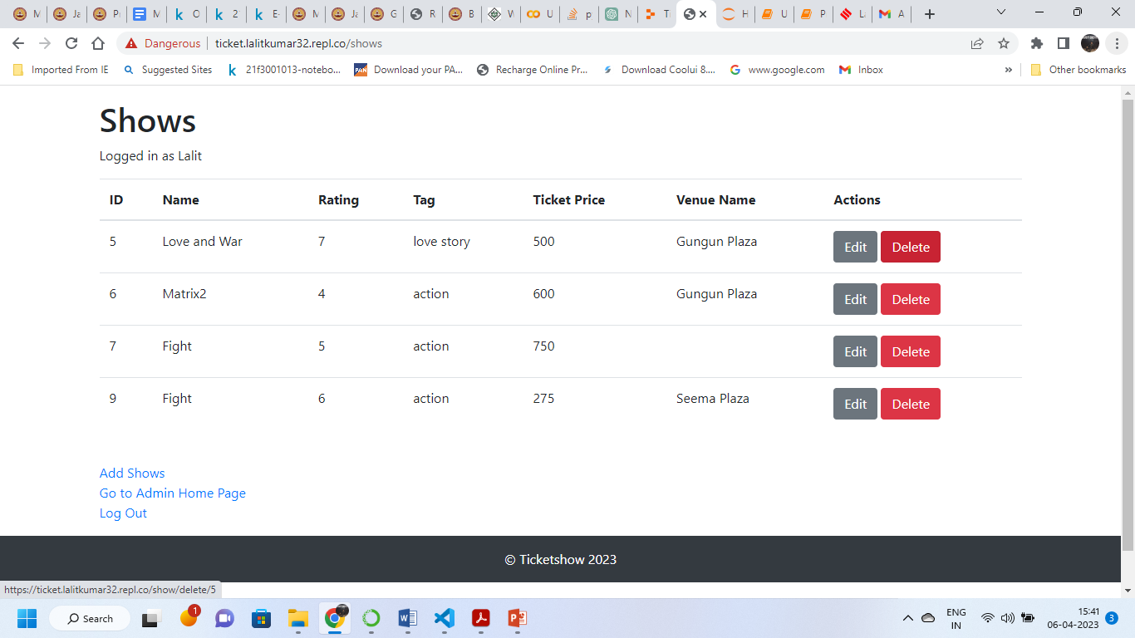
EDIT/DELETE SHOW PAGE

Slide 22
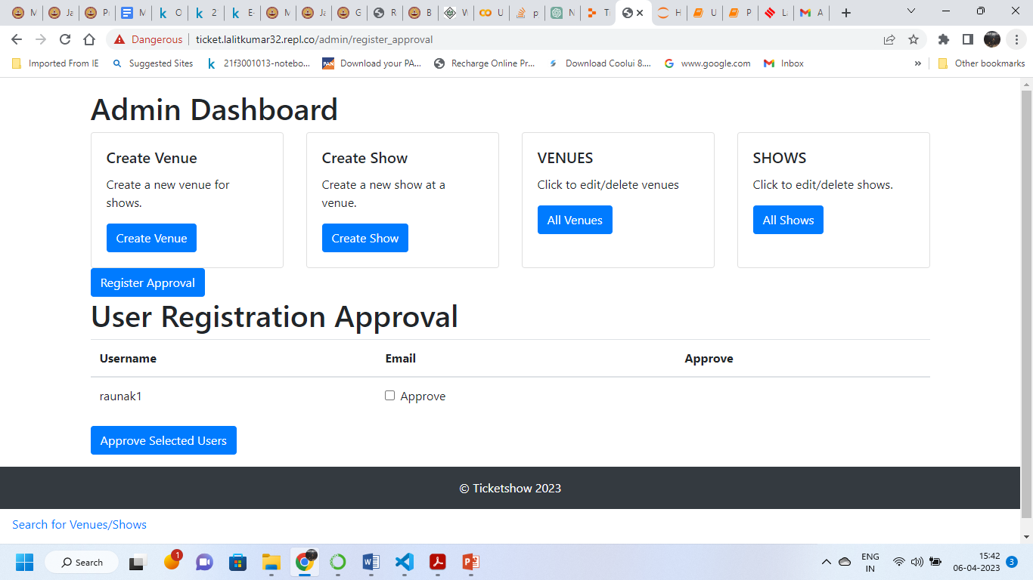
APPROVE REGISTRATION PAGE

Slide 23
?

