Slide 1
ECE1512 - DESIGN THINKING IN PRACTICE
Phase I Review Presentation
AI-Assisted Precision Spraying Bot
Targeted Pesticide Application and Chemical Usage Reduction
Domain:
AI & Robotics in Precision Agriculture
INVO-05
Name | Roll Number
[Team Member 1] | [Roll No. ECE-XXXX]
[Team Member 2] | [Roll No. ECE-XXXX]
[Team Member 3] | [Roll No. ECE-XXXX]
[Team Member 4] | [Roll No. ECE-XXXX]
[Team Member 5] | [Roll No. ECE-XXXX]
Under the supervision of
[Guide Name]
[Assistant / Associate Professor]
Department of Electronics and Communication Engineering

Slide 2
Problem description
Problem Statement
1. Conventional spraying applies pesticides uniformly across entire crop fields — including healthy plants — causing excess chemical usage, higher farming cost, and increased environmental exposure.
2. Farmers need an affordable automated system that can identify target plants / affected regions and deliver pesticides only where required.
Key issues highlighted:
Excess chemical usage • High operational cost • Environmental contamination • Non-target spraying • Need for precision agriculture
Conventional Blanket Spraying → Chemical Waste
vs.
AI Detection → Targeted Spraying → Reduced Chemical Usage

Slide 3
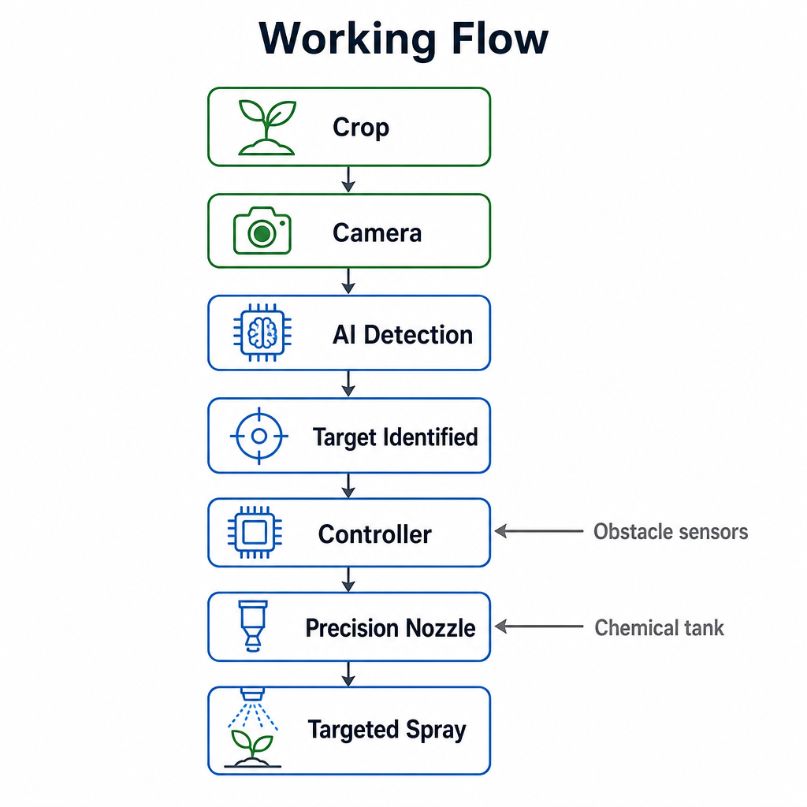
Proposed Solution (Describe your Idea/Solution/Prototype)
Proposed Solution — AI-Assisted Mobile Spraying Bot
A compact autonomous bot using computer vision that detects target plants or affected regions and sprays pesticide only on the detected location.
How it works
• Camera captures crop images while the bot moves through crop rows.
• AI / Computer Vision model identifies target plants or affected regions.
• Controller decides whether to spray and switches the right nozzle.
• Pump delivers a controlled quantity of pesticide only toward the target.
• Ultrasonic / ToF sensors support navigation and obstacle detection.
• Detection & spray events are logged for later analysis.
Innovation: Detect first. Decide precisely. Spray only where required.

Slide 4
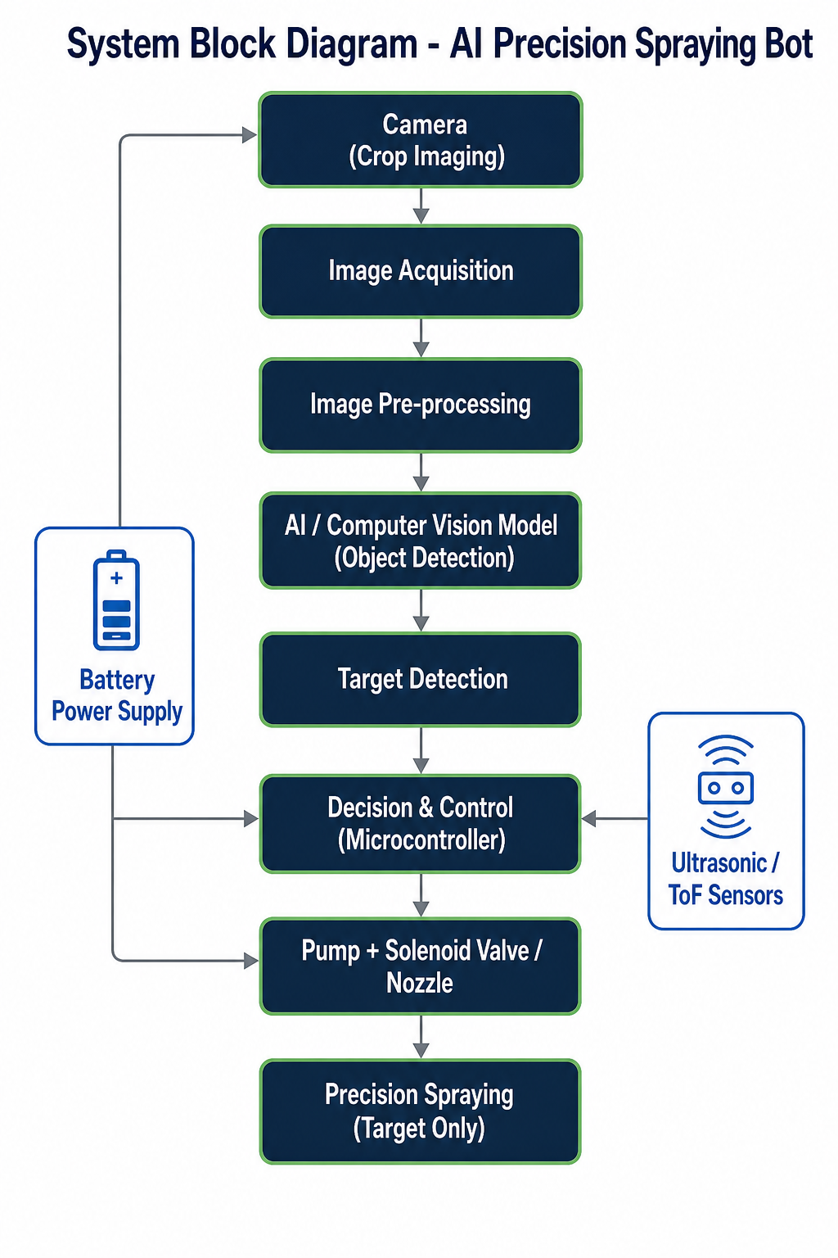
Technical Approach
Workflow
Camera → Image Acquisition → Pre-processing → AI / CV Model → Target Detection → Decision & Control → Pump + Solenoid / Nozzle → Precision Spraying
Hardware Components
• ESP32 / Arduino microcontroller (Raspberry Pi for edge-compute)
• Camera module • DC motors • Motor driver
• Pump • Solenoid valve • Precision spray nozzle • Chemical tank
• Ultrasonic / ToF obstacle sensors • Battery • Robot chassis
Software / AI
• Python • OpenCV • TensorFlow / PyTorch • Object-detection model
• Embedded C / C++ for microcontroller actuation logic
The AI model is trained on labelled images of healthy and affected crops; the microcontroller converts each detection into a controlled spray action.

Slide 5
Impact on Society/Community/Industry
Farmer | Crop | Environment | Agriculture Industry
Environmental
• Reduced unnecessary pesticide application • Lower chemical runoff and environmental exposure • More sustainable crop protection
Economic
• Reduced pesticide wastage and recurring spraying cost • Lower manual spraying labour
Agricultural
• More precise crop treatment • Automated monitoring • Improved input-use efficiency
Social
• Reduced worker exposure to chemicals • Potential low-cost benefit for small and medium-scale farmers
Industry
• Supports the transition toward precision agriculture and smart farming

Slide 6
Expected outcomes
Expected Outcomes
Primary
• Working robotic prototype for targeted spraying • AI-based crop / target detection • Automatic spray actuation • Controlled pesticide delivery • Demonstration of precision spraying
Future Possibilities
• GPS / RTK navigation • IoT monitoring dashboard • Remote monitoring • Multi-crop detection • Improved AI models • Variable-rate spraying • Farm-mapping & analytics
Applicable Outcome Streams (template)
• Product Development • Patent (to be evaluated) • National / State Hackathon (e.g. Smart India Hackathon) • Paper Publication (Journal / Conference applied)
References
Video References (5):
• Niqo RoboSpray — Sustainable Spot-Spray Robot
https://www.youtube.com/watch?v=RvwfLtqa8XU
• Olin College — Autonomous Weeding Robot
https://www.youtube.com/watch?v=1o4XHH5yOmw
• XMachines Autonomous Spraying Robot (greenhouse)
https://www.youtube.com/watch?v=n1G4g6HFJKs
• Verdant Robotics Smart Sprayer — Precision Farming Dealer
https://www.youtube.com/watch?v=6jlHM0x6Nhk
• Digital Agriculture & AI Lab — AI for Crop Disease Detection
https://www.youtube.com/watch?v=xITkfJ78wUI
Article / Research References (5):
• Fan X., Chai X., Zhou J., Sun T. (2023) — Deep learning weed detection & targeted spraying robot (cotton seedling), Computers and Electronics in Agriculture.
https://doi.org/10.1016/j.compag.2023.108269
• Nasir F.E., Tufail M., Haris M., Iqbal J., Khan S., Khan M.T. (2023) — Real-time tobacco-recognition deep-learning robotic sprayer with variable-rate spray, PLoS ONE 18(3): e0283801.
https://doi.org/10.1371/journal.pone.0283801
• Lochan K., Khan A., Elsayed I., Suthar B. et al. (2024) — Advancements in precision spraying of agricultural robots: a comprehensive review, IEEE Access.
https://ieeexplore.ieee.org/document/10654275
• Jiang P., Chen Y., Liu B., He D., Liang C. (2019) — Real-time apple leaf disease detection using improved convolutional neural networks, IEEE Access 7.
https://ieeexplore.ieee.org/document/8706936
• Bari B.S., Islam M.N., Rashid M., Hasan M.J. et al. (2021) — Real-time rice leaf disease diagnosis using Faster R-CNN, PeerJ Computer Science.
https://peerj.com/articles/cs-432/

Slide 7
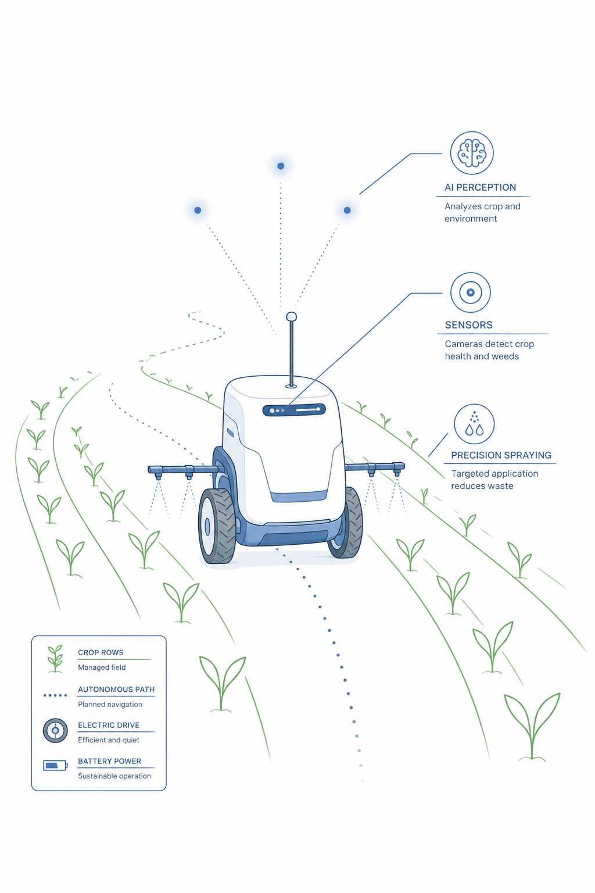
Q & A

