Slide 1
CS535 Time-Series Data Trend Prediction
By: Lalit R Manwani
B-Number: B00764797

Slide 2
WHAT IS TIME – SERIES DATA MINING ???
A time series is a collection of observations made chronologically.
Consists of sequences of values or events obtained over repeated measurements of time (Weekly, quarterly, yearly etc.)
The nature of time series data includes: large in data size, high dimensionality and necessary to update continuously.
Identifying potential trends in time series is important because it imparts knowledge about what has taken place in the past and what will take place in time to come.
Data mining in the time series is the practice of collecting and attempting to spot patterns.

Slide 3
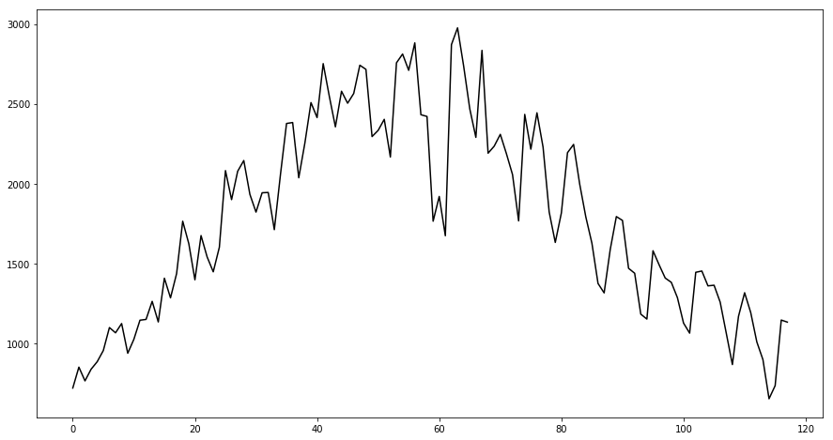
Problem Statement
To project the time series data trend prediction. The specific application scenario is in e-commerce where out of all products 100 key products have to be identified and predicted
To do an overall sale quantity for 100 key product for each day between the 118-th day and the 146-th day (29 days).
To do each sale quantity prediction for the 100 key products for each day between the 118-th day and the 146-th day (29 days).

Slide 4
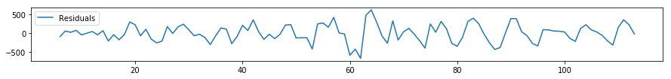
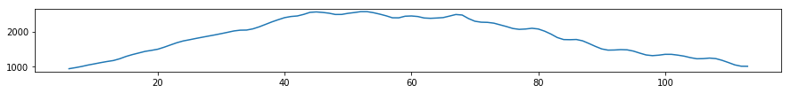
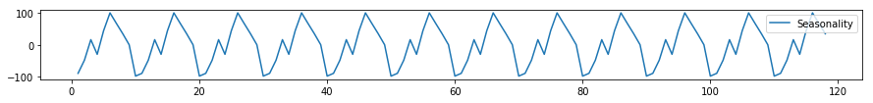
Residual Checking
Trend Analysis
Seasonality Checking

Slide 5
SARIMA
Seasonal AutoRegressive Integrated Moving Average
A generalization of an autoregressive moving average (ARMA) model.
AR : Autoregression. A model that uses the dependent relationship between an observation and some number of lagged observations.
MA: Moving Average. A model that uses the dependency between an observation and a residual error from a moving average model applied to lagged observations.
I : Integrated. The use of differencing of raw observations (e.g. subtracting an observation from an observation at the previous time step) in order to make the time series stationary.
S : Seasonal

Slide 6
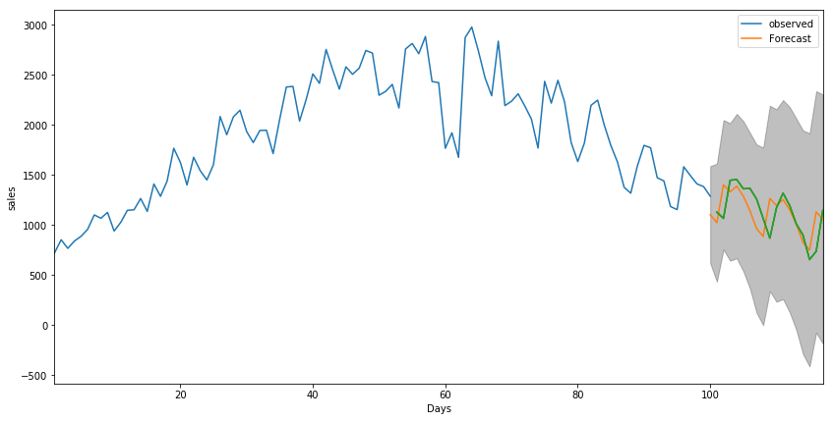
Prediction

Slide 7
References
https://www.sciencedirect.com/science/article/abs/pii/S0952197610001727
https://ieeexplore.ieee.org/document/6906812
https://en.wikipedia.org/wiki/Akaike_information_criterion
https://www.youtube.com/watch?v=m4b5yYx8oWw
https://en.wikipedia.org/wiki/Autoregressive_integrated_moving_average
https://onlinecourses.science.psu.edu/stat510/node/67/

Slide 8
Comparison
Holt’s Winter
SARIMA

Slide 9
Questions??

